Slide 1

Alex Rodriguez
Alexa Simons
Rahul Singal

Slide 2

Our Story

Slide 3
Problem and Opportunity
Estimated Check-in time is 15 minutes according to Stanford Medical Center
Problems:
Time consuming
Inaccurate information
increases operational costs.
15 min
Update Patient Records
Collect Copay or Deductible
Verify Photo ID
Review Insurance Information
Complete Regulatory Forms

Slide 4
Alexa Simons, BME
Alex Rodriguez, ME
Team
Dr. Howard Davis
Kathleen Garde, MD
Rahul Singal, CS
Chief Strategist
Chief Marketing
Chief Technology
Business Mentor
Industry Mentor
Notes:
Everyone explain their qualifications and roles within Hero Healthcare.
Rahul will introduce Dr. Howard Davis
Alex will introduce Kathleen Garde

Slide 5
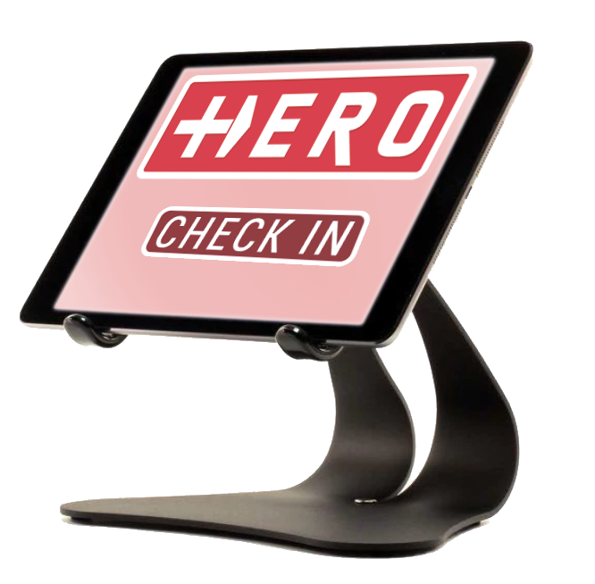
Solution
Tablet Based Self Check-in station
Proprietary Software
Hardware
Physical Stand
ID/Card Scanner
Keyboard
Reduce basic check-in time to under a minute
Offers additional features
Notes:
We will show a prototype using an Ipad
Additional features: Pay for appointments, reschedule, review information

Slide 6
Market Size
200 million outpatient check-ins per year
Our survey of local hospitals give us about
40,000 check-ins per hospital
Target: 0.6% of total market
(120,000 check-ins in 3 hospitals)
Total Market
200 million check ins/year
0.6% of market
120,000 total patients targeted
50% of targeted market
60,000 total Hero interactions
Notes:
Talk about

Slide 7
Growing Market
40 year projection
Increase in elderly population from 48 to 88 million by 2050
Increase in Total population from 325 to 438 million

Slide 8
Revenue Model
Expect 40,000 check-in per hospital
One check in every 6 minutes
Subscription based service
$20,000 per system
Hero System can become a revenue stream for the hospital
One system will cost us $2,000
Tablet, hardware, manufacturing, materials
Maintenance costs
$1,000 annually

Slide 9
Revenue Forecast
 | Year 1 | Year 2 | Year 3
Number of Hospitals using Hero’s system | 3 | 8 (+5) | 13 (+5)
Avg. Total Targeted Patients (40,000 per hospital) | 120,000 | 320,000 (+200,000) | 520,000 (+200,000)
Number of Hero Systems required (1 system per 40,000 check-ins) | 3 | 8 (+5) | 13 (+5)
Subscription Revenue ($20,000 per system) | $60,000 | $160,000 | $260,000
New Hero System Cost ($2000 per system) | ($6,000) | ($20,000) | ($20,000)
Maintenance ($1000 annually per system) | ($3,000) | ($8,000) | ($13,000)
Net Yearly Profit | $51,000 | $132,00 | $227,000

Slide 10


Competition & Competitive Advantage
Hero
Clear Wave
Leader in Medical Check-in Kiosks
HealthAsyst
Healthcare IT company
Competitive Advantage
Kiosks cost in the range of $60,000
Tablet/Software based has competitive advantage

Slide 11

Go to Market Strategy
Utilizing networking and marketing presentations to reach initial customers
SEO to increase hospital traffic to our product website
End goal to be acquired by medical database company for seamless user experience
Month 0
Month 3
Month 6
develop contact with hospital management
Program Hero application for use on tablets
Fabricate working prototype (with ID scanner)
Month 9
Find three pilot hospitals/clinics as our initial customers
Month 12
Fix issues with prototype and release a finished product
Month 18
Expand into 5 new hospitals every consecutive year

Slide 12
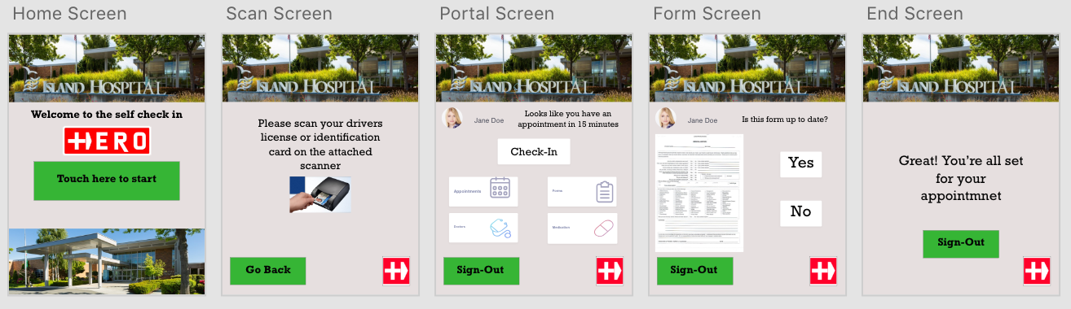
Traction
Prototyping a tablet screen User Experience
Discussion with industry professionals

Slide 13
Business Model
Patients
Hospital Management
New Hospitals
Customers
To fulfill our Go-to-Market Strategy:
Sell directly to hospital management
Incentivize Hospitals to endorse product by
Increasing patient information accuracy
Generating revenue through Administrative Fee
Helps smaller hospitals afford the Hero System

Slide 14
What we need
Connections with Hospital Management
Mentors
Marketing
Mentors
Improve Go-to-Market Strategy
Product development
Advertising and Marketing
Connections with Hospitals
Help locate trial Hospitals

Slide 15
Questions?

