Slide 1

Portfolio Optimization using
Reinforcement Learning
Project Presentation Brief
Name : Rahul Singh
Roll No: M22AI606
Supervisor: Dr. V.V.M.S Chandramouli
Branch: Mtech (Data and Computational Science)
IIT Jodhpur

Slide 2
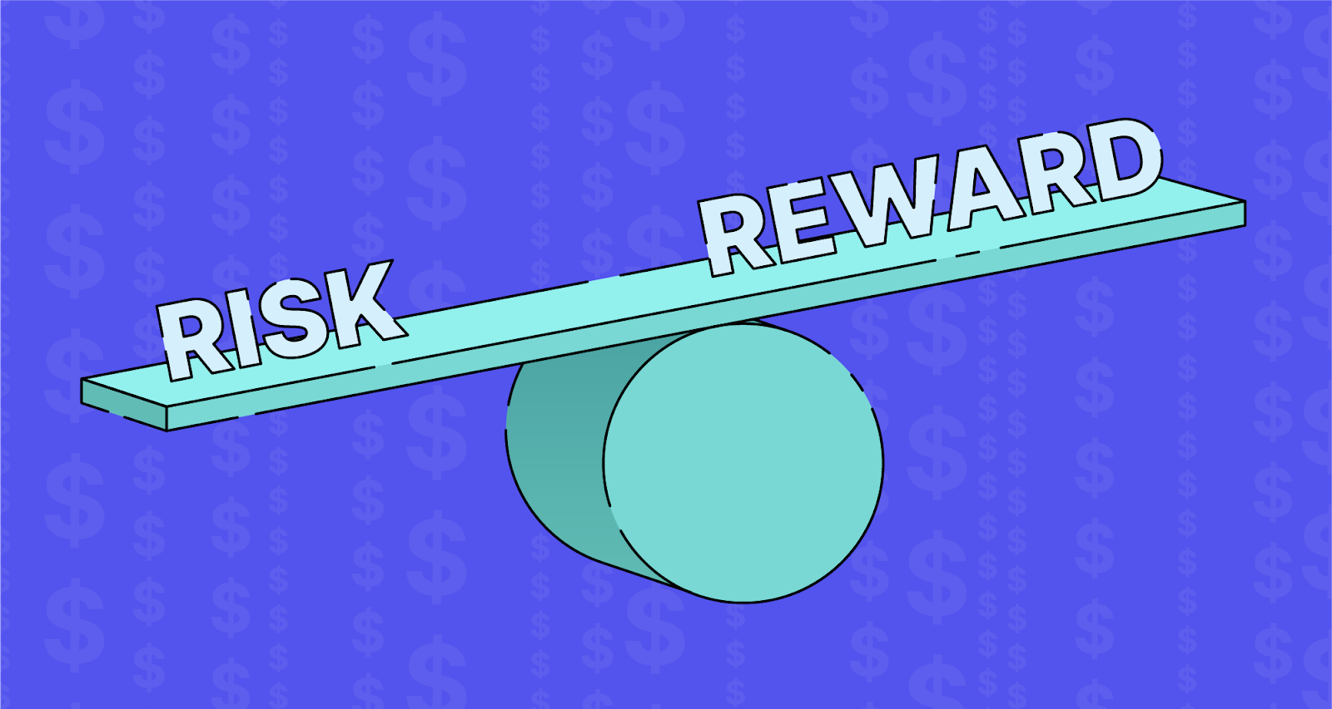
01
Introduction and application
Reinforcement Learning (RL) is a subfield of artificial intelligence (AI) that focuses on training agents to make sequential decisions by interacting with an environment. Unlike supervised learning, where a model is provided with labeled data, RL agents learn through trial and error, receiving feedback in the form of rewards or penalties.
Key Components of RL:
Agent: The learner or decision-maker that interacts with the environment.
Environment: The external system with which the agent interacts.
Actions: The decisions or moves made by the agent within the environment.
Rewards: Numeric feedback indicating the desirability of the agent's actions.

Slide 3
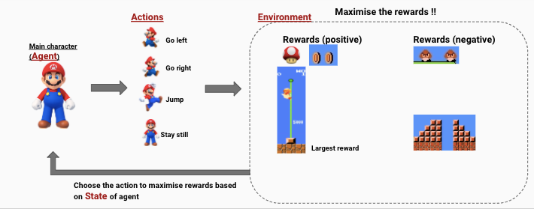

How RL Works:
The agent takes actions in the environment, leading to a change in the environment's state.
The environment provides feedback to the agent in the form of rewards or penalties.
The agent learns to optimize its actions over time to maximize cumulative rewards.
Applications of RL:
Game Playing: RL has achieved remarkable success in mastering complex games such as Chess, Go, and video games.
Robotics: RL is employed to train robots to perform tasks in the real world, adapting to dynamic environments.
Autonomous Vehicles: RL is used for decision-making in self-driving cars, optimizing navigation strategies.
Finance: In portfolio optimization, RL is applied to dynamically allocate resources in stock trading to maximize returns.
Healthcare: RL is used in personalized treatment planning and drug discovery.

Slide 4
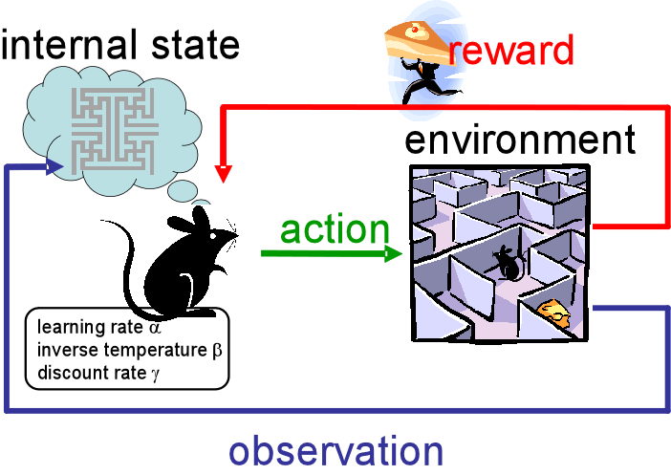

02
Motivation
An attempt to experiment RL framework in portfolio management problems is motivated by the successful implementations and advances made in the RL field. These implementations range from various domains such as video games (Mnih et al., 2018), board gaming (Silver et al., 2021), and protein folding (Callaway, 2020). However, the number of research about RL in the financial domain is growing a lot lately, though.

Slide 5
03
Literature Review
Portfolio construction is one of the most known financial problems. As a result, investment managers, economists, and academics have been spending decades trying to find the best tool and methods to build a portfolio computationally efficient.
Quadratic Programming:
Quadratic optimization methods, like the Critical Line Algorithm (CLA) by Markowitz, are tailored for portfolio optimization. CLA, an open-source implementation by Bailey and López de Prado (2013), guarantees an exact solution within a determined number of iterations. However, it may become unreliable with slightly deviating predicted returns.

Slide 6
->Machine Learning:
Machine Learning (ML) models, such as Support-vector Machines (SVM), have been used for predicting asset prices. In a study by Kim (2003), SVM was employed to predict asset price direction, showcasing its potential as an alternative to other ML methods. Model-based solutions, like SVM and Support-vector Regression (SVR), require additional steps for trading.
->Reinforcement Learning:
Reinforcement Learning (RL) is gaining traction in the financial industry due to its ability to find optimal actions for maximizing rewards. Martinez and Pereira (2020) implemented a daily trading system using the DDPG agent for portfolio optimization on the B3 stock exchange, showcasing alpha generation over three years.
Another DRL solution by da Silva (2021) considered news sentiment and demonstrating readiness for implementation on commercial platforms and integration with brokerage services for automated trading.
These studies spanned from December 31, 2012, to January 31, 2019, for training, and backtesting occurred between February 1, 2019, and February 1, 2020.

Slide 7
04
Problem Statement
>>Given histories of 3 different stocks, how would we allocate a fixed amount of money between these stocks every day so that maximize the likelihood of returns.
>>The objective is to develop of policy (strategy) for building a portfolio. The portfolio is essentially an allocation of available resources across various stocks. The policy then needs to restructure the portfolio over time as new information becomes available.
>>Here the policy should be able to pick the optimal portfolio (allocation).
Our solution is to develop a reinforcement learning model — an agent that allocates stocks at every time step by observing the indicators for each stock.
We then compare this RL policy with Markowitz’ efficient frontier approach — which along with “gut feel” is perhaps the approach employed by most asset managers.

Slide 8
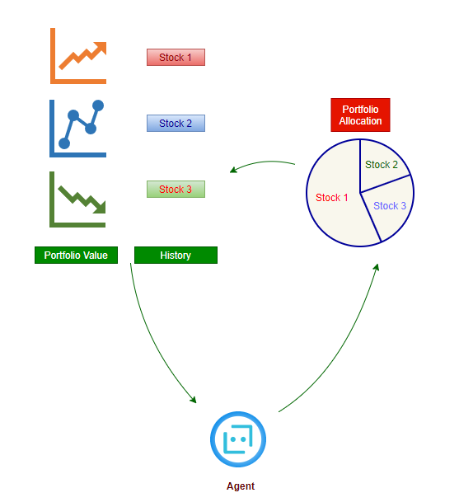

Slide 9
05
Experiment Set Up
A custom environment to simulate the actual trading process. The agent can interact with the environment in the following manner:
The environment provides observations of its current state — indicators for the 3 stocks
The agent passes an action to the environment. The action is the proposed portfolio allocation — e.g. 10% of total value in cash, 30% in stock 1, 30% in stock 2 and 30% in stock 3
The environment changes state by one time step and returns the new state, and the reward(change in value) associated with the previous portfolio

Slide 10
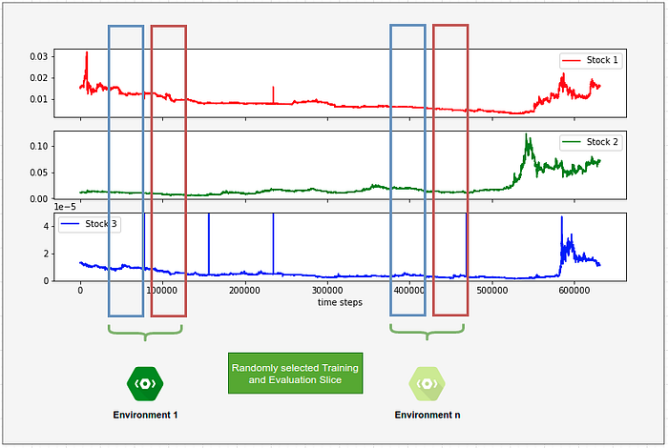
Steps 1 through 3 repeats until the episode is completed. The sum of the rewards obtained at the end of each step is the total reward.
The objective is to maximize the total reward at the end of the episode. Size of an episode is set to 500 time steps. This is randomly sliced from a dataset of 650,000+ time steps.
Every time the environment is initialized, a different section of the full dataset is selected. This would prevent agent from memorizing environment.
Every run of the environment would be different. Further, training and evaluation of the agents are done on different environments.
So the agent learns a policy from one slice of the data. The policy is then evaluated on a different slice of the dataset.
Each initialization of environment picks a different random slice of the dataset

Slide 11
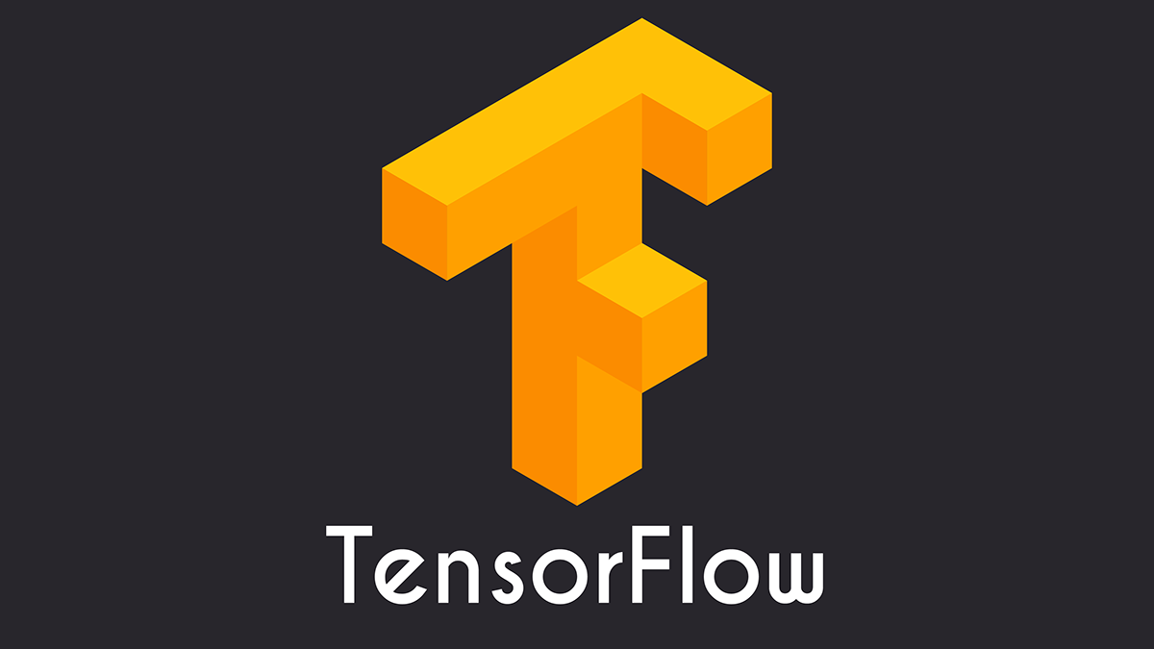
06
Models and Framework
TensorFlow's tf-agents Framework:
Overview:
- TensorFlow's tf-agents is a comprehensive framework for building Reinforcement Learning (RL) models.
- Specifically designed for researchers and practitioners to implement and experiment with RL algorithms efficiently.
Key Components:
1. Actor-Critic Model:
- Central to the tf-agents framework is the Actor-Critic architecture, a popular RL approach combining policy (Actor) and value estimation (Critic).
- The Actor defines the policy, determining the agent's actions, while the Critic evaluates these actions' values.

Slide 12
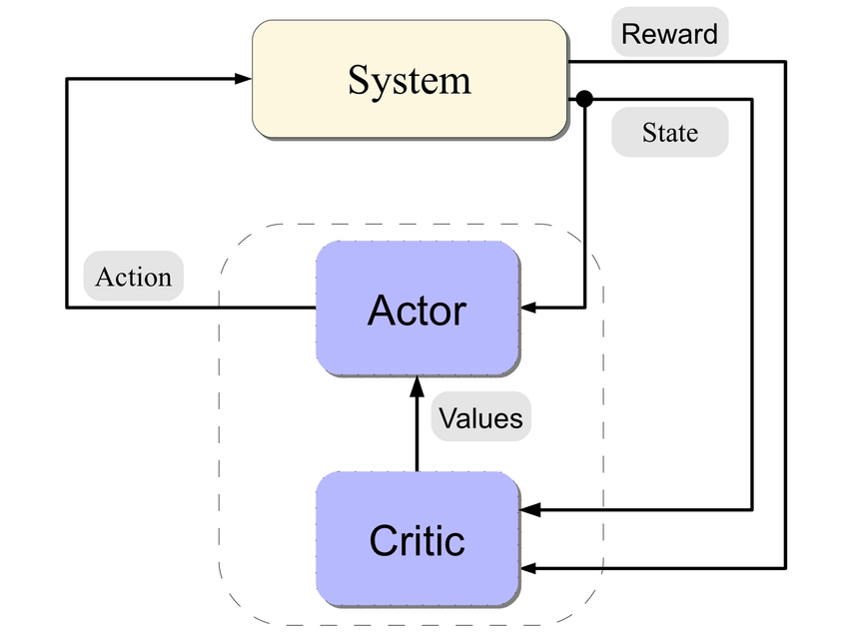
06
2. Environment Interaction:
- The framework facilitates seamless interaction between the RL agent and the environment.
- Agents observe the environment, take actions, and receive feedback in the form of rewards.
3. Training Capabilities:
- Supports the training of RL agents through various algorithms, including DDPG (Deep Deterministic Policy Gradient), used in your project.
4. Flexibility and Customization:
- Allows users to define custom environments, enabling the adaptation of RL models to diverse applications.

Slide 13
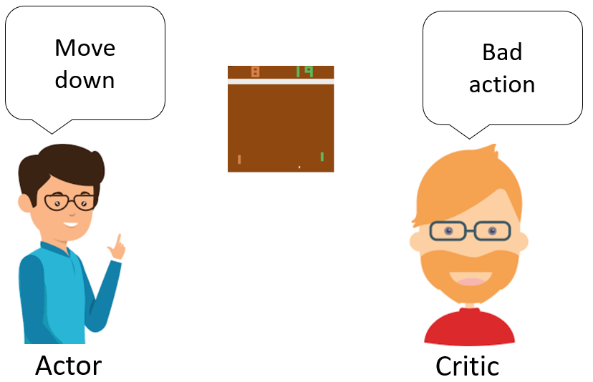
06
Implementation in Project:
- In project, the tf-agents framework is employed to develop and train the RL agent based on the Actor-Critic model.
- The chosen algorithm, DDPG (Deep Deterministic Policy Gradient), utilizes the capabilities of tf-agents for efficient training and interaction with the trading environment.
Advantages:
- TensorFlow's tf-agents offers a scalable and modular platform, making it conducive for RL experimentation in portfolio optimization.
- Its versatility allows for the incorporation of different RL algorithms, facilitating the exploration of various approaches for optimal portfolio allocation.

Slide 14
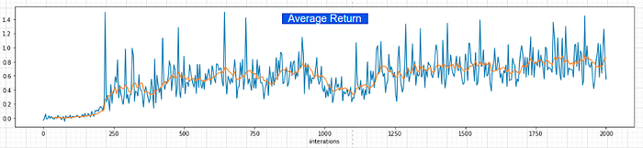
07
Results:
Reinforcement Learning:
Here using an off-the-shelf untuned lazy implementation of Actor Critic model. We would be using tf-agents framework published by tensorflow for this.
Training Actor-Critic model over 2000 iterations

Slide 15
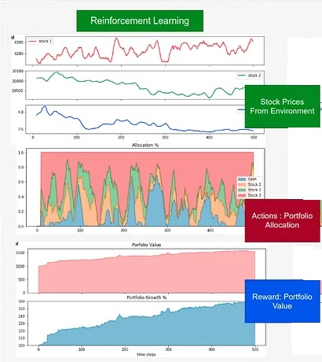
07
Results:
Model evaluation:
Evaluating over 100 runs of the environment,
Average returns : +20%

Slide 16
08
Conclusion
We see that both algorithms allocate significant amount on Stock 3 — It’s because the value of stock 3 is very low and stable. So a small gain in value can result in large return(%) without risking volatility.
We see that during times increased volatility or when all stocks are going down, the RL decides to hedge the losses by selling the stocks and increasing the cash in hand — very smart strategy when we haven’t enabled a short-sell option.
In general, the RL strategy seems to be to identify bursts of small surges in price and capitalize on that immediately.

Slide 17
09
Future Work
Lack of interpretability makes it difficult for investors to invest capital in a portfolio managed only by RL agents. Therefore, a good mix RL agents and human expert knowledge input could make it easier for the interpretability of the model actions and states.
Enhanced RL Algorithms:
Explore advanced RL algorithms and architectures to improve the performance of portfolio optimization.
Consider state-of-the-art algorithms such as Proximal Policy Optimization (PPO) or Trust Region Policy Optimization (TRPO).

Slide 18
09
Future Work
Extended Evaluation Metrics:
Introduce additional evaluation metrics beyond average returns, such as downside risk measures, maximum drawdown, and risk-adjusted performance.
Provide a comprehensive assessment of the model's effectiveness under various performance indicators.
Parallelization and Scalability:
Investigate techniques for parallelizing training processes to accelerate model development.
Assess the scalability of the RL model to handle larger datasets and more complex market scenarios.

Slide 19
10
References
https://www.sciencedirect.com/science/article/pii/S0957417420302803
https://arxiv.org/abs/1706.10059
https://en.wikipedia.org/wiki/Modern_portfolio_theory
https://www.tensorflow.org/agents/overview
Author: B. Lau., Title of Paper: Using Keras and Deep Deterministic Policy Gradient to play TORCS, Year: Oct 2106. Accessed: 2016-12-14, Volume No: 1.
Author: Betancourt, C. and Chen, W.-H., Title of paper: Deep reinforcement learning for portfolio management of markets with a dynamic number of assets. Journal Name: Expert Systems with Applications, Year: 2021, Volume: 164:114002.
https://www.investopedia.com/terms/ p/portfolio-investment.asp

Slide 20

11
Thank You

