Slide 1
EC351: Summer Internship I
"Third Eye for the Blind using Arduino UNO
(A Wearable Device)"
Prepared by :
Rahul Suhagiya (17EC091)
Electronics and Communication Engineering
Guided by :
Dr. Sagar Patel
(Assistant Prof.)
EC Department

Slide 2
Abstract:
Third eye for the blind is an innovation with the help of the multidiscipline subjects like computer science, electronics engineering and health science which helps the blind people to navigate with speed and confidence by detecting the nearby obstacles using the help of ultrasonic waves and notify them with a buzzer sound or vibration. When the sensor detects any object, it will notify the user by beep or vibration. Thus, this is an automated device. Thus, this device will be of a great use for the blinds and help them travel different places.

Slide 3
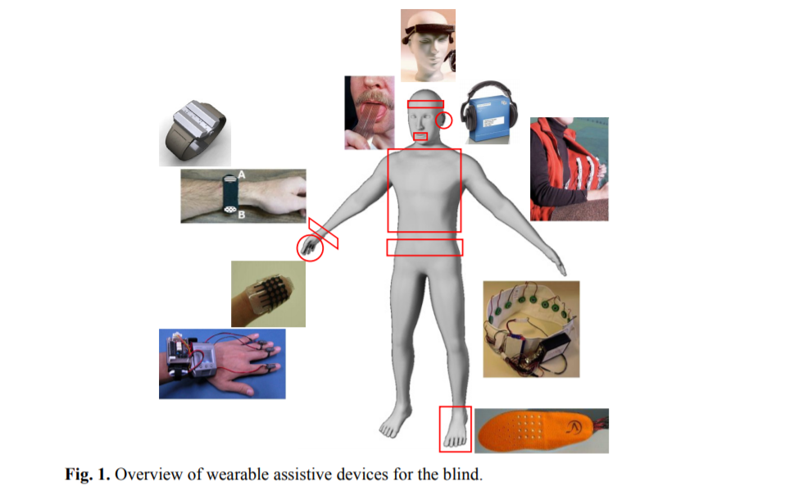
Assistive Devices:

Slide 4
Assistive Devices:
Wearable devices are distinctive from portable devices by allowing hands-free interaction, or at least minimizing the use of hands when using the device.
This is achieved by devices that are actually worn on the body such as head-mounted devices, wristbands, vests, belts, shoes, etc. Portable devices are usually compact, lightweight, they can be easily carried (but not worn) by the user and require constant hand interaction. For example, tactile displays, electronic canes, mobile phones, laptop computers, etc.
The area of wearable devices is currently a “hot” research topic in assisting people with disabilities such as the blind. As this area is still very much young and experimental, there are not many mature commercial products with a wide user base.

Slide 5
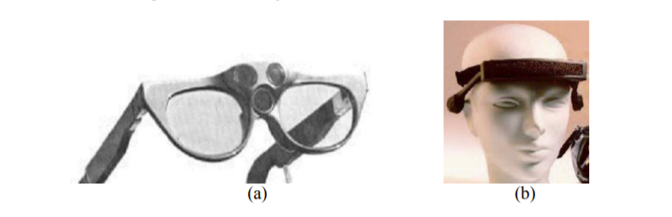
Existing Assistive Devices:
SonicGuide:
Fig. (a) The SonicGuide (1974) and (b) its latest version, the KASPA system (2002).

Slide 6
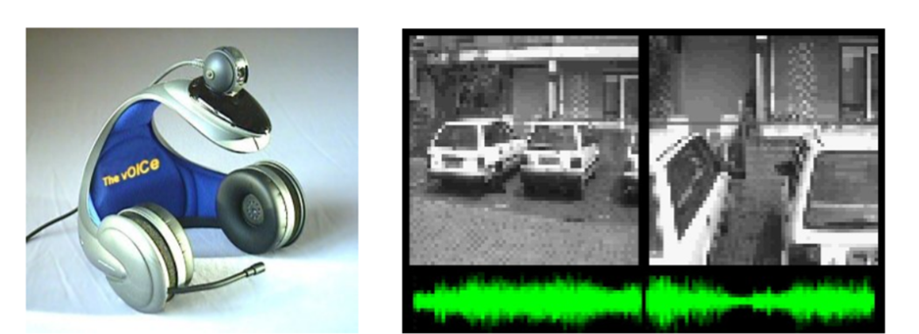
Existing Assistive Devices:
The vOICe:

Slide 7
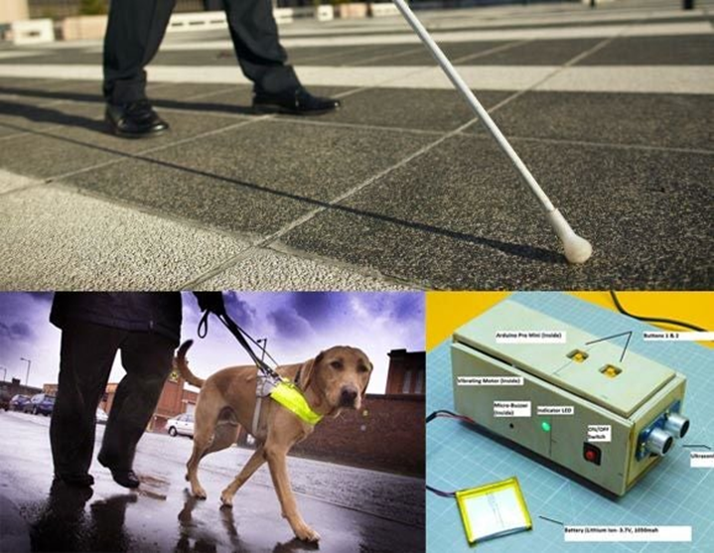
Existing Assistive Devices:
Other solutions:

Slide 8
Problems with existing systems:
White cane - May easily crack/break, The stick may get stuck at pavement cracks of different objects.
Pet dog - Huge cost. (~$42,000 / 280000Rs )
Common Disadvantages (Including the smart devices) Cannot be carried easily,
needs a lot of training to use…

Slide 9
Why this Project?
This devices are equipped with seven ultrasonic sensors, consisting seven modules which are connected to the different parts of the body. Among them, two for both the shoulders, another two for both the knees, another two for both the palms, and one for the head. It’s the choice of the visually impaired people, they can either use one band or put it anywhere on their body wherever they are comfortable.
The intensity of vibrations and the rate of beeping increases with decrease in distance and this is a fully automated device.
This device will help the blind to navigate without holding a stick which is a bit annoying for them.
They can wear the device as a band or like a cloth and it can function very accurately and they only need a very little training to use it as it is quite simple, efficient and easy to operate and wear.

Slide 10
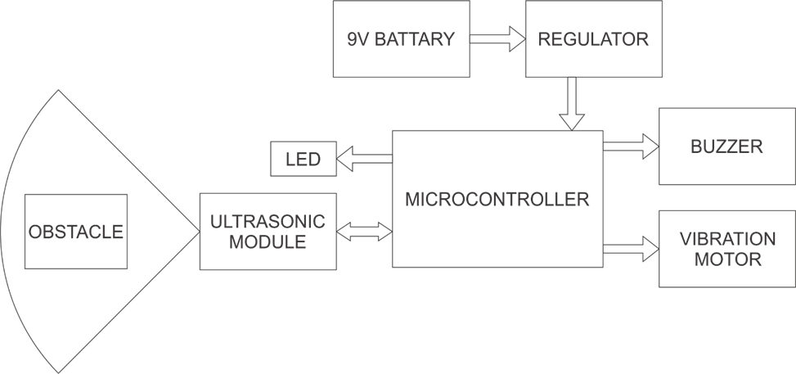
Block Diagram:

Slide 11
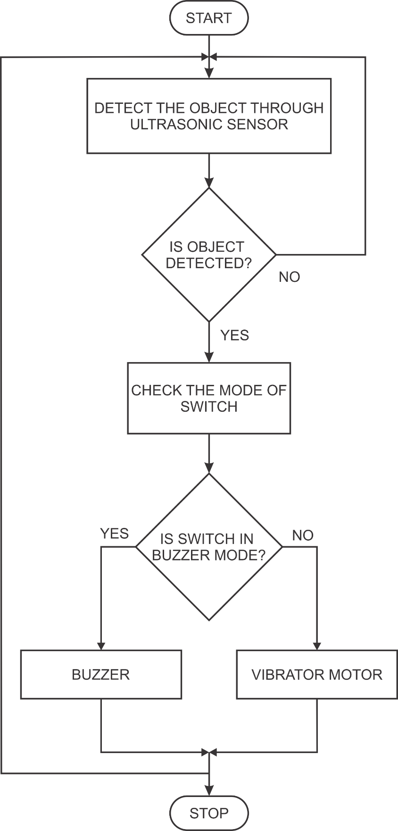
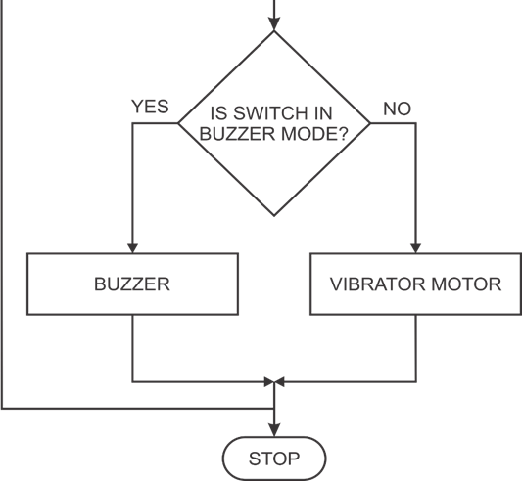
Flow Chart:

Slide 12
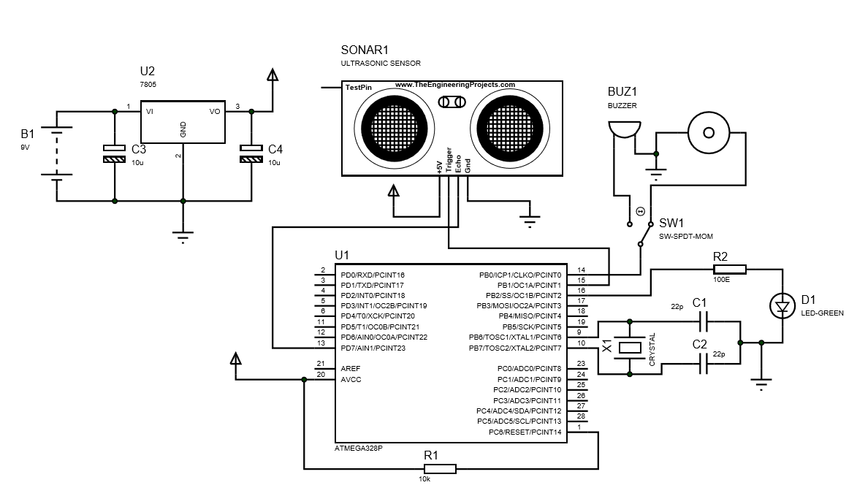
Circuit Diagram:

Slide 13
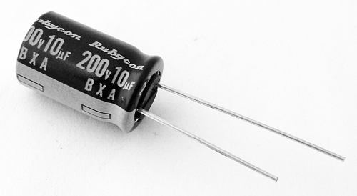
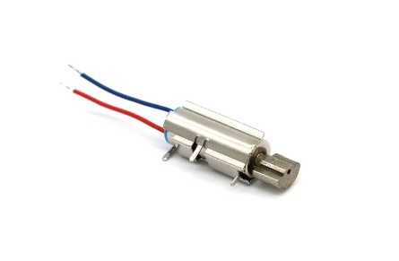
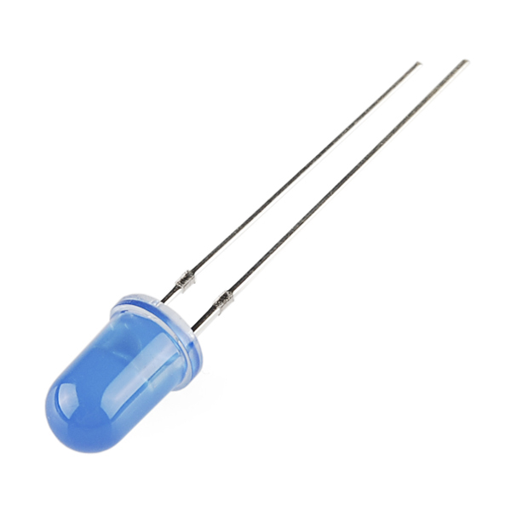
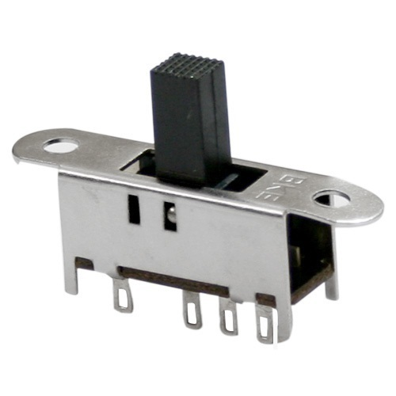
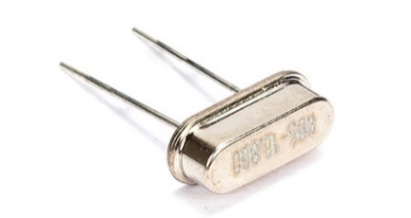
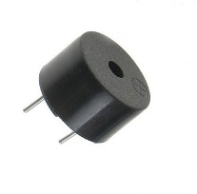
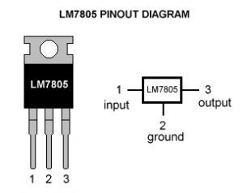
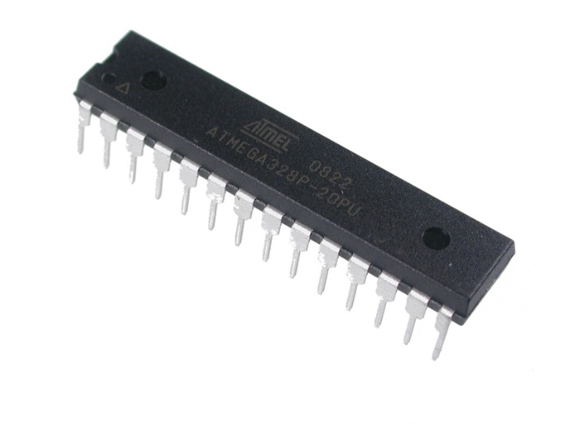
Components:
7 x ATMega328 ICs
7 x Ultrasonic sensor
7 x GPB boards
7 x Vibrating motor
7 x Buzzers
7 x LEDs
7 x Switches
7 x 7805 Regulator ICs
Some elastics and stickers (to make it as a band for wearing)

Slide 14
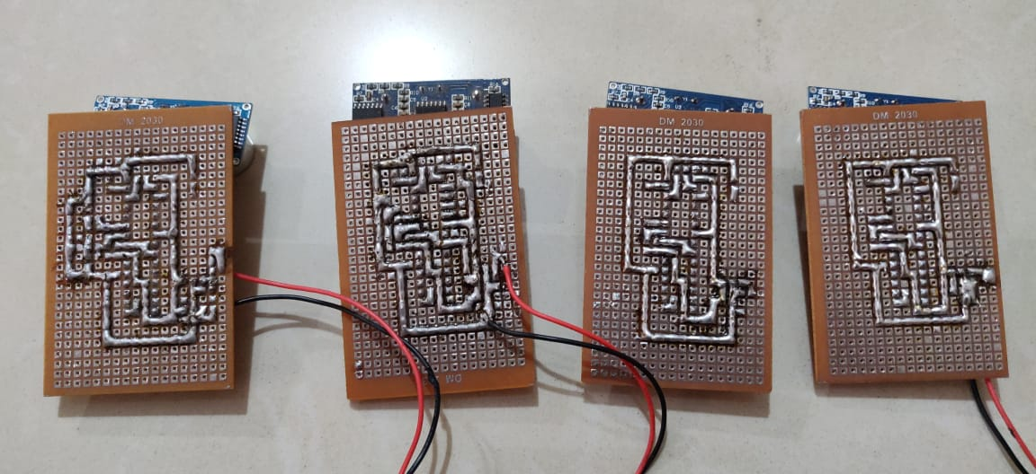
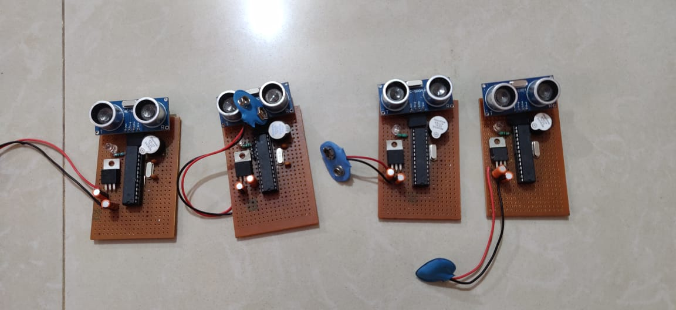
Hardware Implementation:

Slide 15
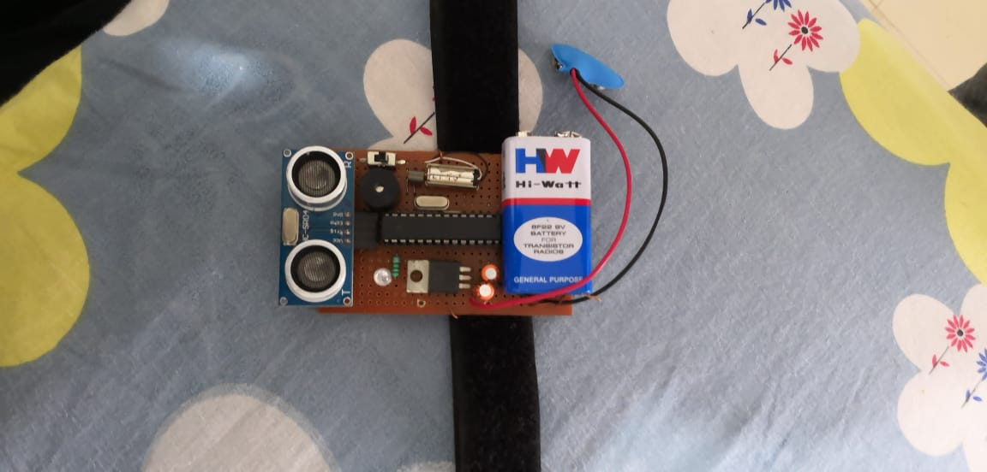
Powering the modules:
•For all the modules we are using a small 9V batteries.

Slide 16
Applications:
This device will help the blind to navigate without holding a stick. Simply wear it as a band or cloth and it can function very accurately and they only need a very little training to use it.
The product developed is light in weight, compact hence does not cause fatigue to the user. So, this helps the blind person to be self-dependent till particular extent.
As this system consists of vibrating motor, it can also be applicable for deaf persons.

Slide 17
Limitations:
It doesn’t show the exact distance of obstacle.
The battery can be drained after certain interval.
It is low accurate in some cases.
The system is only applicable for house/small areas which are familiar too.
The system is non- water-resistance.
The cost of ultrasonic sensor is high comparing to the microcontroller.

Slide 18
Future Enhancement:
The entire project can be made in the form of jacket & gloves, so that the device doesn't need to be wear one by one.
By specifically suing the specialized boards that are designed, using them instead of this microcontroller and also by using high quality ultrasonic sensors makes and gives faster response which make the device capable of working in crowded places and thus this will be implemented in the future enhancement of this device.
It can be still compact.
With the use of GPS one can monitor the location of victims.

Slide 19
Conclusion:
Thus, this project proposed the design and architecture of a new concept of Arduino based Virtual Eye for the blind people. A simple, cheap, efficient, easy to carry, configurable, easy to handle electronic guidance system with many more amazing properties and advantages is proposed to provide constructive assistant and support for the blind and visually impaired persons. The system will be efficient and unique in its capability in specifying the source and distance of the objects that may encounter the blind. It is able to scan and detect the obstacles in the areas like left, right, and in front of the blind person regardless of its height or depth. With the proposed architecture, if constructed with at most accuracy, the blind will be able to move from one place to another without others help.

Slide 20
References:
World Health Organization (2009) Visual impairment and blindness - Fact SheetN°282. Available online at: http://www.who.int/mediacentre/factsheets/fs282/en/
Blind World Magazine (2006) Breaking the chains of paternalism. Available online at: http://home.earthlink.net/~blindworld/NEWS/6-06-14-02.html
Instructables Circuits: https://www.instructables.com/id/THIRD-EYE-FOR-BLINDS-an-Innovative-Wearable-Techno/
National Journal of Multidisciplinary Research and Development
ISSN: 2455-9040 www.nationaljournals.com

Slide 21
Thank You…

