Slide 1
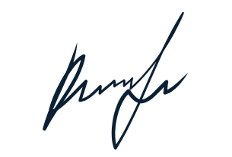
CERTIFICATE
Awarded to
ROSHI BHATI
From VIVEK VIDYALATA
For RUNNER UP in PAINTING
3/15/2023
ROSHI BHATI
Date

