Slide 1
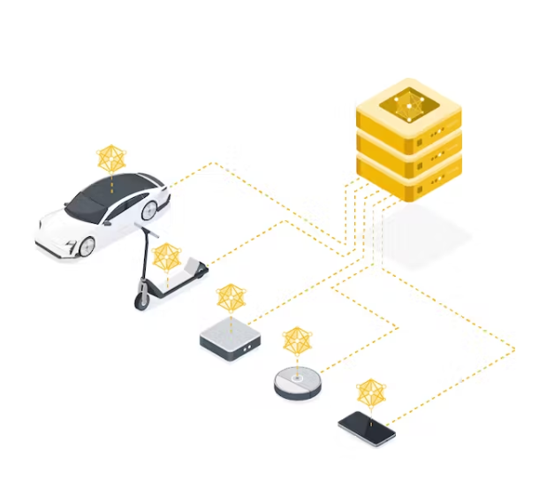
Communication Optimization in Tiny Federated Learning
Rahul Theresaraj

Slide 2
Agenda
Introduction
Federated Learning
Tiny Federated Learning
State of Art
Challenges of Federated Learning
Techniques for Communication Optimization
Diagrams
Applications of Communication Optimization in TFL
Next steps
1

Slide 3
Introduction
Tiny Federated Learning is a combination of TinyML and Federated Learning approach.
Tiny Federated learning trains a shared Machine learning model in an embedded device like microcontrollers.
2

Slide 4
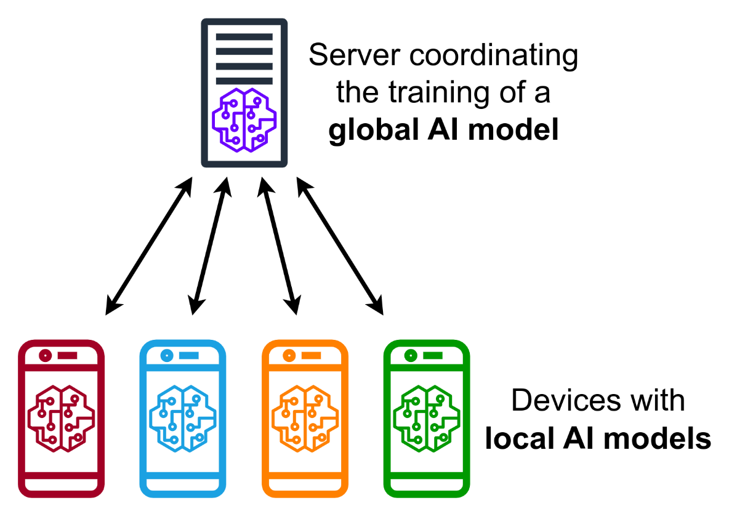
Federated Learning
https://en.wikipedia.org/wiki/File:Centralized_federated_learning_protocol.png
It is a method of Machine learning that enables an algorithm model to be trained across multiple edge devices.
3

Slide 5
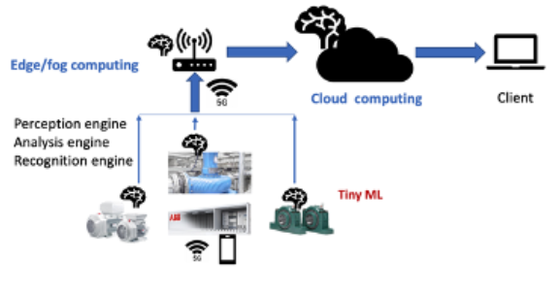
Tiny Federated Learning
https://www.mn.uio.no/ifi/studier/masteroppgaver/nd/image-20211024110426-1.png
It is an approach that aims to train models on decentralized data sources on a tiny edge devices while preserving privacy and security by using low computational cost.
4

Slide 6
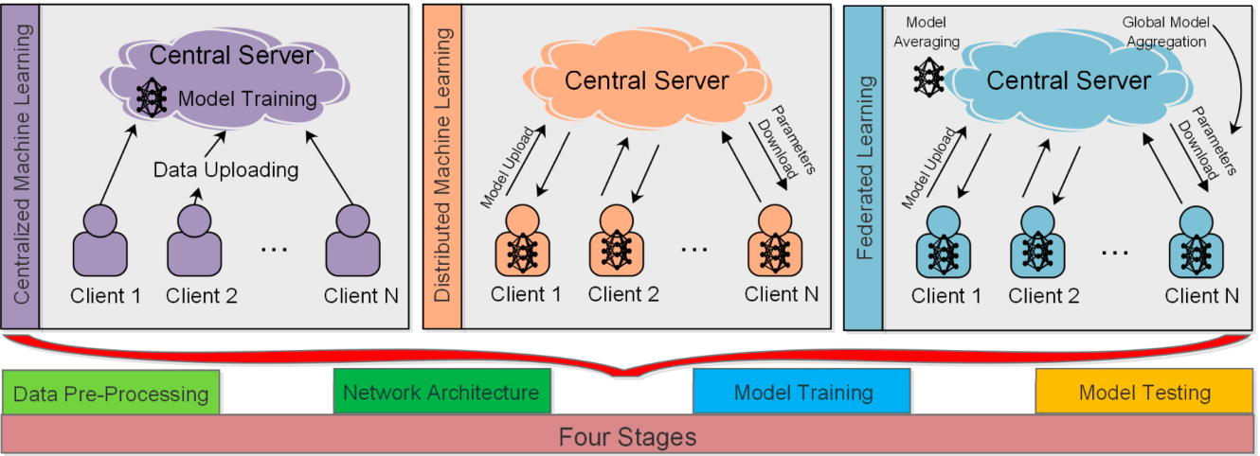
State of Art
https://d3i71xaburhd42.cloudfront.net/f825746074f90e5f2226d7a91ce9fa6224d6644b/250px/5-Figure1-1.png
Federated Learning Versus Classical Machine Learning: A Convergence Comparison.
A Comparison of federated learning with Centralized and distributed machine learning approaches.
5

Slide 7
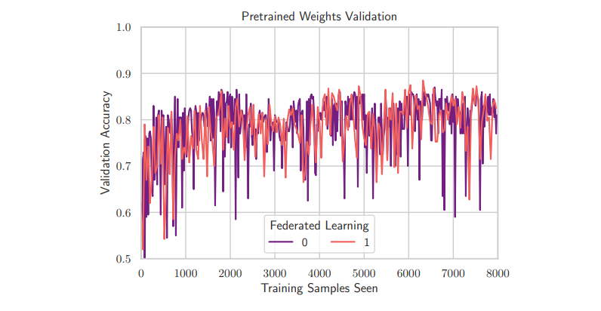
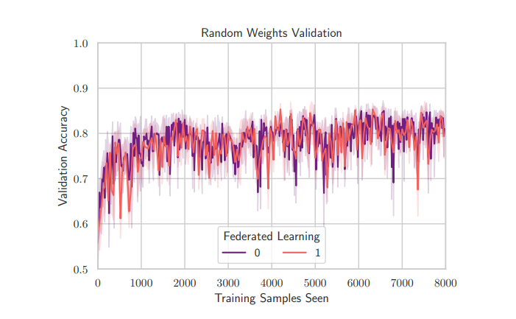
State of Art
https://d3i71xaburhd42.cloudfront.net/9673109a479098d314e60b819b3cd1d47aef6503/250px/3-Figure1-1.png
TINYFEDTL: Federated Transfer learning on Tiny Devices.
Here, The authors implement federated learning on microcontrollers and deploy transfer learning on a resource constrained microcontroller.
6

Slide 8
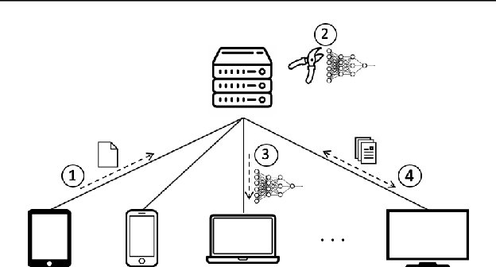
State of Art
https://d3i71xaburhd42.cloudfront.net/c16c10a7f4524e44f3beea4a3516361df3d1d4e7/250px/3-Figure1-1.png
Model Pruning Enables Efficient Federated Learning on Edge Devices
The authors propose a novel approach called as Prune FL with adaptive and distributed parameter pruning, which adapts the model size during Federated Learning to reduce the communication.
7

Slide 9

Challenges of Federated Learning
One of the main challenges in communication optimization for TFL is the limited bandwidth and high latency of wireless communication channels, which can result in slow convergence and poor model accuracy
8

Slide 10
Techniques for Communication Optimization
Quantization
Compression
Sparsification
9

Slide 11
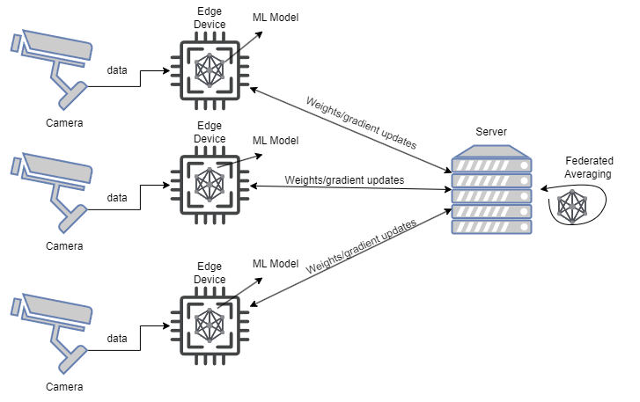
Diagram of a Project
10

Slide 12
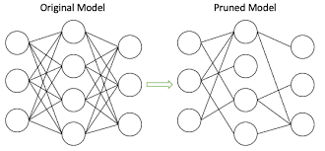
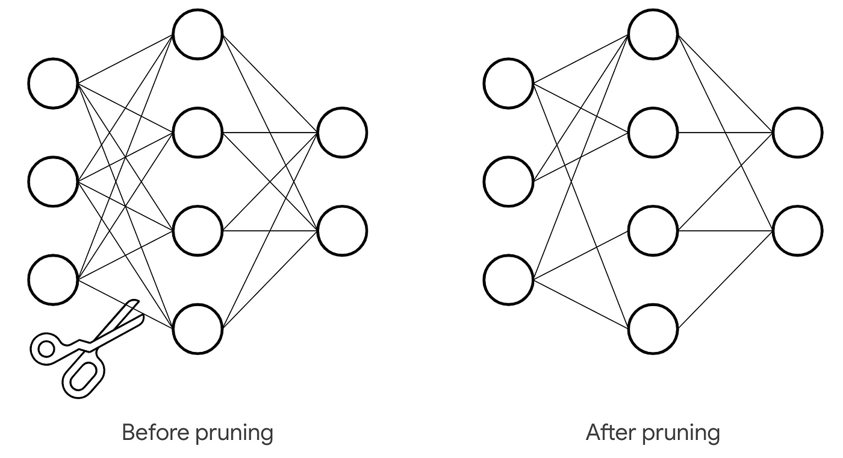
Diagram – Pruning a Model
11

Slide 13
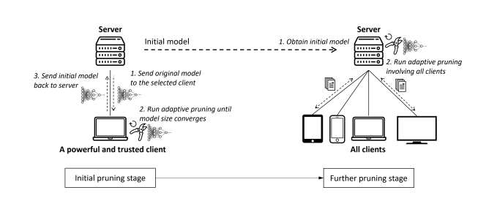
Diagram – Pruned FL diagram
https://arxiv.org/pdf/1909.12326.pdf
12

Slide 14
Applications & Advantages of Communication Optimization in TFL
Applications
Advantages
Personalized healthcare
Smart cities
Autonomous vehicles
Secure and efficient model training on decentralized data source
Preserving privacy
Risk of data breaches
Cyber attacks.
13

Slide 15
Next Steps
Research on bandwidth in Federated learning.
Implementation on Real Edge devices.
14

Slide 16
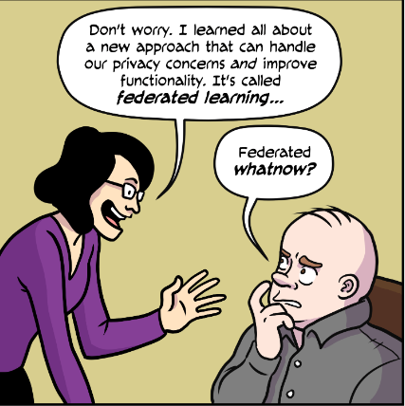
THANK YOU!
15

