Slide 1

Simulation of End To End Data Transmission Over Communication Channel
Simulation Theory for Communication: Project
Presented by
Rahul tyagi
Abhinav SHARMA

Slide 2
Table of Contents
Introduction
Processing input data
Source coding using Huffman algorithm
Channel coding using convolutional codes
Data Modulation
Demodulation
Channel decoding using Viterbi algorithm
Decoding using Huffman algorithm

Slide 3
Introduction
Source Coding
Modulation
Channel Coding
Input Data
AWGN Channel
Source Decoding
Demodulation
Channel decoding
Output
Fig. 1. Schematic of Communication system

Slide 4
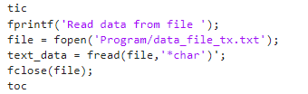
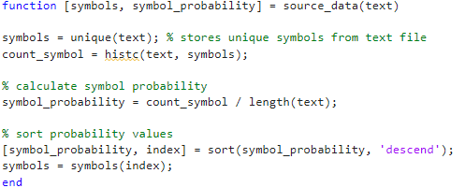
Processing of Input Data

Slide 5
Source Coding: Huffman Algorithm
Lossless Data Compression Technique
Assigns variable-length binary codes to input characters based on their frequencies
Shorter codes are assigned to frequently occurring characters
Entropy Encoding algorithm

Slide 6
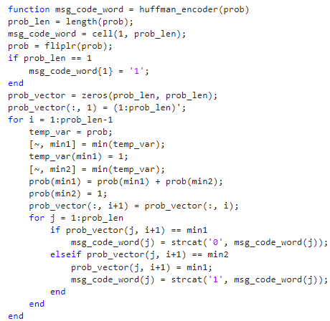
Huffman Coding: MATLAB Code

Slide 7
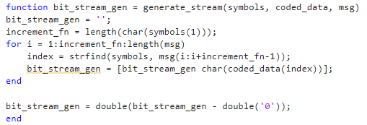
Data Stream Generation

Slide 8
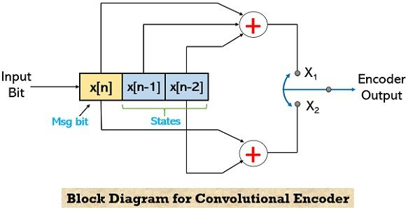
Channel Coding: Convolutional Codes
It is an error-correcting technique used to enhance the reliability of data transmission
It uses dynamic coding to operate on a continuous stream of data using boolean operations to generate parity symbols
Fig. 2. Convolutional Encoder

Slide 9
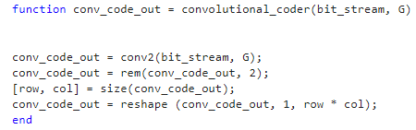
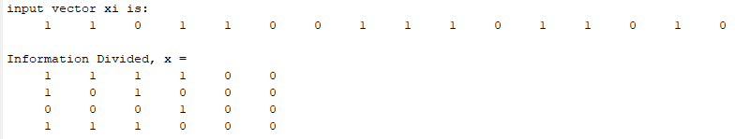
Convolutional Coding: MATLAB Code
Reshape Function

Slide 10
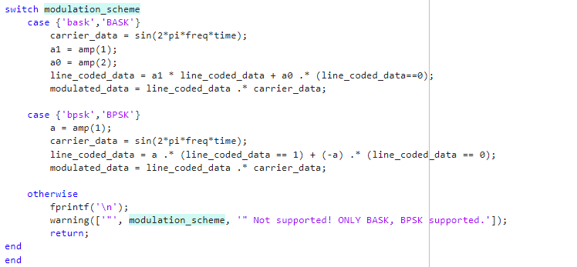
Modulation and Channel Model
BPSK and BASK modulation schemes
AWGN channel considered

Slide 11
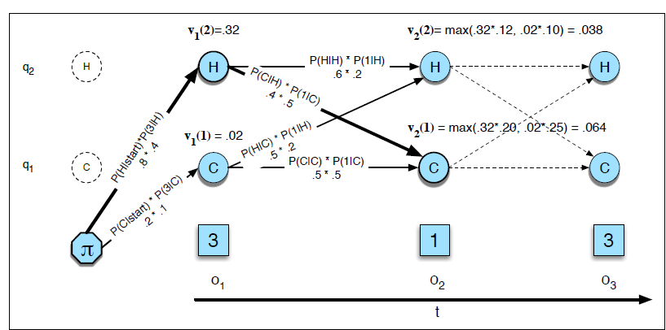
Channel Decoding: Viterbi Algorithm
Fig. 3. Viterbi Trellis

Slide 12
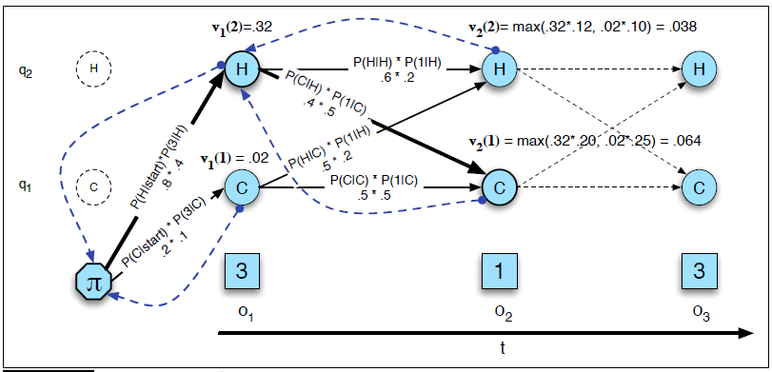
Channel Decoding: Viterbi Algorithm
Fig. 3. Viterbi Backtrace

Slide 13
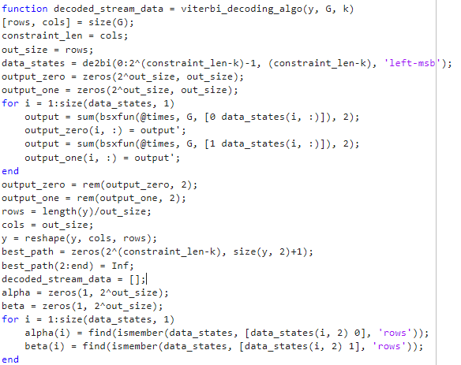
MATLAB Code: Viterbi Algorithm

Slide 14
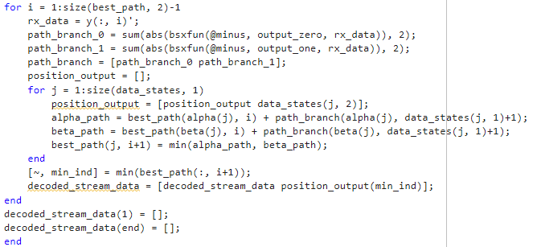
MATLAB Code: Viterbi Algorithm Contd.

Slide 15
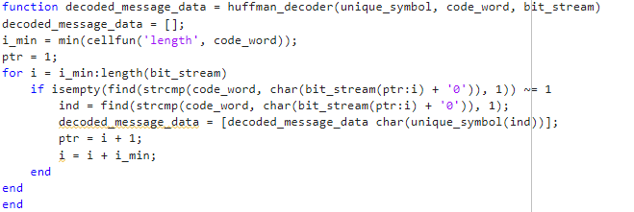
MATLAB Code :Huffman Decoding

Slide 16
MATLAB Code : Huffman Decoding

Slide 17
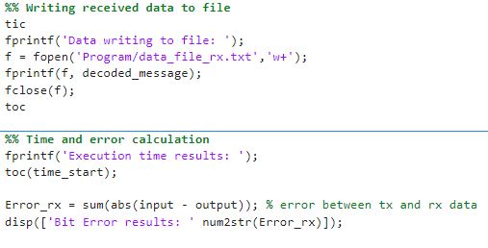
Data writing and Error calculation
The data is written to a file
Error calculated between transmitted and received data

Slide 18
Conclusion
Integration and interfacing of different components of communication systems
End to end simulation of data transmission for enhancing understanding of complete communication system

Slide 19
Questions

