Slide 1
Website Name: Getfit
Group Members:
Samanth Sidhabathuni (C0773700@mylambton.ca)
Rahul Valupadasu (C0768694@mylambton.ca)
Yogita (C0765030@mylambton.ca)
Bharadwaj (C0771698@mylambton.ca)
Radhika (C0768704@mylambton.ca)
Ankita (C0771534@mylambton.ca)

Slide 2
List of items used as per project requirement documentation.
Images , Animations, CSS styles and layout
Data validations using jQuery where ever applicable
Regular expressions for email pattern validation in sign up form
Welcome message after successful login
3 plugins used
JQuery modal plugin(Home page and Food log page)
JQuery data table(Home page)
JQuery date picker(Food log page)

Slide 3
Events Used (Click event, Double Click event, Mouse enter event, Mouse leave event)
Iframe widget for populating google map

Slide 4
Home Page
Landing page will be home page, it consists of nave bar for navigation into other pages
Header has options for login and signup
Jquery modal plugin is used in the login and signup modules
All the fields are validated
There is a BMI calculator with animations
Jquery Data table plugin is used to display the BMI result by highlighting the color around the row of table
When clicked on website logo, user will be sent to home page

Slide 5
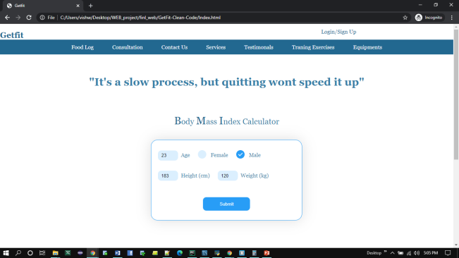
Home Page

Slide 6
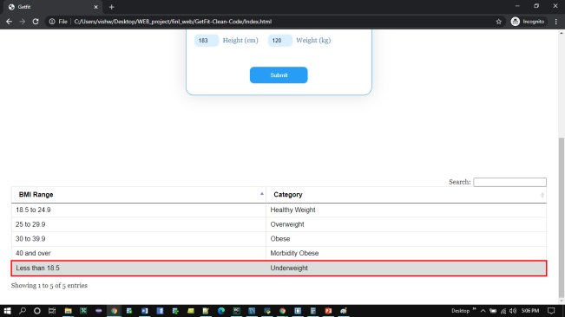
BMI based on input

Slide 7
Login and Signup
Both login and sign up has form validations
Regular expression is used to validate email
Local storage is used to store the email id and check it while login
If user is not registered and, if he tries to login, an error message is shown suggesting him to signup
After successful login, user name with a welcome message will be shown in the header
After login user can use logout feature
Click event handlers are used

Slide 8
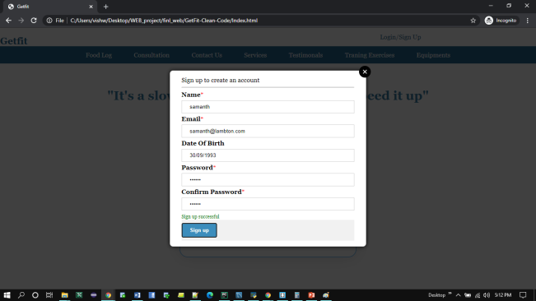
Sign up

Slide 9
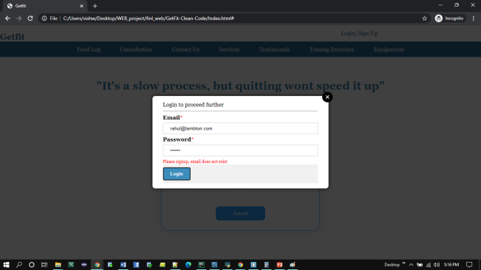
Login with non registered user

Slide 10
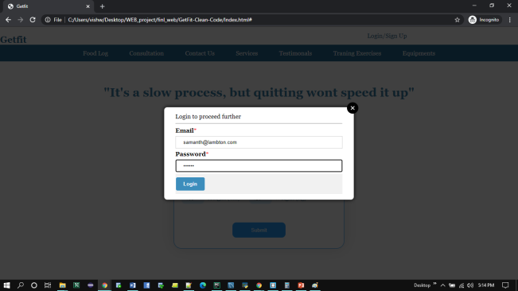
Login with registered user

Slide 11
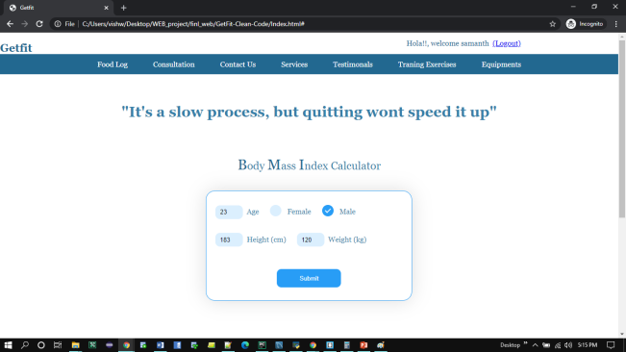
Welcome message after login

Slide 12
Food Log
Food Log page is the used to log daily food details
It also has a feature for taking input of water consumption details
Jquery date picker plugin is used in this page
Jquery animations are used to show the amount of water consumed by the user in pictorial form.
Used double click event handler to edit water input.

Slide 13
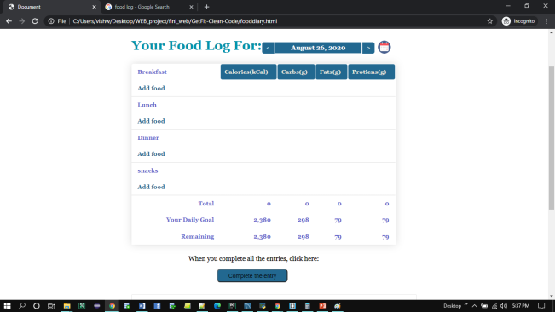
Food log table with date picker

Slide 14
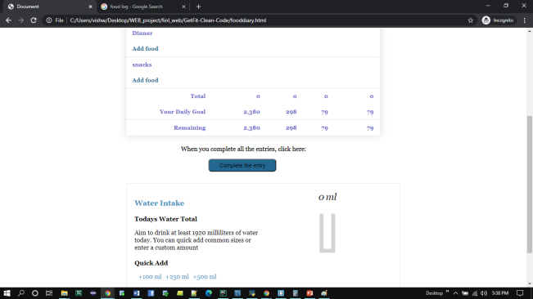
Complete the Entry

Slide 15
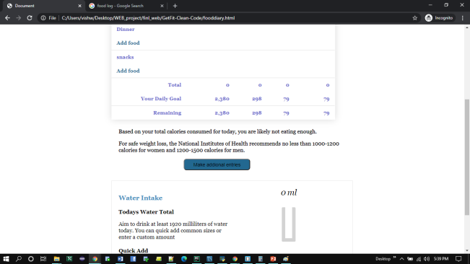
Click event handler on “complete the entry” button

Slide 16
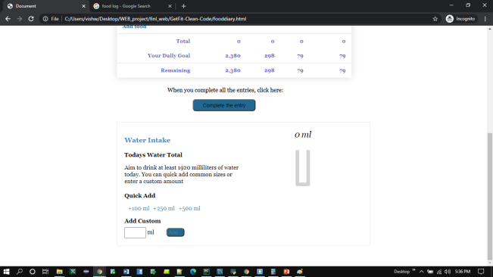
0 ml initial state of water animation

Slide 17
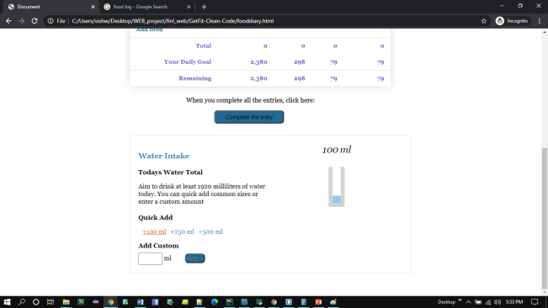
100 ml water input representation

Slide 18

250 ml input water representation

Slide 19
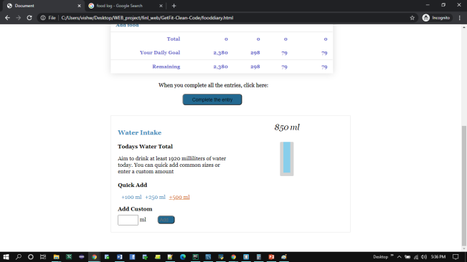
500 ml water input representation

Slide 20
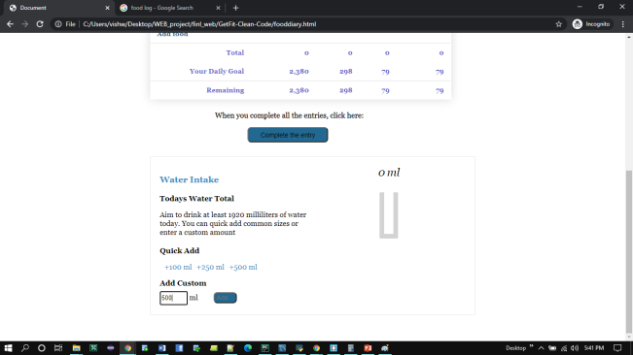
Adding custom water input

Slide 21
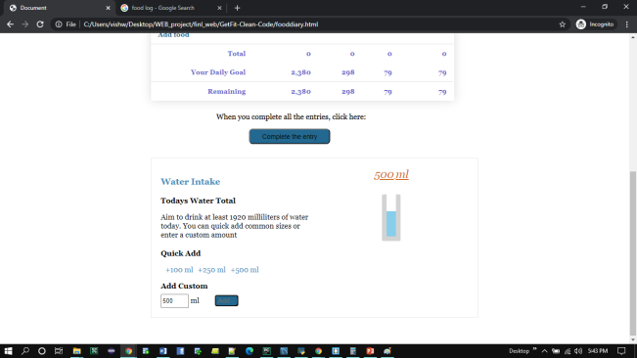
Double click on the total volume value(above the glass)

Slide 22
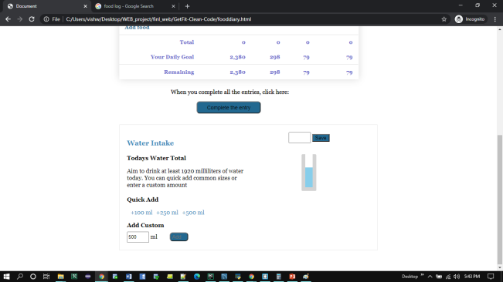
Custom input of water input on double click

Slide 23
Consultation
This page has the information regarding consultation with the service provider.
User can enter the data using the form available.
Iframe widget is used to populate google maps on the page, which will convey address of the service provider.
Form validations are done

Slide 24
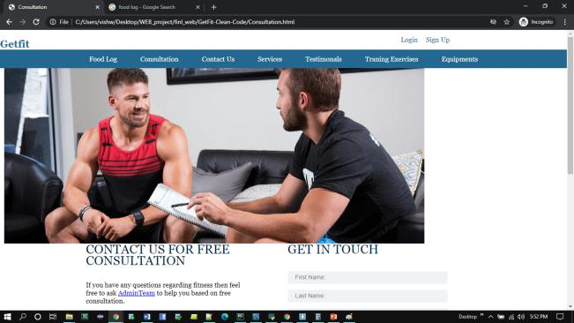
Consultation Page

Slide 25
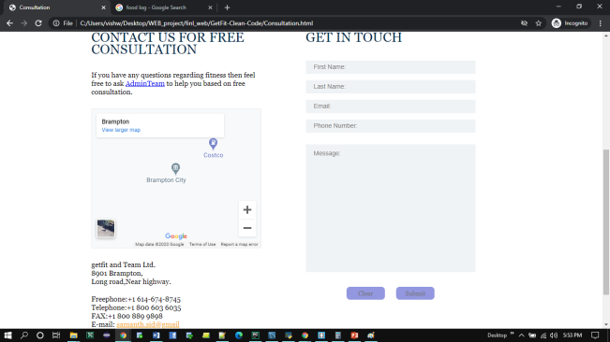
Consultation Page- Map widget(Iframe)

Slide 26
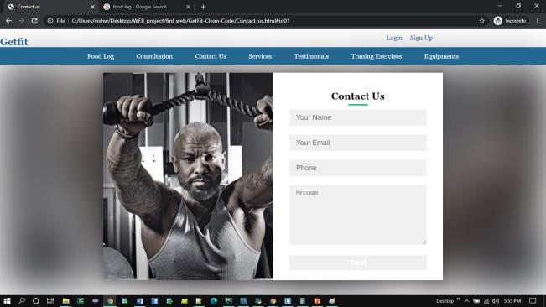
Contact Us Page

Slide 27
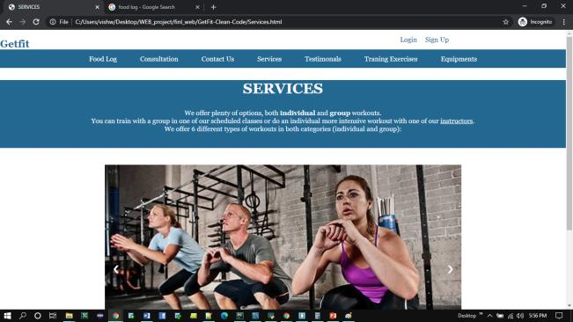
Services Provided

Slide 28
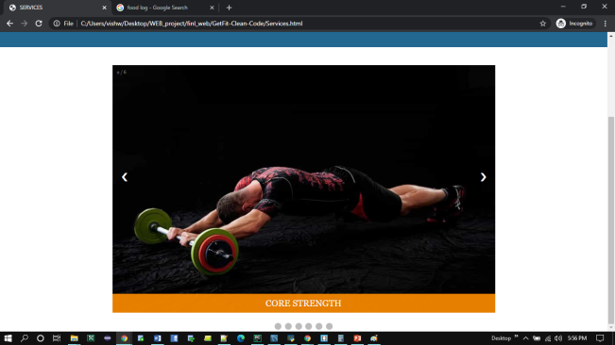
Services Provided- carousel

Slide 29
Testimonials
This page consists of opinions of the customer.
Mouse enter and Mouse leave event handler are used in this page.
Animations are used based on Mouse enter and Mouse leave

Slide 30
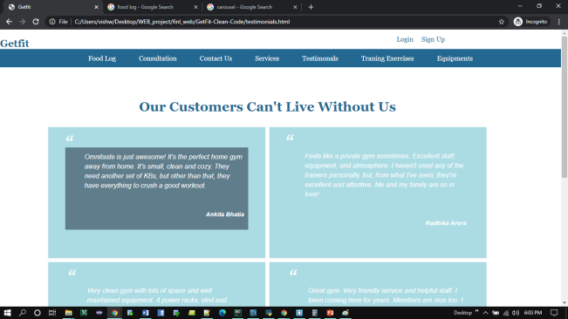
Mouse Enter

Slide 31
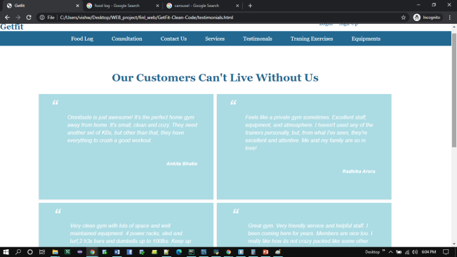
Mouse Leave

Slide 32
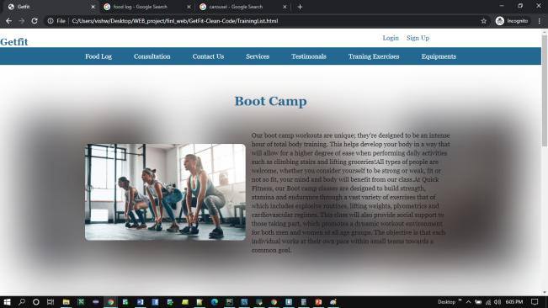
Training Exercises

Slide 33
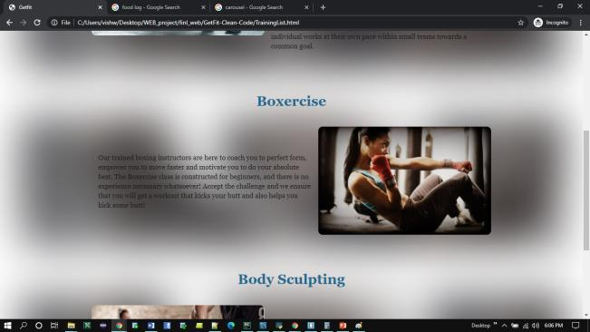
Training Exercises

Slide 34
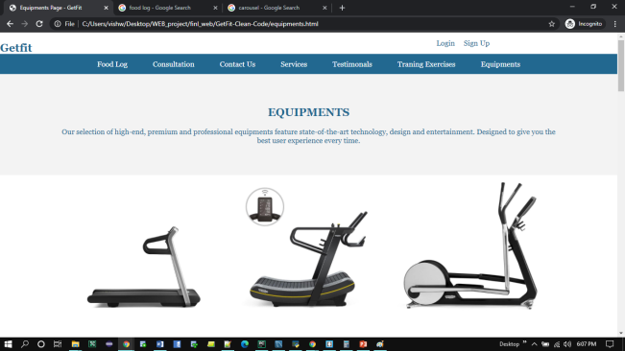
Equipments

Slide 35
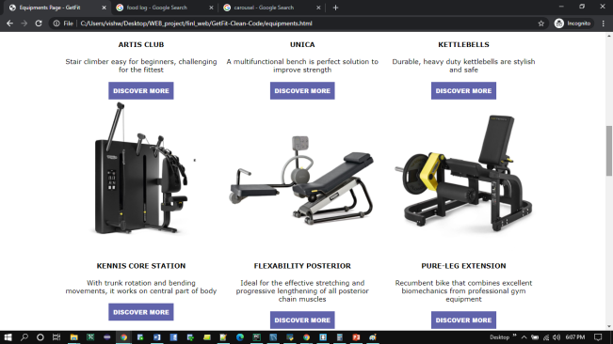
Equipments

