Slide 1
Euler Paths and Circuits

Slide 2


Slide 3
The original problem
A resident of Konigsberg wrote to Leonard Euler saying that a popular pastime for couples was to try to cross each of the seven beautiful bridges in the city exactly once -- without crossing any bridge more than once.

Slide 4
It was believed that it was impossible to do – but why? Could Euler explain the reason?

Slide 5
The Seven Bridges of Konigsberg
In Konigsberg, Germany, a river ran through the city such that in its center was an island, and after passing the island, the river broke into two parts. Seven bridges were built so that the people of the city could get from one part to another.

Slide 6
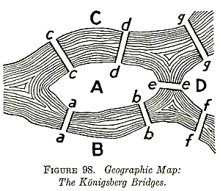
Konigsberg- in days past.

Slide 7
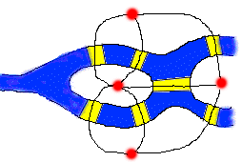
Euler Invents Graph Theory
Euler realized that all problems of this form could be represented by replacing areas of land by points (what we call nodes), and the bridges to and from them by arcs.

Slide 8
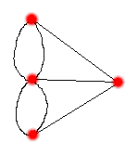
Usually the graph is drawn like this (an isomorphic graph.)

Slide 9
The problem now becomes one of drawing this picture without retracing any line and without picking your pencil up off the paper.

Slide 10
Euler saw that there were 4 vertices that each had an odd number of lines connected to it.
He stated they would either be the beginning or end of his pencil-path.

Slide 11
Paths and Circuits
Euler path- a continuous path that passes through every edge once and only once.
Euler circuit- when a Euler path begins and ends at the same vertex

Slide 12
Euler’s 1st Theorem
If a graph has any vertices of odd degree, then it can't have any Euler circuit.
If a graph is connected and every vertex has an even degree, then it has at least one
Euler circuit (usually more).

Slide 13
Proof: S’pose we have an Euler circuit.
If a node has an odd degree, and the circuit starts at this node, then it must end elsewhere. This is because after we leave the node the first time the node has even degree, and every time we return to the node we must leave it. (On the paired arc.)

Slide 15
If a node is odd, and the circuit begins else where, then it must end at the node. This is a contradiction, since a circuit must end where it began.

Slide 16
Euler Circuit?

Slide 17
If a graph has all even degree nodes, then an Euler Circuit exists.
Algorithm:
Step One: Randomly move from node to node, until stuck. Since all nodes had even degree, the circuit must have stopped at its starting point. (It is a circuit.)
Step Two: If any of the arcs have not been included in our circuit, find an arc that touches our partial circuit, and add in a new circuit.

Slide 18
Each time we add a new circuit, we have included more nodes.
Since there are only a finite number of nodes, eventually the whole graph is included.

Slide 19
Euler’s 2nd Theorem
If a graph has more than two vertices of odd degree, then it cannot have an Euler path.
If a graph is connected and has exactly two vertices of odd degree, then is has at least one Euler path. Any such path must start at one of the odd degree vertices and must end at the other odd degree vertex.

Slide 20
Find the Euler Path

Slide 21
A detail
We said that if the number of odd degree vertices
=0, then Euler circuit
=2, then path

Slide 22
A directed graph –
Is there an Euler Circuit?

Slide 23
Euler for a connected directed graph
If at each node the number in = number out, then there is an Euler circuit
If at one node number in = number out +1 and at one other node number in = number out -1, and all other nodes have number in = number out, then there is an Euler path.

Slide 24
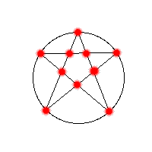
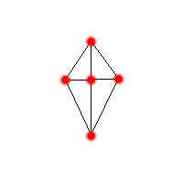
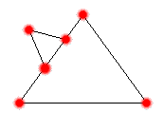
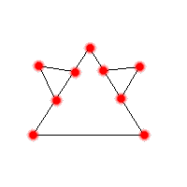
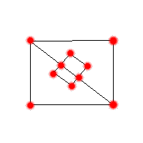
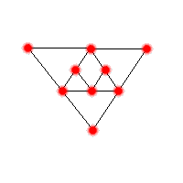
Path, circuit, or neither…?

Slide 25
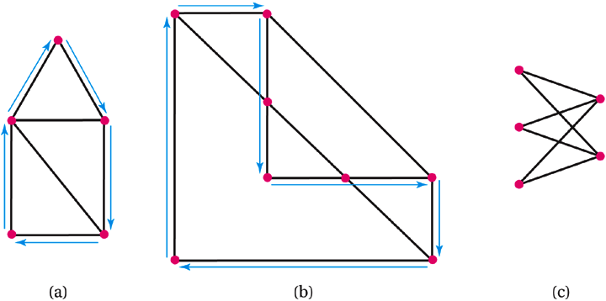
Hamiltonian Circuits
13-B
A Hamiltonian circuit is a path that passes through every vertex of a network exactly once and returns to the starting vertex. The paths indicated by arrows in (a) and (b) are Hamiltonian circuits, while (c) has no Hamiltonian circuits.
Copyright © 2008 Pearson Education, Inc.
Slide 13-<number>

Slide 26




The Traveling Salesman Problem
13-B
Which path is a Hamilton circuit?
a)
b)
c)
d)
A
D
B
C
Copyright © 2008 Pearson Education, Inc.
Slide 13-<number>

Slide 27
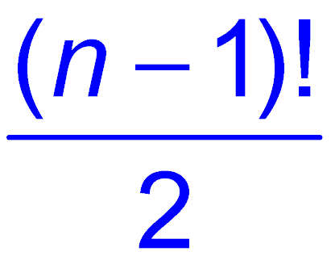
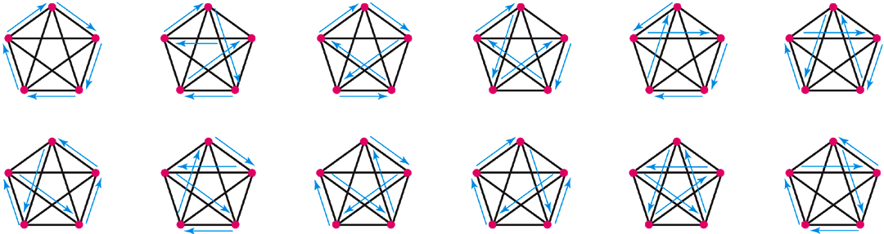
Hamiltonian Circuits in Complete Networks
13-B
The number of Hamiltonian Circuits in a complete network of order n is .
The twelve Hamiltonian circuits for a complete network of order 5.
Copyright © 2008 Pearson Education, Inc.
Slide 13-<number>

Slide 28
Calculating the Number of Hamiltonian Circuits
Network of order 3:
Network of order 4:
Network of order 5:
Network of order 6:
Network of order 7:
Copyright © 2008 Pearson Education, Inc.
Slide 13-<number>

Slide 29
The Traveling Salesman Problem
13-B
How many Hamilton circuits are possible in a complete network of order 8?
a) 7!/2
b) 8!/2
c) 8!
d) 9!/2
Copyright © 2008 Pearson Education, Inc.
Slide 13-<number>

Slide 30
The Traveling Salesman Problem
13-B
How many Hamilton circuits are possible in a complete network of order 8?
a) 7!/2
b) 8!/2
c) 8!
d) 9!/2
Copyright © 2008 Pearson Education, Inc.
Slide 13-<number>

Slide 31
Solving Traveling Salesman Problems
13-B
The solution to a traveling salesman problem is the shortest path (smallest total of the lengths) that starts and ends in the same place and visits each city once.

Slide 32
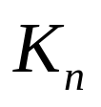
Hamilton Circuit
Given a graph, when is there a circuit passing through each node exactly one time?
Hard to solve – only general algorithm known is to try each possible path, starting at each vertex in turn.
For there are n! possible trials.

