Slide 1

Secure, Structured & Scalable Coding Education
Introducing Virtual Labs centered on classrooms and secure coding education.
Designed to empower academic institutions with scalable, structured learning environments.

Slide 2
How We Outperform Generic Coding Platforms
Classroom-Role Based Login
Secure Docker-Based Test Environments
Faculty and students access tailored environments securely.
Isolated, safe code execution without cheating risks.
Assignment & Test Management
Centralized Storage & Access Control
Create deadlines, tests, and auto-evaluate solutions.
Manage code, submissions, and user roles in one place.

Slide 3
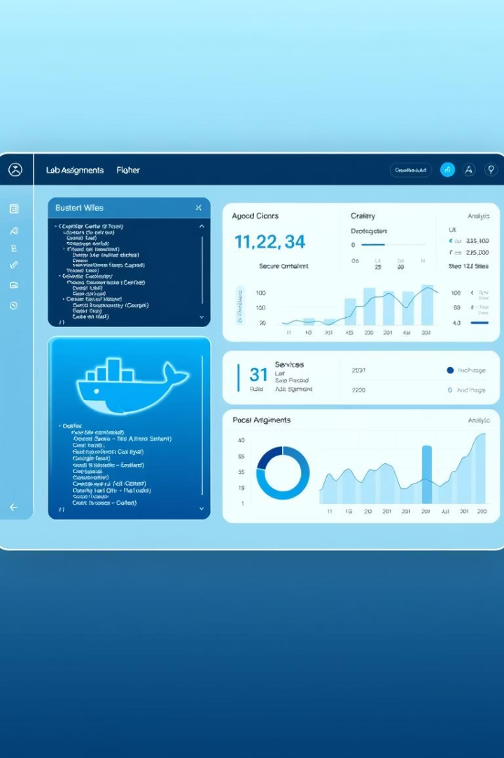
Unique Features Driving Innovation
1
Lab-Centric Design
Built exclusively for academic coding labs and workflows.
2
Security First with Docker
Ensures safe, isolated exam and lab execution environments.
3
Comprehensive Faculty Workflow
From class creation to assignment review and deadlines.
4
Extensible Backend & Custom APIs
Supports institutional needs with flexible backend controls.

Slide 4

Key Takeaway
“Not just another IDE — a complete lab management system for modern coding education.”
Elevate secure coding education with a platform built for institutions.

