Slide 1
DATA CLEANING, SCHEMA NORMALISATION, DATA PROCESSING & DATA INGESTION FOR BIG DATA USING SPARK
Guided by Mr. Shiva Karthik
Mr. Deshmukh Shreyas Shrikrishna PRN 210940125017
Mr. Parmar Abhishek Rajeshbhai PRN 210940125031
Ms. Riann Thomas PRN 210940125038
Mr. Sanket Sambhaji Jadhav PRN 210940125040
Mr. Wangawar Rahul Narsimalu PRN 210940125055

Slide 2
CONTENT
Introduction
Data Extraction
Data Transformation – Schema Normalization, Cleaning, Processing
Loading – Data Ingestion
AirFlow

Slide 3
introduction

Slide 4
Extraction
Transformation
A common schema is developed
Cleaning and Validation of the data
Load the data into the desired file system
Automate the entire workflow using Apache Airflow

Slide 5
Data extraction

Slide 6
Kaggle Stackoverflow users data
https://archive.org/download/stackexchange
Email Attachment
imbox =Imbox(hostname, username, password, ssl, ssl_context, starttls)
imbox.messages()
message.attachments

Slide 7
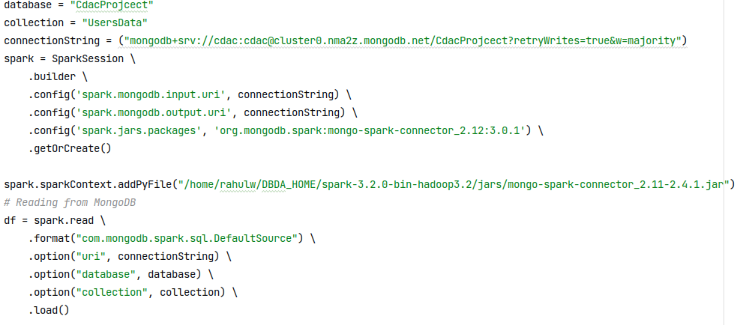
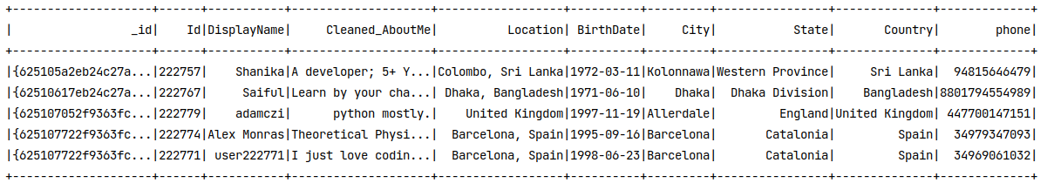
Data from MongoDB

Slide 8

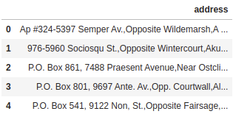
Data.gov.in

Slide 9
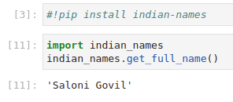
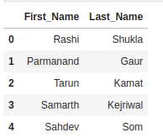
Synthetic data
Name Generation :
indian-names

Slide 10
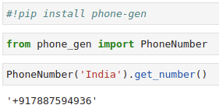
Synthetic data
Phone Number Generation :
phone_gen

Slide 11
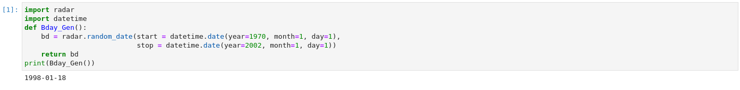
Synthetic data
Birthdate :
radar
datetime

Slide 12
Five different files with different formats
CSV from Email attachment,
Json,
CSV,
Excel,
Indian data in json
Read in PySpark dataframes
Why pyspark?
Passed on for Data transformation

Slide 13
Data transformation

Slide 14
Filtering of columns
Id
display_name
about_me
age
creation_date
last_access_date
location
reputation
up_votes
down_votes
Birthdate
PhoneNumber

Slide 15
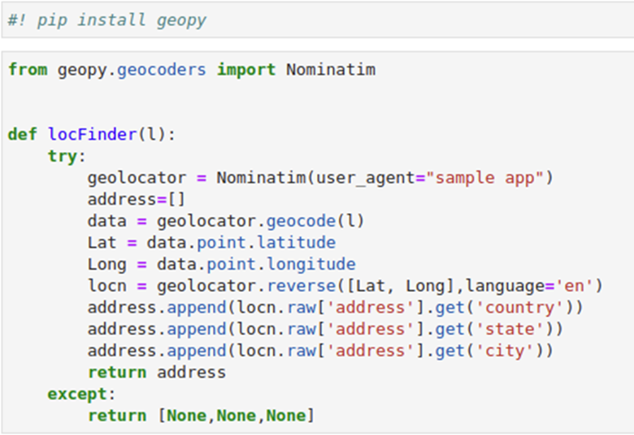
Transformation of Location
Geopy – geocoder
Nominatim – OpenStreetMaps
Using Location column, Country, State and City columns are derived

Slide 16
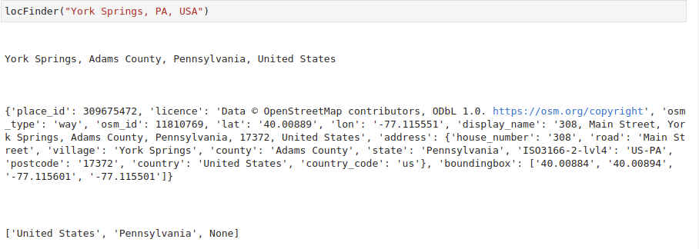

Slide 17
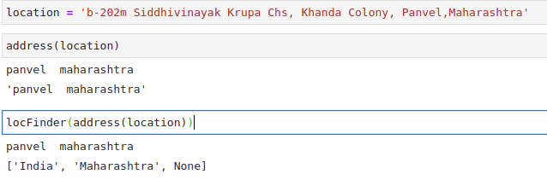
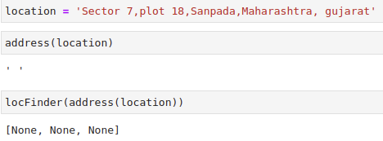
Additional function for Indian addresses which are typically very unstructured
Uses geopy as well

Slide 18
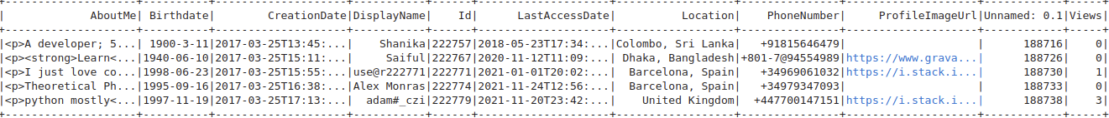
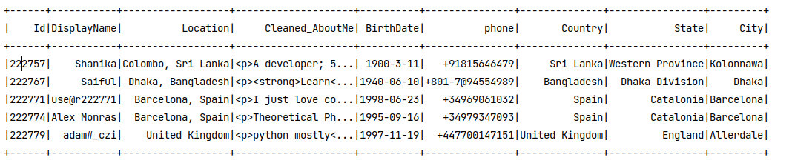
Before
After

Slide 19

Cleaning AboutMe
AboutMe feature had html tags in it. Two approaches
Python’s bs4 Library

Slide 20
2. Using regex
Simple tags and href attributes “<[^>]*>” with “ ”
To identify the line separator, we are replacing “\n” with “.”
Substituting all the non-alphabets “[^a-zA-Z]+” with “ ”
Original data
<p><strong>By day:</strong> PhD Student.</p>\n\n<p><strong>By night:</strong> I make weird electronic music.</p>\n
After regex
By day PhD Student By night I make weird electronic music

Slide 21
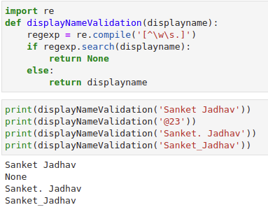
Cleaning DisplayName
The regex “[^\w\s.]” is used to clean the DisplayNames with anything other than characters, spaces, dots, and underscores.

Slide 22
Validation Birthdate
Initially this regex was created to Validate Birthdate
prog = re.compile("^(19|20)\d\d[-/;](0[1-9]|1[0-2])[-/;]([1-9]|0[1-9]|[12][0-9]|3[01])$")
Limitations:
Will detect invalid dates such as 30th of February, 31st of April, etc. as valid dates

Slide 23
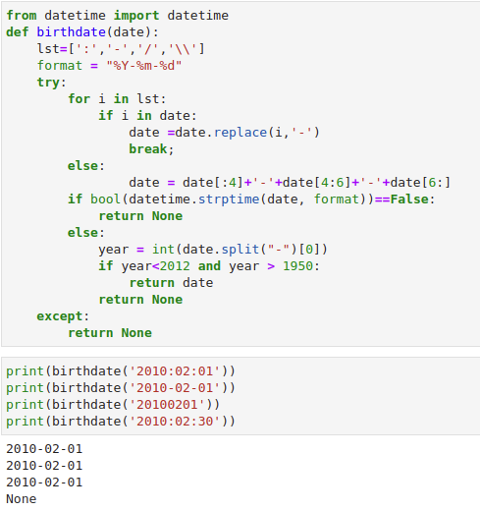
Validation Birthdate
Date with multiple separators or without separators will be converted to the proper format and stored
Dates in invalid Format will be cleaned out

Slide 24
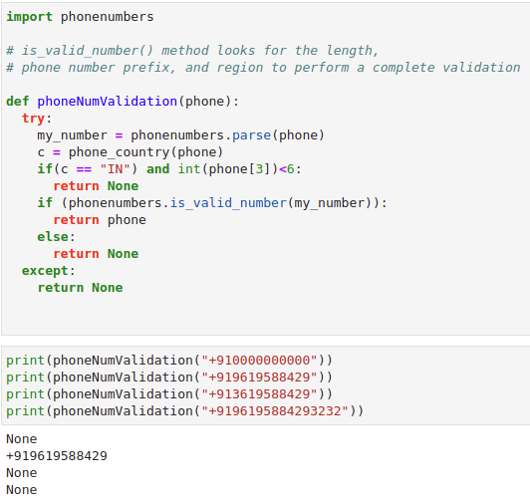
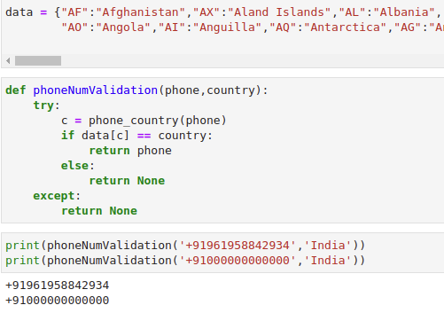
Validation PhoneNumber
phone_iso3166.country
phonenumbers

Slide 25
Spark API to apply multiple functions at once to the dataframe.
cleaned = final_users.rdd.map(lambda line: Row(Id = line[0],
DisplayName = display_name_validation(line[1]),
AboutMe = line[2],
Location = line[3],
BirthDate = birthdate_val(line[4]),
PhoneNumber = phone_validation(line[5], line[9]),
City = line[6],
State = line[8],
Country = line[7])).toDF()
These additional Steps were taken for better performance
Dataframe.cache()
SparkSession.catalog.clearCache()

Slide 26
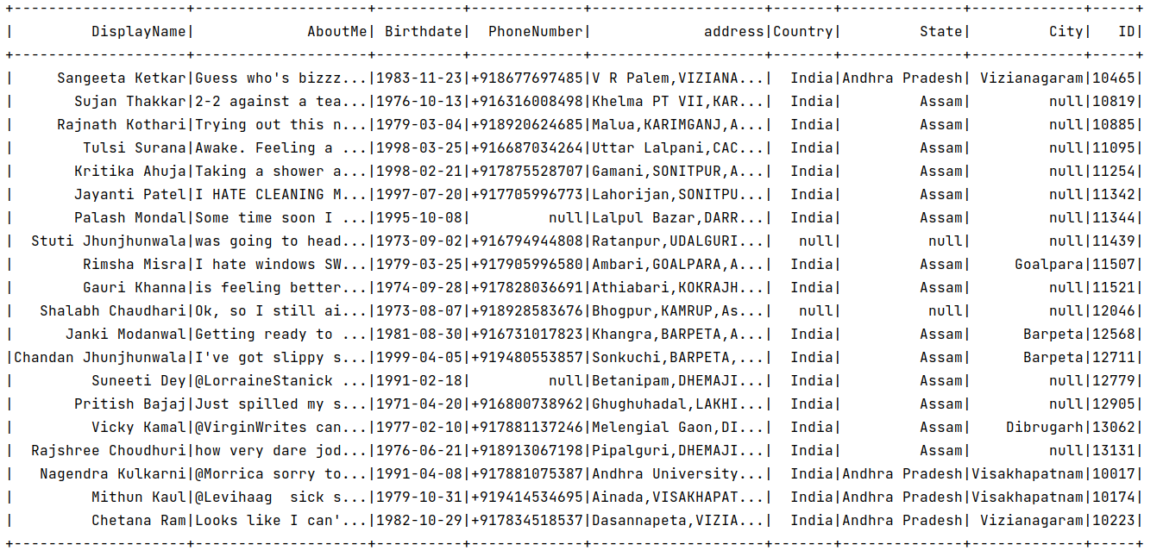
Final Transformed Dataframe

Slide 27
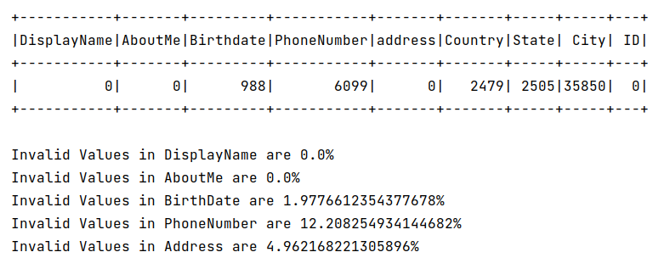
Reports

Slide 28
LOADING

Slide 29
All the transformed and cleaned dataframes will be stored onto HDFS in .json format individually :
Part_1.json
Part_2.json
Part_3.json
Part_4.json
Part_5.json
Part_6.json
df.write.mode("overwrite").json("hdfs://localhost:9000/SparkERIngest/dq_good/latest_part2.json")

Slide 30
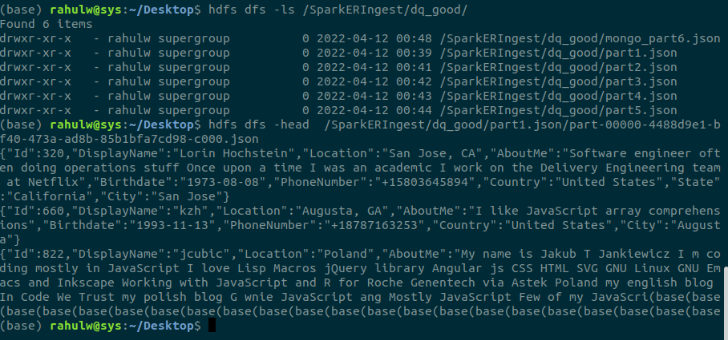
Files stored on HDFS

Slide 31
airflow

Slide 32
What is Airflow?
How does it work?
Components of Airflow:
Tasks
Operators

Slide 33
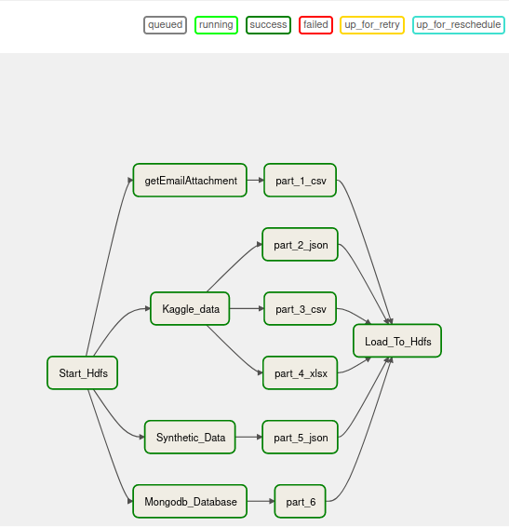
Graph view of tasks
Hdfs_startup >> emailExtract >> part1 >> Load
Hdfs_startup >> Kaggle_data >> part2 >> Load
Hdfs_startup >> Kaggle_data >> part3 >> Load
Hdfs_startup >> Kaggle_data >> part4 >> Load
Hdfs_startup >> Synthetic_Data >> part5 >> Load
Hdfs_startup >> Mongodb_Database >> part6 >> Load

Slide 34
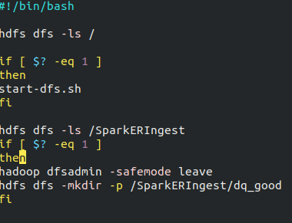
Script to start HDFS

Slide 35
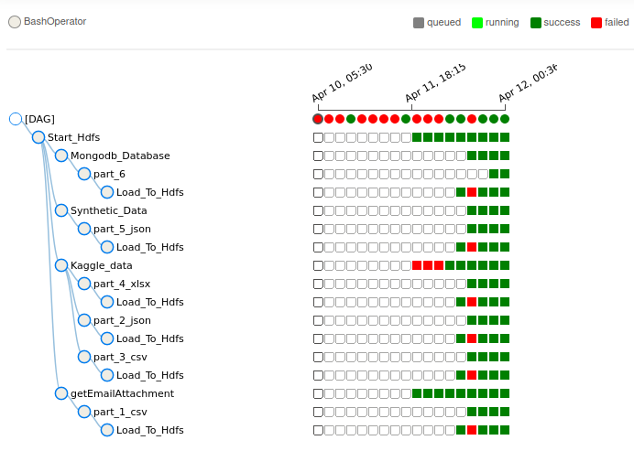
Tree View of tasks:

Slide 36
Thank you

