Slide 1
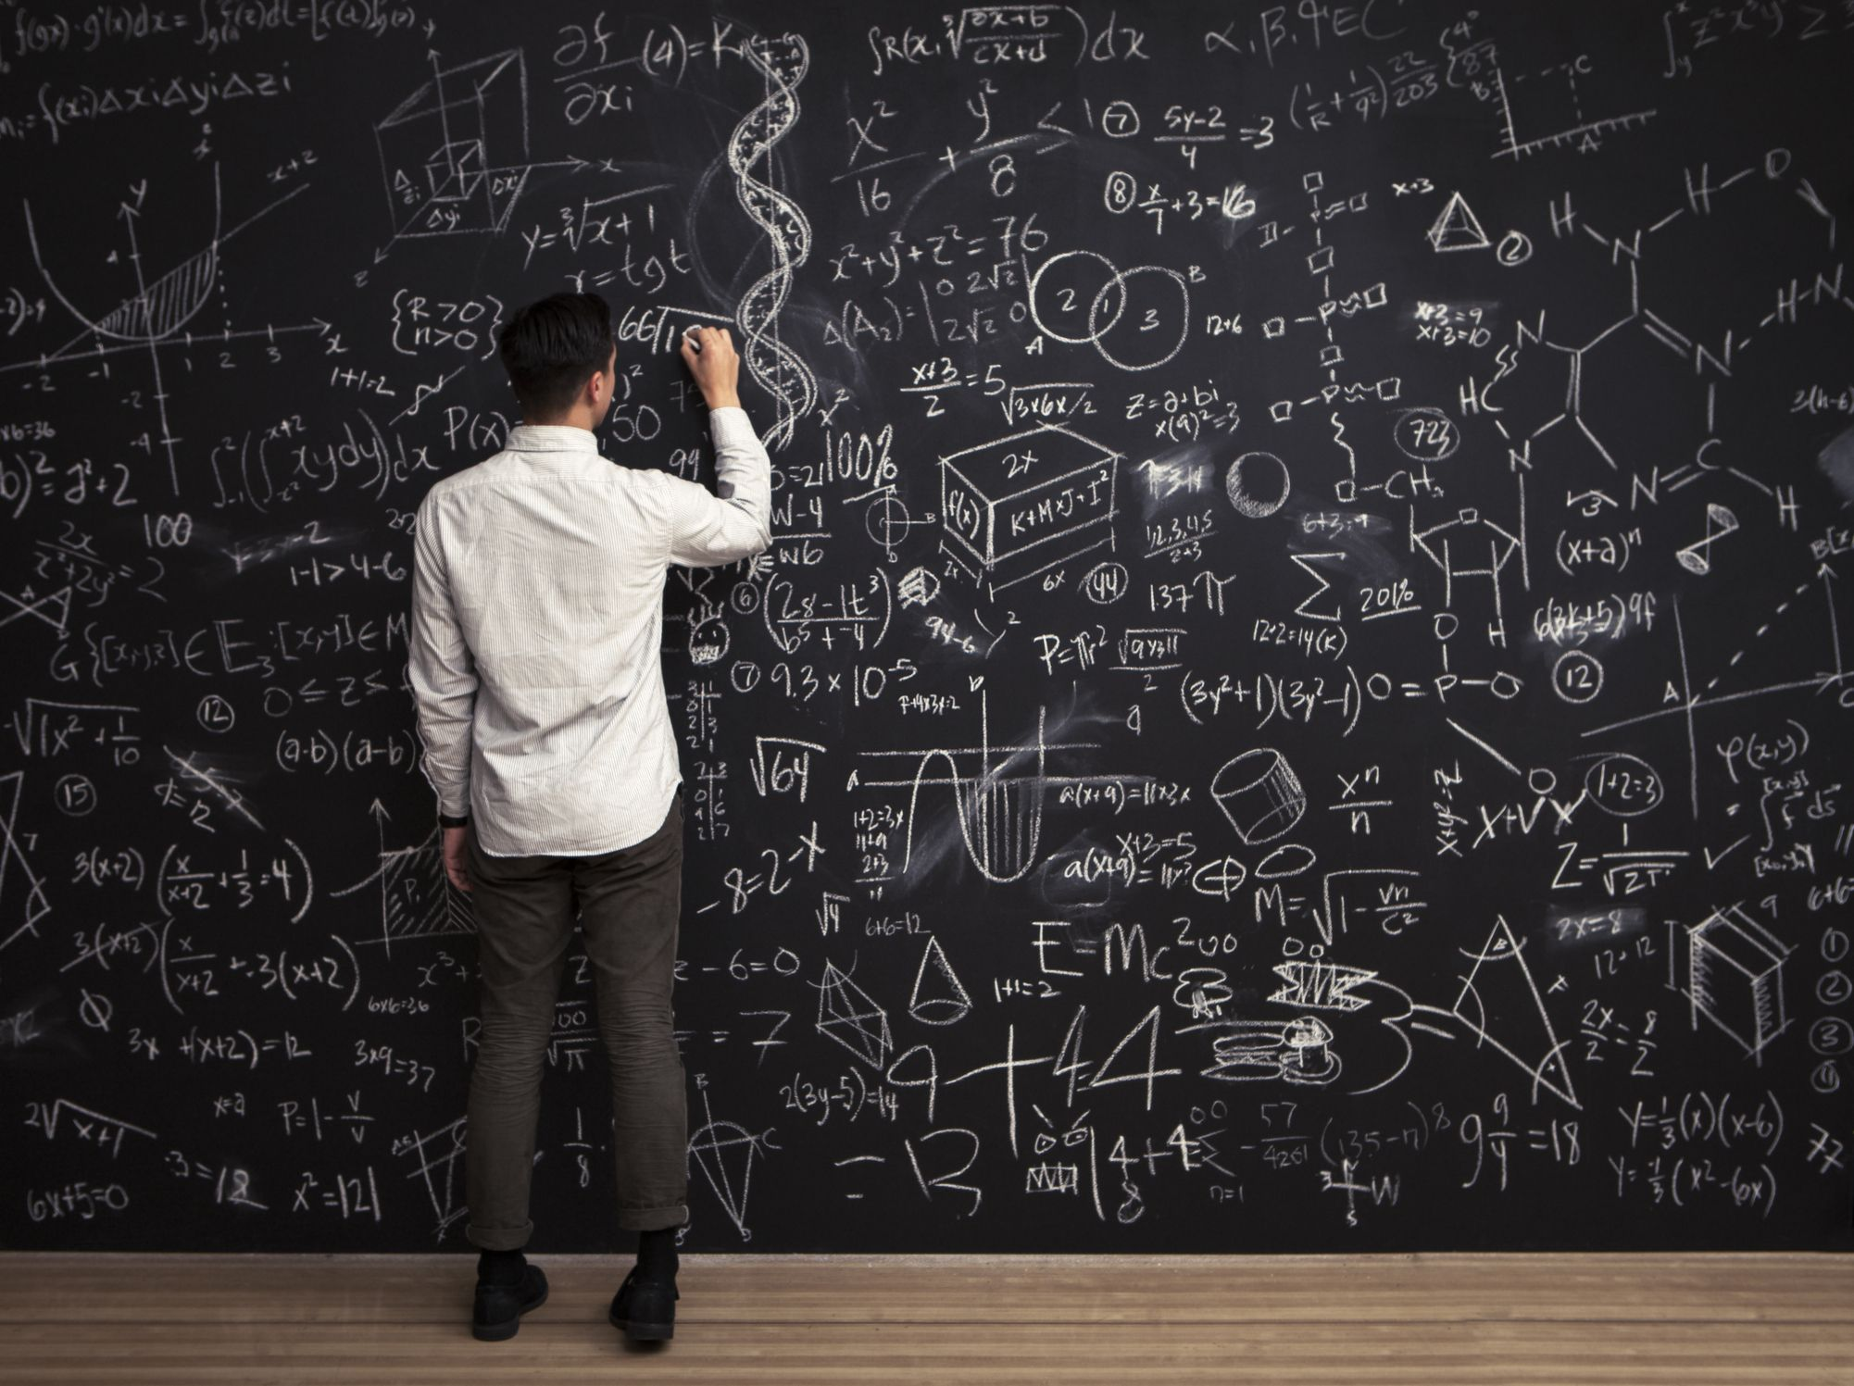

problem solving case
RAHUL BENNET

Slide 2
To develop data matching system.
Data matching system can also be used to detect duplicate records within a single database.
To implement AI and ML.
To check the data by using multiple software.

