Slide 1


PROJECT PRESENTATION
On Lost and Found Website

Slide 2
Presented By..
Abhishek Verma: 201500027
Rahul Bishnoi:
201500543
Rashi Shivhare: 201500559
Paras Dubey :
201500461

Slide 3
Outlines
About the project
Need and Motivation
Technologies Used
Home page
Category Page
Claim File
Add New Item
Lost Items
All Claims
Thank you

Slide 4
About the Project
A lost and found website for a college is a platform that allows students, faculty, and staff to report lost or found items within the campus premises. These websites are specifically designed to cater to the needs of a college community, where students frequently misplace items like textbooks, laptops, ID cards, and other personal belongings.
The website usually requires users to provide details such as the type of item, location where it was lost or found, and contact information. In addition, some lost and found websites for colleges may also include a description of the lost item or a photo to help identify it.

Slide 5
Need and Motivation
The purpose of the website is to create a convenient and efficient system for managing lost items within the college community, promoting a sense of community responsibility and accountability, and ultimately reducing the burden on staff and students who may otherwise have to spend valuable time searching for lost items or reporting lost items to multiple departments.

Slide 6
Technologies Used.
MERN
M: Mongo-DB
E: Express-JS R: React N: NodeJS
CSS
MUI

Slide 7
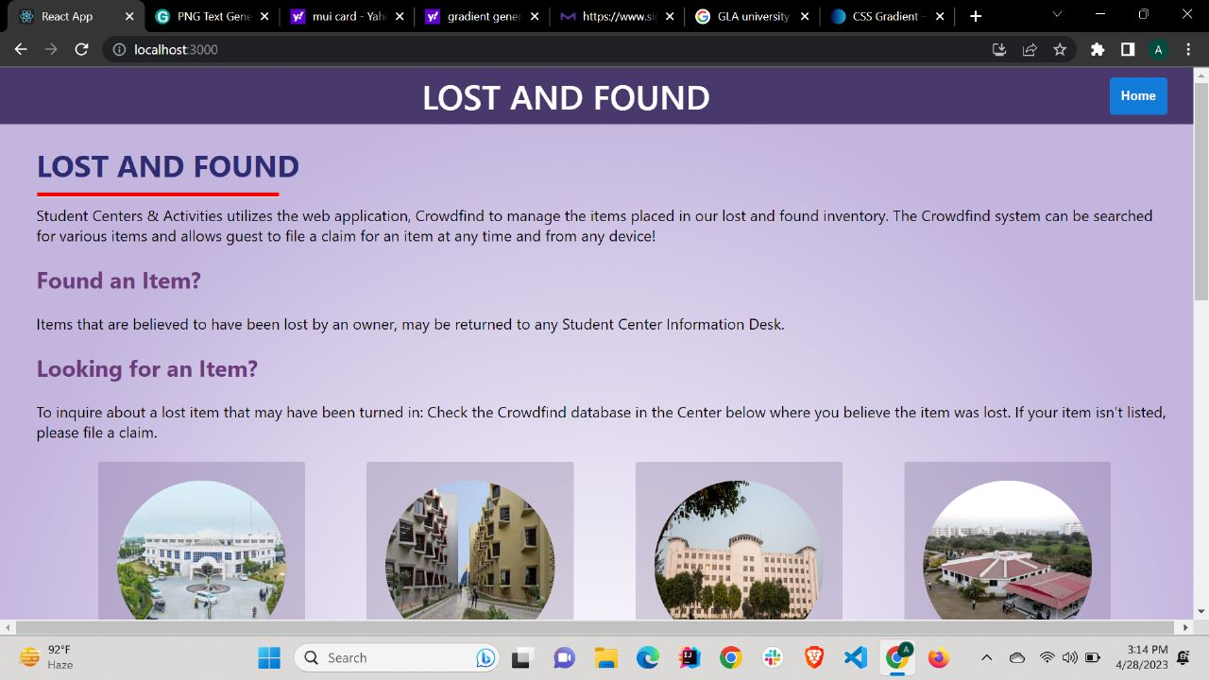
Home page
This is the very first page of our website .
Here there are four section and we can explore as needed..

Slide 8
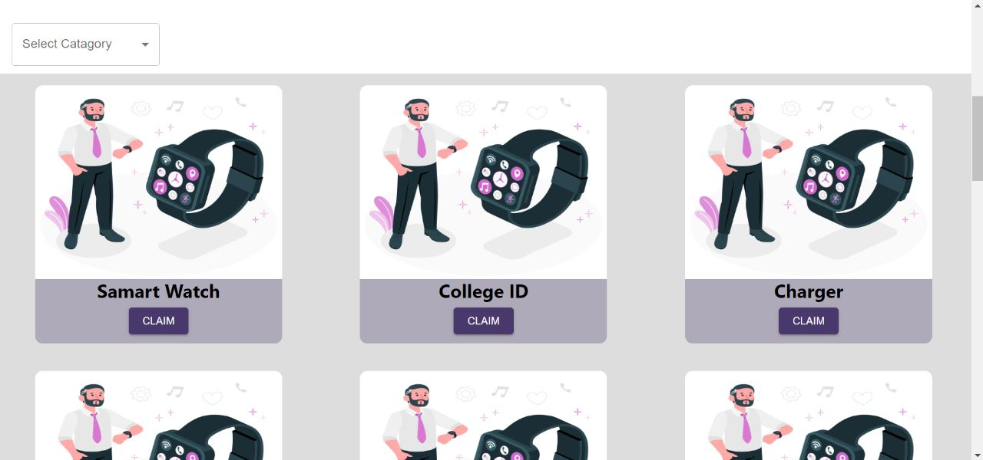
Category page
These are all different sections which includes smart watch , college id, electronic , clothing .
According to user need he will search items and claim that item.

Slide 9
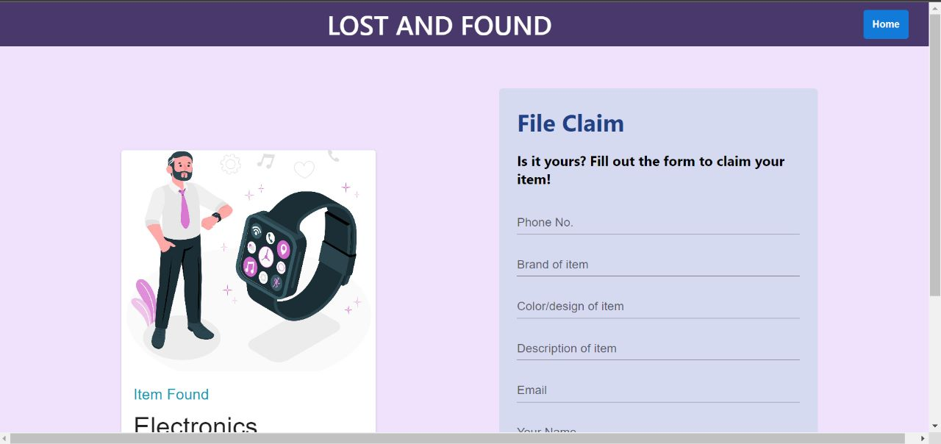
Claim file
Here the user will file a claim request by providing his essential details and also provide description of the missing item

Slide 10
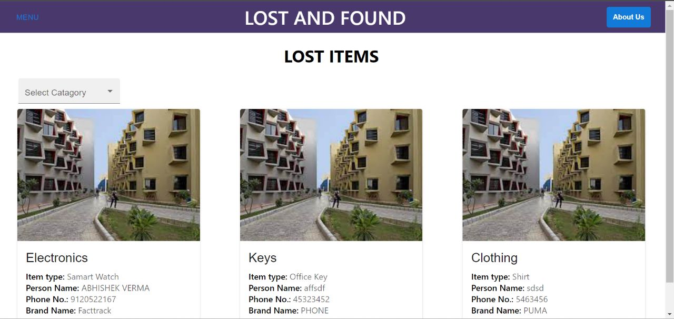
Lost Items
User will claim lost item by selecting categories .
Like keys Electronics ,clothing after admin will verify user request and lost item will be returned.

Slide 11

Thank you

