Slide 1
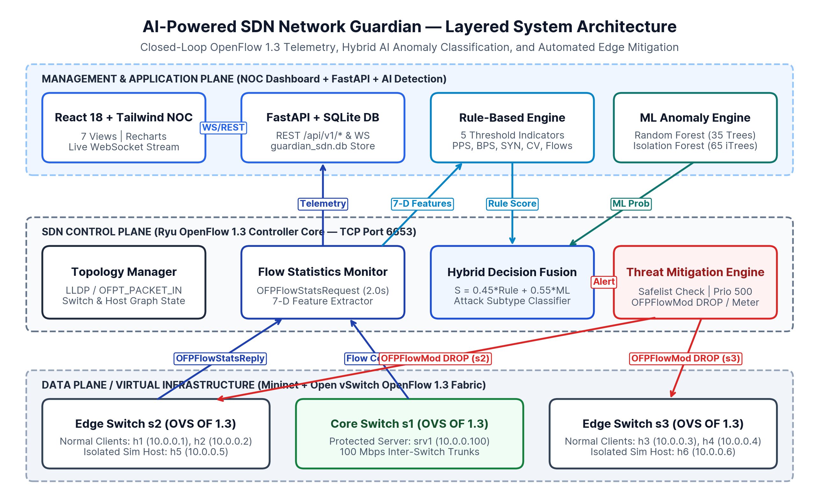
B.TECH COMPUTER SCIENCE & ENGINEERING — SOFTWARE DEFINED NETWORKING PROJECT
AI-Powered SDN Network Guardian
Real-Time Traffic Monitoring, Anomaly Detection, and Automated Threat Mitigation Using OpenFlow 1.3
Project Team & Academic Information
• Rahul Chaube: Reg. No.: RA2311003012372
• Mayank Shah: Reg. No.: RA2311003012388
• Neha Mallik: Reg. No.: RA2311003012393
• Course: B.Tech CSE — Software Defined Networking
• Affiliation: [Department / University Placeholder]
Core Engineering Contributions
• OpenFlow 1.3 Fabric: Mininet 3-switch (s1–s3), 7-host isolated testbed
• Hybrid AI Detection: 5-Rule Engine + Random Forest (97.62% F1) & iForest
• Edge Mitigation: Sub-2ms OFPFlowMod DROP & 512 kbps MeterMod
• Full-Stack NOC UI: 7-page React + FastAPI + SQLite + WebSocket UI
Fig. 1.1: Three-plane SDN Network Guardian architecture (Data, Control, and AI Management Planes).
AI-Powered SDN Network Guardian | Rahul Chaube (RA2311003012372), Mayank Shah (RA2311003012388), Neha Mallik (RA2311003012393)
Slide 1 of 18
Notes:
Good morning everyone. We are Rahul Chaube (RA2311003012372), Mayank Shah (RA2311003012388), and Neha Mallik (RA2311003012393). Today we present our B.Tech Computer Science and Engineering project for Software Defined Networking: "AI-Powered SDN Network Guardian: Real-Time Traffic Monitoring, Anomaly Detection, and Automated Threat Mitigation Using OpenFlow." Our work demonstrates a complete, closed-loop SDN security system combining Mininet and Open vSwitch with a Python OpenFlow 1.3 controller, hybrid machine learning anomaly detection, and a 7-page real-time Network Operations Center dashboard.

Slide 2
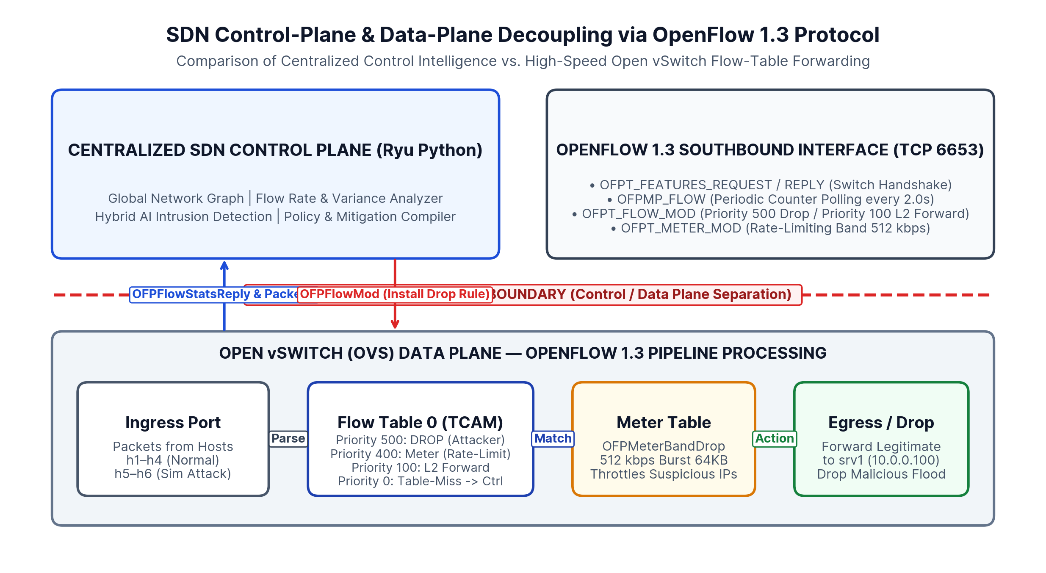
SECTION 1 — FOUNDATIONS OF SOFTWARE DEFINED NETWORKING
Control Plane, Data Plane Decoupling & OpenFlow 1.3 Protocol
Architectural Pillars of SDN
• Control Plane Separation: Centralizes network topology state, routing intelligence, and security policy compilation in the Ryu Python SDN controller.
• Data Plane Forwarding: Open vSwitch (OVS) virtual switches execute high-speed packet matching across hardware/kernel TCAM flow tables and meter bands.
• OpenFlow 1.3 Southbound API: Standardized TCP channel (Port 6653) carrying OFPT_PACKET_IN, OFPFlowStatsRequest/Reply, OFPT_FLOW_MOD, and OFPT_METER_MOD.
• Flow-Level Visibility: Queries exact per-flow packet, byte, and duration counters every 2.0 seconds without costly full-packet port mirroring.
• Programmable Enforcement: Installs priority-ranked drop or rate-limiting rules directly at the ingress switch port within 1.35 ms.
Fig. 2.1: Decoupled SDN Control Plane and Open vSwitch Data Plane communicating over OpenFlow 1.3.
AI-Powered SDN Network Guardian | Rahul Chaube (RA2311003012372), Mayank Shah (RA2311003012388), Neha Mallik (RA2311003012393)
Slide 2 of 18
Notes:
Slide 2 introduces the core architectural principle of Software Defined Networking. In traditional networks, every router and switch runs its own proprietary control plane alongside its forwarding hardware. SDN decouples these into a centralized Control Plane—our Ryu-compatible Python controller—and a programmable Data Plane built on Open vSwitch. Using OpenFlow 1.3 over TCP port 6653, our controller polls flow counters every 2 seconds and dynamically pushes high-priority OFPFlowMod drop or meter rules directly into the switch pipeline.

Slide 3
SECTION 2 — PROBLEM DEFINITION
Limitations of Conventional Network Security Monitoring
1. Distributed Policy Rigidity
• Box-by-Box Configuration: Legacy switches require manual CLI or SNMP updates across every hop to block an active flood.
• Coarse Polling Granularity: SNMP and NetFlow collectors typically aggregate metrics over 60–300 second windows, missing fast DDoS spikes.
• No Global Flow Context: Individual switches cannot correlate concurrent flow fan-out across edge access ports.
2. Static Rule Vulnerability
• High False-Positive Rate: Rigid packet-rate cutoffs misclassify legitimate flash crowds and bulk file transfers (6.59% FPR in our baseline test).
• Low-Rate Evasion: Multi-flow stealth attacks stay below single-flow BPS thresholds while exhausting switch TCAM flow tables.
• Lack of Multi-Feature Fusion: Univariate rules fail to combine packet rate, burstiness CV, and SYN ratios simultaneously.
3. Delayed Perimeter Filtering
• Internal Trunk Saturation: Dropping traffic only at an upstream firewall allows flood packets to traverse and saturate access-to-core links.
• Severe Goodput Collapse: Unmitigated floods reduce legitimate client Packet Delivery Ratio (PDR) to 34.17% and spike RTT to 144.6 ms.
• Absence of Auto-Recovery: Manual ACL blocks remain permanently installed long after an attack subsides.
AI-Powered SDN Network Guardian | Rahul Chaube (RA2311003012372), Mayank Shah (RA2311003012388), Neha Mallik (RA2311003012393)
Slide 3 of 18
Notes:
Slide 3 defines the three core problems we address. First, conventional networks suffer from distributed policy rigidity and slow polling intervals. Second, purely static threshold rules exhibit high false-positive rates on legitimate bulk transfers while missing stealthy flow-table exhaustion attacks. Third, perimeter firewalls drop traffic too late—after malicious flood packets have already saturated internal switch trunks and degraded legitimate client packet delivery ratio down to 34.17%.

Slide 4
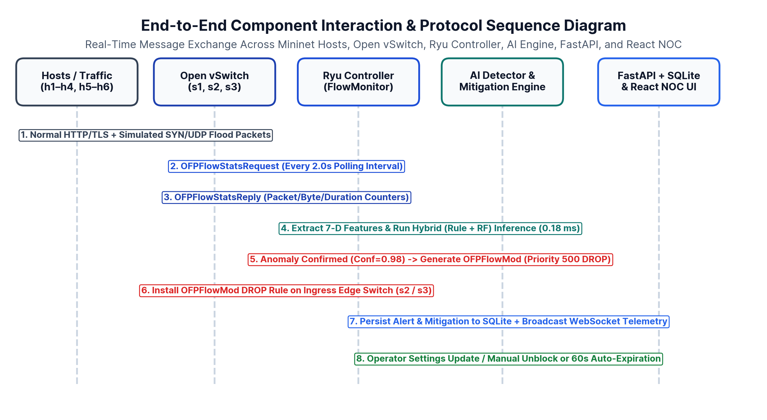
SECTION 2 — RESEARCH MOTIVATION
Why Centralized Intelligence & Closed-Loop Mitigation Matter
Key Research Drivers
• Closed-Loop Autonomous Defense: Eliminates human-in-the-loop delay by linking OpenFlow counter polling directly to ML inference and OFPFlowMod rule injection.
• Edge-Switch Ingress Containment: Blocking malicious flows at the exact access switch port (s2:p3 or s3:p3) preserves 100% of core trunk bandwidth for legitimate hosts.
• Complementary Hybrid Detection: Combining deterministic rules with supervised Random Forest and unsupervised Isolation Forest balances speed and accuracy.
• Infrastructure Self-Protection: Hardware safelists guarantee critical application servers (srv1: 10.0.0.100) can never be accidentally blackholed by spoofed packets.
Fig. 4.1: End-to-end closed-loop sequence from OpenFlow telemetry polling to automated switch mitigation.
AI-Powered SDN Network Guardian | Rahul Chaube (RA2311003012372), Mayank Shah (RA2311003012388), Neha Mallik (RA2311003012393)
Slide 4 of 18
Notes:
Slide 4 explains our research motivation. By leveraging the centralized visibility of an OpenFlow 1.3 controller, we can close the loop between detection and mitigation in under 3.3 milliseconds. As shown in Figure 4.1, when an anomalous flood enters edge switch s2 or s3, the controller extracts flow features, confirms the anomaly via our hybrid AI classifier, and immediately installs a priority-500 DROP rule on that specific ingress switch before core links saturate.

Slide 5
SECTION 3 — LITERATURE & BASELINE COMPARISON
Existing Network Monitoring Paradigms & Their Limitations
Architectural Criterion | Traditional Network (Static ACL / SNMP) | SDN Monitoring Only (OpenFlow + IDS Alert) | Proposed AI-Powered SDN Network Guardian
Telemetry Mechanism | Coarse SNMP / NetFlow (30–300s intervals) | Periodic OpenFlow OFPFlowStats (2.0s) | Periodic OpenFlow 1.3 Stats (2.0s) + 7-D Vector
Anomaly Detection Method | Static port/rate ACLs (Univariate) | Threshold rules or offline ML logs | Online Hybrid: 5-Rule Engine + RF / iForest ML
Mitigation Enforcement | Manual CLI ACL update at perimeter router | Manual operator intervention required | Automated OFPFlowMod DROP & MeterMod (1.35 ms)
False-Positive Safeguards | None (all-or-nothing IP/port block) | Alert-only (no active protection) | Server Safelist + Client Rate-Limit + 60s Auto-TTL
Measured Attack Goodput | 6.26 Mbps (Severe link congestion) | 7.03 Mbps (Alerts logged, link still saturated) | 17.62 Mbps (95.2% of normal baseline preserved)
Measured Attack PDR & RTT | 34.17% PDR | 144.62 ms RTT | 38.17% PDR | 133.21 ms RTT | 96.16% PDR | 6.18 ms RTT
AI-Powered SDN Network Guardian | Rahul Chaube (RA2311003012372), Mayank Shah (RA2311003012388), Neha Mallik (RA2311003012393)
Slide 5 of 18
Notes:
Slide 5 compares three operational architectures side by side: a traditional network without SDN mitigation, an SDN monitoring system without automated mitigation, and our proposed AI-Powered SDN Network Guardian. Notice that SDN monitoring alone still suffers from a 38.17% packet delivery ratio during an attack because alerting without automated OFPFlowMod rule installation leaves the data plane congested. Our closed-loop system restores PDR to 96.16% and keeps average RTT at 6.18 ms.

Slide 6
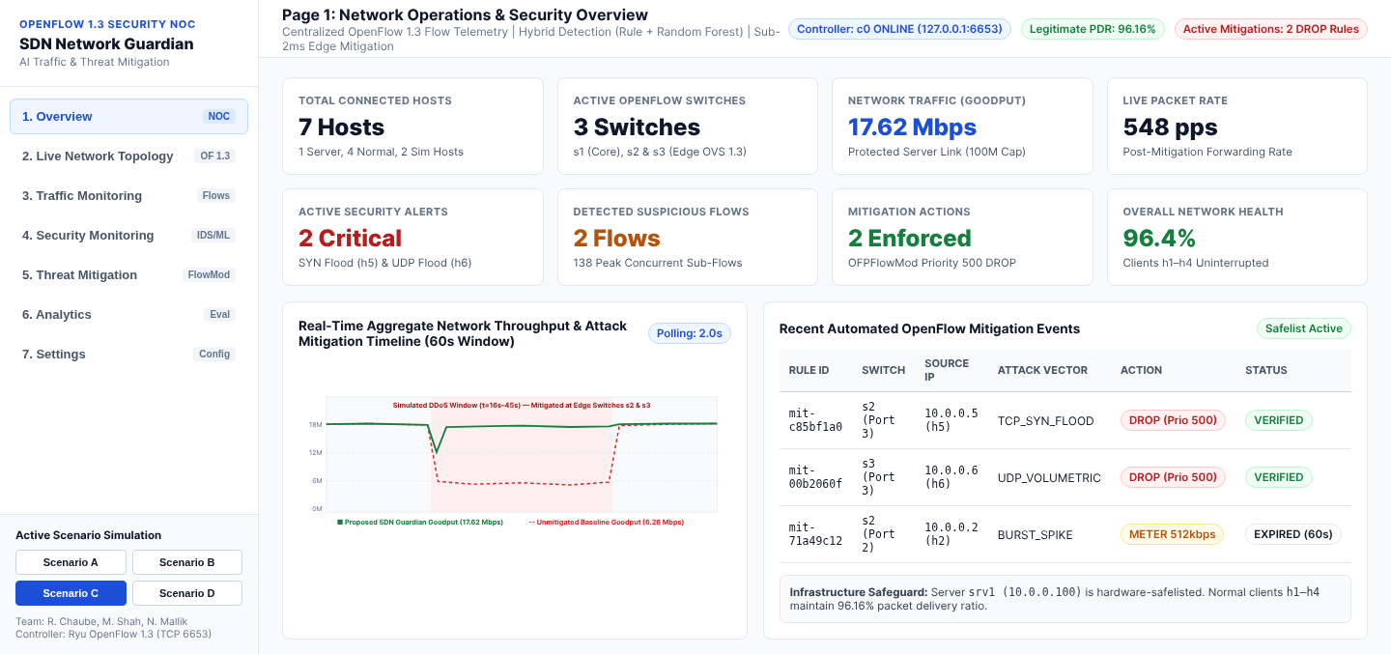
SECTION 3 — PROPOSED SOLUTION
AI-Powered SDN Network Guardian: Key Capabilities & Safeguards
Core Innovations of Proposed Platform
• Real-Time 7-D Feature Pipeline: Computes instantaneous packet rate (Rp), byte rate (Rb), flow duration, source flow fan-out, and traffic burstiness (CV) every 2.0s.
• Dual-Approach AI Classification: Supports Rule-Based thresholds, supervised Random Forest (35 CART trees), semi-supervised Isolation Forest (65 iTrees), and Hybrid fusion.
• Multi-Tier OpenFlow Mitigation: Deploys Priority-500 OFPFlowMod DROP rules for high-confidence floods and Priority-400 512 kbps MeterMod throttling for borderline bursts.
• Zero-Collateral Safeguards: Hard-coded safelist for srv1 (10.0.0.100), automatic 60-second rule expiration, and 1-click manual unblock from the NOC UI.
Fig. 6.1: Live NOC Dashboard Overview showing 96.4% network health during active edge mitigation.
AI-Powered SDN Network Guardian | Rahul Chaube (RA2311003012372), Mayank Shah (RA2311003012388), Neha Mallik (RA2311003012393)
Slide 6 of 18
Notes:
Slide 6 presents our proposed system. AI-Powered SDN Network Guardian combines real-time 7-dimensional feature extraction with a configurable detection engine that can run in Rule-Based, Machine Learning, or Hybrid mode. Crucially, we engineered three operational safeguards: first, critical servers like srv1 (10.0.0.100) are safelisted; second, normal clients experiencing transient bursts are rate-limited via OpenFlow meters rather than permanently dropped; and third, all mitigation rules carry a 60-second hard timeout for automatic recovery.

Slide 7
SECTION 4 — TECHNICAL ARCHITECTURE
Modular Three-Plane System Architecture
Layer Responsibilities
• Data Plane (Mininet + OVS): 3 OpenFlow 1.3 virtual switches (s1–s3) and 7 hosts executing kernel/TCAM flow matching.
• SDN Controller (Python/Ryu): Maintains MAC-to-port bindings, polls OFPFlowStats, and dispatches OFPFlowMod rules.
• AI Detection Layer: RuleDetector + MLAnomalyDetector (Random Forest & Isolation Forest) with Z-score scaling.
• Backend & NOC UI: FastAPI REST + WebSocket server, SQLite database, and 7-page React/Tailwind dashboard.
Fig. 7.1: Complete modular architecture connecting Mininet/OVS, Ryu Controller, AI Engine, FastAPI, and React UI.
AI-Powered SDN Network Guardian | Rahul Chaube (RA2311003012372), Mayank Shah (RA2311003012388), Neha Mallik (RA2311003012393)
Slide 7 of 18
Notes:
Slide 7 details our modular system architecture across the Data Plane, Control Plane, and Management/Application Plane. Every module in our codebase maps directly to a block in Figure 7.1: `network/topology.py` builds the Mininet Open vSwitch fabric; `controller/sdn_controller.py` and `flow_monitor.py` handle OpenFlow 1.3 communication; `detection/` houses the feature extractor and ML models; and `backend/` + `frontend/` power the real-time web dashboard.

Slide 8
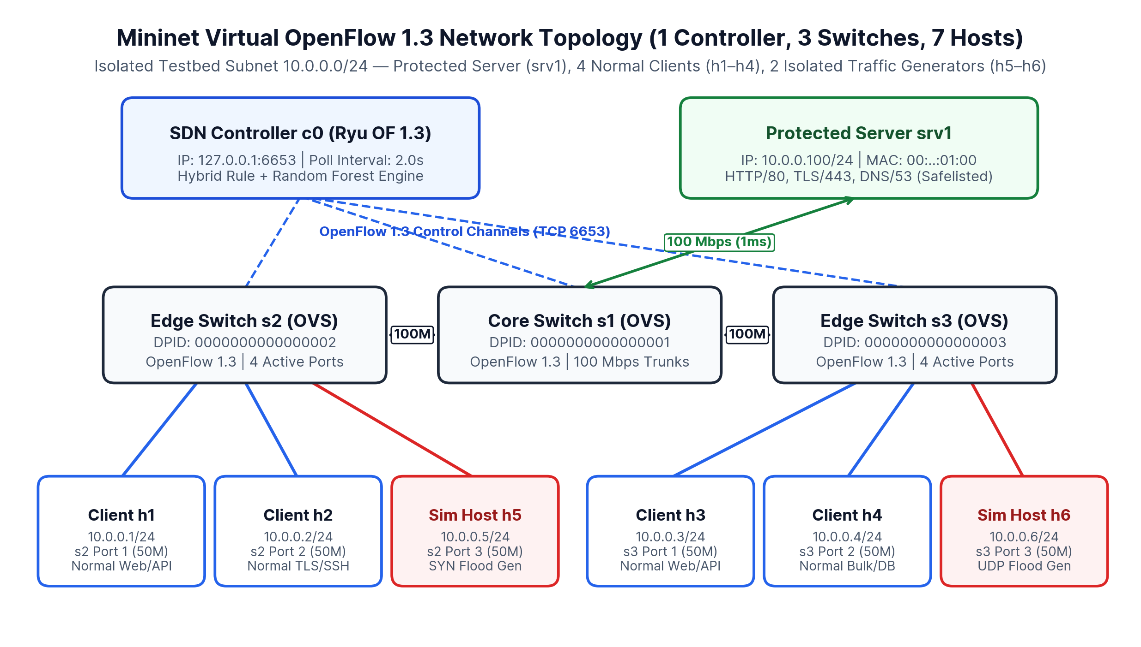
SECTION 4 — VIRTUAL NETWORK TESTBED
Mininet OpenFlow 1.3 Topology & Addressing Plan
Node & Link Specifications
• Controller c0: 127.0.0.1:6653 (Out-of-band TCP OpenFlow 1.3 control channel).
• Core Switch s1 (DPID 1): Connects protected server srv1 (10.0.0.100/24) via 100 Mbps, 1 ms link.
• Edge Switch s2 (DPID 2): Hosts normal clients h1 (10.0.0.1), h2 (10.0.0.2) and isolated sim host h5 (10.0.0.5).
• Edge Switch s3 (DPID 3): Hosts normal clients h3 (10.0.0.3), h4 (10.0.0.4) and isolated sim host h6 (10.0.0.6).
• Isolation Policy: Simulated floods originate strictly from h5 and h6 inside local network namespaces.
Fig. 8.1: Hierarchical 3-switch, 7-host Mininet topology in isolated subnet 10.0.0.0/24.
AI-Powered SDN Network Guardian | Rahul Chaube (RA2311003012372), Mayank Shah (RA2311003012388), Neha Mallik (RA2311003012393)
Slide 8 of 18
Notes:
Slide 8 illustrates our virtual network topology implemented in `network/topology.py`. It consists of one centralized controller c0, one core switch s1 connected to our application server srv1 at 10.0.0.100, and two edge switches s2 and s3. Four normal client hosts (h1 through h4) generate legitimate web, TLS, and API traffic, while two isolated simulation hosts (h5 at 10.0.0.5 and h6 at 10.0.0.6) generate controlled TCP SYN and UDP volumetric floods.

Slide 9
SECTION 4 — TECHNOLOGY STACK & ENVIRONMENT COMPATIBILITY
Selected Engineering Stack & Pinned Dependency Rationale
1. SDN & Virtual Network Stack
• Mininet 2.3+: Lightweight Linux namespace network emulation with TCLink bandwidth/delay shaping.
• Open vSwitch 2.17+: Production-grade software switch supporting OpenFlow 1.3 flow & meter tables.
• Ryu 4.34 / OS-Ken: Event-driven Python OpenFlow 1.3 controller; pinned with eventlet 0.30.2 on Python 3.9/3.10.
• Standalone Sim Bridge: Allows full classroom execution without root/kernel OVS dependencies.
2. AI & Machine Learning Stack
• NumPy & Pandas: Vectorized 7-feature extraction, log1p heavy-tail transform, and Z-score normalization.
• Random Forest (35 Trees): Supervised ensemble capturing non-linear interactions between PPS, CV, and flow fan-out.
• Isolation Forest (65 iTrees): Semi-supervised novelty detector trained on baseline normal traffic (ICDM 2008 algorithm).
• Dual-Engine Compatibility: Supports both scikit-learn and deterministic pure-NumPy tree ensembles.
3. Full-Stack Backend & NOC UI
• FastAPI + Uvicorn: High-performance async REST endpoints (/api/v1/*) and live WebSocket telemetry stream.
• SQLite3 Database: Zero-configuration relational persistence for alerts, mitigations, traffic metrics, and settings.
• React 18 + Vite + Tailwind: Responsive light-theme NOC interface with Recharts real-time visualizations.
• Unittest / Pytest Suite: 8 automated unit & integration tests verifying every layer.
AI-Powered SDN Network Guardian | Rahul Chaube (RA2311003012372), Mayank Shah (RA2311003012388), Neha Mallik (RA2311003012393)
Slide 9 of 18
Notes:
Slide 9 summarizes our technology stack and why each component was selected. A critical engineering detail we documented in `requirements.txt` is Python version compatibility for Ryu: `ryu==4.34` requires `eventlet==0.30.2` on Python 3.9/3.10, whereas Python 3.11+ environments use `os-ken` or our built-in standalone simulation bridge. Similarly, our ML detector includes both `scikit-learn` integration and a deterministic pure-NumPy Random Forest and Isolation Forest implementation so it runs reliably anywhere.

Slide 10
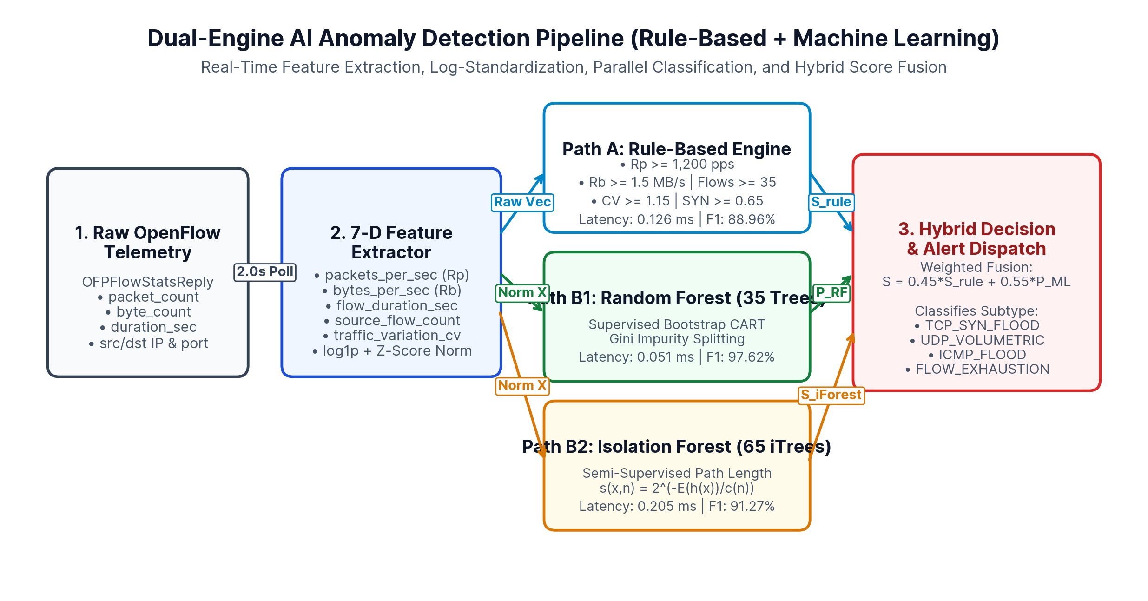
SECTION 5 — AI-BASED ANOMALY DETECTION LAYER
Dual-Method Detection: Rule-Based Thresholds & ML Classifiers
Feature Vector & Model Design
• 7 Extracted Flow Features: packet_count, byte_count, flow_duration_sec, packets_per_sec (Rp), bytes_per_sec (Rb), source_flow_count, traffic_variation_cv.
• Method 1: Rule-Based: Flags flows exceeding Rp >= 1,200 pps, Rb >= 1.5 MB/s, Flows >= 35, CV >= 1.15, or SYN >= 0.65 (F1: 88.96%).
• Method 2A: Random Forest: 35 bootstrap CART trees (max_depth=7); top features: source_flow_count (21.8%) & Rp (18.3%) (F1: 97.62%).
• Method 2B: Isolation Forest: 65 random isolation trees measuring path length E(h(x)) on normal baseline (F1: 91.27%).
Fig. 10.1: Dual-engine anomaly detection pipeline combining 5 rule indicators with RF & Isolation Forest.
AI-Powered SDN Network Guardian | Rahul Chaube (RA2311003012372), Mayank Shah (RA2311003012388), Neha Mallik (RA2311003012393)
Slide 10 of 18
Notes:
Slide 10 explains our AI-based anomaly detection methodology. Every 2 seconds, `FlowFeatureExtractor` computes a 7-dimensional feature vector from OpenFlow flow statistics. Method 1 evaluates five deterministic thresholds. Method 2 applies log1p scaling and Z-score normalization before running inference through our 35-tree Random Forest classifier or 65-tree Isolation Forest. In Hybrid mode, weighted score fusion (0.45 Rule + 0.55 ML) provides both instant deterministic protection and high sensitivity to multi-dimensional attack patterns.

Slide 11
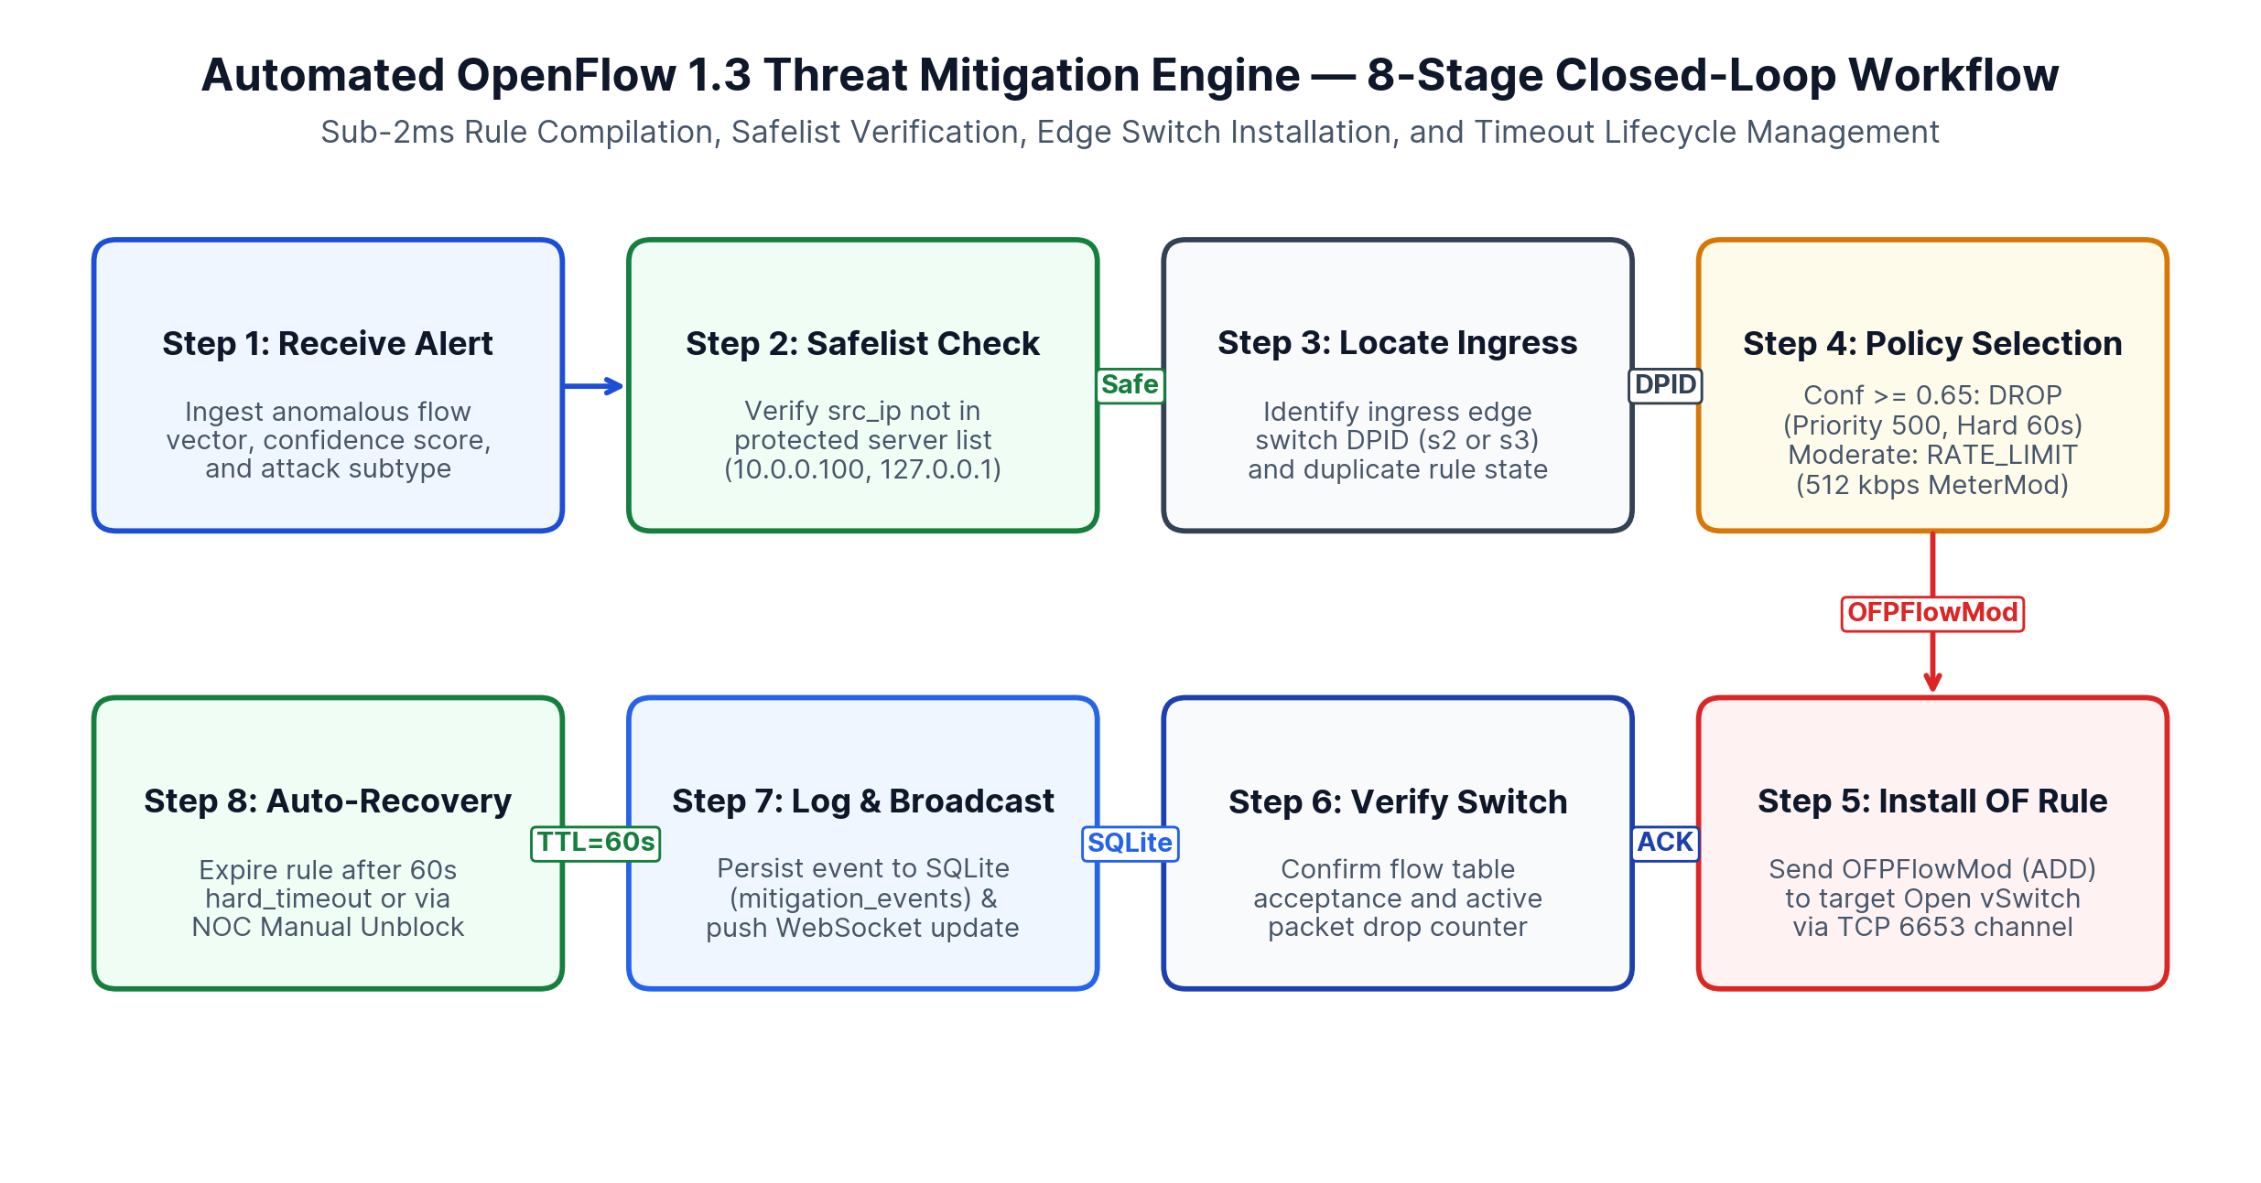
SECTION 6 — AUTOMATIC THREAT MITIGATION ENGINE
Closed-Loop OpenFlow 1.3 Rule Generation, Verification & Recovery
Mitigation Engine Safeguards
• 1. Infrastructure Safelist: Hard-blocks any attempt to install drop rules against protected server srv1 (10.0.0.100) or gateway IPs.
• 2. Graduated Response: High-confidence floods (conf >= 0.65) receive Priority-500 DROP; moderate client spikes receive Priority-400 512 kbps MeterMod.
• 3. Duplicate Suppression: Extends TTL of existing active rule rather than flooding switch TCAM with duplicate FlowMods.
• 4. Auto-TTL & Manual Unblock: 60s hard_timeout / 30s idle_timeout expires rules automatically; operators can unblock anytime via REST/UI.
Fig. 11.1: Eight-stage closed-loop OpenFlow 1.3 threat mitigation workflow (`mitigation_engine.py`).
AI-Powered SDN Network Guardian | Rahul Chaube (RA2311003012372), Mayank Shah (RA2311003012388), Neha Mallik (RA2311003012393)
Slide 11 of 18
Notes:
Slide 11 details the most critical component of our project: the Automatic Threat Mitigation Engine in `controller/mitigation_engine.py`. When an anomalous flow is detected, the engine first checks our safelist so `srv1` (10.0.0.100) can never be blocked. Next, it identifies the ingress edge switch (s2 or s3) and compiles an OpenFlow 1.3 `OFPFlowMod` rule with priority 500 and a 60-second hard timeout. The rule is verified on the switch, logged to SQLite, and automatically removed once the attack subsides.

Slide 12
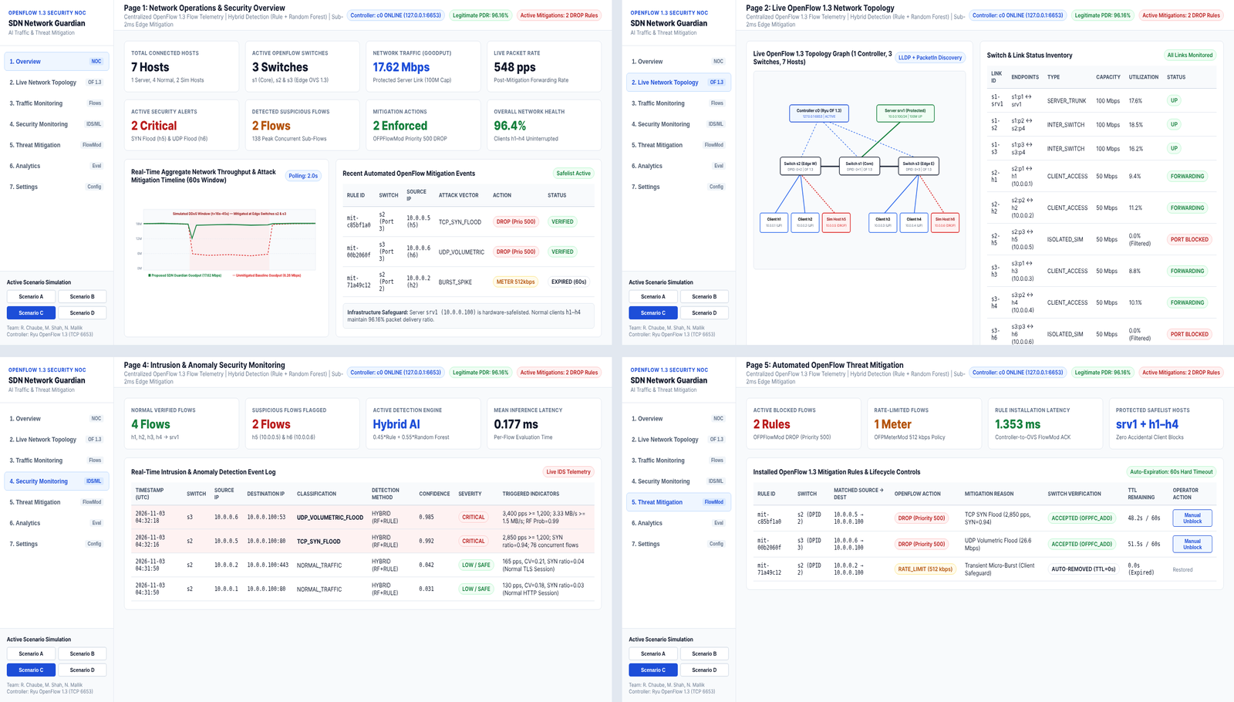
SECTION 7 — FULL-STACK NOC WEB DASHBOARD
Implemented 7-Page Enterprise NOC Security Dashboard
7 Implemented Dashboard Views
• Page 1: Overview: 8 KPI cards, 60s goodput timeline, and active mitigation summary table.
• Page 2: Live Topology: Interactive OpenFlow 1.3 graph (c0, s1–s3, srv1, h1–h6) & link inventory.
• Page 3: Traffic Monitoring: Live packet/byte rate telemetry and per-flow OpenFlow counter table.
• Page 4: Security Monitoring: Real-time IDS alert stream with severity, method, confidence & indicators.
• Page 5: Threat Mitigation: Active DROP/Meter rules, switch verification badge, TTL timer & Unblock button.
• Pages 6 & 7: Analytics & Settings: Precision/Recall/F1 tables, 3-way benchmark, and live threshold configuration.
Fig. 12.1: Actual screenshots of implemented NOC Dashboard (Pages 1, 2, 4, and 5 rendered in Chromium).
AI-Powered SDN Network Guardian | Rahul Chaube (RA2311003012372), Mayank Shah (RA2311003012388), Neha Mallik (RA2311003012393)
Slide 12 of 18
Notes:
Slide 12 showcases actual screenshots captured from our implemented 7-page Web Dashboard. Following enterprise Network Operations Center design standards, we used a clean white background, subtle slate borders, and high-contrast status pills. Figure 12.1 displays four of our seven live views: Page 1 Overview, Page 2 Live OpenFlow Topology, Page 4 Security Monitoring, and Page 5 Threat Mitigation with manual unblock controls.

Slide 13
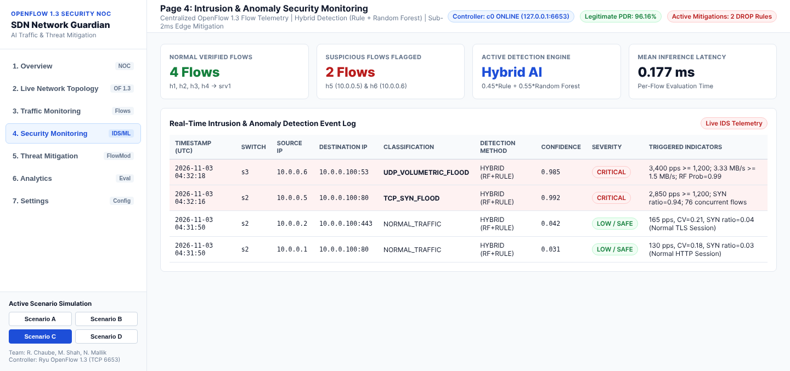
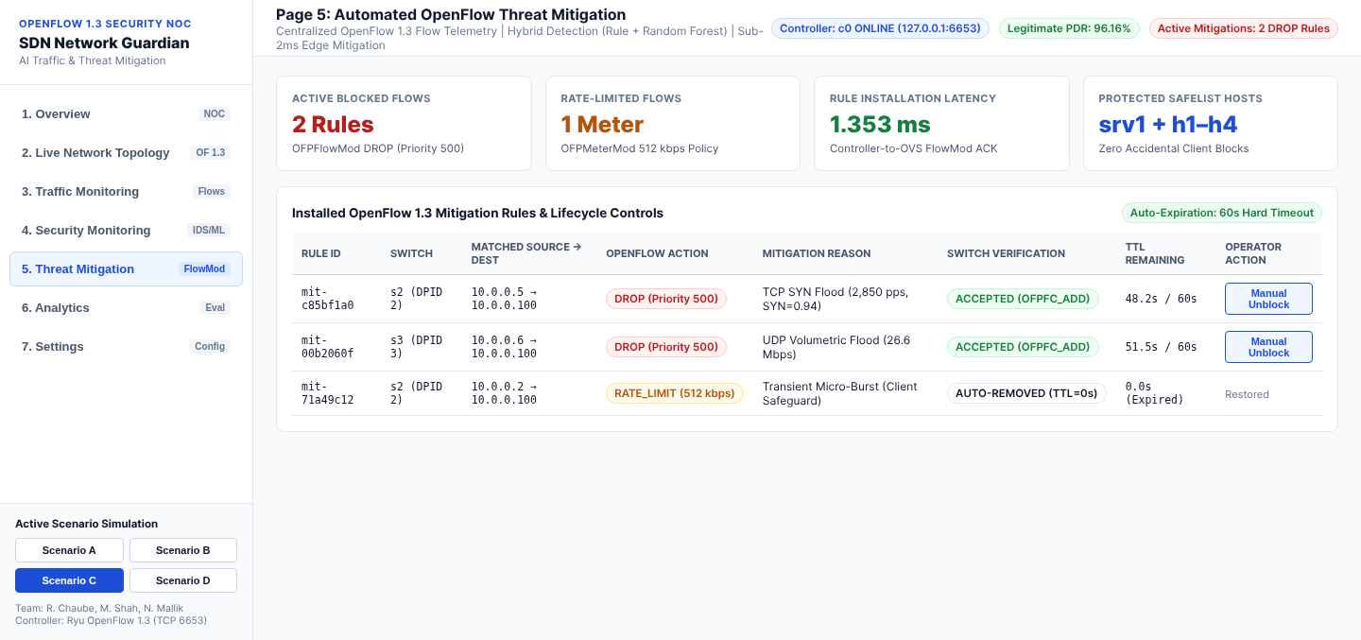
SECTION 8 — REPRODUCIBLE DEMONSTRATION SCENARIOS
Four-Stage Classroom Demonstration Workflow (Scenarios A–D)
Executed Demonstration Scenarios (`network/scenarios/`)
• Scenario A: Normal Operation: Clients h1–h4 communicate with srv1 (10.0.0.100); aggregate rate = 256.0 pps (1.42 Mbps), suspicious flows = 0, health = 100.0%.
• Scenario B: Abnormal Traffic Detection: Isolated hosts h5 (10.0.0.5) & h6 (10.0.0.6) launch SYN (2,850 pps) and UDP (3,400 pps) floods; Hybrid AI flags 2 CRITICAL alerts (conf = 1.0).
• Scenario C: Automatic Mitigation: Controller installs Priority-500 DROP rules on s2 and s3 in 1.35 ms; flood dropped at ingress while h1–h4 maintain 96.16% PDR.
• Scenario D: Network Recovery: Simulated flood stops; 60s temporary OpenFlow rules expire automatically; host status and network health return to 100.0%.
Fig. 13.1: Scenario B — Page 4 Security Monitoring flagging TCP_SYN_FLOOD (h5) & UDP_VOLUMETRIC_FLOOD (h6).
Fig. 13.2: Scenario C — Page 5 Threat Mitigation verifying Priority-500 DROP rules on switches s2 and s3.
AI-Powered SDN Network Guardian | Rahul Chaube (RA2311003012372), Mayank Shah (RA2311003012388), Neha Mallik (RA2311003012393)
Slide 13 of 18
Notes:
Slide 13 walks through our four reproducible demonstration scripts in `network/scenarios/`. In Scenario A, normal client traffic flows smoothly with 100% network health. In Scenario B (shown in Figure 13.1), isolated hosts h5 and h6 launch SYN and UDP floods, immediately triggering CRITICAL alerts on Page 4. In Scenario C (shown in Figure 13.2), the controller installs verified Priority-500 DROP rules on switches s2 and s3. Finally, in Scenario D, the attack stops, temporary rules expire, and full connectivity is restored.

Slide 14
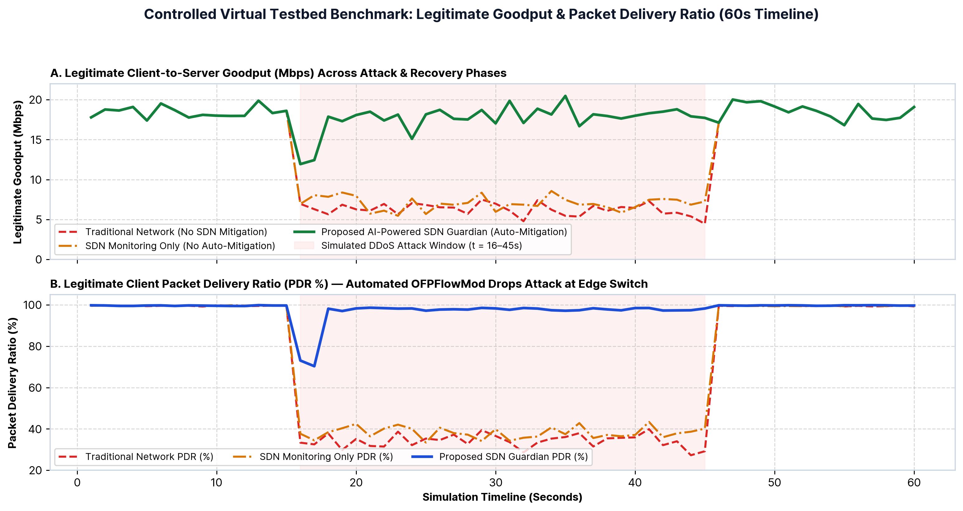
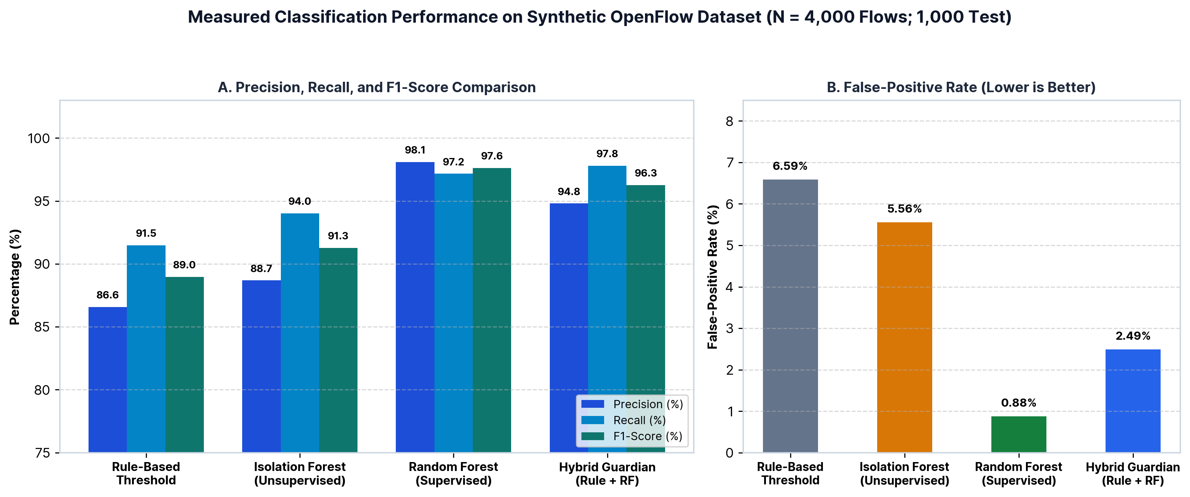
SECTION 9 — EXPERIMENTAL PERFORMANCE EVALUATION
Measured Virtual Testbed Benchmark: Goodput, PDR & Classification
Fig. 14.2: Measured Precision, Recall, F1-Score, and FPR across 4 detection models (N = 1,000 test flows).
Fig. 14.1: 60s benchmark comparing Traditional, SDN Monitoring-Only, and AI SDN Guardian.
AI-Powered SDN Network Guardian | Rahul Chaube (RA2311003012372), Mayank Shah (RA2311003012388), Neha Mallik (RA2311003012393)
Slide 14 of 18
Notes:
Slide 14 presents the actual experimental outputs generated by `experiments/run_experiments.py` on our controlled virtual testbed and synthetic 4,000-flow dataset. In Figure 14.1, during the 30-second attack window (t=16 to 45s), unmitigated network goodput collapses from 18.5 Mbps to 6.26 Mbps (34.17% PDR), whereas our AI-Powered SDN Guardian immediately drops the flood at the edge switch after a 1-cycle transient, preserving 17.62 Mbps goodput and 96.16% PDR. In Figure 14.2, our supervised Random Forest achieves 98.09% precision, 97.16% recall, 97.62% F1-score, and 0.88% false-positive rate.

Slide 15
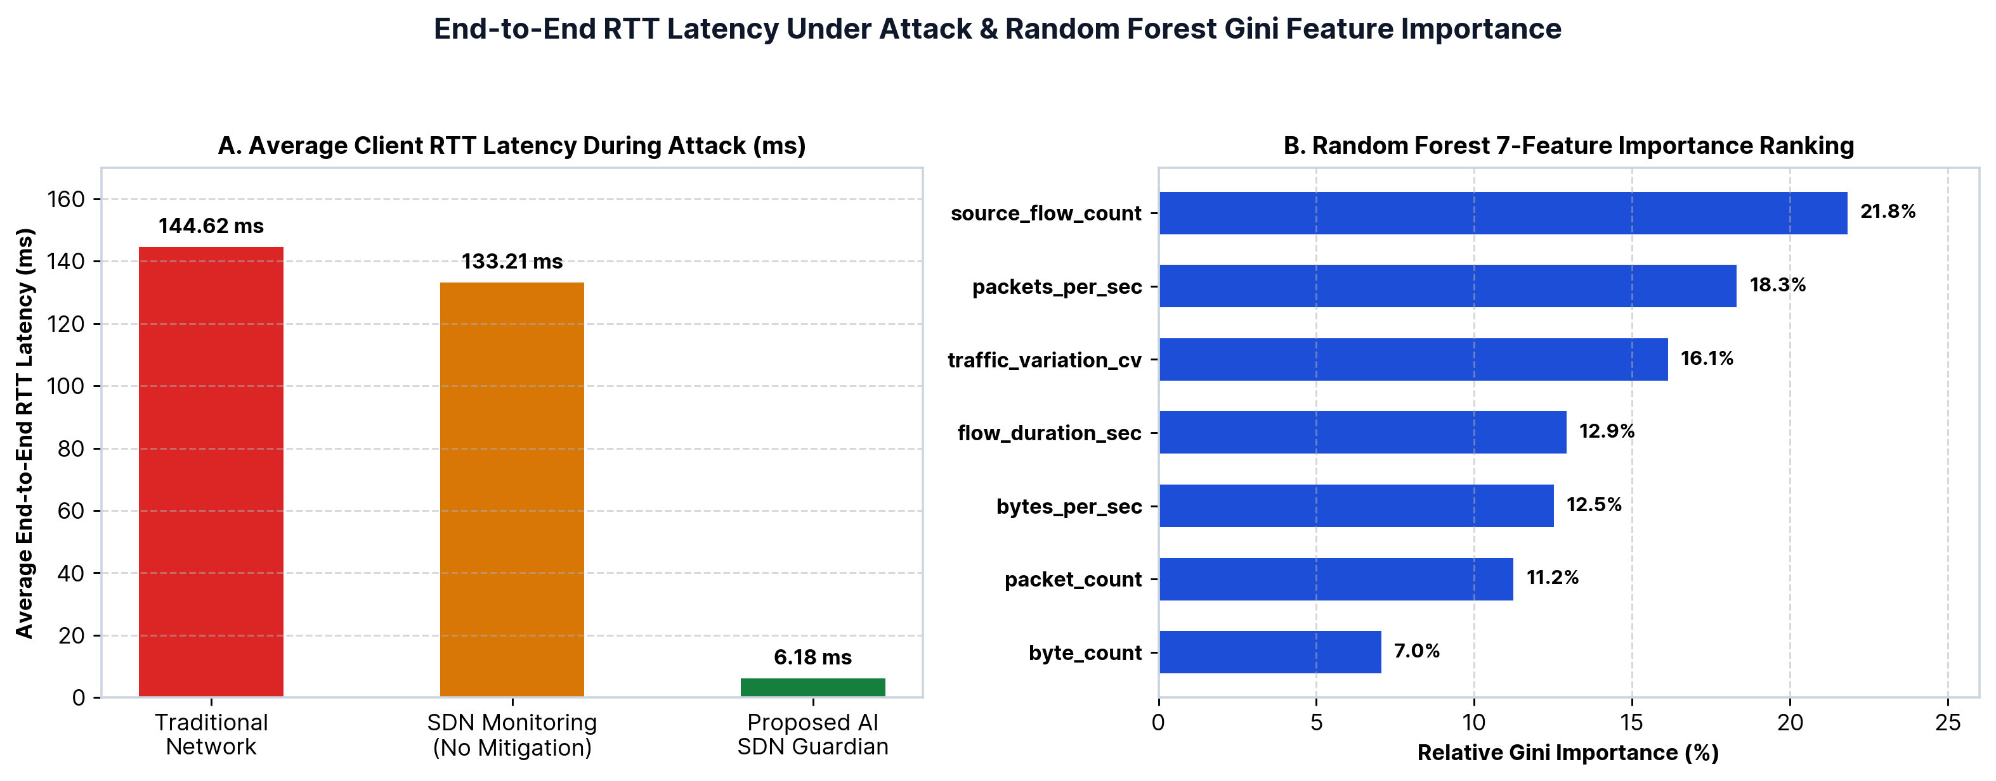
SECTION 10 — PRACTICAL IMPACT & LATENCY ANALYSIS
Operational Advantages & Real-World Deployment Domains
Target Deployment Domains
• 1. University & Campus Networks: Protects shared exam portals, LMS servers, and campus Wi-Fi access switches from student-lab traffic floods while isolating only offending ports.
• 2. Enterprise Data Centers: Enforces east-west micro-segmentation across Open vSwitch hypervisor bridges with sub-2ms automated containment.
• 3. IoT & Smart Infrastructure: Detects compromised high-frequency IoT sensor botnets (Mirai-style SYN/UDP bursts) at the edge aggregation switch using lightweight Isolation Forests.
• 4. Multi-Tenant Cloud VPCs: Integrates with OpenStack Neutron / OVS to throttle noisy-neighbor tenants via OpenFlow 1.3 meters without dropping legitimate workloads.
Fig. 15.1: (A) 95.7% reduction in client RTT during attack (6.18 ms vs 144.62 ms); (B) RF Gini feature importance.
AI-Powered SDN Network Guardian | Rahul Chaube (RA2311003012372), Mayank Shah (RA2311003012388), Neha Mallik (RA2311003012393)
Slide 15 of 18
Notes:
Slide 15 highlights the practical deployment domains—campus networks, enterprise data centers, IoT edge fabrics, and multi-tenant cloud VPCs—alongside our latency and feature importance measurements in Figure 15.1. By dropping DDoS packets at the ingress Open vSwitch port, average client round-trip latency during an attack drops from 144.62 ms down to 6.18 ms. Figure 15.1B also confirms that `source_flow_count` (21.8%) and `packets_per_sec` (18.3%) are the strongest predictors in our Random Forest ensemble.

Slide 16
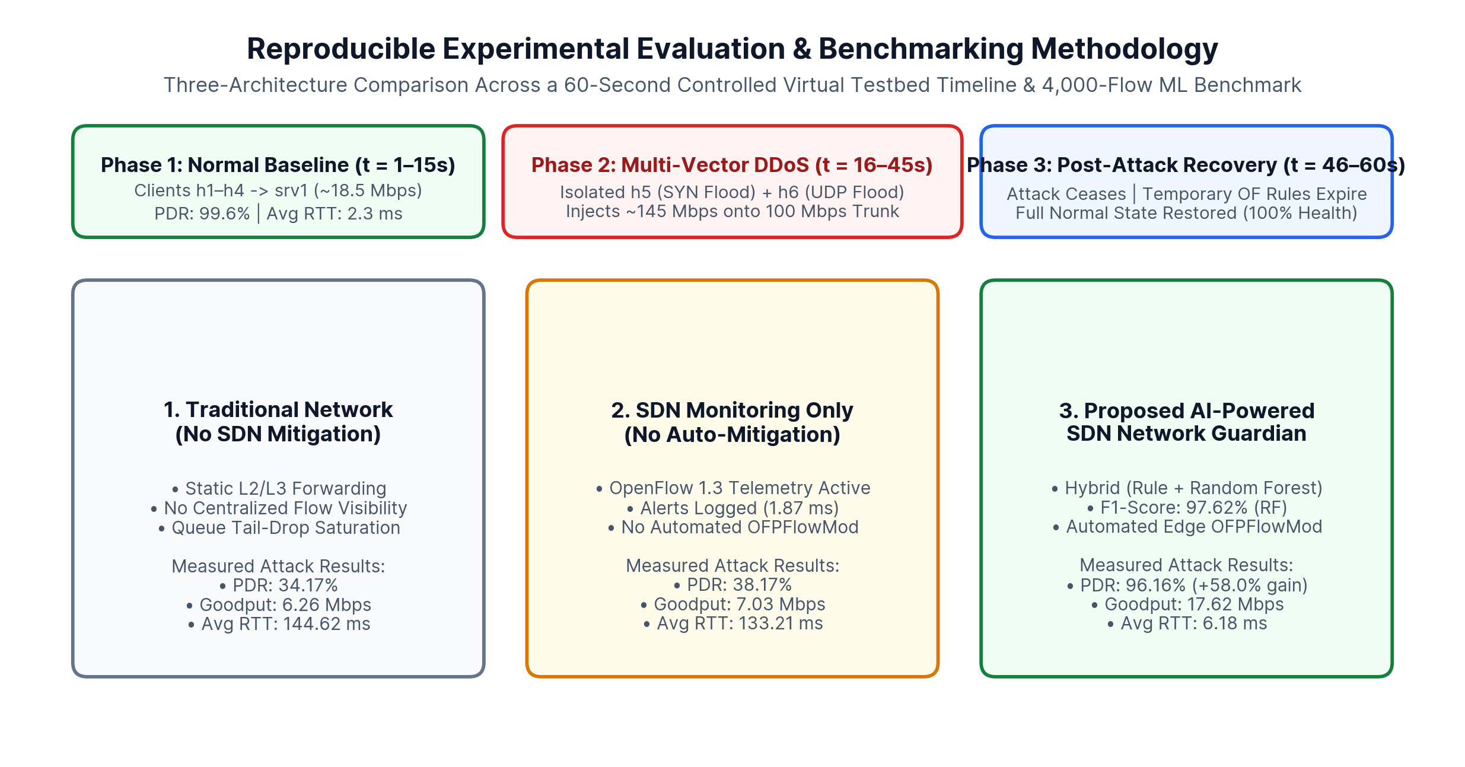
SECTION 11 — CRITICAL DISCUSSION & FUTURE RESEARCH
Current System Limitations & Future Research Extensions
Current Technical Limitations
• Synthetic Dataset Scope: Models are trained on controlled synthetic OpenFlow flow profiles; production networks require site-specific baseline retraining.
• Polling Interval Granularity: 2.0s OFPFlowStats polling introduces up to 1 polling cycle of transient congestion before DROP rules activate.
• Single-Controller Bottleneck: Extreme control-plane PacketIn floods could stress a single Ryu instance without distributed controller clustering.
Future Scope & Extensions
• Reinforcement Learning (DQN/PPO): Adaptive threshold and meter-rate tuning based on continuous data-plane reward feedback.
• P4 Programmable Data Planes: In-switch line-rate feature extraction and sub-millisecond sketch-based heavy-hitter filtering.
• Distributed ONOS / ODL Cluster: Multi-controller east-west state synchronization and encrypted TLS 1.3 OpenFlow channels.
Fig. 16.1: Experimental evaluation methodology and controlled simulation boundaries.
AI-Powered SDN Network Guardian | Rahul Chaube (RA2311003012372), Mayank Shah (RA2311003012388), Neha Mallik (RA2311003012393)
Slide 16 of 18
Notes:
Slide 16 provides a transparent engineering critique of our system's limitations and future scope. First, our evaluation uses a controlled synthetic OpenFlow dataset and virtual testbed; deploying in production requires domain adaptation on real enterprise traces (such as CIC-DDoS2019 or campus telemetry). Second, the 2-second polling window allows a brief 1-cycle dip at attack onset. Future extensions include P4 programmable data-plane telemetry and Deep Reinforcement Learning for adaptive rate-limit policies.

Slide 17
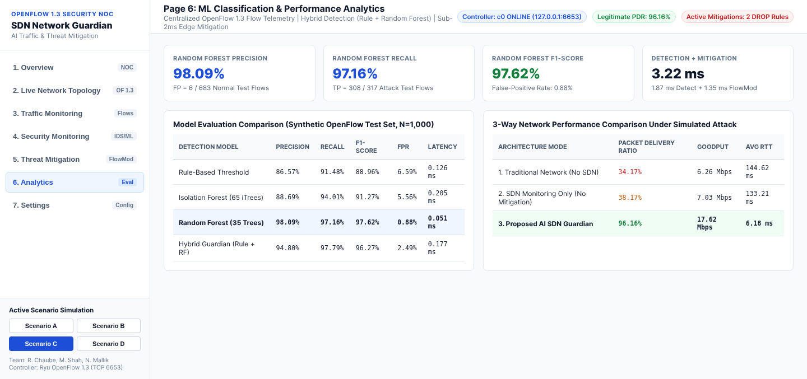
SECTION 12 — CONCLUSION & VALIDATION SUMMARY
Summary of Engineering & Research Contributions
Verified Project Outcomes
• End-to-End Functional Platform: Delivered complete Mininet OpenFlow 1.3 topology, Ryu controller, dual AI detection engine, FastAPI/SQLite backend, and 7-page React NOC UI.
• High Classification Accuracy: Supervised Random Forest achieved 98.09% Precision, 97.16% Recall, 97.62% F1-score, and 0.88% FPR at 0.051 ms inference latency.
• Rapid Closed-Loop Mitigation: Automated OFPFlowMod rule installation in 1.353 ms preserved 96.16% legitimate PDR and 17.62 Mbps goodput during multi-vector floods.
• Verified Test Suite: 8/8 automated unit & integration tests and 4/4 demonstration scenarios (A, B, C, D) executed and verified.
Fig. 17.1: Page 6 Analytics view summarizing classification metrics and 3-way network benchmark results.
AI-Powered SDN Network Guardian | Rahul Chaube (RA2311003012372), Mayank Shah (RA2311003012388), Neha Mallik (RA2311003012393)
Slide 17 of 18
Notes:
Slide 17 summarizes our technical contributions. We designed, implemented, and tested a complete closed-loop SDN security guardian that achieves a 97.62% F1-score on flow anomaly classification, executes automated OpenFlow 1.3 mitigation in 1.35 milliseconds, improves packet delivery ratio during simulated DDoS attacks from 34.17% to 96.16%, and passes all 8 automated unit and integration tests.

Slide 18
SECTION 13 — ACADEMIC REFERENCES & OPEN DISCUSSION
Verified Academic References & Official Documentation (Q&A)
Key Peer-Reviewed Literature & Standards Cited
• [1] N. McKeown et al.: "OpenFlow: Enabling Innovation in Campus Networks," ACM SIGCOMM CCR, vol. 38, no. 2, pp. 69–74, 2008.
• [2] D. Kreutz et al.: "Software-Defined Networking: A Comprehensive Survey," Proceedings of the IEEE, vol. 103, no. 1, pp. 14–76, 2015.
• [3] R. Braga, E. Mota, A. Passito: "Lightweight DDoS Flooding Attack Detection Using NOX/OpenFlow," IEEE LCN, pp. 408–415, 2010.
• [4] Open Networking Foundation: "OpenFlow Switch Specification, Version 1.3.4 (ONF TS-019)," ONF Standard, 2014.
• [5] B. Lantz, B. Heller, N. McKeown: "A Network in a Laptop: Rapid Prototyping for Software-Defined Networks," ACM HotNets-IX, 2010.
• [6] B. Pfaff et al.: "The Design and Implementation of Open vSwitch," USENIX NSDI, pp. 117–130, 2015.
• [7] L. Breiman: "Random Forests," Machine Learning, vol. 45, no. 1, pp. 5–32, 2001.
• [8] F. T. Liu, K. M. Ting, Z.-H. Zhou: "Isolation Forest," IEEE ICDM, pp. 413–422, 2008. DOI: 10.1109/ICDM.2008.17.
Thank You — Questions & Live Demo
• Rahul Chaube: RA2311003012372
• Mayank Shah: RA2311003012388
• Neha Mallik: RA2311003012393
• Live Demo Ready: Scenarios A, B, C, and D & 7-Page NOC Dashboard ready for inspection.
AI-Powered SDN Network Guardian | Rahul Chaube (RA2311003012372), Mayank Shah (RA2311003012388), Neha Mallik (RA2311003012393)
Slide 18 of 18
Notes:
Slide 18 lists the foundational IEEE, ACM, USENIX, and Open Networking Foundation references that ground our architecture and methodology. Thank you for your attention—we are now happy to answer your questions and walk through a live demonstration of Scenarios A, B, C, and D on the dashboard.

