Slide 1
Capstone Project 03
Cardiovasular Risk Prediction
Presented By -:
Rahul Chauhan
Data Science Trainee, Almabetter
Banglore

Slide 2
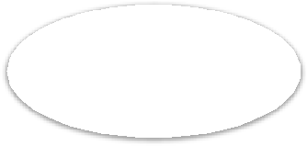
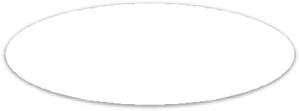
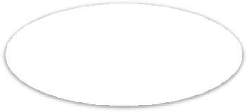

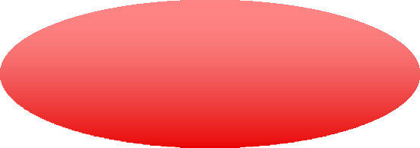





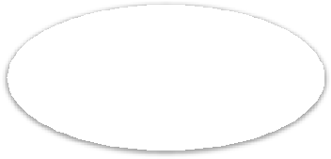
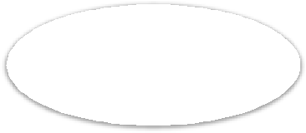

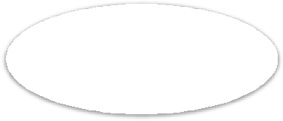





Pipeline
Business Understanding
Problem Statement
Introduction
Data
Preparation
ML Models
Conclusion

Slide 3



.Introduction
Cardiovascular disease (CVD) is increasing daily in this modern world. According to the World Health Organization (WHO), an estimated 17 million people die each year from cardiovascular disease, particularly heart attacks and strokes [1]. It is, therefore, necessary to record the most important symptoms and health habits that contribute to CVD. Various tests are performed prior to diagnosis of CVD, including auscultation, ECG, blood pressure, cholesterol and blood sugar. These tests are often long and long when a patient's condition may be critical and he or she must start taking medication immediately, so it becomes important to prioritize the tests. Several health habits contribute to CVD. Therefore, it is also necessary to know which health habits contribute to CVD.

Slide 4
es
Approach
As the problem statement says the main objective is to predict whether the patient has a 10-year risk of future coronary heart disease (CHD). I have used the Decision Tree Classifier,Logistic Regression, Random Forest Classifier, K Near Neighbor, Naive Bayes Classifier, SVM Classifier, Gradient Boosting Classifier to train the model.

Slide 5
Tools Used
The whole project was done using python, in google collaborator. Following libraries were used for analyzing the data and visualizing:
Pandas: Extensively used to load and wrangle with the dataset.
Matplotlib: Used for visualization.
Seaborn: Used for visualization.
Warnings: For filtering and ignoring warnings.
Numpy: For some math operations in predictions.
Sklearn: For analysis and prediction.
Stats models: For outliers influence.

Slide 6
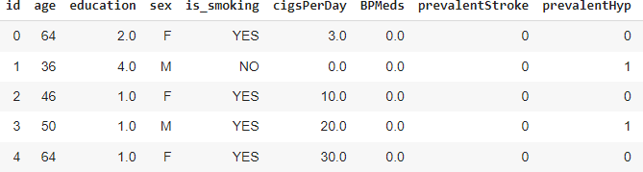
Pandas DataFrame
The table shows the dataset in the form of Pandas DataFrame. The dataset has 3391 rows and 17 columns.

Slide 7
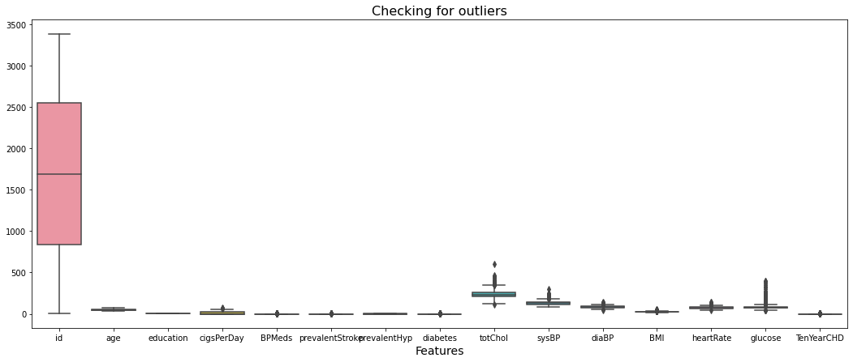
Checking for Outliers

Slide 8
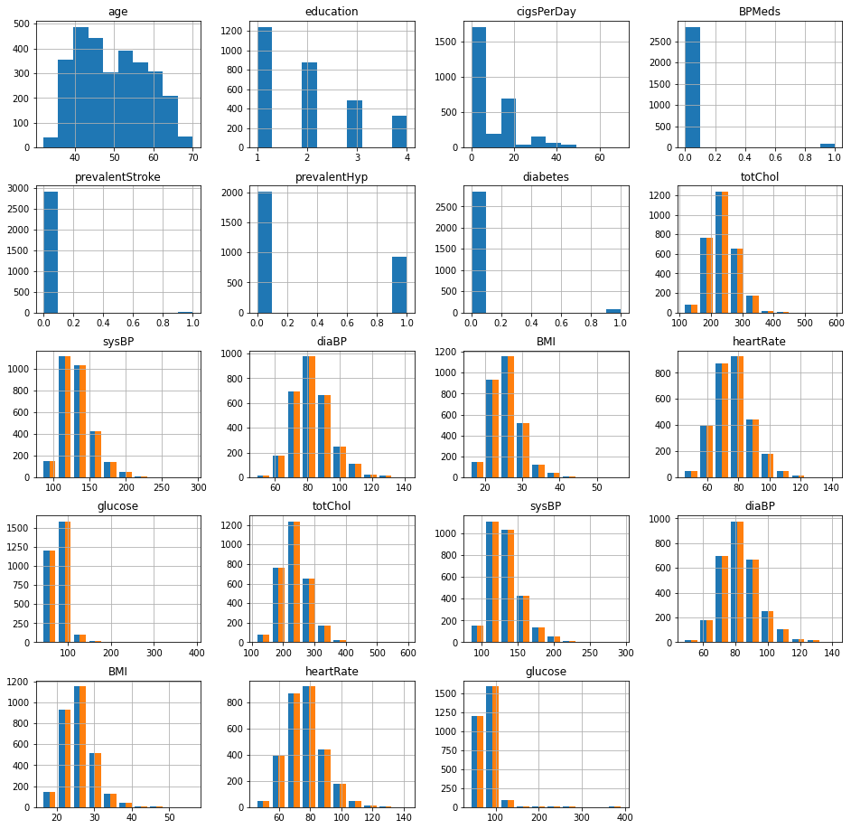
t
Histogram representation of the data

Slide 9
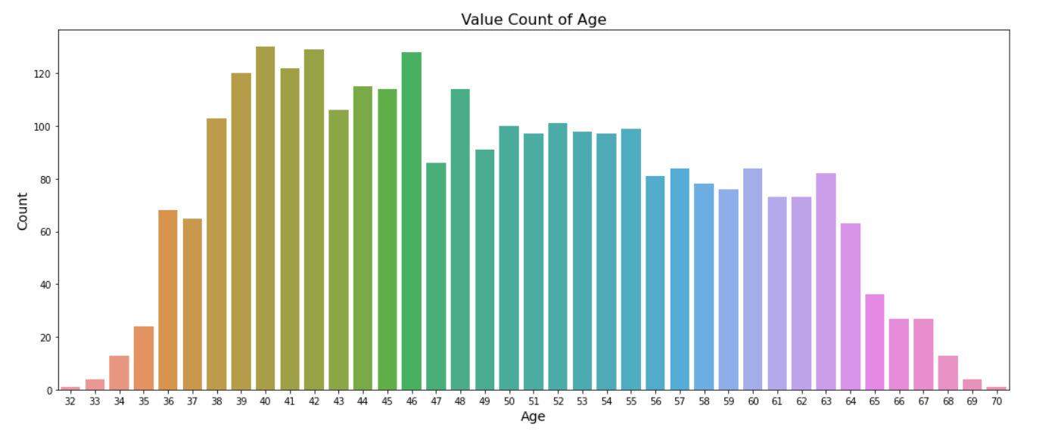

Slide 10
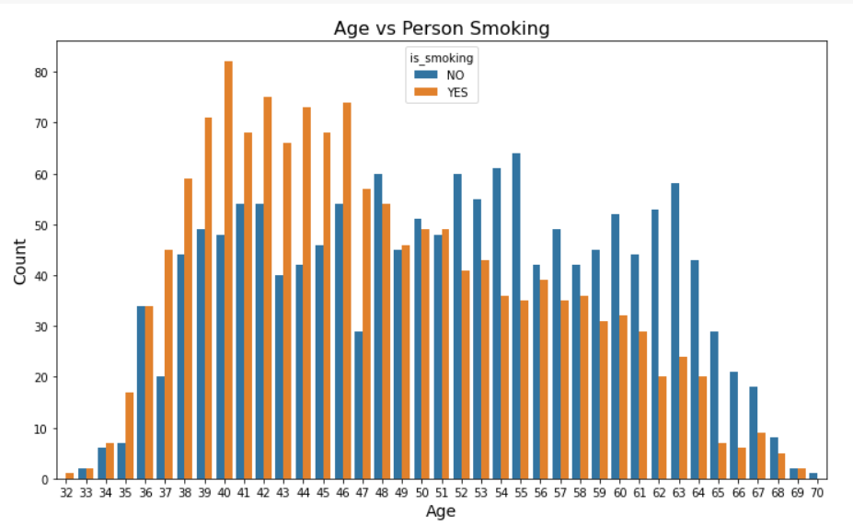

Slide 11
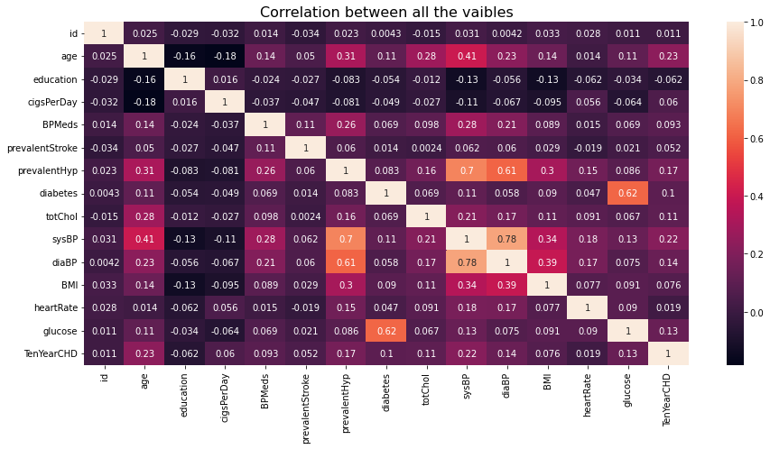
Correlation Heatmap:

Slide 12
Checking for Multi Correlation Process De
Variance Inflation Factor
The Variance Inflation Factor is used when we have the multi-collinearity between the features. The factor helps in reducing the inflation between the features by dropping some of the features which are having a high correlation among them.
In the given dataset the correlation between the features is very high and some of the features are dropped to reduce the correlation among them. Mainly bill amount features.

Slide 13
Data Modeling
After the data preparation is completed it is ready for the purpose of analysis. Only numerical valued features are taken into consideration. The data were combined and labeled as X and y as independent and dependent variables respectively. The open, high and low columns are taken as independent variables (X) and the closing price is taken as dependent variable (y).
Splitting the data
The train_test_split was imported from the sklearn.model_selection. The data is now divided into 80% and 20% as train and test splits respectively. 80% of the data is taken for training the model and 20% is for a test and the random state was taken as 0

Slide 14
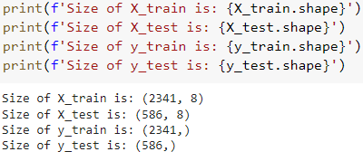
overview
Scaling the data
To normalize the data minmaxscaler was used from sklearn.preprocessing. It scales the data in the form of the standard deviation of the feature multiplied with the difference of maximum and minimum, again it was added to a minimum. At first, the training data was made fit into the scaling function and test data is transformed now. The output we get is X_train, X_test, y_train, y_test.

Slide 15
Model Evaluators(Metrics) :
Classification Report
A Classification report is used to measure the quality of predictions from a classification algorithm. How many predictions are True and how many are False. More specifically, True Positives, False Positives, True negatives and False Negatives are used to predict the metrics of a classification report.
The report shows the main classification metrics precision, recall and f1-score on a per-class basis. The metrics are calculated by using true and false positives, true and false negatives.

Slide 16
Confusion matrix
In machine learning and statistical classification, a confusion matrix is a table in which predictions are represented in columns and actual status is represented by rows. Sometimes this is reversed, with actual instances in rows and predictions in columns. The table is an extension of the confusion matrix in predictive
analytics and makes it easy to see whether mislabeling has occurred and whether the predictions are more or less correct.
A confusion matrix is also known as an error matrix, and it is a type of contingency table.
●

Slide 17
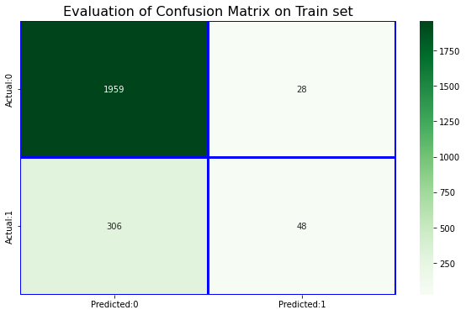
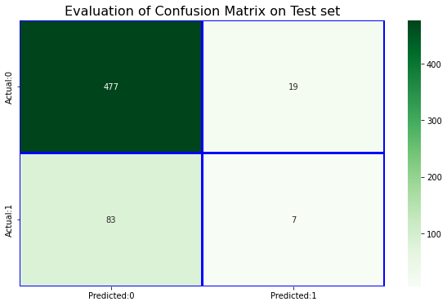


Model Implementation
Decision Tree Classifier
Decision tree build classification or regression models in the form of a tree structure. It breaks down a dataset into smaller and smaller subsets while at the same time an associated decision tree is incrementally developed. The final result is a tree with decision nodes and leaf nodes.

Slide 18
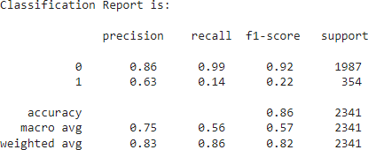
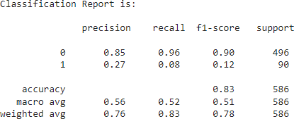
Classification Report on Train/Trest dataset:

Slide 19
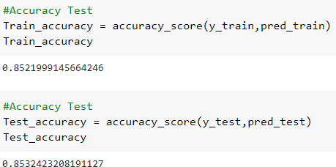
1. Logistic Regression
A logistic regression is a type of statistical procedure. It is used to refer specifically to the problem in which the dependent variable is binary, that is the number of available categories is two, while the problem with more than two categories is referred to as multi logistic regression.
Cross validation on Logistic Regression

Slide 20
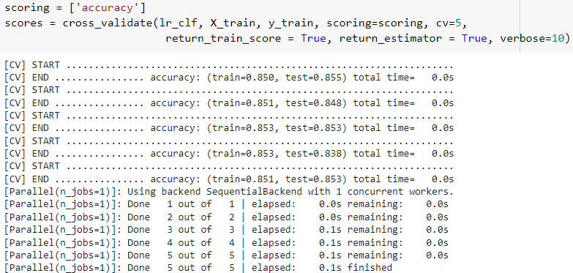
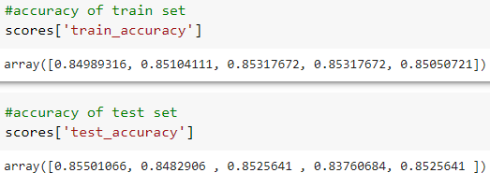

Slide 21


3. K-Neighbor Classiﬁer
The K Nearest Neighbor algorithm falls under the Supervised Learning category and is used for classification (most commonly) and regression. It is a versatile algorithm also used for imputing missing values and resampling datasets.

Slide 22
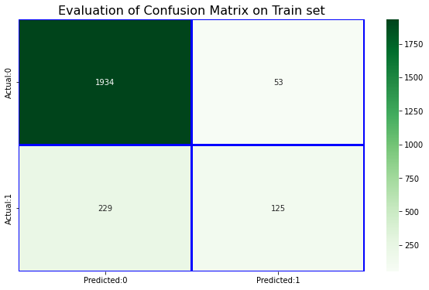
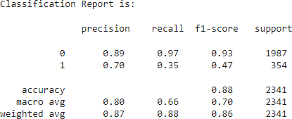
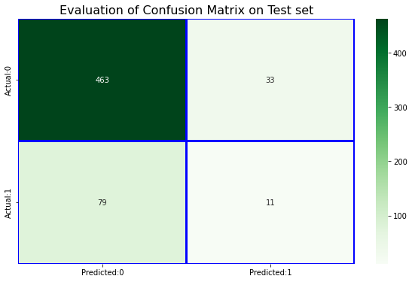
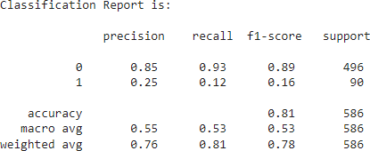

Slide 23
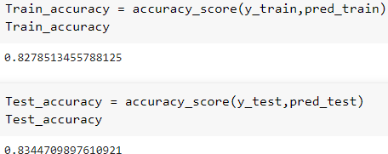
4. Naive Bayes Classiﬁer:
Naive Bayes is a simple and powerful algorithm for predictive modeling.
Naive Bayes is called naive because it assumes that each input variable is independent. This is a strong assumption and unrealistic for real data; however, the technique is very effective on a large range of complex problems.

Slide 24
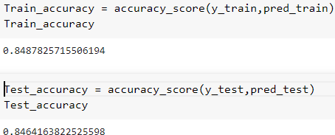
5. SVM Classiﬁer
Support Vector Machine (SVM) is a classification technique used for the classification of linear as well as non-linear data. SVM is the margin based classifier. It selects the maximum margin. This model is further used to
perform classification of testing data.

Slide 25
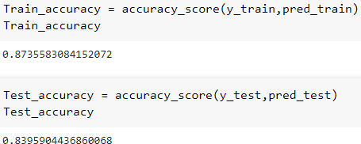
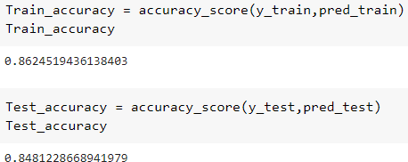
6. Gradient Boosting Classiﬁer
Gradient boosting classifiers are a group of machine learning algorithms that combine many weak learning models together to create a strong predictive model. Decision trees are usually used when doing gradient boosting.
Tuning:

Slide 26
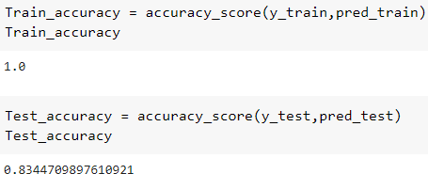
7. Random Forest Classiﬁer
Random Forest is a supervised learning algorithm that uses ensemble learning methods for classification, regression and other tasks that operates by constructing a multitude of decision trees at training time and outputting the class that is the mode of the classes(classification).
Accuracy on Train and Test data set (Tuning)

Slide 27
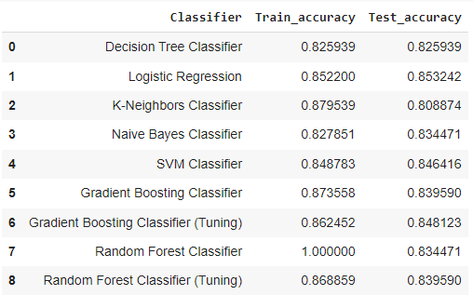
Comparing all the models

Slide 28
Conclusion :
Deﬁning dependent variables and EDA on Dataset.
We have patients from the 32 to 70 age group. Number of patients from the 38 to 46 age group is high with smoking habits.
Number of female patients is higher than male patients.
There are 1307 male patients in the dataset out of which 809 male patients smoke cigarettes.
There are 1620 female patients in the dataset out of which 638 female patients smoke cigarettes.
Number of patients with medical history like blood pressure medication, Diabetes, and patients who previously had a stroke is very low.
We used the Decision Tree,Logistic Regression,Random Forest Classiﬁer, KNear Neighbor, Naive Bayes,SVM, Gradient Boosting Classiﬁer to train the model.

Slide 29
Logistic Regression ,SVM classiﬁer,Gradient Boosting Classiﬁer(Tuning) these models give good accuracy on test data with 86%, 85%, 85% respectively.
If we want to choose only the best one model it is better to train the model with Logistic Regression which has 85.32% accuracy on test data

Slide 30


