Slide 1
New York City Taxi dataset
Submitted by :
Rahul chhabra 000933841

Slide 2
Objective
To explore and analyze the NYC Taxi dataset.
Understand patterns in taxi usage across time, locations, and fares.
Identify key insights to improve transportation planning or business strategy.

Slide 3
Dataset Overview
Source: NYC Taxi & Limousine Commission (TLC)
Period: January 2015 (sample shown)
Size: 50+ columns, millions of rows in full dataset

Slide 4
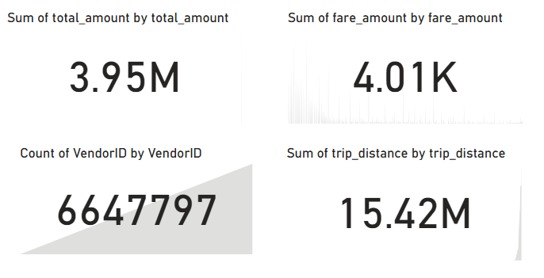
Power BI Dashboard

Slide 5
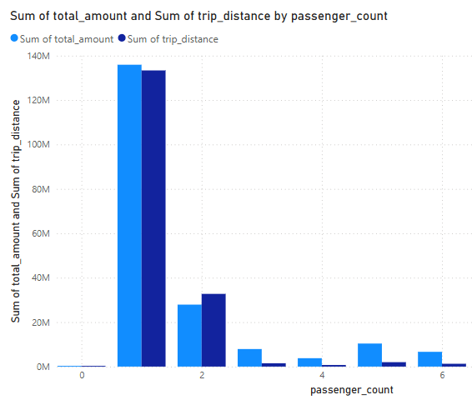
Number of travelers and distance traveled?

Slide 6
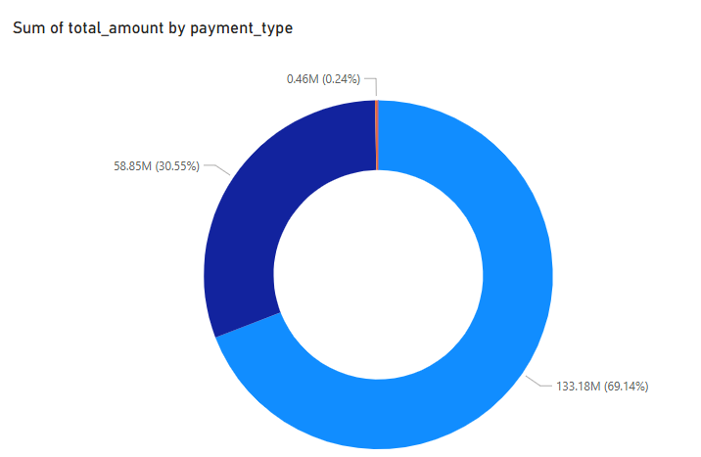
What are the preferred payment methods for NYC Taxi drivers?
133.18M (69.14%) Apple pay
58.85M (30.55%) Credit/Debit Card direct
0.46M (0.24%) Cash

Slide 7
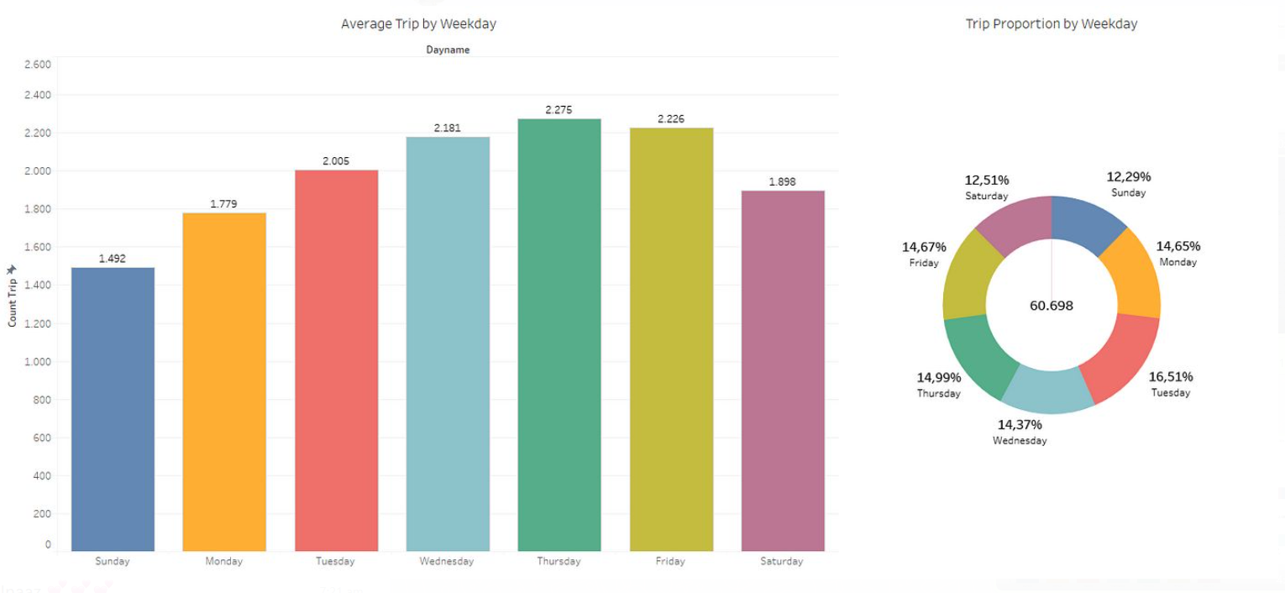
What is the proportion of taxi used day wise?

Slide 8
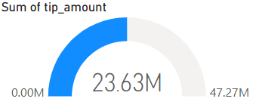
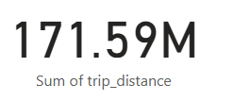
When do people tend to tip more and what is there minimum distance travelled?
Most trips are short (Under 3 miles)
Majority of users pay with Online mode(Apple Pay).
Tip percentages are higher during peak hours.

Slide 9
How can transportation or business strategies be improved using this data?
Short trip dominance could inform micro transit solutions or pricing models.
High Digital payment usage can guide investment in app-based taxi services.
Peak hours tripping patterns could help with driver incentive plans or surge pricing models.

Slide 10
Thank You!

