Slide 1
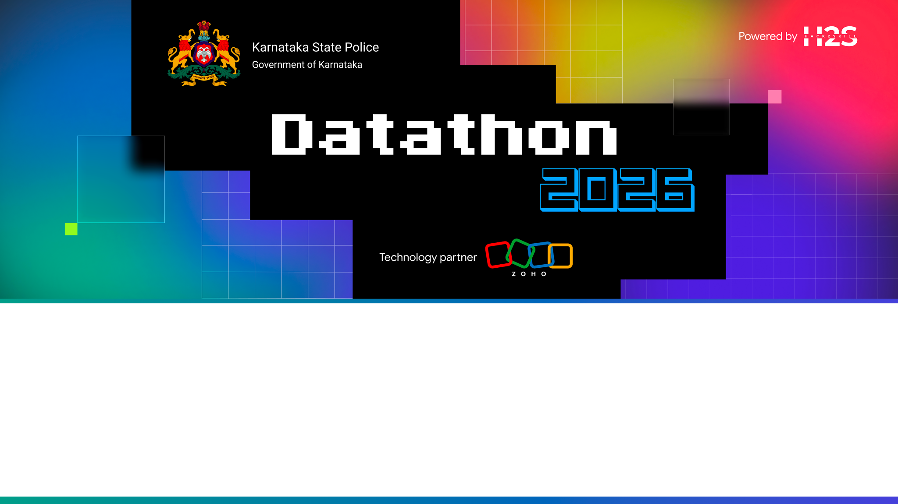
Team Details
Team name: Agentic_masters
Team leader name: Gokul D
Team size: 5
Problem Statement: Challenge 01 — Intelligent Conversational AI for the KSP Crime Database

Slide 2

Brief about the solution
An agentic Investigation Copilot for the Karnataka State Police. One natural-language question — by text or voice, in English or ಕನ್ನಡ — runs a complete investigation:
• Conversational case retrieval (FIRs, accused, victims, locations, status, history)
• Criminal-network graph + financial money-trail with mule-account detection
• Crime hotspot map + recency-weighted next-hotspot forecast
• Explainable risk scoring & offender profiling — with the reasons shown
• Sociological insights, similar-case search & investigator decision support
• Auto-generated, fully cited PDF investigation report
Every answer is grounded in records with case-ID citations — zero hallucination. A browser prototype today, packaged for Catalyst-native deployment.

Slide 3
Opportunities
How different from existing ideas?
Not a chatbot or static dashboard — an autonomous agent that fuses conversation + graph + geospatial + financial + sociological analysis, and cites every fact (most LLM tools hallucinate).
How will it solve the problem?
Collapses hours of manual case-stitching (search → link → map → report) into one query for investigators, analysts and policymakers.
USP of the proposed solution
Zero-hallucination grounded answers · one-question autonomous investigation · explainable AI · bilingual + voice · Catalyst-native + role-governed.

Slide 4
List of features offered by the solution
• 🤖 Conversational copilot — NL + voice, English/ಕನ್ನಡ, context-aware follow-ups
• ✅ Grounded answers with case-ID citations (zero hallucination)
• ⭐ Autonomous Investigation — one query runs the whole pipeline
• 🗺️ Crime hotspot map (heatmap + area-label markers + predicted hotspot)
• 🕸️ Criminal network graph (associates · phones · vehicles · cases)
• 💸 Financial money-trail with mule-account detection
• 🏙️ Sociological insights (socio-economic correlation + demographics)
• 🔮 Explainable forecast & risk · 🔎 similar-case search · 📈 timeline
• 📄 One-click cited PDF investigation report
• 🔐 Role-based access + PII masking + audit log · 🌓 light/dark + voice

Slide 5
Process flow diagram or Use-case diagram
1
Ask
(text / voice)
2
Parse
intent
3
Grounded
retrieval
4
Analyse
graph·geo·₹·socio
5
Explain
+ cited PDF
→
→
→
→
One question triggers the full pipeline autonomously. The grounded-retrieval step cites the exact case IDs used, so every downstream panel and the report are verifiable end-to-end.

Slide 6
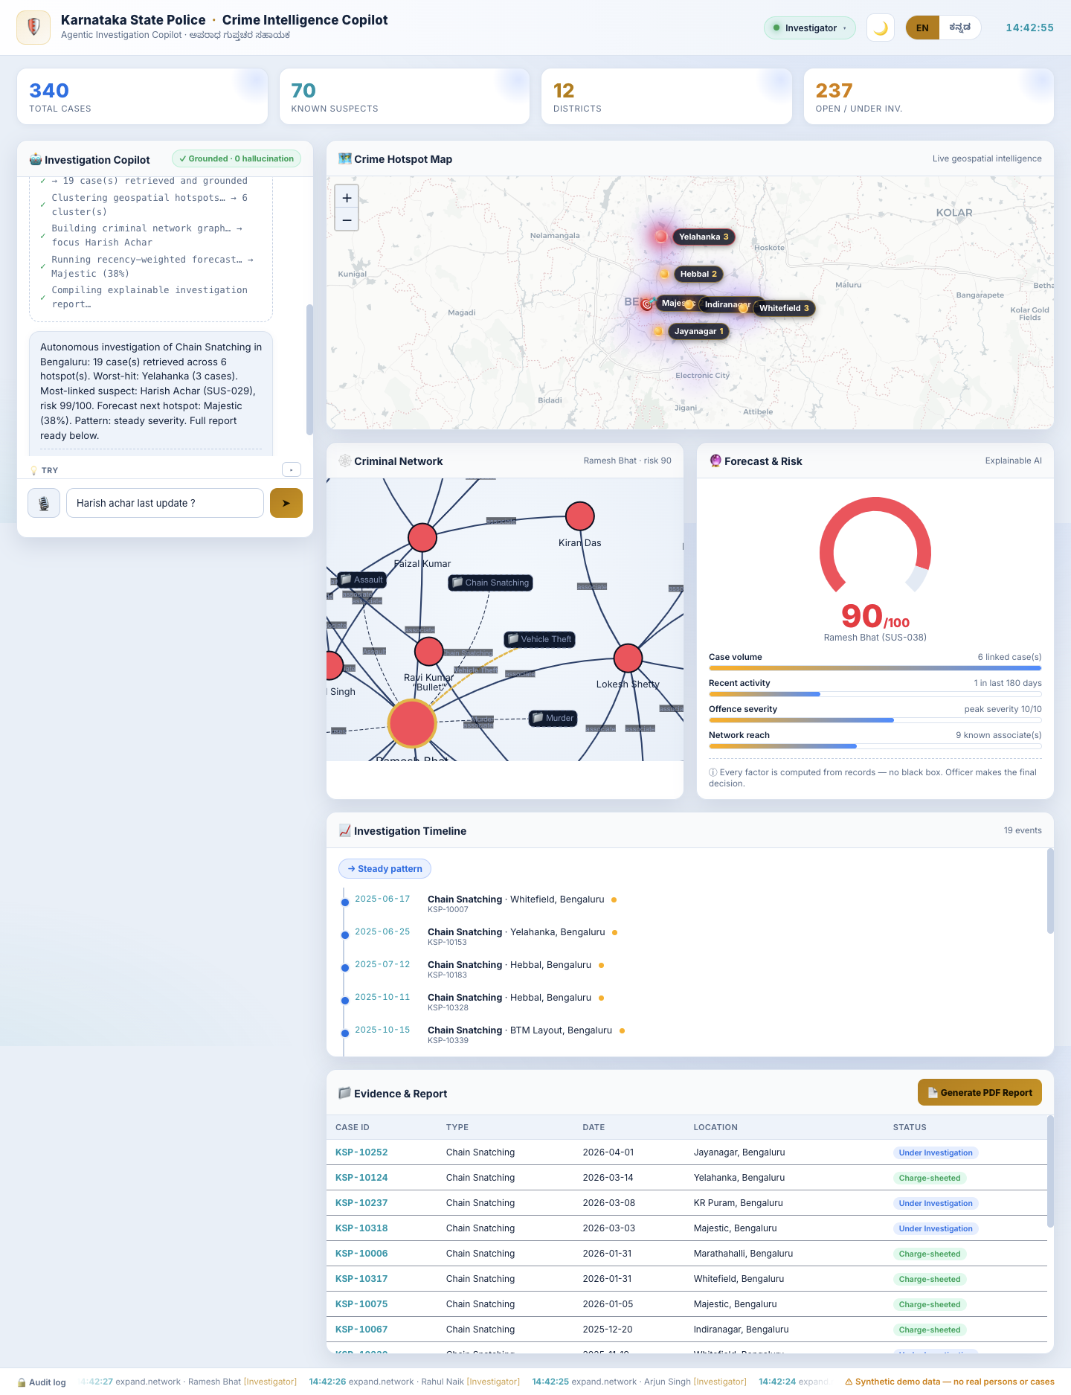
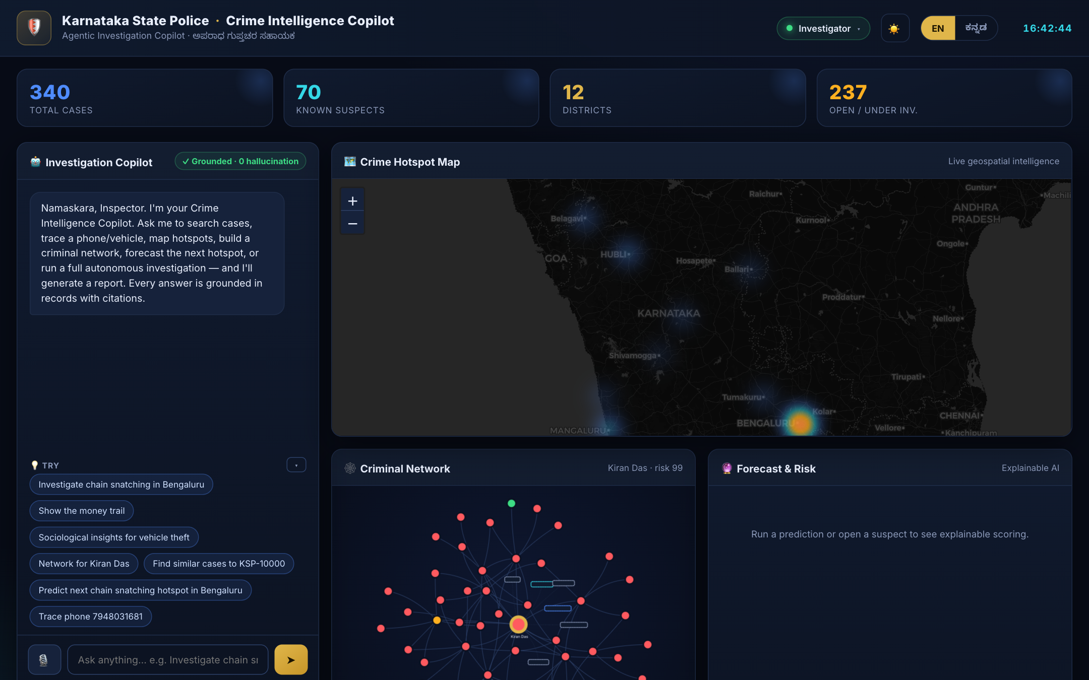
Wireframes/Mock diagrams of the proposed solution (optional)
Single-screen command centre — the actual prototype UI:
• Left: conversational Investigation Copilot (text + voice)
• Centre: live crime hotspot map
• Right: criminal network + explainable forecast & risk
• Below: investigation timeline, cited evidence & PDF report
• Top bar: KPI strip, role switcher, EN / ಕನ್ನಡ, light / dark

Slide 7
Architecture diagram of the proposed solution
Officer · text / voice · English + ಕನ್ನಡ
↓
Frontend (Catalyst Web Client Hosting): Copilot · Map · Network · Charts · PDF · RBAC · Light/Dark
↓
Grounded Engine (isomorphic — browser & Catalyst Function): parse → retrieve (with citations) → network · geo · forecast · finance · socio
↓
Catalyst Services: Functions · Data Store · QuickML (LLM+RAG) · Zia AutoML · Zia Voice · SmartBrowz · Auth · Circuits

Slide 8
Technologies to be used in the solution
Prototype (this build)
• Frontend: Vanilla JS, HTML5, CSS3 (no build step)
• Maps: Leaflet + heat + CARTO tiles
• Graph / Charts: vis-network, Chart.js
• PDF: jsPDF · Voice: Web Speech API
• Engine: isomorphic JS (browser + Node)
Production (Catalyst by Zoho)
• Web Client Hosting (frontend) + Serverless Functions
• Data Store (FIR/CCTNS) + full-text search
• QuickML — LLM + RAG (conversational AI)
• Zia AutoML (risk/forecast) · Zia Services (voice)
• SmartBrowz (PDF) · Authentication (RBAC) · Circuits

Slide 9
List down Catalyst Services being used in the solution
• Frontend / SPA → Web Client Hosting
• Backend logic / API → Serverless Functions
• Crime database + search → Data Store
• Conversational AI + RAG → QuickML (LLM Serving, RAG)
• Risk / forecast models → Zia AutoML
• Voice (STT / TTS / translate) → Zia Services
• PDF report generation → SmartBrowz
• Login + role-based access → Authentication
• Autonomous pipeline → Circuits
• Early-warning alerts → Cron + Push Notifications + Mail
• Event-driven re-analysis → Signals + Event Functions
• API security / throttling → API Gateway

Slide 10
Estimated implementation cost (optional)
• Prototype: ₹0 — runs in-browser; backend on Catalyst free credits (code KSPH26).
• Pilot / Production: usage-based on Catalyst (Functions, Data Store, QuickML & Zia) — no third-party licences, all first-party services.
• Front-end libraries (Leaflet, vis-network, Chart.js) are open-source — no cost.
• Scales with data volume and query load; no fixed infrastructure to maintain.

Slide 11
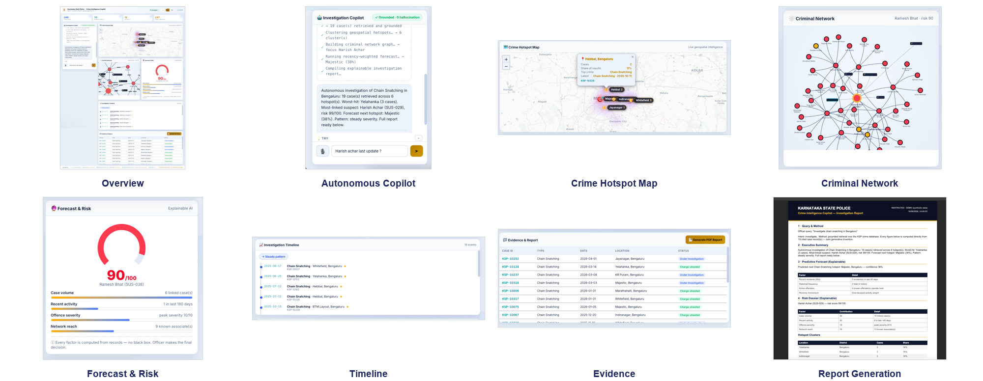
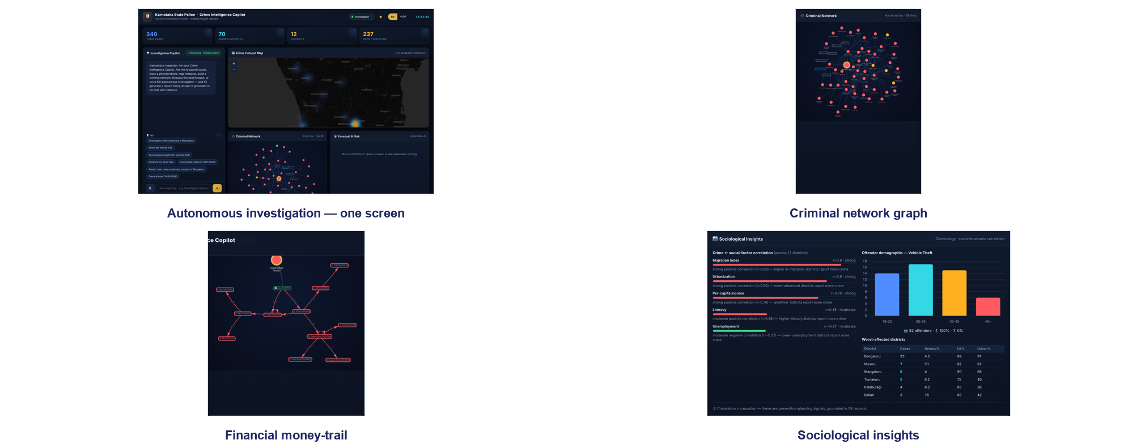
Snapshots of the prototype

Slide 12
Prototype Performance report/Benchmarking
• Dataset: 340 cases · 70 suspects · victims, bank accounts & transactions, socio-economic indicators across 12 districts (synthetic, deterministic).
• Latency: queries resolve client-side in <50 ms (no network round-trip); first paint <1.5 s.
• Reliability: seeded data → identical, reproducible demos; runs offline (except map tiles).
• Trust: 100% of answers carry source case-ID citations; risk/forecast factors fully itemised.
• Footprint: near-zero install — static files, no build, no API keys; isomorphic engine verified headless in Node.

Slide 13
Provide links to your:
GitHub Public Repository: https://github.com/Rahulcse79/ksp-crime-intelligence-copilot
Demo Video Link (3 Minutes): https://youtu.be/JPELdK2ek-4?si=Q3h_THqVh7ePymEp
Deployed Link: https://ksp-crime-intelligence-copilot-60073126408.development.catalystserverless.in/app/index.html

Slide 14
Additional Details/Future Development (if any)
• Connect real CCTNS / KSP data via Catalyst Data Store (replacing synthetic data).
• QuickML LLM+RAG for full free-form & Kannada query understanding; Zia AutoML models with validation metrics.
• Seasonal & event-based trend analysis + Cron early-warning alerts (gang / organised crime).
• CCTV / ANPR / face integration, predictive patrolling, multi-state — “CrimeOS”.
• Field-officer mobile app and deeper financial-intelligence workflows.

