Slide 1



Mining for Patterns: An Analysis of NITJ WiFi Speeds
By:
Rahul Deb Nath (23103114)
Rittik Ganchaudhuri (23103123)

Slide 2
Introduction & Objectives
What? An analysis of WiFi speed test data collected from various locations on the NITJ campus.
Why? To understand network performance and find actionable patterns.
Objectives:
• Analyze typical download/upload speeds.
• Identify how performance varies by location.
• Discover patterns based on time of day.
• Visualize findings using R.

Slide 3
The Dataset
Source: NITJ_WiFi_Speed.csv
Size: ~270 observations
Key Columns:
• spot_location (e.g., 'New Library Building')
• d_speed(mbps)
• u_speed(mbps)
• pk_loss(%)
• date & time

Slide 4
Methodology
Tool: R Programming Language & RStudio
Packages: tidyverse (for data wrangling & plotting), lubridate (for time), janitor (for cleaning)
Process:
1. Load: Read the CSV data.
2. Clean: Standardized column names and location text.
3. Feature Engineering: Created hour_of_day column.
4. Analyze & Plot: Aggregated data and generated 6 plots (Histograms, Boxplots, Bar Charts, etc.).

Slide 5
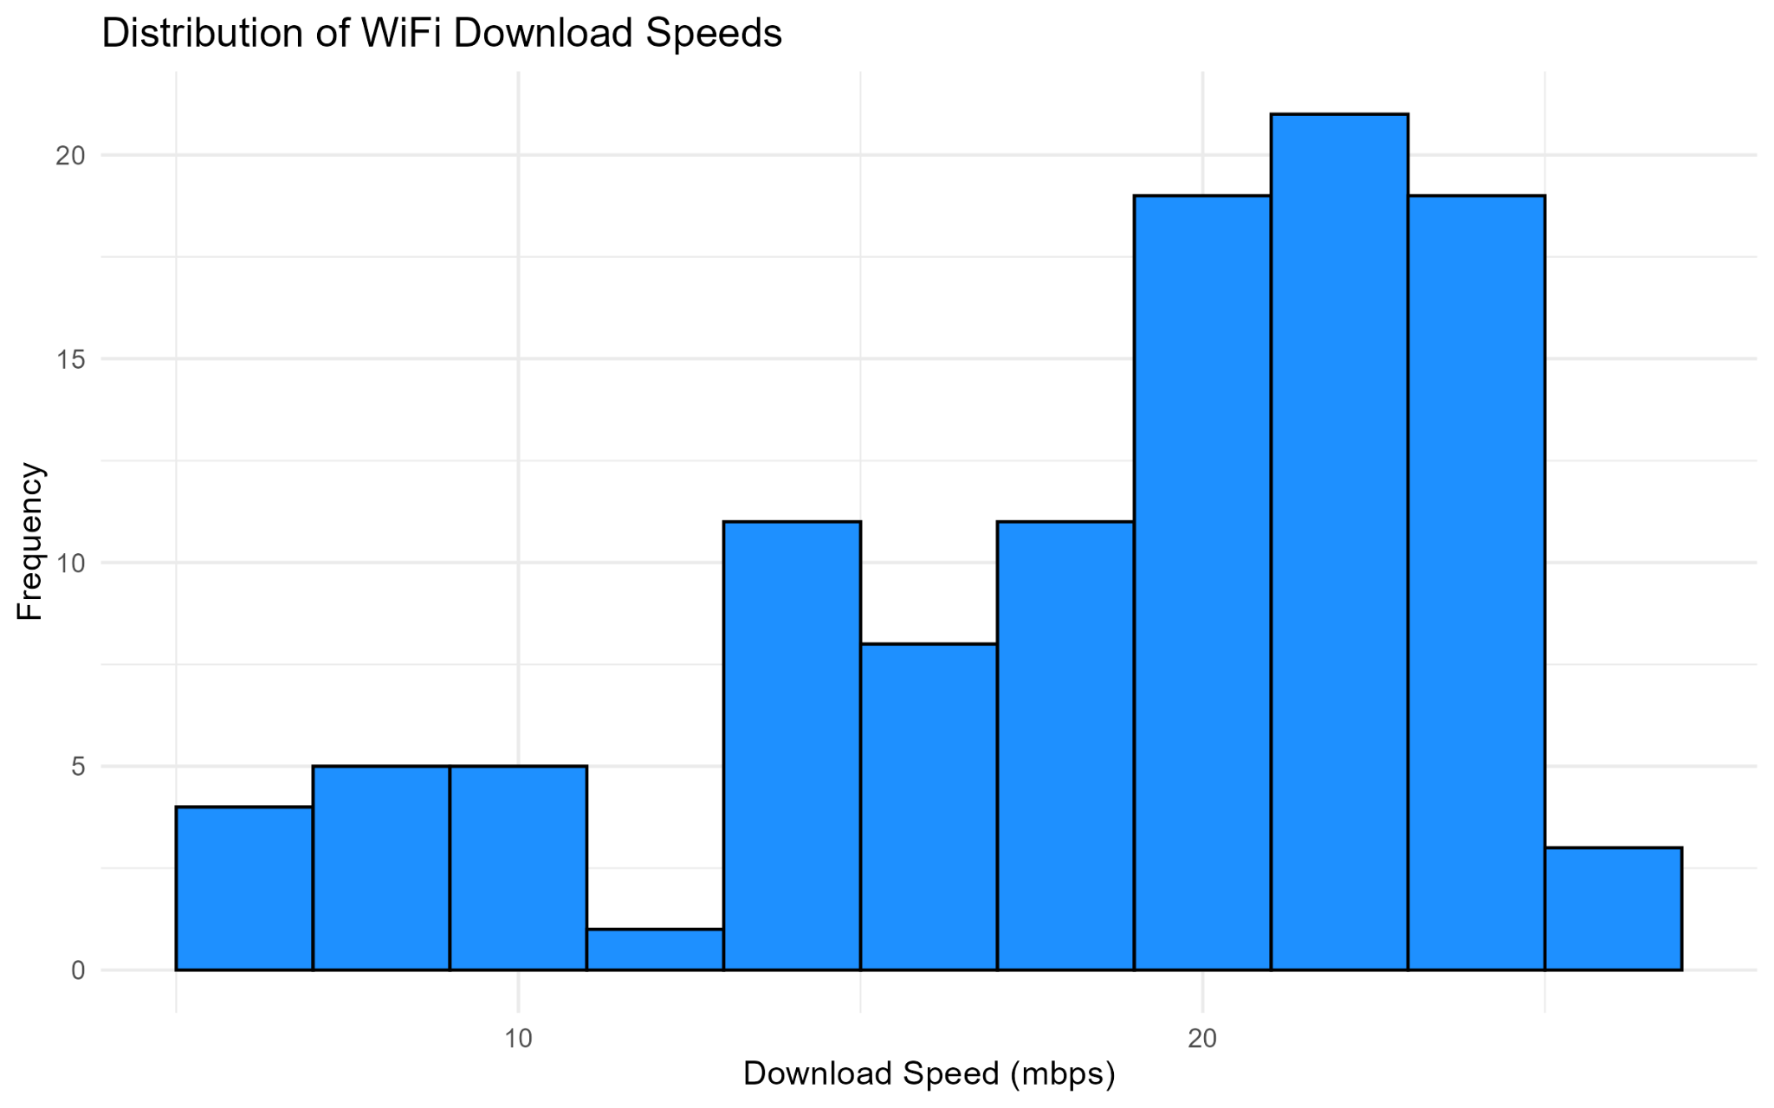
Result 1 - How Fast is the WiFi?
Finding: The most common download speed is 20-22 mbps.
Takeaway: The vast majority of tests fall within a solid 15-25 mbps range, indicating generally good performance.
NITJ WiFi Data Mining Project | Department of CSE

Slide 6
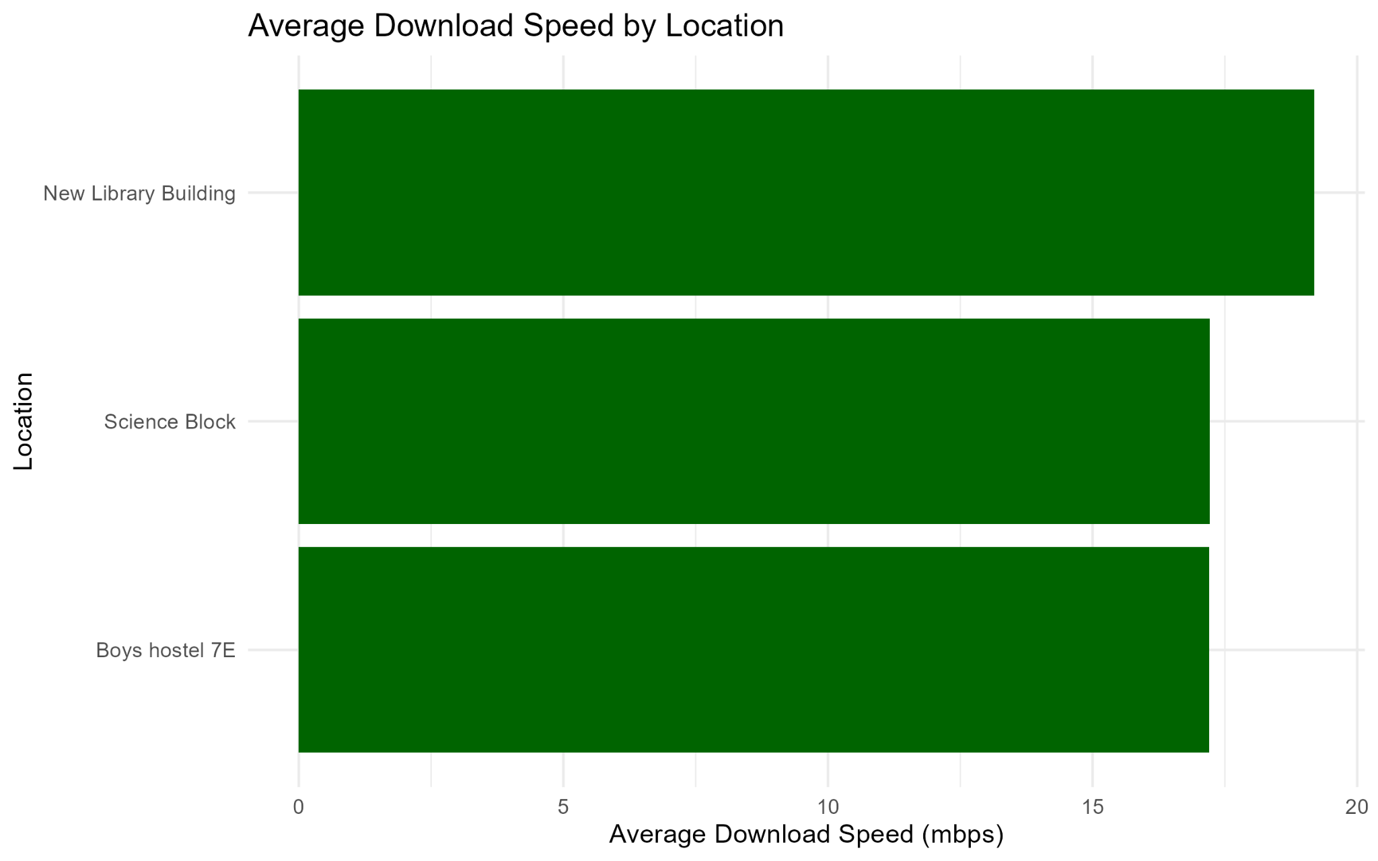
Result 2 - Which Location is Fastest (Average)?
Finding: Location is a major factor for average speed.
Takeaway: The 'New Library Building' has the highest average speed, while the 'IT Block' and 'Science Block' are consistently slower.
NITJ WiFi Data Mining Project | Department of CSE

Slide 7
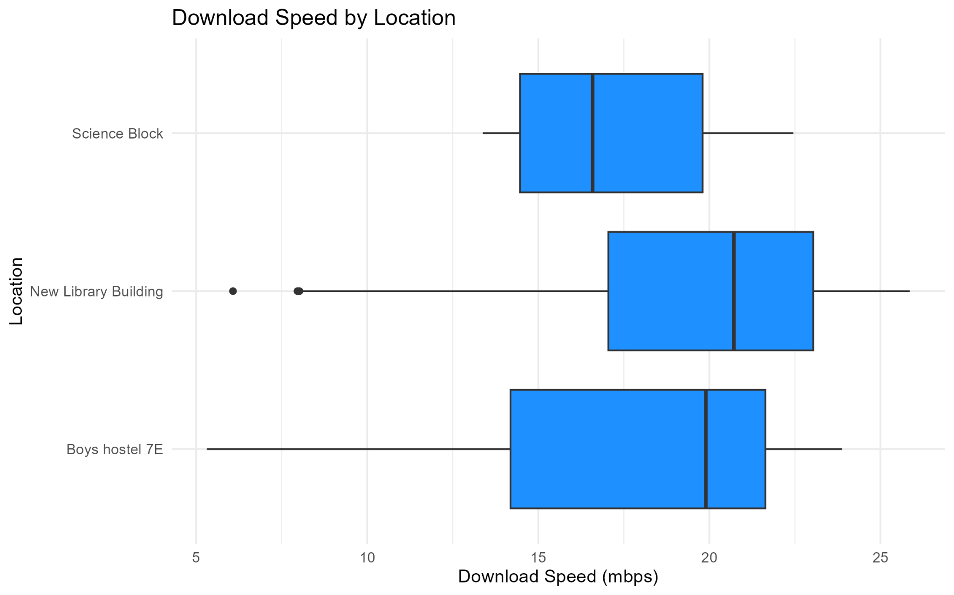
Result 3 - Which Location is Most Reliable?
Finding: This boxplot shows the full distribution (median, spread, and outliers) for each location.
Takeaway: It confirms the 'New Library Building' is fastest. It also shows the 'IT Block' is unreliable, with a very wide spread of results and many low-speed outliers.
NITJ WiFi Data Mining Project | Department of CSE

Slide 8
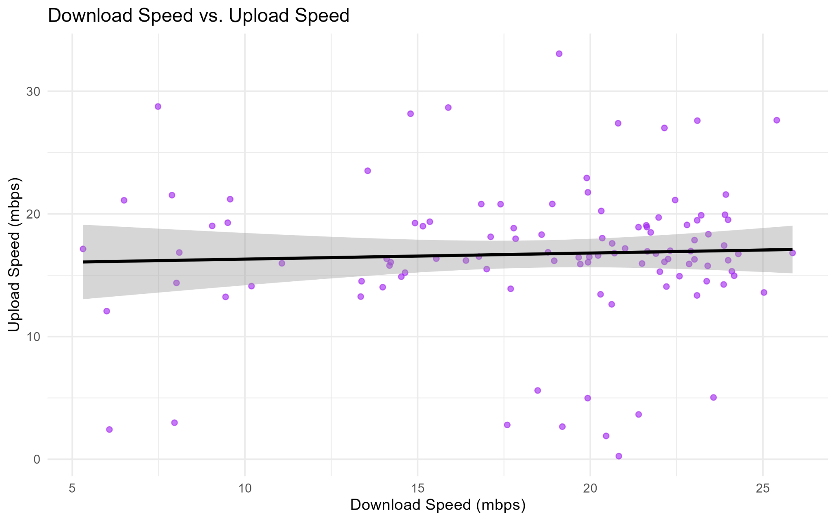
Result 4 - Other Correlations
Finding 1 (Left): Download and Upload speeds are positively correlated. If one is fast, the other usually is too.
NITJ WiFi Data Mining Project | Department of CSE

Slide 9
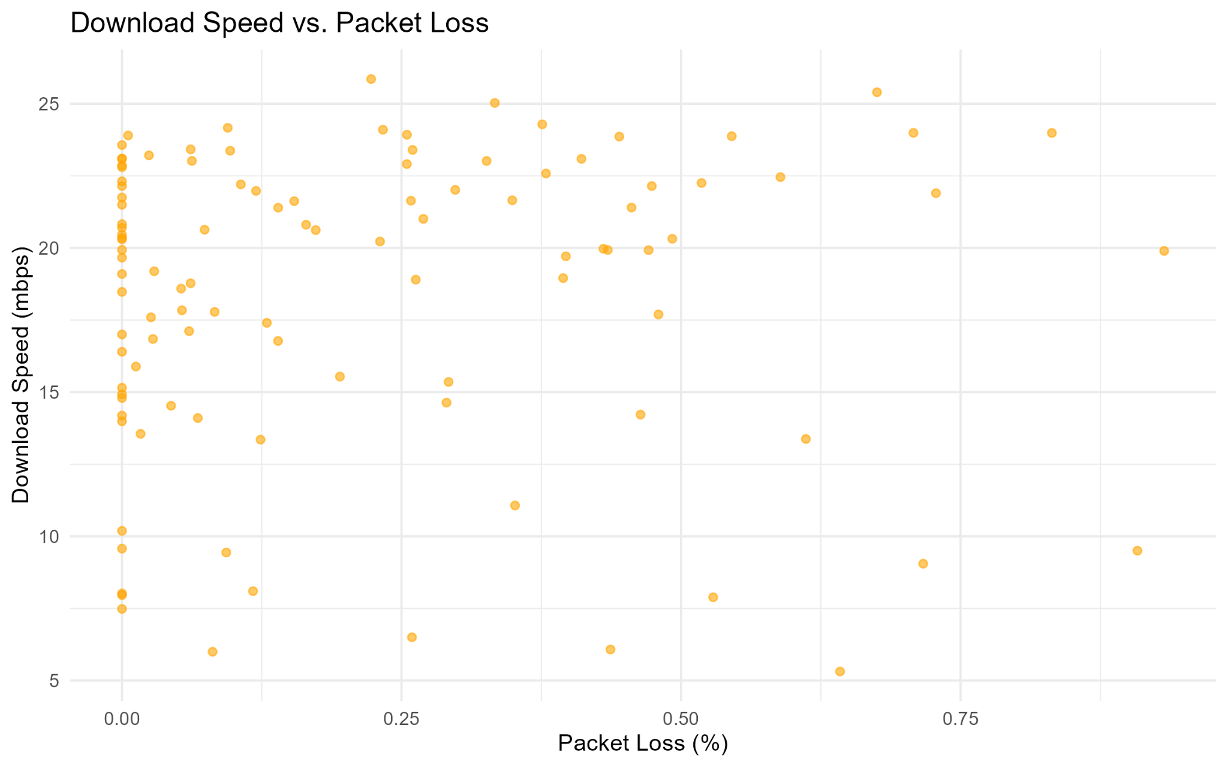
Result 4 - Other Correlations
Finding 2 (Right): Packet Loss is almost 0% for all tests. This is excellent and means the connection is very stable.
NITJ WiFi Data Mining Project | Department of CSE

Slide 10
Conclusion & Questions
Key Findings:
• Good Speed: Typical speed is 15-25 mbps.
• Location is Key: The 'New Library' is the fastest and most reliable spot. The 'IT Block' is unreliable.
• Time Matters: Fastest in the afternoon, slowest at 3 AM.
• Very Stable: Packet loss is near zero.
NITJ WiFi Data Mining Project | Department of CSE

