Slide 1

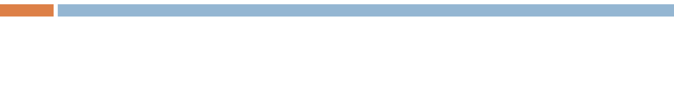
Group A5:
DISEASE PROGNOSIS USING RANDOM FOREST
Presented by
D. Rahul 245321748022
G. Chandu 245321748025
N. Vishal 245321748064
Under the supervision of
Mr. P. Nageswara Rao

Slide 2

Project Introduction
What exactly is Disease Prognosis?
Disease prognosis refers to the prediction of the likely course and outcome of a medical
condition.
Importance: Importance: Early prognosis can lead to timely interventions and personalized treatment plans.
Aim of our project
In our project we predict health outcomes with advanced data analysis based on user symptoms.
Benefits of Using ML for Disease Prognosis
- ML considers individual health data for customized disease prognosis, optimizing treatment strategies.
- ML algorithms analyze subtle patterns, enabling early disease identification before symptoms manifest.
- Enhanced prognostic accuracy leads to more effective and targeted interventions, elevating the overall quality of patient care.
- ML-based prognosis contributes valuable insights for ongoing medical research, fostering advancements in understanding and treating diseases.

Slide 3




Technologies Used
Html, Css, Js
- HTML structures content, CSS styles presentation, and JS adds interactivity to web pages.
Node.JS – A runtime environment for executing javascript code outside of a web browser
Express.JS – Express.js is a web application framework for Node.js, simplifying server-side JavaScript
development.
Python – A high level, multi-purpose programming language.
We used python specifically for implementing machine learning and extracting trained features from external
windows pe files

Slide 4






The Machine Learning Model
Dataset source: Dataset
We trained a machine learning model with the dataset, which contains 132 parameters on which 42 different types of diseases can be predicted.
The model was trained using the Random Forest Classifier algorithm, with an observed training accuracy of 99.7%.
Random Forest
Accuracy:99.7% 100%
In order to leverage the model later using a python script, we saved it with the help of a python module called ‘pickle’.
ML Model
Pickle Module

Slide 5










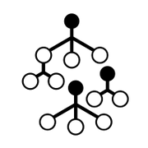





Project Workflow
The 'python-shell' module is used to
run external python scripts.
Here, trained ml model makes a prediction based on symptoms and also finds the Wikipedia Url of the disease.
The symptoms are forwarded
to the backend.
Symptoms are given as input.
The final result is
displayed on the frontend
The result is forwarded
to the frontend
The prediction is made and the result is sent
to the backend.

Slide 6
RANDOM FOREST
KEY POINTS :
Ensemble Learning: Random Forest is an ensemble learning method, meaning it combines the predictions of multiple individual models to improve overall performance.
Decision Trees: The base models used in Random Forest are decision trees. Each tree is constructed independently, and the final prediction is based on the aggregate of predictions from all trees.
Bagging: Random Forest employs a technique called bagging (Bootstrap Aggregating) to train each decision tree on a randomly selected subset of the training data with replacement. This helps reduce overfitting and variance in the model.
Random Feature Selection: At each split in the decision tree, only a random subset of features is considered. This introduces further randomness into the model and helps decorrelate the trees, leading to more diverse and robust predictions.
Out-of-Bag (OOB) Error Estimation: Random Forest uses the out-of-bag samples (samples not used in the training of a particular tree) to estimate the model's performance without the need for cross-validation.
Feature Importance: Random Forest provides a measure of feature importance, indicating the contribution of each feature to the model's predictive performance. This can be useful for feature selection and understanding the underlying data patterns.

Slide 7


