Slide 1

A.S.U.R (Anonymous System For User Reporting)
Unleash the power of Anonymity for a Safer Tomorrow
Theme: Blockchain And Cyber Security

Slide 2
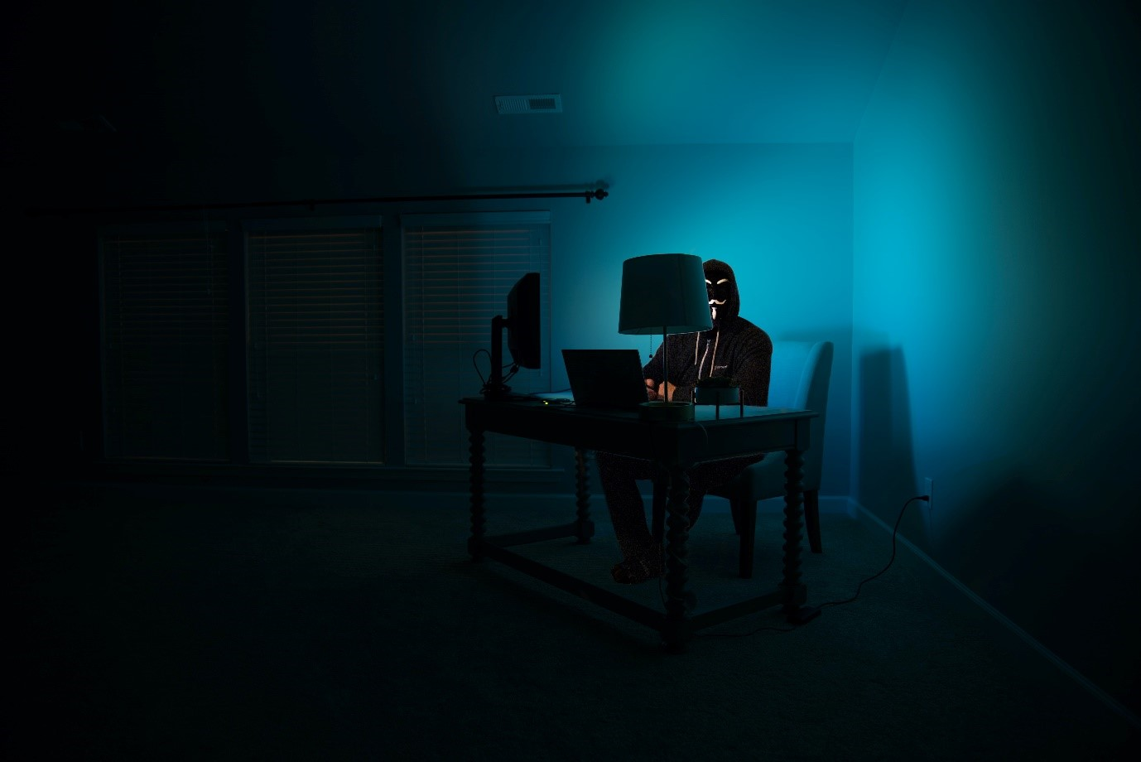
PROBLEM STATEMENT
01
Develop a System to monitor and track activities being carried out on dark web or using various cryptocurrencies under the umbrella of anonymity.

Slide 3
AIM
02
To create a secure and anonymous tip reporting system on the dark web where users can report illicit activities to the government, with rewards for valid tips and penalties for false reports.

Slide 4
OUR SOLUTION
03
Our Solution is a revolution in Anonymous Reporting on dark web
We plan to develop a platform(website) which users can access through the TOR network
Any user can report any illicit activity anonymously through our website and this information would be sent securely to verified authorities.

Slide 5
OUR SOLUTION
03
Further if the tip is found to be true, the anonymous user would be eligible for rewards in the form of cryptocurrency!
This idea sets our solution apart because users on dark web are always on the hunt to earn cryptocurrencies such as bitcoin. Hence this system will work as a win-win for both parties.

Slide 6
What about false reports?
04
To avoid false information reporting that might potentially misguide authorities, we are implementing an additional feature
Any anonymous reporter must first pledge some amount in the form of cryptocurrency.
This amount will be lost if information reported is false( Somewhat like the proof of stake in Blockchain Consensus Mechanism).

Slide 7


WHO WILL REPORT IF THERE ARE ONLY SCAMMERS AND HACKERS ON THE DARK WEB?

Slide 8
05
USERS OF DARK WEB
Only Approximately 6.7% of global users use the dark web for illicit activities
such as sharing malware, distributing child abuse content, or selling illegal
Substances Or weapons.
Tor counts a whopping two million active users in 2022.
Types of users include:
1. Privacy Advocates
2. Ethical Hackers
3. Cyber Criminals/Hacktivists
4. Cryptocurrency Enthusiasts
5. Extremists
6. Government Agencies

Slide 9
Users who would be willing to report for rewards
06
Whistleblowers
Ethical Hackers
White Hat Hackers
Competing Criminals
Skilled Journalists

