Slide 1

Product Requirements & Wireframes

Slide 2
Dash Board | My Companies | Start ups | Investors | Enablers | News
Naren | Log out
Company 123
Profile
Corporate Finance
Planning & Budgeting
Income Statement
Balance Sheet
Cash Flow Statement
Forecasting
Income Statement
Balance Sheet
Cash Flow Statement
Industry Benchmarking
Business Modelling & Valuation
Due Diligence
Fund Raising
Investor Tools
Company 123 – Dash Board
Side Bar Requirements:
The side bar must include PROFILE where all information of the company is captured along with all of our services
The link that the user is exploring must be high lighted
Sub-links must be tabbed at 3 character spaces (instead of standard 8)
When user click on a different Product Suite, other expanded suite must collapse
When the user logs in, the side bar must show primary company details always (we could think of last selected company to be shown as well – TBD)
Use “Agency FB” font
Head Bar Requirements:
The number Leader logo must be embedded into the head bar color without any white patch
When a user logs in, the head bar must show links specified above.
The first page must be Dashboard
The Side Bar must have links for the Primary Company of the user
Name of the user and Log Out link as shown above
Use “Agency FB” font
Dash Board Requirements:
List of companies that user is part of
List of Start ups the user has liked or latest ones added to our database
List of Investors the user has liked or the most popular ones in our network
List of Enablers the user is working with or the most popular ones in our network
List of startups other investors indicate interest
List of startups where investors are inviting syndicate investors
List of startups in the same industry that the user prefers
Latest industry news of the industry or start ups or investors the user is associated with

Slide 3
Dash Board | My Companies | Start ups | Investors | Enablers | News
Naren | Log out
Company 123
Profile
Corporate Finance
Due Diligence
Fund Raising
Investor Tools
Company 123 – My Companies – Primary Company or last selected company
Default Page Requirements:
Brief Profile and link to uploaded documents
Services signed up for
Recent activities of the user
Team members associated with this company with their thumbnail pictures
List of user who have favorited this company
News associated with this company (pulled from the internet)
When the user clicks on any link in the side bar, follow the functionality and wireframe needs

Slide 4
Dash Board | My Companies | Start ups | Investors | Enablers | News
Naren | Log out
Company 123
Profile
Corporate Finance
Due Diligence
Fund Raising
Investor Tools
Company 123 – My Companies – Primary Company or last selected company
Basic Information
Products & Services
Pitch Presentation & Video
Business Plan & Financials
Valuation & Bench Marking Founders & Organization
Cap Table
News & Events
Company Ask
Profile details to be present if you are a Start up:
Basic Information (Summary, Logo image, Company Name…)
Products & Services (Name, Summary, & links)
Pitch Video (Upload / Embed)
Pitch Presentation (Upload/ Embed)
Business Plan
Financials & Shareholders
Valuation Reports (Upload)
Bench Marking Reports (Upload)
Challenges
News (links)
Contact Information (website, email, phone and so on)
PLUS: refer to the excel to add the other fields needed.
Reference page –
https://pitchbook.com/profiles/company/51386-05#signals
Profile details to be present if you are an Investor:
Basic Information (Summary, Logo image, Company Name…)
Products & Services (Name, Summary, & links)
Pitch Video (Upload / Embed)
Pitch Presentation (Upload/ Embed)
Investment Portfolio (Company, Fund Size, Stage of funding, Country, Sector)
Exits (Company, Country, Sector)
News (links)
Contact Information (website, email, phone and so on)
Profile details to be present if you are an Enabler:
Basic Information (Summary, Logo image, Company Name…)
Products & Services (Name, Summary, & links – Buy side, sell side are mandatory)
Pitch Video (Upload / Embed)
Pitch Presentation (Upload/ Embed)
Portfolio
News (links)
Contact Information (website, email, phone and so on)

Slide 5
Dash Board | My Companies | Start ups | Investors | Enablers | News
Naren | Log out
Company 123
Profile
Corporate Finance
Due Diligence
Fund Raising
Investor Tools
Company 123 – My Companies – Primary Company or last selected company – Profile
Basic Information
Products & Services
Pitch Presentation & Video
Business Plan & Financials
Valuation & Bench Marking
Founders & Organization
Cap Table
News & Events
Company Ask
Company Name
Manartha Solutions Private Limited
Company Vision
Virtualize investment / funding activities for the start-up ecosystem
Founded In
July 30, 2018
Products & Services
Online Virtual CFO Functions Platform for start ups and investors. End to end funding lifecycle management.
Industry / Sector
FinTech, Investments & Funding
Type of Business
B2B
Key Competitors
Zoho, PeopleSoft
Number of Employees (Including founders)
15
Three Year Revenue & Profit
Current Year (YTD): Revenue = $50,000 | P/L = -$5,000
Previous Year: Revenue = $50,000 | P/L = -$5,000
A year before: Revenue = $50,000 | P/L = -$5,000
Address
1234, 12 Street
Bengaluru, Karnataka - 560022
Number of Customers
5
Online Presence
www.numberleader.com
Additional Information
The company wants to bring awareness among start up founders about the importance of
Contact Information
E Mail: info@numberleader.com
Phone Number: 123-123-1234

Slide 6
Dash Board | My Companies | Start ups | Investors | Enablers | News
Naren | Log out
+
Company 123
Profile
Corporate Finance
Due Diligence
Fund Raising
Investor Tools
Company 123 – My Companies – Primary Company or last selected company – Profile
Basic Information
Products & Services
Pitch Presentation & Video
Business Plan & Financials
Valuation & Bench Marking
Founders & Organization
Cap Table
News & Events
Company Ask
Product 1
Number Leader
Description
Number Leader is a virtual CFO functions platform that enables start up and investors to work together to manage end to end funding life cycle
Industry / Sector
FinTech, Investments & Funding
Type of Business
B2B
Problems Solved
Lack of single source of information. Slow process of valuation. Delayed funding
Launch Date
5th July 2020
Market Size (TAM) / CAGR
$500,000,0000 / 12.55%
Three Year Revenue & Profit
Current Year (YTD): Revenue = $50,000 | P/L = -$5,000
Previous Year: Revenue = $50,000 | P/L = -$5,000
A year before: Revenue = $50,000 | P/L = -$5,000
Customers
Google, Microsoft, Thellion
Competitors
Google, Microsoft, Thellion
When there are no products, display the form in the format given below and allow the user to enter details. Plus button is disabled!
When there are entries already, please have + button enabled, and when the user clicks on it, show the entry form as given below. When saved, show the list of products, latest at the top.

Slide 7
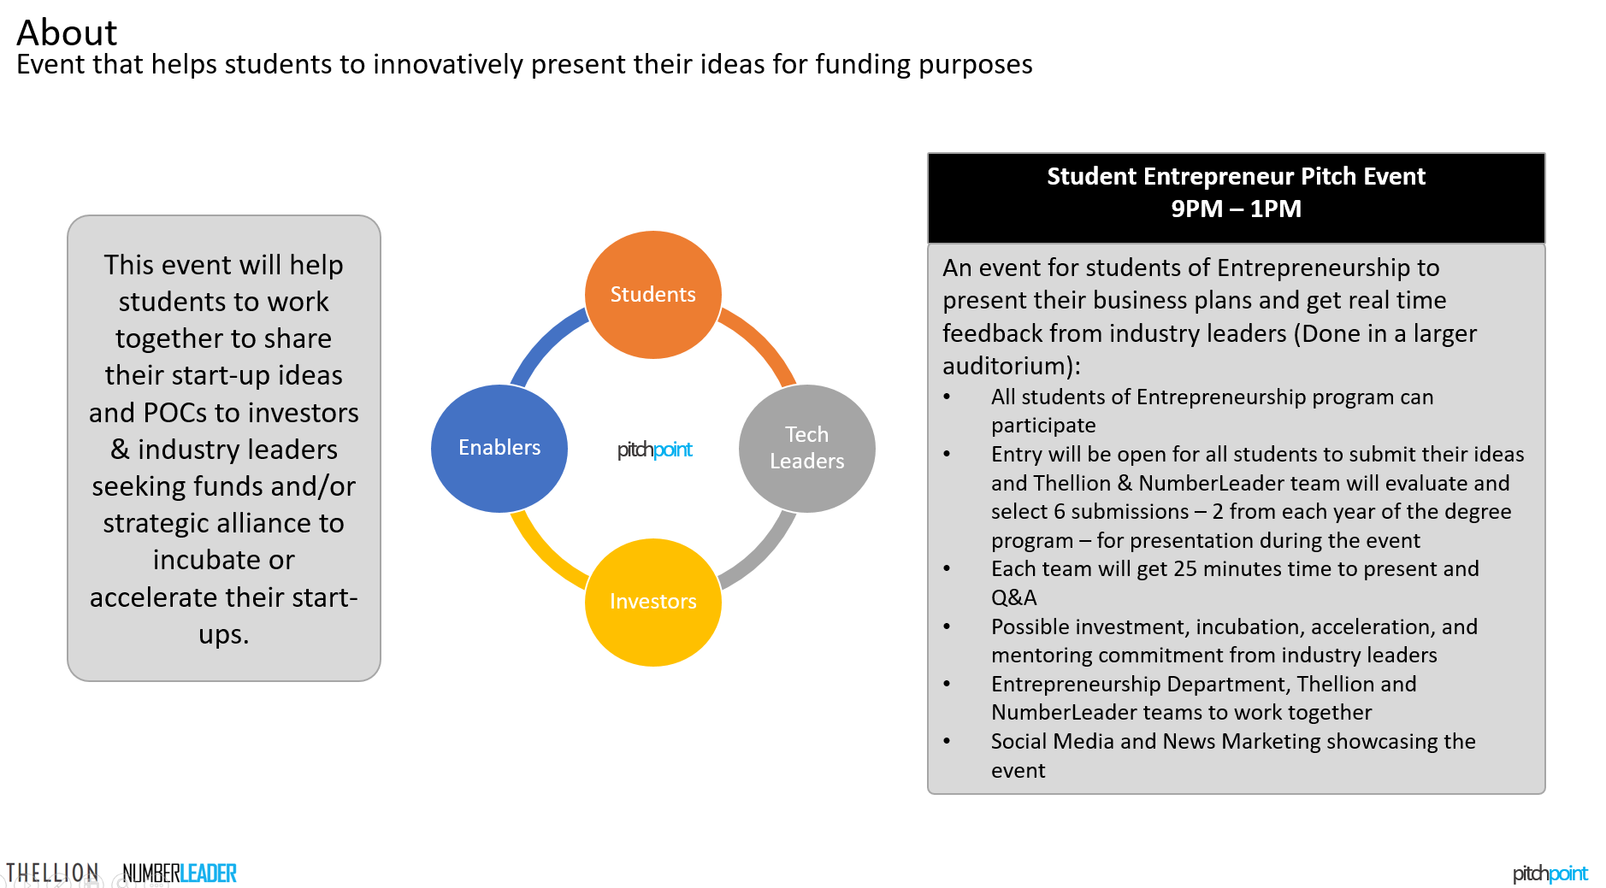
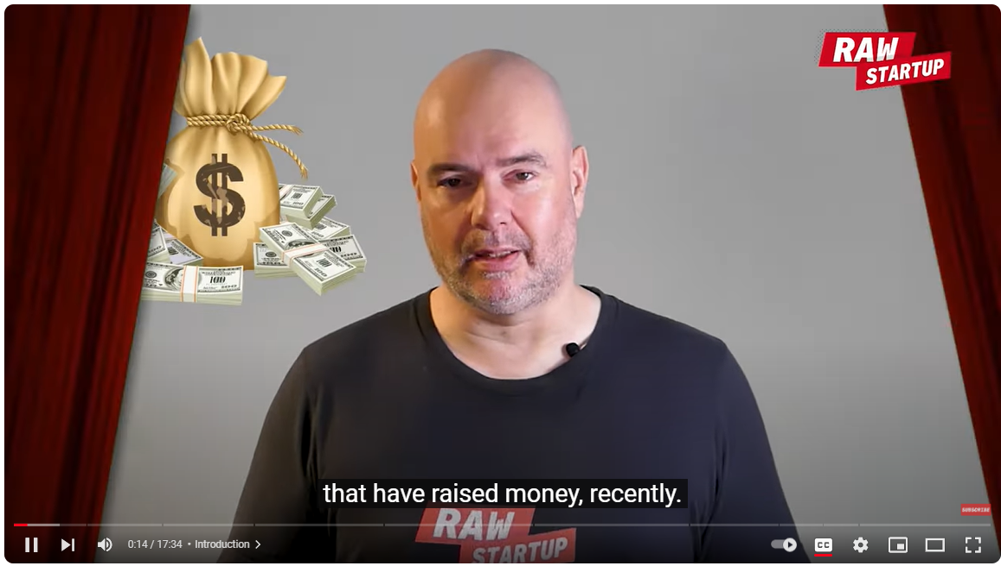
Dash Board | My Companies | Start ups | Investors | Enablers | News
Naren | Log out
+
Company 123
Profile
Corporate Finance
Due Diligence
Fund Raising
Investor Tools
Company 123 – My Companies – Primary Company or last selected company – Profile
Company
Manartha Solutions Private Limited
Basic Information
Products & Services
Pitch Presentation & Video
Business Plan & Financials
Valuation & Bench Marking Founders & Organization
Cap Table
News & Events
Company Ask
Pitch Presentation
Pitch Video
When there are no documents here, display the form in the format given below and allow the user to enter details. Plus button is disabled!
When there are already entries here, PLUS button is enabled. When they click on a + button:
Product: Product 1 / Product 2 (Pull this list from what the user has already provided in product/services list. Company name should be at the top since users can pitch their company itself which may just one product)
Type: Presentation / Video Link (These two options should let you decide what buttons or input fields you will show the user.)
The user must be able to upload either a PDF presentation or a video link pitching the Company or any product. You should provide the options based on the information already entered
+
+
Product Name
Number Leader
Pitch Presentation
Pitch Video

Slide 8
Dash Board | My Companies | Start ups | Investors | Enablers | News
Naren | Log out
+
Company 123
Profile
Corporate Finance
Due Diligence
Fund Raising
Investor Tools
Company 123 – My Companies – Primary Company or last selected company – Profile
When they click on the + button:
Product: Company / Product 1 / Product 2 (Pull this list from what the user has already provided in product/services list. Company name should be at the top since users can upload documents for their company itself which may just one product)
Type: Business Plan / Financial Statements (These two options should let you decide what buttons or input fields you will show the user.)
If Financial Statements:
Ask three options: Income Statement, Balance Sheet, Cash Flow
Period: Let them input the year of the statements
Upload OR Integrate with Zoho / Tally Prime
The user must be able to upload either a PDF presentation & MS Excel Sheets
Basic Information
Products & Services
Pitch Presentation & Video
Business Plan & Financials
Valuation & Bench Marking Founders & Organization
Cap Table
News & Events
Company Ask
Company
Manartha Solutions
Business Plan << Upload the PDF format – embed the slides >>
Financial Statements
Year 1: Link to statements
Year 2: Link to statements
<< List all the statements user has uploaded >>
+
+
Product
Number Leader
Business Plan << Upload the PDF format – embed the slides >>
Financial Statements
Year 1: Link to statements
Year 2: Link to statements
<< List all the statements user has uploaded >>

Slide 9
Dash Board | My Companies | Start ups | Investors | Enablers | News
Naren | Log out
+
Company 123
Profile
Corporate Finance
Due Diligence
Fund Raising
Investor Tools
Company 123 – My Companies – Primary Company or last selected company – Profile
Basic Information
Products & Services
Pitch Presentation & Video
Business Plan & Financials
Valuation & Bench Marking Founders & Organization
Cap Table
News & Events
Company Ask
Company
Manartha Solutions – June 2023
Current Valuation
$5,000,0000
Valuation Source / Vendor
KPMG
Valuation Date
June 2023
Valuation Documents
<< Valuation is done only on a company. Allow user to upload multiple documents here and list them all. Eventually we will provide a button to the user to use our Valuation Feature to generate the details OR show already generated valuation report here >>
Bench Marking / Market Research Documents
<< Allow user to upload bench marking documents - Eventually, this will have information from our own Bench Marking services if the user has used it OR we can provide a button to auto generate bench marking details.>>
Company
Manartha Solutions – June 2021
Current Valuation
$3,000,0000
Valuation Source / Vendor
KPMG
Valuation Date
June 2023
Valuation Documents
<< Valuation is done only on a company. Allow user to upload multiple documents here and list them all. Eventually we will provide a button to the user to use our Valuation Feature to generate the details OR show already generated valuation report here >>
Bench Marking / Market Research Documents
<< Allow user to upload bench marking documents - Eventually, this will have information from our own Bench Marking services if the user has used it OR we can provide a button to auto generate bench marking details.>>

Slide 10

Dash Board | My Companies | Start ups | Investors | Enablers | News
Naren | Log out
+
Company 123
Profile
Corporate Finance
Due Diligence
Fund Raising
Investor Tools
Company 123 – My Companies – Primary Company or last selected company – Profile
Basic Information
Products & Services
Pitch Presentation & Video
Business Plan & Financials
Valuation & Bench Marking Founders & Organization
Cap Table
News & Events
Company Ask
Name: Nitish Kashyap
Title: Founder & CEO
Date Joined: 1st August, 2020
LinkedIn: www.linked.com/nitish
Profile:
Nitish is the founder of Manartha Solutions and has a passion for virtualizing CFO functions and services to make things easier for start ups and investors.
Name: Naren Narayana
Title: Co Founder & CTO
Date Joined: 1st August, 2023
LinkedIn: www.linked.com/naren
Profile:
Nitish is the founder of Manartha Solutions and has a passion for virtualizing CFO functions and services to make things easier for start ups and investors.
Name: Nitish Kashyap
Title: Founder & CEO
Date Joined: 1st August, 2020
LinkedIn: www.linked.com/nitish
Profile:
Nitish is the founder of Manartha Solutions and has a passion for virtualizing CFO functions and services to make things easier for start ups and investors.
Name: Naren Narayana
Title: Co Founder & CTO
Date Joined: 1st August, 2023
LinkedIn: www.linked.com/naren
Profile:
Nitish is the founder of Manartha Solutions and has a passion for virtualizing CFO functions and services to make things easier for start ups and investors.

Slide 11
Dash Board | My Companies | Start ups | Investors | Enablers | News
Naren | Log out
+
Company 123
Profile
Corporate Finance
Due Diligence
Fund Raising
Investor Tools
Company 123 – My Companies – Primary Company or last selected company – Profile
When the user clicks on + button, show the form to request the following information
Shareholder:
Founder
Executive
Investor
Incubator
Accelerator
Government
Other
Name:
Naren Narayana
Equity Share:
Equity %
Invested Since
Inception / Pre Seed / Seed / Series A / Series B / Series C / Others
Investment Amount:
$100,000
Valuation:
$100,000
Details:
Explain details with additional information
Basic Information
Products & Services
Pitch Presentation & Video
Business Plan & Financials
Valuation & Bench Marking Founders & Organization
Cap Table
News & Events
Company Ask
Shareholder | Name | Equity Share | Invested Since | Investment Amount | Valuation | Details
Founder | Nitish Kashyap | XX% |  |  |  | Founder owner & CEO
Founder | Naren Narayana | XX% |  |  |  | Help us with business decisions and planning
Mentor | TBD | XX% |  |  |  | Be out mentor every step of the way
Investor | XXX Ventures | XX% | $100,0000 |  |  | Invested in 2024 at valuation of $500,000
Investor | ZZZ Capital Investors | Xx% |  |  |  | Invested in 2023 at a valuation of $200,000

Slide 12
Dash Board | My Companies | Start ups | Investors | Enablers | News
Naren | Log out
+
Company 123
Profile
Corporate Finance
Due Diligence
Fund Raising
Investor Tools
Company 123 – My Companies – Primary Company or last selected company – Profile
Basic Information
Products & Services
Pitch Presentation & Video
Business Plan & Financials
Valuation & Bench Marking Founders & Organization
Cap Table
News & Events
Company Ask
Allow user to add LINKS to the news / events related to the company
Date: 6th July 2024
Brief Summary:
Thellion & Number Leader Partner with Thellion to conduct PitchPoint event bringing in students, start ups, and investors together
Link: www.Thellion.com
Date: 6th July 2024
Brief Summary:
Thellion & Number Leader Partner with Thellion to conduct PitchPoint event bringing in students, start ups, and investors together
Link: www.Thellion.com
Date: 6th July 2024
Brief Summary:
Thellion & Number Leader Partner with Thellion to conduct PitchPoint event bringing in students, start ups, and investors together
Link: www.Thellion.com
Date: 6th July 2024
Brief Summary:
Thellion & Number Leader Partner with Thellion to conduct PitchPoint event bringing in students, start ups, and investors together
Link: www.Thellion.com

Slide 13
Dash Board | My Companies | Start ups | Investors | Enablers | News
Naren | Log out
+
Company 123
Profile
Corporate Finance
Due Diligence
Fund Raising
Investor Tools
Company 123 – My Companies – Primary Company or last selected company – Profile
Basic Information
Products & Services
Pitch Presentation & Video
Business Plan & Financials
Valuation & Bench Marking Founders & Organization
Cap Table
News & Events
Company Ask
Current Valuation:
$400,000 (Pull this from other sources where user has already entered)
When the user clicks on + button, show the form to request the following information
Ask:
Funds
Mentorship
Business Strategy
Product Strategy
Technology Strategy
Marketing Strategy
Sales Strategy
Organizational Strategy
Other
Value:
$100,000
For Equity:
Equity %
Details:
Explain details with additional information
Ask | Value | Equity Share | Details
Funds | $100,000 | 25% | To be used for marketing costs, hiring new talent
Business Strategy | - | 2% | Help us with business decisions and planning
Mentor | - | 3% | Be out mentor every step of the way

Slide 14
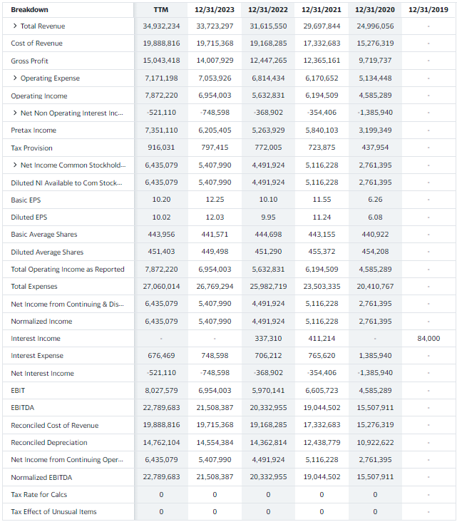
Dash Board | My Companies | Start ups | Investors | Enablers | News
Naren | Log out
+
Company 123
Profile
Corporate Finance
Planning & Budgeting
Income Statement
Balance Sheet
Cash Flow Statement
Forecasting
Income Statement
Balance Sheet
Cash Flow Statement
Industry Benchmarking
Business Modelling & Valuation
Due Diligence
Fund Raising
Investor Tools
Corporate Finance – Planning & Budgeting – Income Statement
Requirements:
The side bar must show all the links
When clicked: The page must display Income Statement (all editable entries as well as calculable ones in the format mention to the left)
7 additional columns must be shown to display any planned or empty data
Additional columns must show the planned & budgeted numbers. If there is nothing, leave it empty
Any empty column when clicked must become editable and use should be able to enter details including the period.
Column heading must specify the period (In the example to the left – annual data end date is shown but we should show the date range)
Option to add monthly data, quarterly data or annual data. Months to group under quarters and quarters to group under years. Grouping is not just collapsing, it is creating subtotals too.
If the user has more planned data – the columns must be horizontally scrollable or next 6 columns link should load more information or the previous six columns. You can also do this one column at a time.
The plus button at the right side is to add new Income Statement
While adding a new statement, user must be given an option to import existing audited statement to the table which shouldn’t be allowed to edit. This is done to give the user a reference to plan and budget new statements!
These requirements are same for other financial statements as well – Balance Sheet and Cash Flow Statement

Slide 15
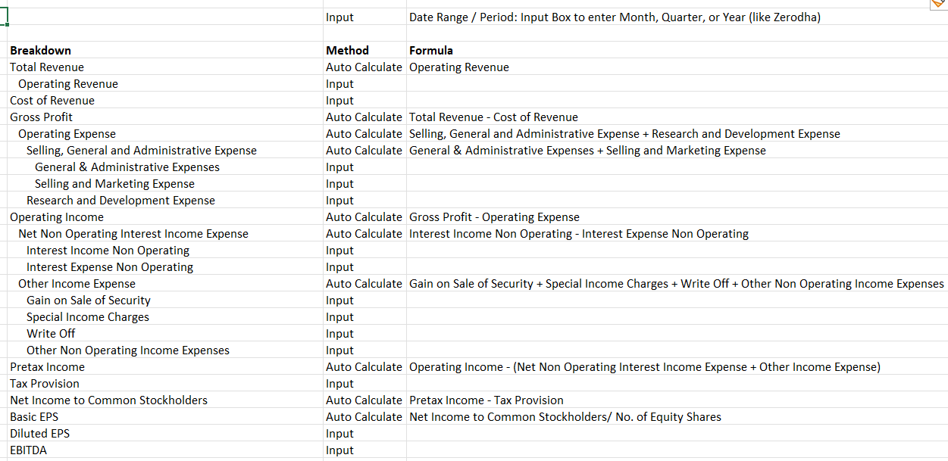
Dash Board | My Companies | Start ups | Investors | Enablers | News
Naren | Log out
Company 123
Profile
Corporate Finance
Planning & Budgeting
Income Statement
Balance Sheet
Cash Flow Statement
Forecasting
Income Statement
Balance Sheet
Cash Flow Statement
Industry Benchmarking
Business Modelling & Valuation
Due Diligence
Fund Raising
Investor Tools
Corporate Finance – Planning & Budgeting – Income Statement
SAVE / EDIT / DELETE
Notes:
When a user clicks on a particular period in statements page, he/she comes to this page in edit mode. User can delete / edit / save a statement in this page
This is the EDIT page to add an Income Statement
Allow use to select currency
Save button will save the details.

Slide 16
Dash Board | My Companies | Start ups | Investors | Enablers | News
Naren | Log out
+
Company 123
Profile
Corporate Finance
Planning & Budgeting
Income Statement
Balance Sheet
Cash Flow Statement
Forecasting
Income Statement
Balance Sheet
Cash Flow Statement
Industry Benchmarking
Business Modelling & Valuation
Due Diligence
Fund Raising
Investor Tools
Corporate Finance – Planning & Budgeting – Income Statement
Past Statements (Drop down of years):
Planned & Budgeted Statements (drop down of recent periods):
Requirements:
The side bar must show all the links
By default show the last forecasted numbers to start with. If nothing exists, pull the latest annual statement or planned statement with empty columns for the user to forecast. If there is no data at all, show empty tables with a + button in the middle to initiate forecasting where user must start from period 0 entering the data. In this case, ask the user to either create at least 1 Planning & Budgeting OR pull the data from an integrated tool. Forecasting can’t happen unless there is past data or planned data. User must select ONE from past or planned statement to initiate forecasting! He can select either of them.
Past Statements: Drop down menu of years. When select a year, show information pulled from government database or a tool that the user has integrated with. If the user selects previous year, show actuals from previous years and add empty columns for the user to forecast.
Planned & Budgeted Statements: Drop down of recent periods. When clicked on a certain period, pull information from the local database. If the user selects latest period, add 7 empty columns to forecast with similar period.
Editable fields must take % increase or decrease (this must automatically change the value) or actual value changed (this must automatically change % compared to previous period value) to forecast numbers for each year.
Allow user to save these details in separate DB tables.
These requirements are same for other financial statements as well – Balance Sheet and Cash Flow Statement

Slide 17
Dash Board | My Companies | Start ups | Investors | Enablers | News
Naren | Log out
Company 123
Profile
Corporate Finance
Planning & Budgeting
Income Statement
Balance Sheet
Cash Flow Statement
Forecasting
Income Statement
Balance Sheet
Cash Flow Statement
Industry Benchmarking
Business Modelling & Valuation
Due Diligence
Fund Raising
Investor Tools
Corporate Finance – Planning & Budgeting – Income Statement
Past Statements (Drop down of years):
SAVE / EDIT / DELETE
Planned & Budgeted Statements (drop down of recent periods):
Preselected Data | % | Period+1 | % | Period+2 | % | Period+3 | % | Period+4 | % | Period+5 | Definition
Notes:
User must have at least ONE past statement or planned & Budgeted statement to initiate forecasting.
If there is already forecasted data for a particular period, user must display those numbers
User must be able to edit, save, delete the forecasted statement in this page
User can select one of past statements or planned & budgeted statements
% indicates change from the selected period. What ever user enters in period one get automatically filled into subsequent columns as well in that row (Example: If user enter 8% increase in Period+1, same increase is entered in all revenue rows for all periods. User can change this % for subsequent years
% input is allowed only for those fields that need input, rest are automatically calculated.
Phase 1: only % fields are input fields, the Period+1… numbers are auto-calculated.

Slide 18
Dash Board | My Companies | Start ups | Investors | Enablers | News
Naren | Log out
Company 123
Profile
Corporate Finance
Planning & Budgeting
Income Statement
Balance Sheet
Cash Flow Statement
Forecasting
Income Statement
Balance Sheet
Cash Flow Statement
Industry Benchmarking
Business Modelling & Valuation
Due Diligence
Fund Raising
Investor Tools
Company 123 – Start ups
Start up Favourites:
Company 1
Company 2
Company 3
Company 4
Select an industry:
By default we should list the companies in the industry that the user has selected the company in My Companies:
Company 1
Company 2
Company 3
Company 4
Default Page Requirements:
Side bar should show own company details
When the user clicks on Start Ups link in the head board, it should take the user to our start up world of database where we have public information of start ups from different sources (member start ups, those pulled govt. databases – TBD to see if we can pull and display the information, and public company information
When the user clicks on a company, we should change the SIDE BAR with start up related information links (TBD)
The SIDE BAR links must show all public information of the company that has been selected

Slide 19
Dash Board | My Companies | Start ups | Investors | Enablers | News
Naren | Log out
Start up Select 123
Profile
Products & Services
Founders & Team
Pitch Video
Pitch Presentation
Business Plan
Financials
Valuation
Bench Marking
Challenges
News
Contact / Reach
Start ups – Company 123
Start up Favourites:
Company 1
Company 2
Company 3
Company 4
Select an industry:
By default we should list the companies in the industry that the user has selected the company in My Companies:
Company 1
Company 2
Company 3
Company 4
Default Page Requirements:
Start up page for any selected start up must show all information about that company for others to evaluate – especially the investors and enablers. The information shown can be controlled based on whether the user is another start up or an investor or an enabler. Other start ups / enablers don’t have to see Business Plan, Financials, Valuation details. Investors must be able to see these crucial information
Some information can be bought such as business plan, financials, valuation, bench marking. When a user clicks on these links, we take them to payment page!
When the user clicks on Start Ups link in the head board, it should take the user to our start up world of database where we have public information of start ups from different sources (member start ups, those pulled govt. databases – TBD to see if we can pull and display the information, and public company information
When the user clicks on a company, we should change the SIDE BAR with start up related information links (TBD)
The SIDE BAR links must show all public information of the company that has been selected

Slide 20
Dash Board | My Companies | Start ups | Investors | Enablers | News
Naren | Log out
Investor 123
Profile
Products & Services
Founders & Team
Pitch Video
Pitch Presentation
Portfolio
Exits
News
Contact / Reach
Start ups – Company 123
Investor Favourites:
Investor 1
Investor 2
Investor 3
Investor 4
Select an industry:
By default we should list the companies in the industry that the user has selected the company in My Companies:
Investor 1
Investor 2
Investor 3
Investor 4
Default Page Requirements:
Start up page for any selected start up must show all information about that company for others to evaluate – especially the investors and enablers. The information shown can be controlled based on whether the user is another start up or an investor or an enabler. Other start ups / enablers don’t have to see Business Plan, Financials, Valuation details. Investors must be able to see these crucial information
Some information can be bought such as financials, valuation, bench marking. When a user clicks on these links, we take them to payment page!
When the user clicks on Start Ups link in the head board, it should take the user to our start up world of database where we have public information of start ups from different sources (member start ups, those pulled govt. databases – TBD to see if we can pull and display the information, and public company information
When the user clicks on a company, we should change the SIDE BAR with start up related information links (TBD)
The SIDE BAR links must show all public information of the company that has been selected

Slide 21
Dash Board | My Companies | Start ups | Investors | Enablers | News
Naren | Log out
Company 123
Profile
Products & Services
Founders & Team
Pitch Video
Pitch Presentation
Portfolio
News
Contact / Reach
Start ups – Company 123
Enabler Favourites:
Enabler 1
Enabler 2
Enabler 3
Enabler 4
Select an industry:
By default we should list the companies in the industry that the user has selected the company in My Companies:
Enabler 1
Enabler 2
Enabler 3
Enabler 4
Default Page Requirements:
Start up page for any selected start up must show all information about that company for others to evaluate – especially the investors and enablers. The information shown can be controlled based on whether the user is another start up or an investor or an enabler. Other start ups / enablers don’t have to see Business Plan, Financials, Valuation details. Investors must be able to see these crucial information
Some information can be bought such as financials, valuation, bench marking. When a user clicks on these links, we take them to payment page!
When the user clicks on Start Ups link in the head board, it should take the user to our start up world of database where we have public information of start ups from different sources (member start ups, those pulled govt. databases – TBD to see if we can pull and display the information, and public company information
When the user clicks on a company, we should change the SIDE BAR with start up related information links (TBD)
The SIDE BAR links must show all public information of the company that has been selected

Slide 22
Dash Board | My Companies | Start ups | Investors | Enablers | News
Naren | Log out
News
Start up News
Investor News
Industry News
Technology News
Link 1
Link 2
Start up News
Pull news links from various sources

