Slide 1

T20 World Cup Score Prediction
A CRISP-ML(Q) based Model
By : Rahul Janjirala

Slide 2
About me
Background:
Academic Qualification: B.Tech
Motivation for Learning Data Science:
Fascination with uncovering insights from data
Excitement about problem-solving and innovation in the field
Work Experience:
Status: Fresher
Data Science Intern at Innomatics Research Labs
Profile Links:
GitHub: https://github.com/Rahuljanji
LinkedIn: https://www.linkedin.com/in/rahuljanjirala/

Slide 3
Contents
Introduction
Business Problem
Objective and Proposed Solution
Expected Outcome
About the Data
Data Preprocessing
Feature Engineering
Deployment
Output
Conclusion

Slide 4
Introduction
The T20 World Cup is the premier international tournament for the exciting, fast-paced format of cricket known as Twenty20 (T20). Here's a quick rundown:
Action-Packed Cricket: Matches are short and explosive, typically lasting around 3 hours, with each team batting for just 20 overs (120 balls). This format prioritizes big hitting, quick bowling, and athletic fielding, making for thrilling and unpredictable matches.
International Competition: The T20 World Cup brings together the top national cricket teams from around the world. It's a chance to see the best players battle it out for the ultimate prize – being crowned World Champion.

Slide 5
CRISP-ML(Q)
Cross-Industry Standard Process model for Machine Learning
1. Business Understanding & Data Understanding
2 . Data Preparation
3 . Model Building
4 . Model Evaluation
5 . Model Deployment
6 . Monitoring and maintainance

Slide 6
Business Problem
Machine Learning for T20 World Cup Cricket Score Prediction
While predicting exact scores in cricket matches is incredibly challenging, you can definitely build a machine learning model to forecast match outcomes or score ranges for the T20 World Cup.
Goal: Predict the outcome of T20 World Cup matches score ranges for each team.

Slide 7
Objective
The objective in this scenario is to build a machine learning model that can predict the outcome of T20 World Cup cricket matches.
By analyzing historical data about teams, players, and match conditions, the model can learn patterns and use them to make predictions for upcoming matches. It's important to remember that cricket has inherent uncertainties, so the goal is to provide informed predictions rather than guaranteed outcomes.
Proposed Solution
We'll use machine learning tricks to analyse lots of cricket data and build a smart score prediction. It will learn from previous match datasets.

Slide 8
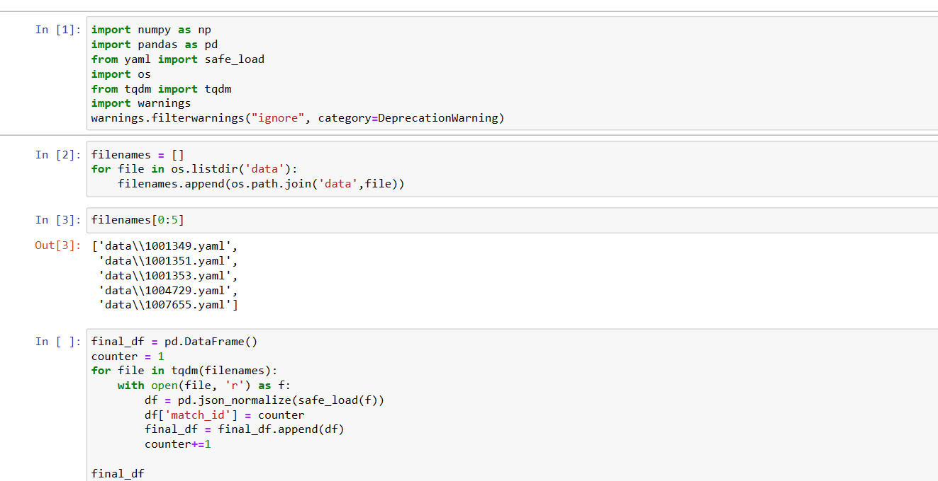
Load the Data
Transformed raw YAML files, extracted from Kaggle, into a structured format CSV using coding techniques. This process likely involved parsing the YAML data, extracting relevant information, and converting it into a tabular format compatible with CSV.

Slide 9
Data Preprocessing
To enhance the clarity and usability of your dataset, which initially comprised 1432 rows and 28 columns and seemed imbalanced and unclear, you employed data preprocessing techniques. This involved a series of steps aimed at cleaning, transforming, and organizing the data to make it more structured and understandable. Through these preprocessing techniques, you refined the dataset, making it more suitable for analysis, modeling, and interpretation.
DATA PREPROCESSING TECHNIQUES THAT I USED :
Missing Values - Discreatization
Type casting - Transformation
Outliers
Duplicates
Encoding/Dummy Variable Creation
Scaling

Slide 10
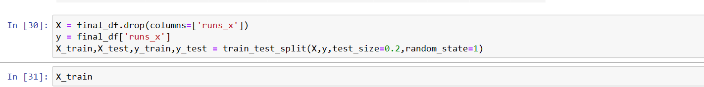
Model Building
After Data Preprocessing My .csv file has 30768 rows and 8 columns
To prevent data leakage and ensure the integrity of our analysis, we first partitioned the dataset into distinct subsets. This separation allowed us to maintain a clear distinction between our training and testing data, avoiding any inadvertent contamination of information between the two.
Using train test split , Split the data into Input fefatures and Output Features.

Slide 11
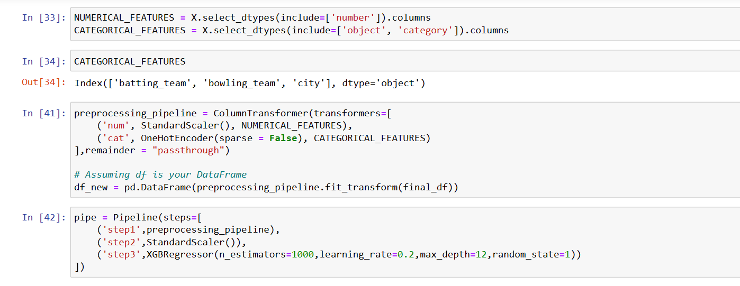
Model Building
XGBoost
This project focuses on supervised machine learning, specifically regression modeling. For this purpose, we employ XGBoost (Extreme Gradient Boosting), a widely used machine learning library renowned for its effectiveness in gradient boosting trees. In regression tasks, XGBoost serves as a powerful regressor, particularly suited for structured or tabular data. Its speed and performance make it a preferred choice for predictive modeling tasks, ensuring accurate and efficient analysis of the dataset at hand.

Slide 12
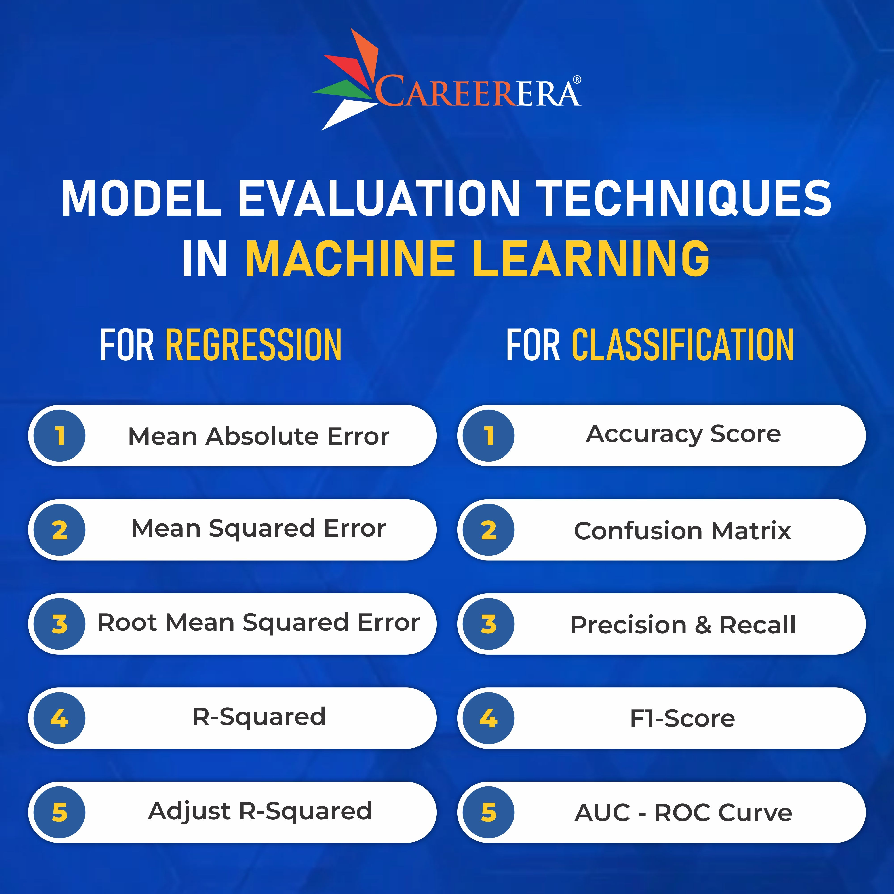
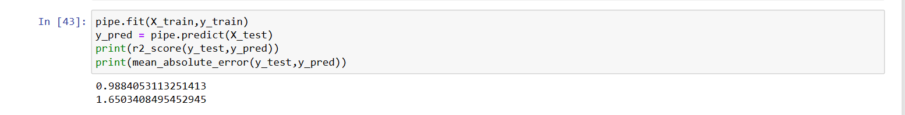
Model Evaluation
As my project is related to regression technique I used r2 score and mean absolute error.
When r2 score increases then the accuracy increases , when the accuracy increases then it will be give a good model.

Slide 13
Model Deployment
Hosting the application in the production so that end user can use our application to predict the unseen or future data.
Using Local based deployment frameworks I deployed using Stream lit ,we can also use Flask or Fast API .
Stream lit is an open-source Python library that simplifies the process of creating web applications for machine learning and data science projects. It allows developers to quickly build interactive and customizable web interfaces directly from their Python scripts, without the need for web development expertise.

Slide 14
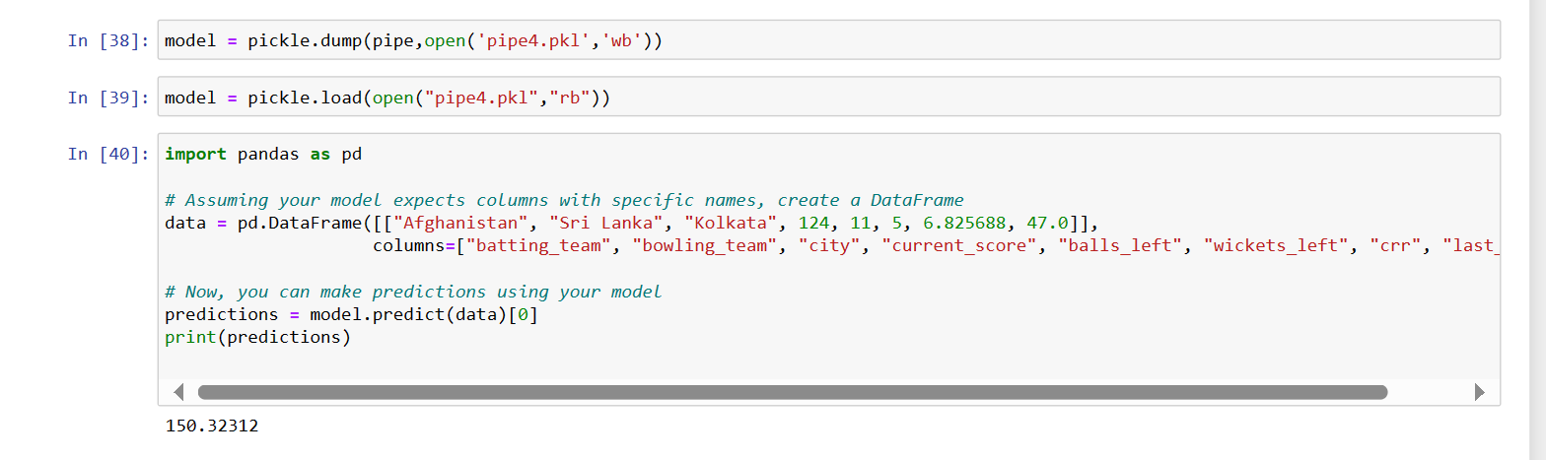
Model Deployment
Deployment: Stream lit provides built-in support for deploying web applications to various platforms, including Streamlit Sharing, Heroku, and AWS. This makes it easy to share your machine learning projects with colleagues, clients, or the wider community.

Slide 15

Output

Slide 16
Conclusion
After training and evaluating various machine learning models on historical T20 cricket match data, we have developed a predictive model capable of forecasting the scores of T20 World Cup matches with reasonable accuracy. By leveraging features such as team performance, player statistics, match venue, and historical match outcomes, our model demonstrates the potential to provide valuable insights into the expected scores of upcoming T20 World Cup matches.
Through rigorous testing and validation, we have observed that our model performs well across different test datasets, indicating its robustness and generalization capability. While no model is perfect, and there are inherent uncertainties in predicting cricket scores due to the dynamic nature of the sport, our model serves as a useful tool for estimating the likely scores of T20 World Cup matches and informing strategic decisions for teams, broadcasters, and cricket enthusiasts.

Slide 17



