Slide 1

E Commerce company or DTH
Problem statement:-An E Commerce company or DTH (you can choose either of these two domains) provider is facing a lot of competition in the current market and it has become a challenge to retain the existing customers in the current situation. Hence, the company wants to develop a model through which they can do churn prediction of the accounts and provide segmented offers to the potential churners. In this company, account churn is a major thing because 1 account can have multiple customers. hence by losing one account the company might be losing more than one customer. You have been assigned to develop a churn prediction model for this company and provide business recommendations on the campaign. Your campaign suggestion should be unique and be very clear on the campaign offer because your recommendation will go through the revenue assurance team. If they find that you are giving a lot of free (or subsidized) stuff thereby making a loss to the company; they are not going to approve your recommendation. Hence be very careful while providing campaign recommendation .

Slide 2
Variable | Description
AccountID | account unique identifier
Churn | account churn flag (Target)
Tenure | Tenure of account
City_Tier | Tier of primary customer's city
CC_Contacted_L12m | How many times all the customers of the account has contacted customer care in last 12months
Payment | Preferred Payment mode of the customers in the account
Gender | Gender of the primary customer of the account
Service_Score | Satisfaction score given by customers of the account on service provided by company
Account_user_count | Number of customers tagged with this account
account_segment | Account segmentation on the basis of spend
CC_Agent_Score | Satisfaction score given by customers of the account on customer care service provided by company
Marital_Status | Marital status of the primary customer of the account
rev_per_month | Monthly average revenue generated by account in last 12 months
Complain_l12m | Any complaints has been raised by account in last 12 months
rev_growth_yoy | revenue growth percentage of the account (last 12 months vs last 24 to 13 month)
coupon_used_l12m | How many times customers have used coupons to do the payment in last 12 months
Day_Since_CC_connect | Number of days since no customers in the account has contacted the customer care
cashback_l12m | Monthly average cashback generated by account in last 12 months
Login_device | Preferred login device of the customers in the account
Data Description
There is always an event that serves as the trigger that urges you to start analysing churn. For example, you might see a sudden jump in your churn rate in a given month, or perhaps your churn has been on a gradual increase for the past 8-9 months. These are indications of red flags, which means that you need to dig in a little deeper to find out what’s happening with your data. The trigger doesn’t necessarily have to be negative. For instance, you might have just rolled out a product on boarding email series for a couple of new customers a few weeks ago, and you wish to see if it had any impact on your churn rate. This also falls under the purview of Churn Analysis. It is suggested that you should turn to Churn Analysis whenever you notice something out of the ordinary, irrespective of whether that is good or bad or if you can make a change that could potentially impact churn.

Slide 3
Constraints
1.How Customer Churn Can be Defined for E-commerce or DTH company?
2.What features can be utilized in order to build a predictive model for customer churn in E-commerce or DTH company?
3.What are the remedies for data imbalance in churn data sets?
4.Market Competition
5.Social media presence or following
6.Any negative feedback /dissatisfaction from customer

Slide 4
Modelling Approach used & why
The purpose of this whole exercise is to explore the dataset. Do the exploratory data analysis. Explore the dataset and analysis of An E-Commerce Company or DTH, the company wants to develop a model through which they can do churn prediction of the accounts and provide segmented offers to the potential churners. We are using the best module to find religion for customer churn.
Customer Churn is very expensive for any business or organization. A high Churn Rate requires a company to deal with the stress of doubling down to bring in new customers; just to stay afloat. Even a minuscule single-digit increase in the Churn Rate can seriously impede a company’s growth rate and what’s worse is that high Churn Rates are more likely to compound over time.
This is necessary for every organization to retain their customer to sustain in the market. Customer Churn can lead to financial loss and so we need to study this project.
Expose Product Weaknesses: Churn Analysis plays a crucial role in revealing the patterns that indicate the common motivators for customers to part ways with your company. These could be anything from price productivity to poor product adoption. It is also instrumental in demonstrating the exact way customers engage with your product throughout their lifecycle. You can use this to maximize what your customers already love, and improve upon everything they don’t.
Unearth Customer Opportunities: Customer experience improvement comes with a need to understand the customer requirements and expectations at every stage of their journey and moulding your product accordingly. Churn Analysis depicts trends in customer behaviour at every touch point. Personalized engagement preferred by your customers allows you to make your customers feel valued and appreciated.

Slide 5
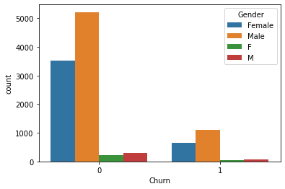
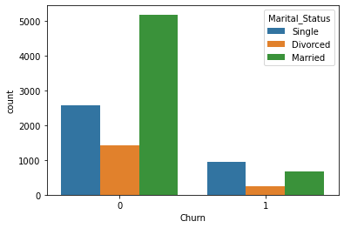
Churn ratio Gender & Marital
1.Male -6328,Female-4178,M-376,F-270 rung entry so name are change where using Male & M are similar and Female and F are similar.
2. Total no of customer churn Male=6328+376=6704
3.Total no of customer churn Female=4178+270=4448
2.Type of customer churn Marital Status (Married=5860,Single=3520,Divorced=1668)

Slide 6
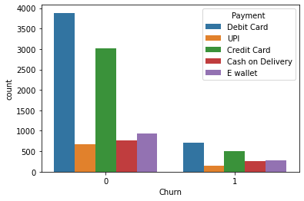
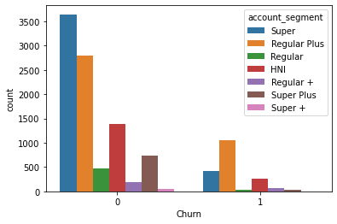
Customer Bank account using & DTH customer account type
Customer payment mode Debit Card user customer no higher use then Credit Card user .
E DTH company offer are plan Super ,Regular plus both plan churn count higher .

Slide 7
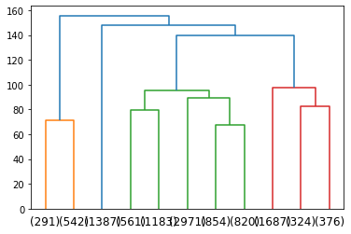

Using clustering K-Mean:-
Create clusters denoted in three number 1,2,3.

Slide 8
Model building and interpretation
We have prepared the following model procedures to Analyze and review the dataset and get the performance and importance of the features available on the dataset to gather more information about the subjects. Following is the list of model building procedures that can be used in this project -
Logistics Regression (2) Decision Tree (3) Random Forest (4) Linear Discriminant Analysis (5) K Nearest Neighbours (6) Naive Bayes (7) Gradient Boosting (8) Extreme Gradient Boosting
For every model building procure, we have gone through the following steps to get outputs generated by the algorithm –
(a) Model Prediction
(b) Model Performance
(c) ROC-AUC Graph
(d) Model Performance Metrics

Slide 9
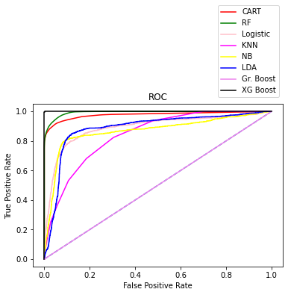
Train all model
These prediction all Train Eight models need to achieve high AUC values. the sample data is divided into 70% for training and 30% for testing. We have applied feature engineering, effective feature transformation and selection approach to make the features ready for machine learning algorithms. Best XG Boost ,RF & CART AUC curve are best shown in campier all models .

Slide 10
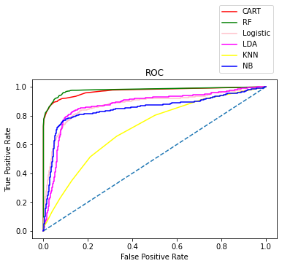
Test all model
These prediction all Test six models need to achieve high AUC values. the sample data is divided into 70% for training and 30% for testing. We have applied feature engineering, effective feature transformation and selection approach to make the features ready for machine learning algorithms. Best Model RF & CART AUC curve are best shown in campier all models .

Slide 11
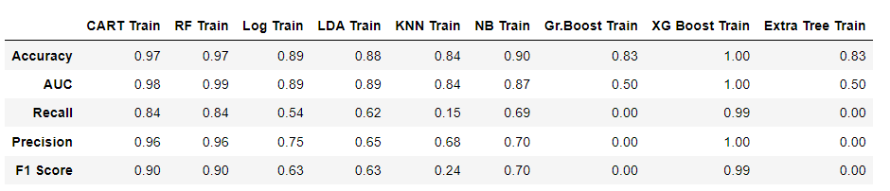
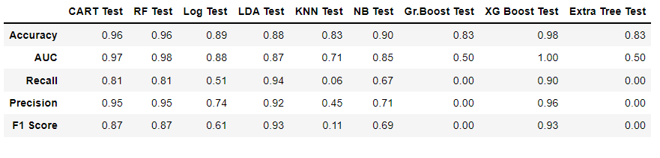
Modal Performance
Train
Test
These algorithms are Logistics Regression, Decision Tree, Random Forest, Linear Discriminant Analysis, K Nearest Neighbours, Naive Bayes, Gradient Boosting, Extreme Gradient Boosting, and Extra Tree Classifier. The method of preparation and selection of features and entering the EDTH features had the biggest impact on the success of this model since the value of AUC reached 96.0%. Random Forest & CART model achieved the best results in all measurements. The AUC value was 96.0%. The comes in second place and the LDA & KNN and Decision Tree came third and fourth regarding AUC values. We have evaluated the models by fitting a new dataset related to different periods and without any proactive action from marketing, RF also gave the best result with 96.0% AUC. The decrease in result could be due to the non-stationary data model phenomenon, so the model needs training each period of time.

Slide 12
Insights from Analysis
What we have understood from assessing the tenure that there are quiet a lot of customers are new to the
platform. This is a good opportunity for the company to bring in new strategies and work upon increasing the
customer retention .
>The people that have contacting the customer care is high.
>The number of times CC have been contacted by a single account is high as 132, this is alarming high.
>We have noted that comparatively 3 to 4 users per account is higher in number. This is helping us to understand
that the products and the offers we need to plan to offer should be crafted keeping in mind that it is a for wider
age distribution.
>Better offers around less priced subscription plan will help us to retain new customers, increase customer numbers
The lower priced subscription plans are more favoured by the customers.
>The revenue growth yoy is seeming bright with mean and median around 15%.

Slide 13
Recommendations
We can suggest management to segment customers based on ‘City-Tiers’.
The reasons for this suggestion are :
a. Clear demographic divide
b. Very distinct behaviour within each tier across multiple parameters.
c. Each tier can be approached with local and custom offers.
d. Marketing can be done both on online and offline platform across clearly defined tiers.

Slide 14
Thanks

