Slide 1

Dr Mahalingam College of Engineering & Technology
Department of Artificial Intelligence and Data Science 19ADPN6401 Project
Team Number: 23BADA019
Domain: Data Science
Guide : Dr.M.Balakrishnan, ASP/AI&DS
Title : Pancreatic Cancer detection
Team Members: Rahul Kannan P (21BAD020)
Akash K(21BAD054)
Aravindh R (21BAD036)

Slide 2
Contents
Problem description(domain)
Findings of Literature survey
Objective
Existing System Block Diagram
Drawback
List of Modules and detailed Module description
Results
Conclusion
Snapshots
Online Course / Publication Details
References

Slide 3
PROBLEM DESCRIPTION
Pancreatic cancer is a type of cancer that affects the pancreas, an organ in the abdomen that helps regulate blood sugar levels and digestive function. It is one of the most deadly forms of cancer, with a five-year survival rate of just 9%.
Early detection of pancreatic cancer is crucial for improving patient outcomes, as treatment options are more effective when the cancer is detected at an early stage.
Symptoms of pancreatic cancer can include abdominal pain, jaundice, weight loss, and changes in blood sugar levels.

Slide 4
Literature Identified and Findings

Slide 5
1. PCA(Principal Component Analysis)
Principal component analysis (PCA) is the process of computing the principal components and using them to perform a change of basis on the data, sometimes using only the first few principal components and ignoring the rest.
PCA helps in dimensionality reduction of the dataset

Slide 6
2. ROC Curve
An ROC curve (receiver operating characteristic curve) is a graph showing the performance of a classification model at all classification thresholds.
This curve plots two parameters:
True Positive Rate
False Positive Rate
It works best for balanced data

Slide 7
3. F1 score
F1 score is a Machine Learning evaluation metric that measures a model’s accuracy. It combines the precision and recall scores of a model.
The accuracy metric computes how many times a model made a correct prediction across the entire dataset. This can be a reliable metric only if the dataset is class-balanced; that is, each class of the dataset has the same number of samples.

Slide 8
4. Decision Tree Algorithm
Decision Tree is a Supervised learning technique that can be used for both classification and Regression problems, but mostly it is preferred for solving Classification problems. It is a tree-structured classifier, where internal nodes represent the features of a dataset, branches represent the decision rules and each leaf node represents the outcome.
In a Decision tree, there are two nodes, which are the Decision Node and Leaf Node. Decision nodes are used to make any decision and have multiple branches, whereas Leaf nodes are the output of those decisions and do not contain any further branches.

Slide 9
OBJECTIVE
The main objective in this dataset is predicting diagnosis, and more specifically, differentiating between 3 (pancreatic cancer) versus 2 (non-cancerous pancreas condition) and 1 (healthy). The dataset includes information on stage of pancreatic cancer, and diagnosis for non-cancerous patients, but remember—these won't be available to a predictive model. The goal, after all, is to predict the presence of disease before it's diagnosed, not after!

Slide 10
EXISTING SYSTEM BLOCK DIAGRAM
Data preprocessing
Process for removing null value in data
Redundant data is removed
Reading the data
Removal of excess column for avoiding overfitting
Feature engineering for increase correlation
Checking for correlation
Scaling the training data using standardization
Model preparation
Prediction with test data
Importing DesionTree classifier
Fit and transform data
For better accuracy repeat process 5
Checking for accuracy of model

Slide 11
DRAWBACKS OF EXISTING SYSTEM
Lack of symptoms: In the early stages of pancreatic cancer, there are often no obvious symptoms. As a result, the cancer may go undetected until it has already spread to other parts of the body.
Non-specific symptoms: When symptoms do appear, they can be vague and non-specific, such as abdominal pain, back pain, and fatigue. These symptoms can also be associated with other conditions, which can make it difficult to diagnose pancreatic cancer.

Slide 12
DRAWBACKS OF EXISTING SYSTEM
Lack of reliable screening tests: There are currently no reliable screening tests for pancreatic cancer, unlike other cancers such as breast cancer and colon cancer. As a result, pancreatic cancer is often not diagnosed until it has reached an advanced stage.

Slide 13
MODULE DESCRIPTION
1. Data pre-processing:
Data preprocessing is the process of cleaning, transforming, and preparing raw data to make it suitable for analysis.
Implementation of Standardization:
Standardization is implemented in training data for scaling purpose.
3. Implementation of feature engineering:
Increase the accuracy of model

Slide 14
MODULE DESCRIPTION
4. Implementation of Decision tree classifier:
Decision tree classifier algorithm is used to predict the independent variable based on how the model learned by using training data
5. Visualization of Results:
The results are plotted in the form of a graph for easy visualization.

Slide 15
RESULTS AND DISCUSSION
DATA SET :
A dataset in CSV (Comma Separated Values) format is a file that contains tabular data in plain text format. In a CSV file, each line represents a row of data, and each value within a row is separated by a comma.CSV files are commonly used for storing and exchanging data between different software applications, as they are lightweight, easy to read and write, and widely supported by many programming languages.
https://www.kaggle.com/datasets/johnjdavisiv/urinary-biomarkers-for-pancreatic-cancer

Slide 16
RESULTS AND DISCUSSION
The test accuracies are tested by F1 scores for which precision and recall values are considered ( p is the number of correct positive results divided by the number of all positive results returned by the classifier, and r is the number of correct positive results divided by the number of all relevant samples).
A confusion matrix has been used to analyze the accuracy of each gesture and 30% of Dataset sample is used for this purpose

Slide 17
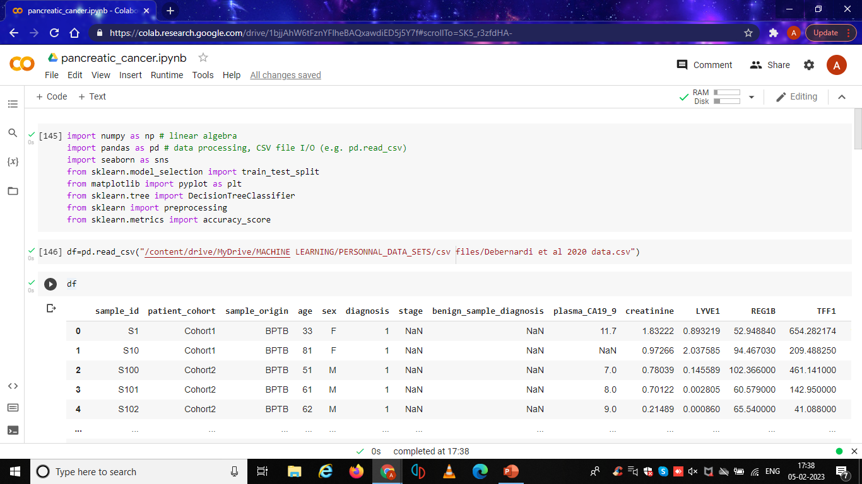
SNAPSHOTS
Prediction of Gestures

Slide 18
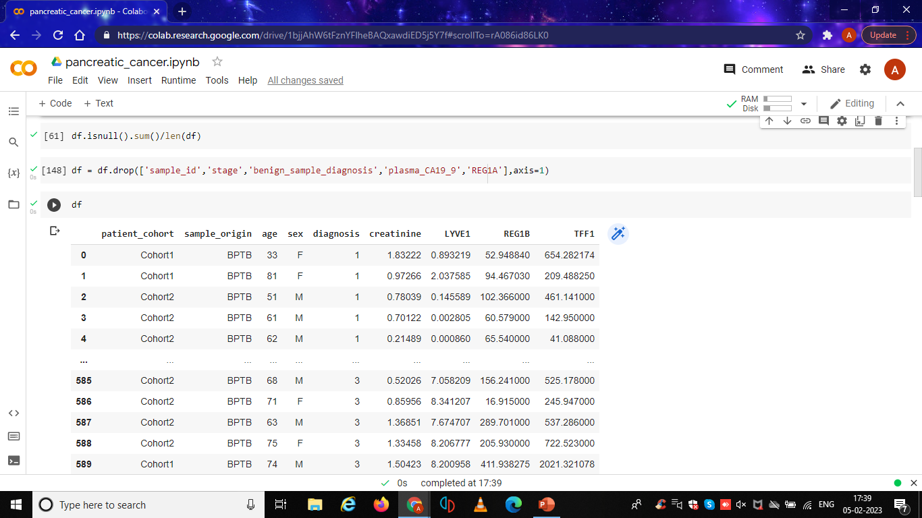
SNAPSHOTS

Slide 19
SNAPSHOTS

Slide 20
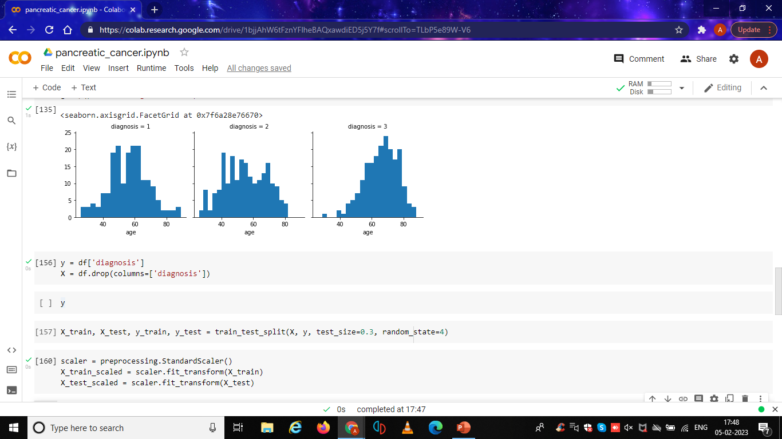
SNAPSHOTS

Slide 21
ONLINE COURSE DETAILS
NAME (ROLL NO) | COURSE NAME | PLATFORM | No. OF WEEKS | REMARKS/ STATUS
Rahulkannan P (21bad020) Akash K(21BAD054) Aravindh R (21BAD036) | The joy of computing using Python Meachine learning alogrithms Meachine learning alogrithms | NPTEL Great learning Great learning | 12 weeks 5 weeks 5 weeks | Ongoing Ongoing Ongoing

Slide 22
CONCLUSION
Despite these advancements, early detection of pancreatic cancer remains a challenge, and more research is needed to improve the accuracy and reliability of detection methods. Additionally, increased awareness and education about pancreatic cancer can help individuals and healthcare professionals recognize the symptoms and risk factors associated with this disease, leading to earlier detection and better outcomes for patients. Therefore this model is created to achieve it's best performance in detection of pancreatic cancer.

Slide 23
REFERENCES
By Nagesh Singh Chauhan ,nuggets on February 9, 2022 in MachineLearning (https://www.kdnuggets.com/2020/01/decision-tree-algorithm-explained.html)
2. Cardot, H. & Degras, D. Online principal component analysis in high dimension: which algorithmtochoose?Int.Stat.Rev.86, 29,50(2018)
(https://onlinelibrary.wiley.com/doi/epdf/10.1111/insr.12220)
.

Slide 24
REFERENCES
Vance K, Alitinok A, Winfree S, Jensen-Smith H, Swanson BJ, Grandgenett PM. et al. Machine learning analyses of highly-multiplexed immunofluorescence identifies distinct tumor and stromal cell populations in primary pancreatic tumors. Cancer Biomark. 2022;33:219–35.

Slide 25
Thank You
Pancreatic Cancer detection

