Slide 1


Intel® Unnati
Industrial Training Program - Project
Mentor:
Dr. Ramachandra A C
Professor, Dept. of ECE
Submitted by – Rahul K C (1NT21EC106)
- Shriya Reddy(1NT21IS082)

Slide 2
Problem Statement
Power Manager Telemetry
In the era of 5G and edge computing, the deployment of devices across various locations has led to increased power consumption. To mitigate this, governments are urging enterprises to reduce power usage and achieve net-zero power consumption. Additionally, with rising electricity costs, it is crucial to understand the total power drawn by systems by Researching and identifying open-source tools for power measurement, Identifying and documenting the available knobs in a system to measure power, Collect power telemetry data from CPU, memory, NIC, and TDP etc., Measure and record system power utilization for CPU, NIC, and TDP based on the input parameter of system utilization percentage.

Slide 3
Objectives
Ability to obtain telemetry data for system components (CPU, memory, NIC, and TDP).
Execute traffic to achieve 100% system utilization using containers.
Collect and analyze telemetry data.
Develop a solution to measure system power utilization based on input parameters (percentage of system utilization), with specific focus on CPU, NIC, and TDP.

Slide 4
Unique Idea Brief (Solution)
Adaptive Power Management System: Implement a system that dynamically adjusts power settings based on real-time utilization data. This system uses machine learning algorithms to predict usage patterns and optimize power settings, reducing overall consumption without compromising performance.

Slide 5
Process-flow
Requirement Analysis: Understand the need for power measurement and the metrics required (CPU, memory, NIC, TDP).
Tool Research: Identify open-source tools for power measurement.
System Knob Identification: Document the available system knobs for measuring power.
Data Collection Setup: Configure systems to collect power telemetry data.
Data Collection: Gather telemetry data for CPU, memory, NIC, and TDP.
Data Analysis: Analyze the collected data to understand power utilization.
Reporting: Generate reports on system power utilization.

Slide 6
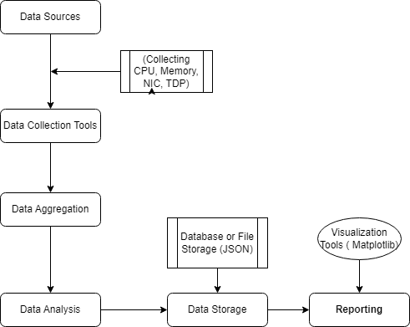
Architecture Diagram

Slide 7
Technologies Used
Programming Languages: Python
Data Collection Tools: Powerstat, PowertopData
Storage: JSON
Data Analysis Tools: Python libraries (Pandas, NumPy)
Visualization Tools: Matplotlib
Libraries: psutil

Slide 8
Team members and contribution:
Team Member 1 - L Shriya Reddy
Research and Tool Selection: Identified and evaluated open-source tools for power measurement, such as Powerstat and Powertop.
System Knobs Documentation: Documented various system knobs and metrics (CPU, memory, NIC, TDP) for power measurement.
Data Analysis: Analyzed collected telemetry data to understand power utilization patterns.
Team Member 2 – Rahul K C
Data Collection Script Development: Created scripts (e.g., power_telemetry.py) to collect power telemetry data from the system.
Setup Configuration: Configured and deployed the data collection setup on target systems, ensuring accurate data logging and storage.
Data Visualization: Developed visualizations (e.g., plot_power_data.py) to display power utilization over time.
Reporting: Generated detailed reports on system power utilization and provided recommendations for optimization.

Slide 9
Results
Power Utilization Reports: Detailed insights into power consumption patterns.
Optimized Power Settings: Reduced power consumption based on adaptive management.
Cost Savings: Lower electricity costs due to efficient power usage.
By implementing a comprehensive system for power telemetry collection and analysis, enterprises can achieve significant reductions in power consumption. This not only meets regulatory requirements but also leads to substantial cost savings, contributing to sustainability goals in the era of 5G and edge computing.

Slide 10
THANK YOU

