Slide 1
CI/CD
ASSIGNMENT
SUMMITED BY :RAHUL KUMAR
INTERNS BATCH 5 AUGUST

Slide 2
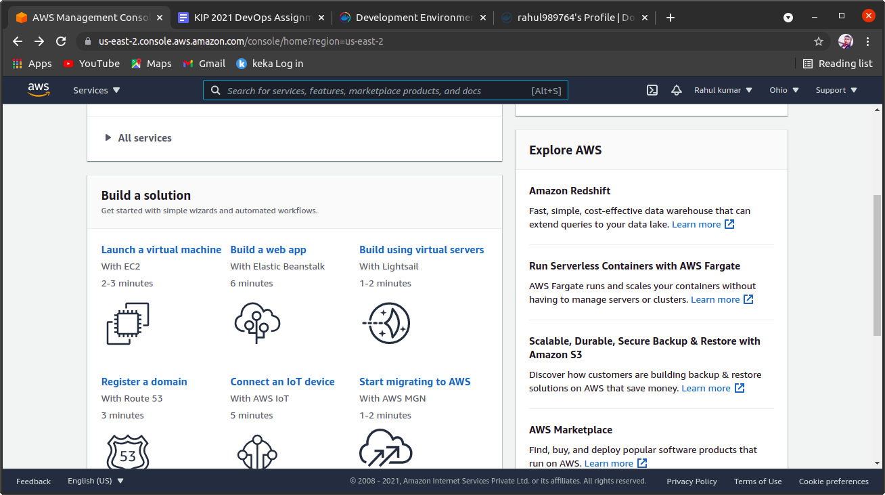
STEP 1
STEP 1:- first we login in AWS account and open aws console then start or launch virtual machine

Slide 3
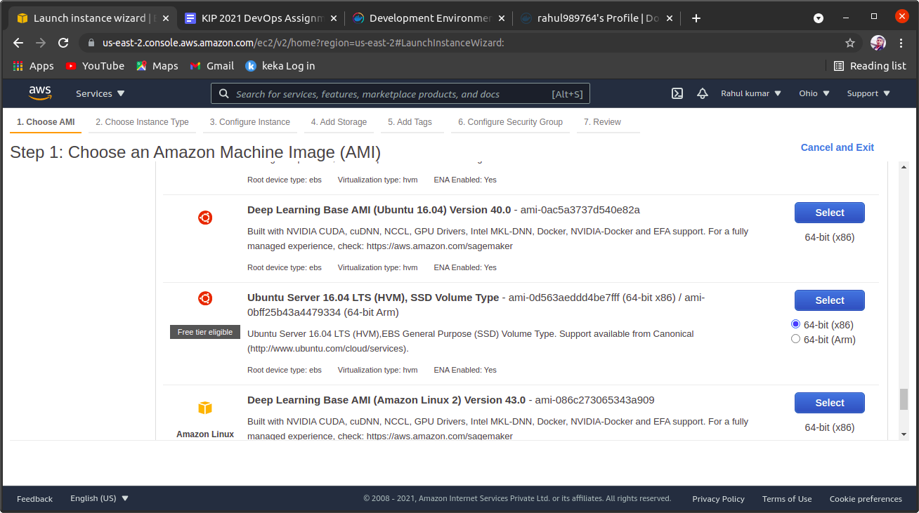
STEP 2
STEP 2:-
Choose an Amazon Machine Image ,like in this we select ubuntu server 20 LTS.for linux ubuntu system

Slide 4
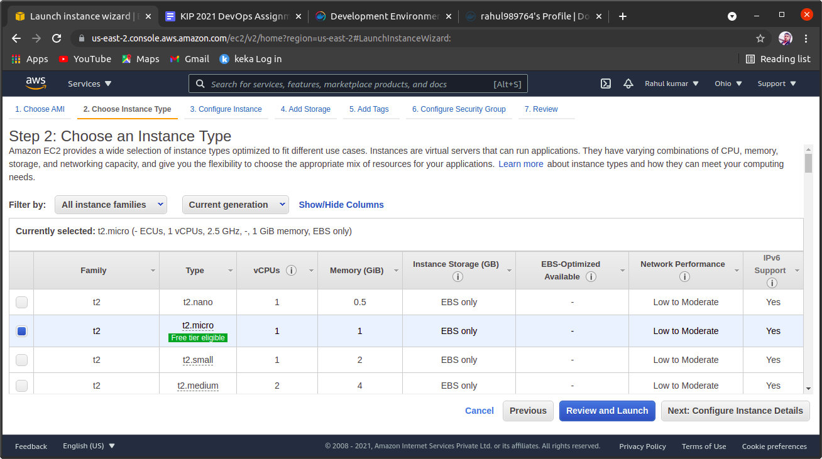
STEP 3
STEP 3:-choose an Instance type in aws console ,like we select t2 micro then click on review and launch

Slide 5
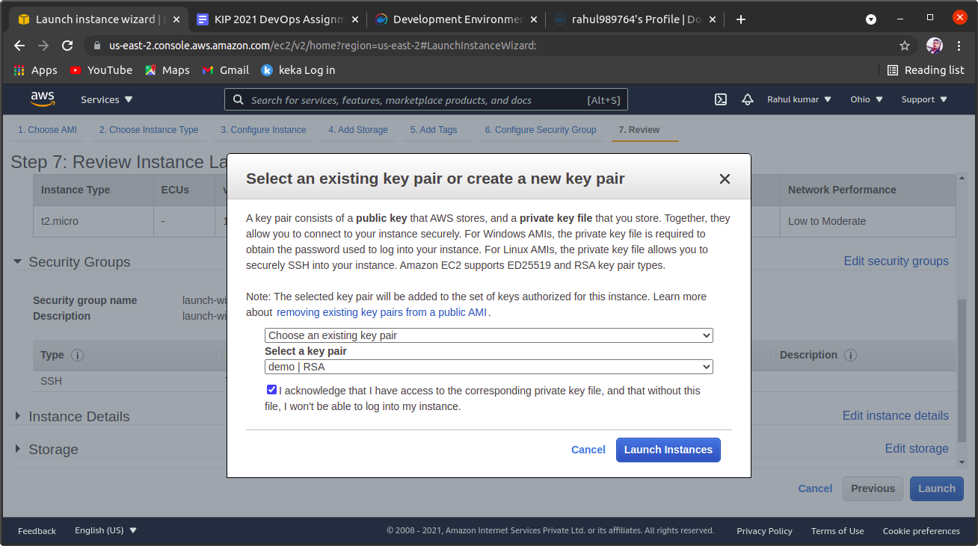
STEP 4
STEP 4:-
After step 3 we select an key pair or we create new key pair and download it after that we again launch it

Slide 6
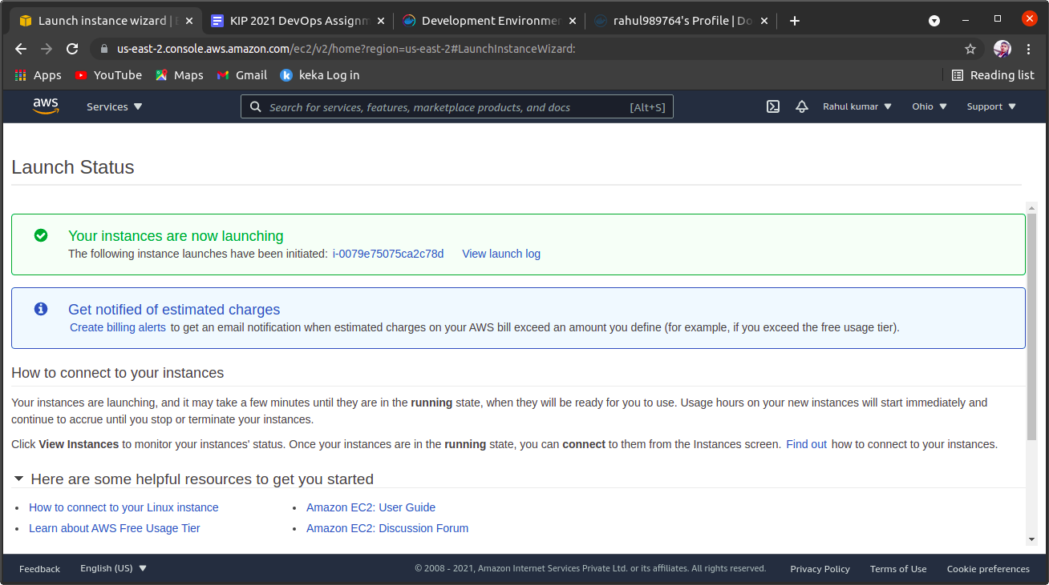
STEP 5
STEP 6:
We launch it and we see launch status like that

Slide 7
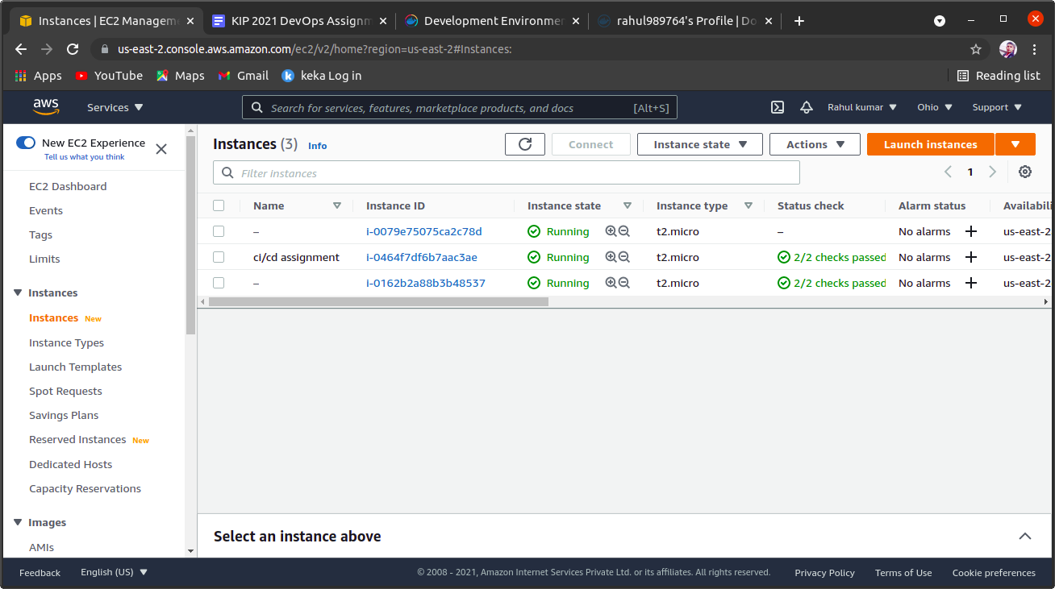
STEP 6
STEP 6:-
After launch we select our instance and click security
We add local host port 8080 like

Slide 8
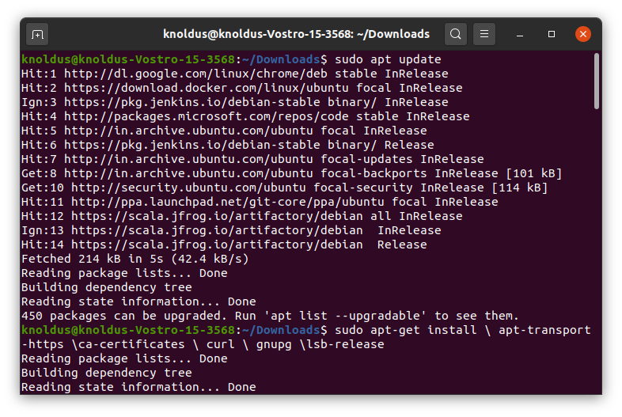
STEP 7

Slide 9
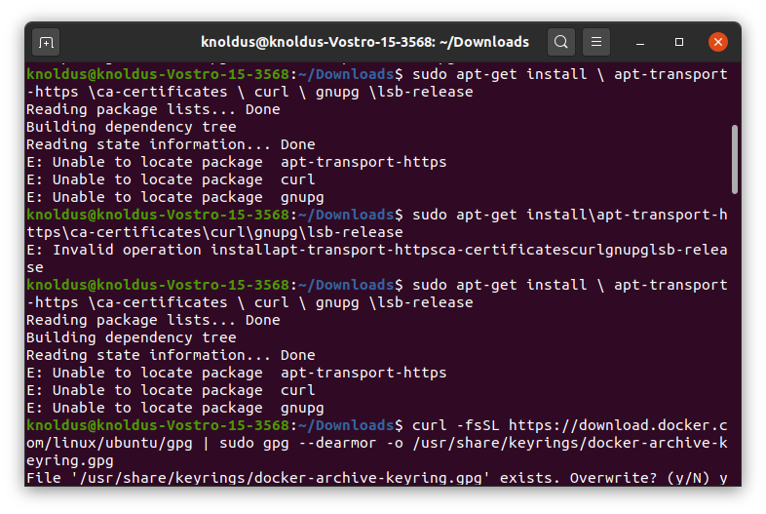
STEP 8

Slide 10
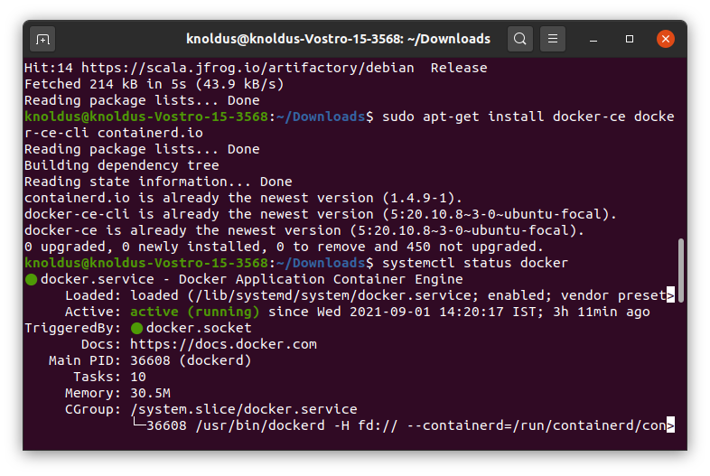
STEP 9

Slide 11
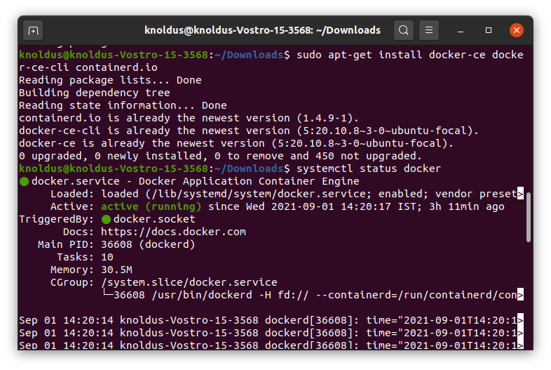
STEP 10

Slide 12
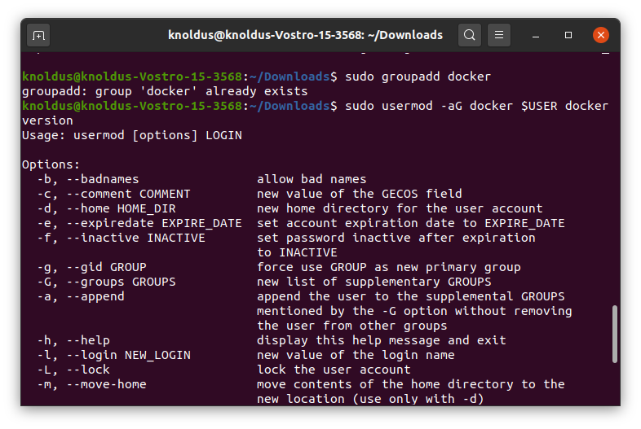
STEP 11

Slide 13
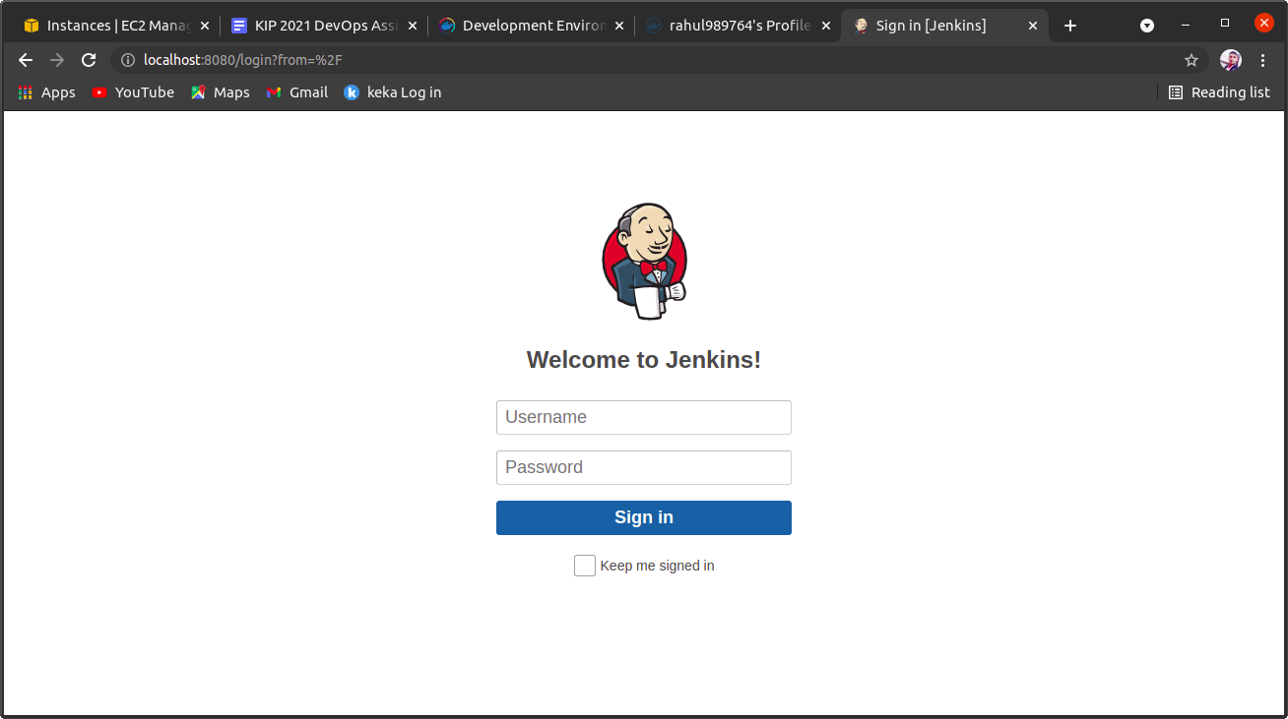
STEP 11
In STEP 11
We go to our browser and type local host 8080 port number which we create earlier

Slide 14
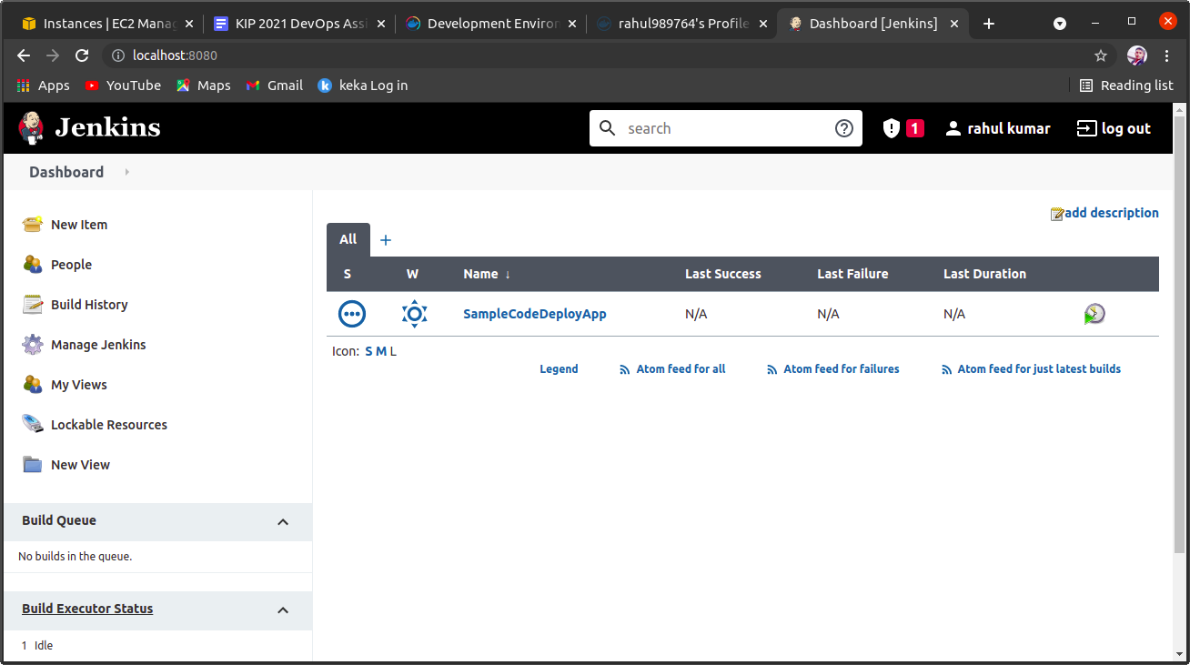
STEP 13
STEP 13:-
After login jenkins account then go to jenkins dashboard and select new item and freestyle mode

Slide 15
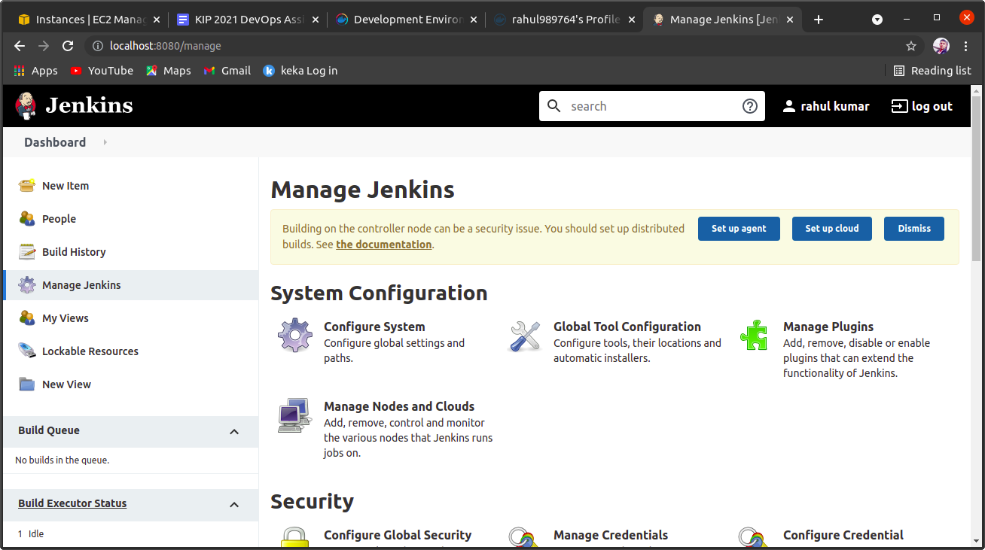
STEP 14
STEP 14:-
IN this window we click manage jenkins and then we manage plugins
After that we manage credentials in next slide

Slide 16
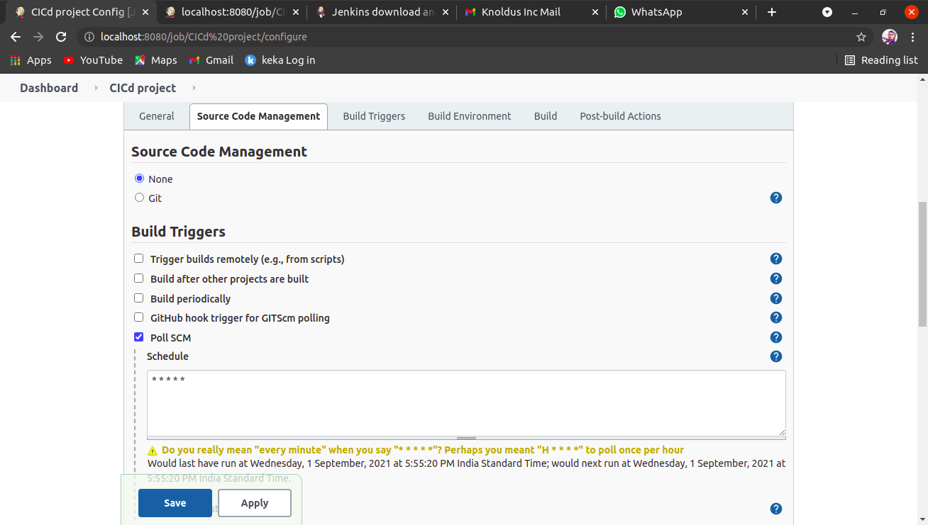
STEP 15

Slide 17
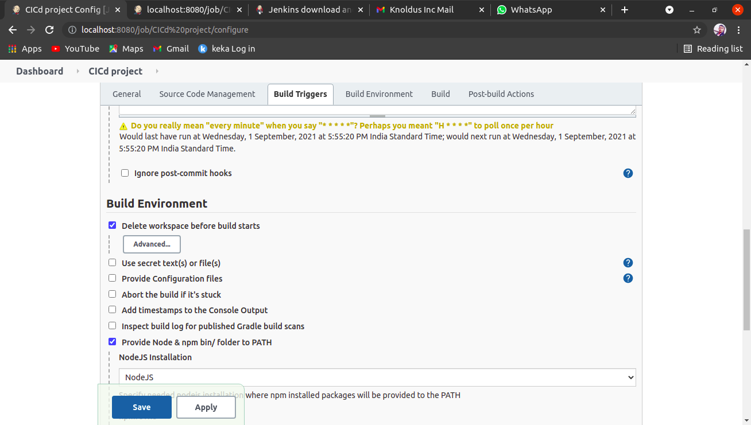
STEP 16

Slide 18
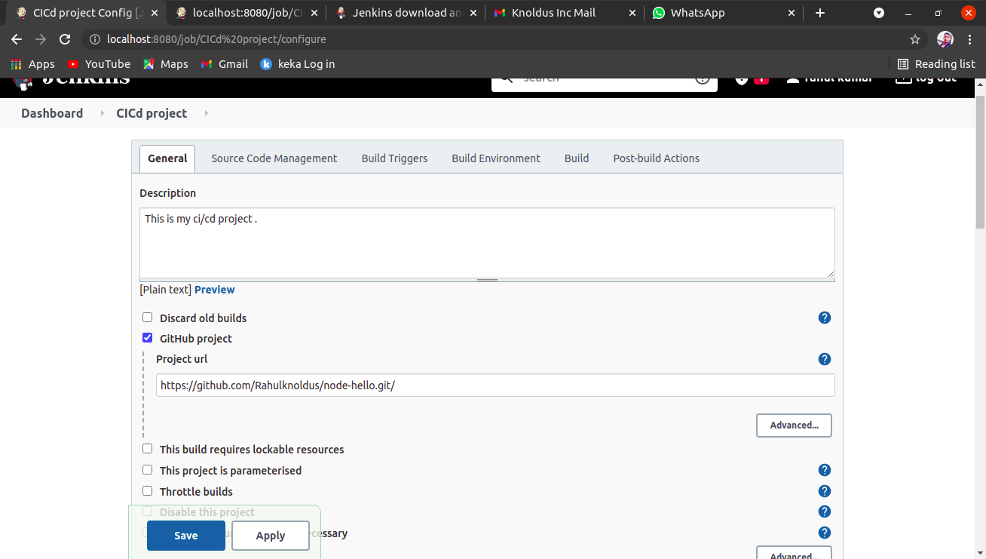
STEP 17

Slide 19
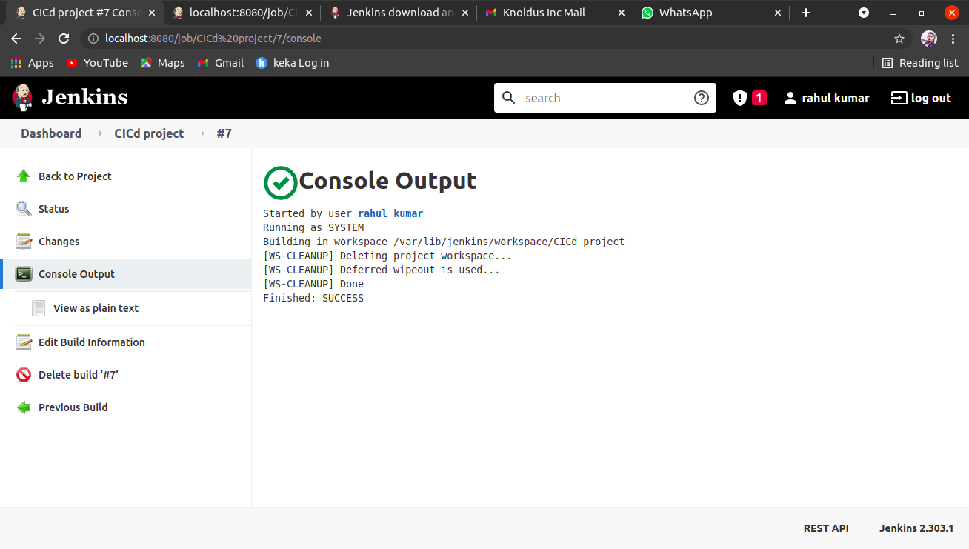
STEP 18

Slide 20
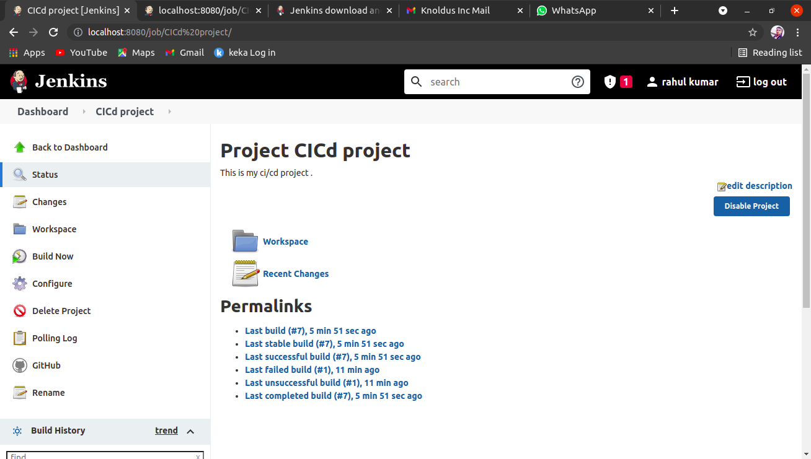
STEP 19

