Slide 1
Docker ASSIGNMENT
SUBMITTED BY :RAHUL KUMAR
INTERNS BATCH 5 AUGUST

Slide 2
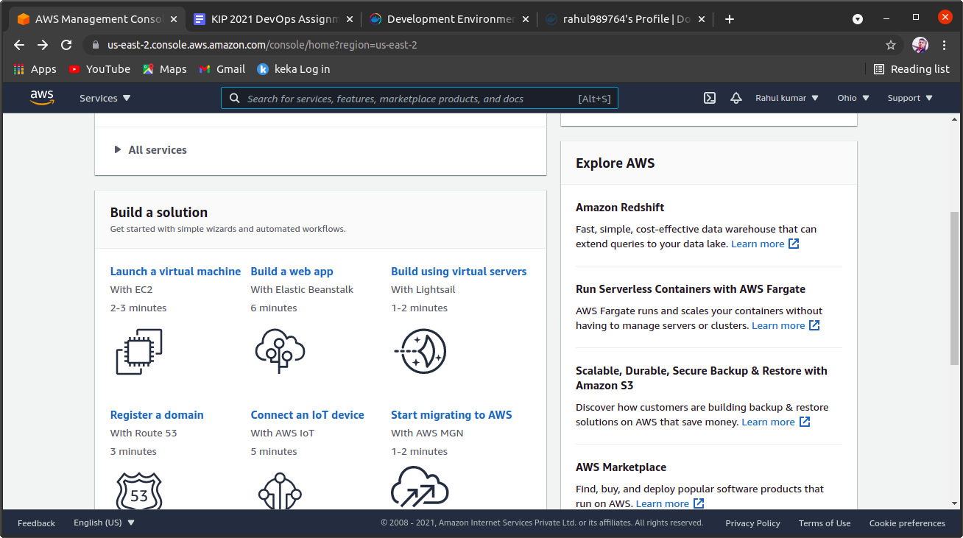
STEP 1
STEP 1:- first we login in AWS account and open aws console then start or launch virtual machine

Slide 3
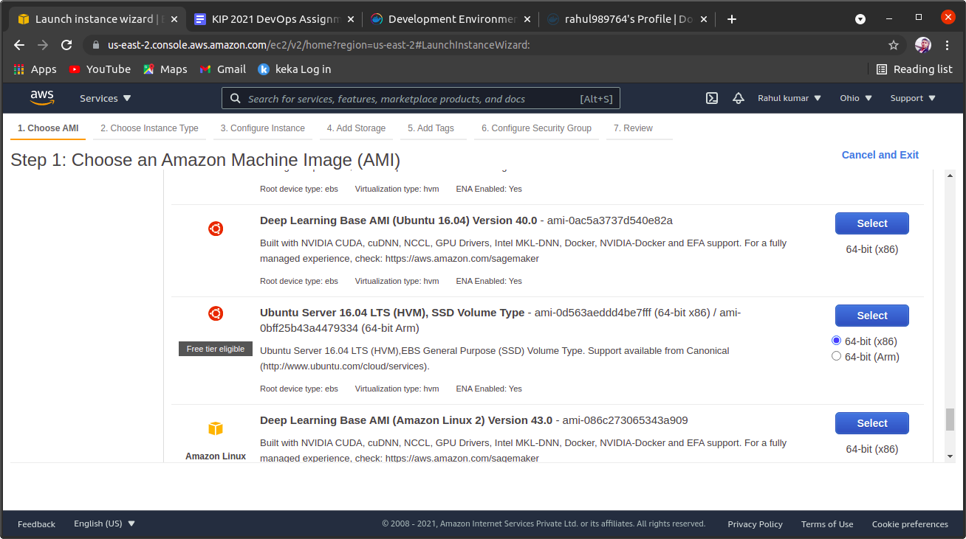
STEP 2
STEP 2:-
Choose an Amazon Machine Image ,like in this we select ubuntu server 20 LTS.for linux ubuntu system

Slide 4
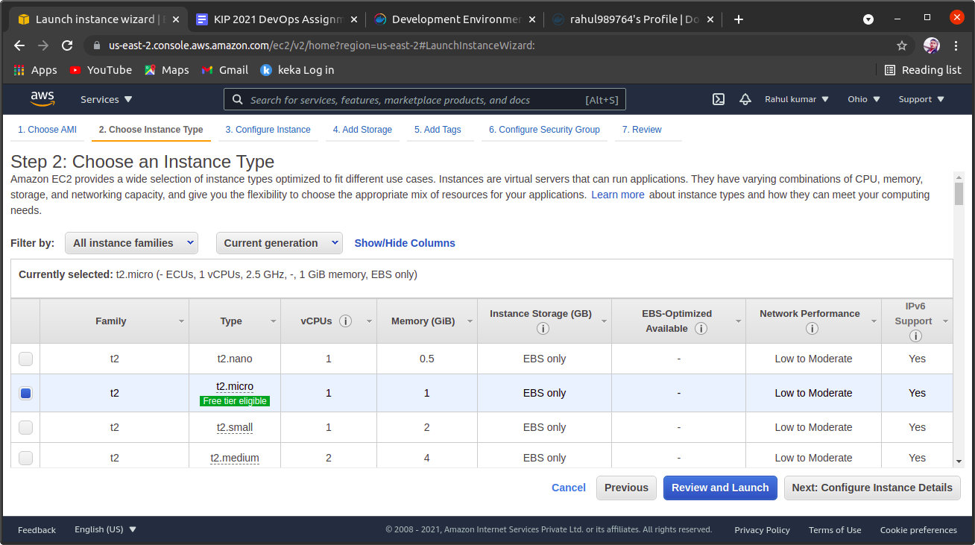
STEP 3
STEP 3:-choose an Instance type in aws console ,like we select t2 micro then click on review and launch

Slide 5
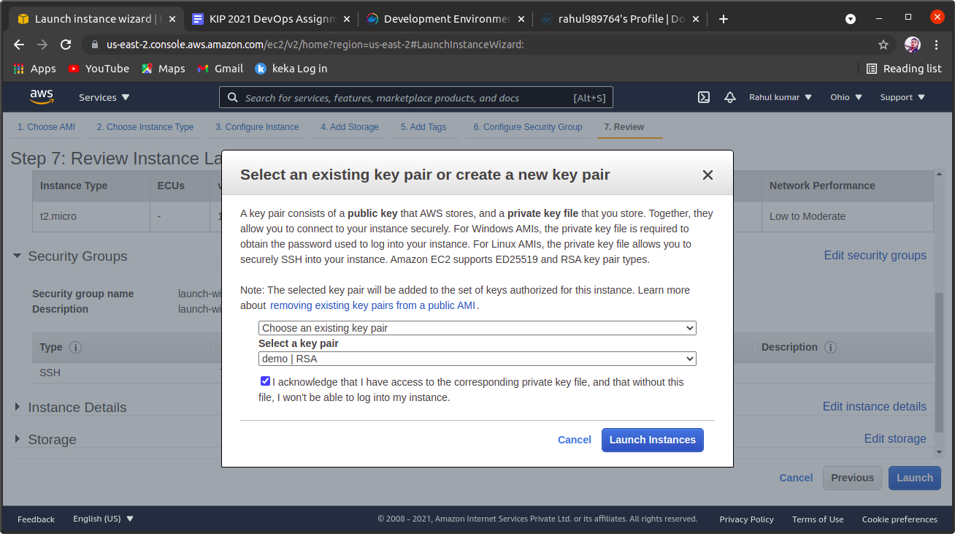
STEP 4
STEP 4:-
After step 3 we select an key pair or we create new key pair and download it after that we again launch it

Slide 6
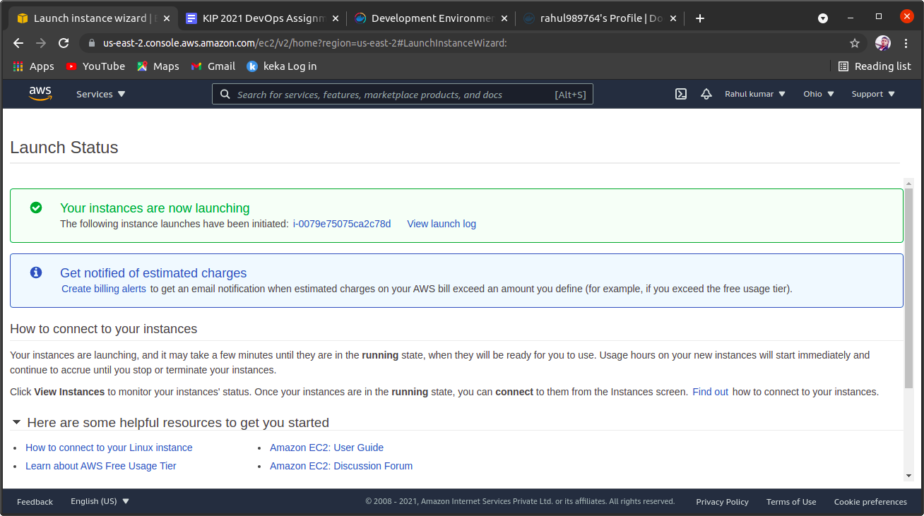
STEP 5
STEP 6:
We launch it and we see launch status like that

Slide 7
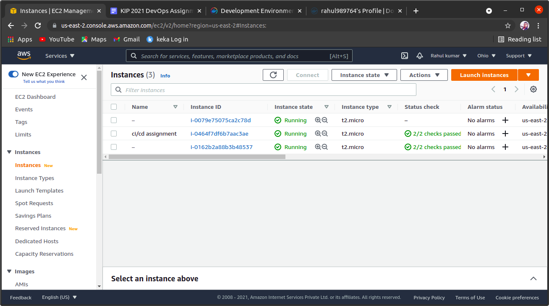
STEP 6
STEP 6:-
After launch we select our instance and click security
We add local host port 8080 like

Slide 8
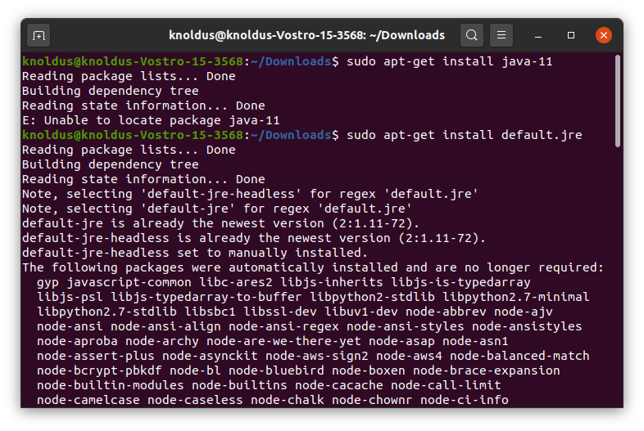
STEP 7
STEP 7:-
After creating intense we open terminal and type and run following commands

Slide 9
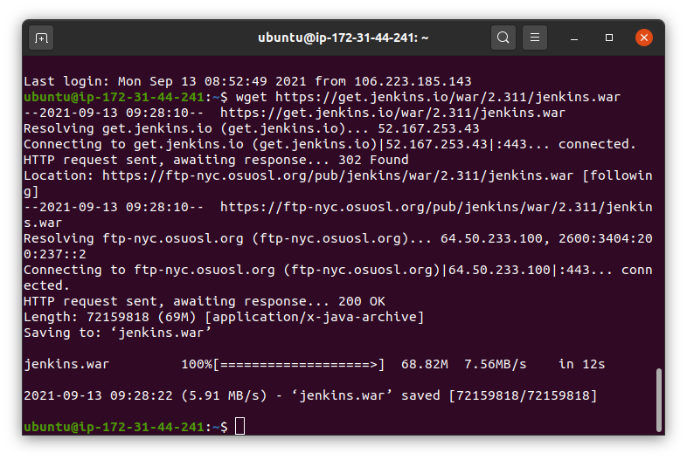
STEP 8
Step 8:
After download default-jre file
We run download command for jenkins
And reboot instance and refresh page.

Slide 10
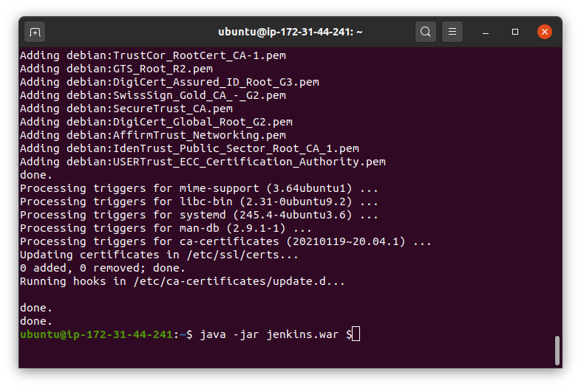
STEP 9
Step 9:-
After run or download java and jenkins we run java -jar jenkins.war $ command to run jenkins

Slide 11
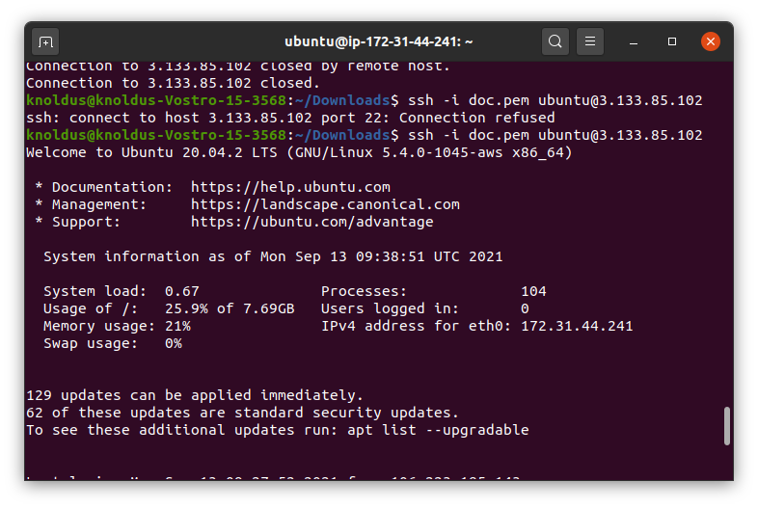
STEP 10
Step 10:-
After run java -jar command we again run ssh -i doc.pem ubuntu@instance ip command tp run instance

Slide 12
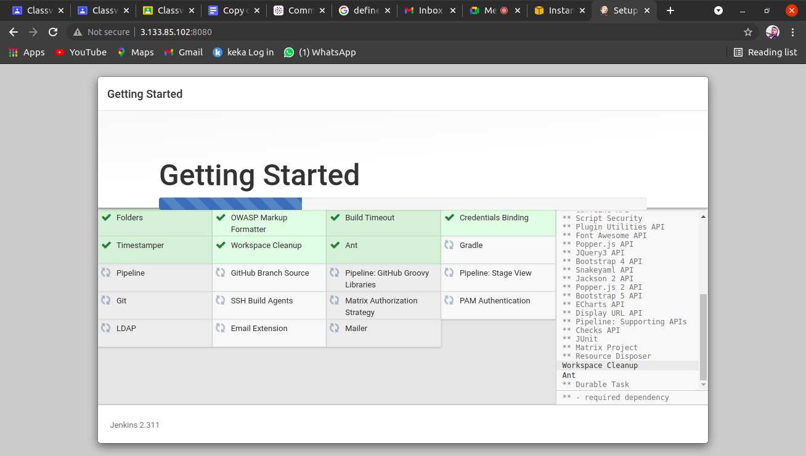
STEP 11
Step 11:-
After that we copy ip address of instance and paste into url instance_ip:8080 the jenkins login window open

Slide 13
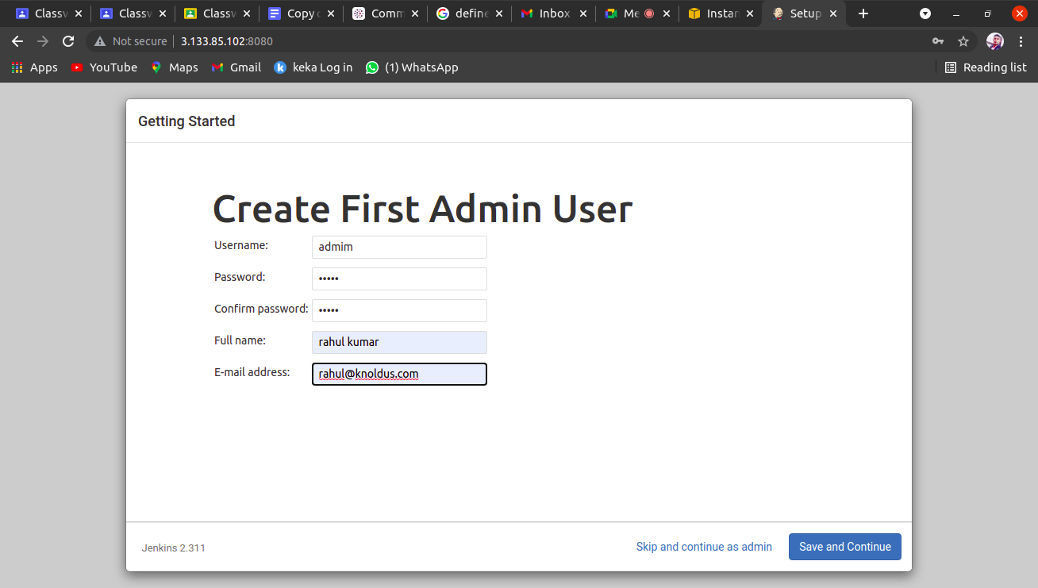
STEP 12

Slide 14
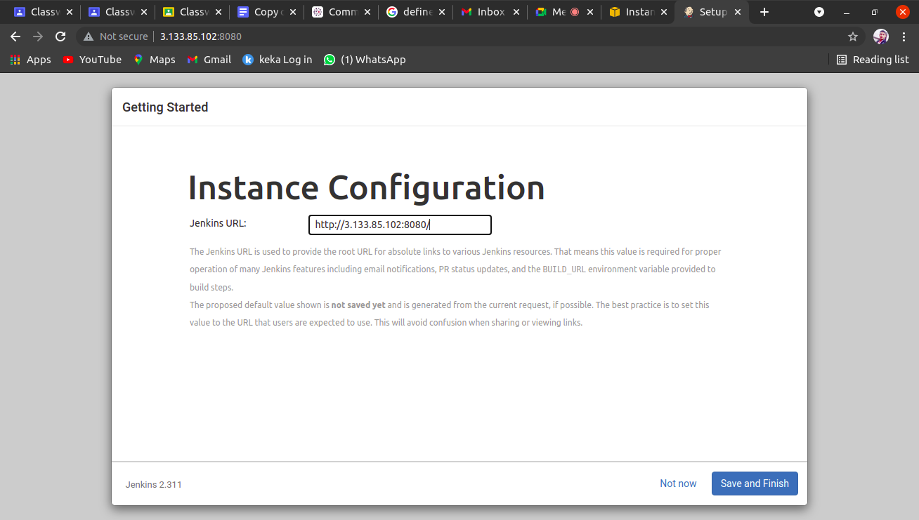
STEP 13
Step 13:-
After login in jenkins we see instance configration in which we see jenkins localhost:8080

Slide 15
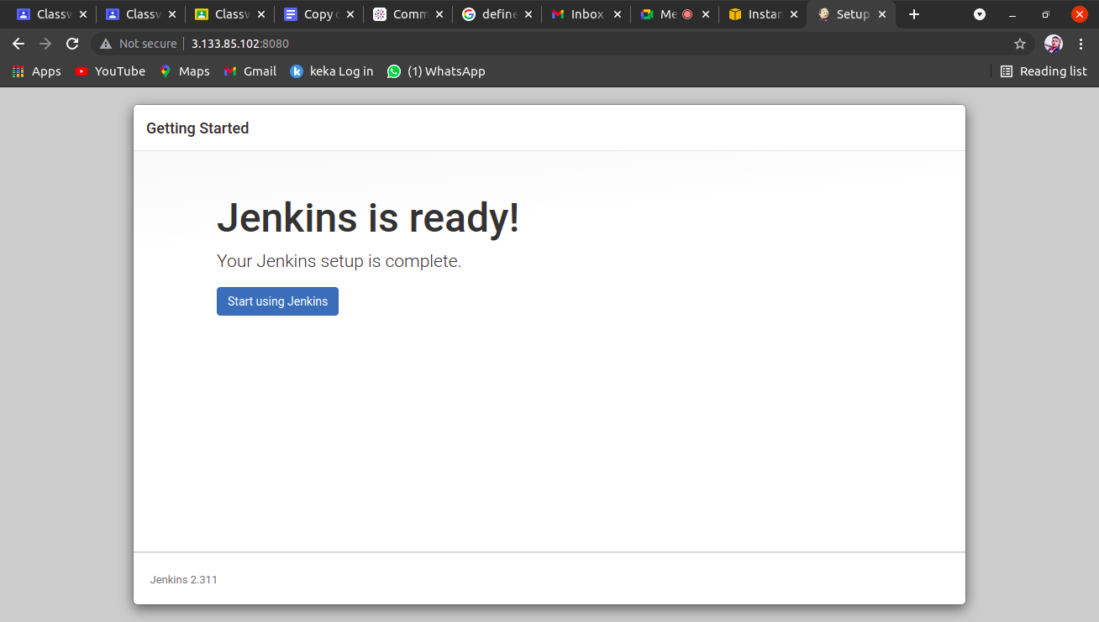
STEP 14

Slide 16
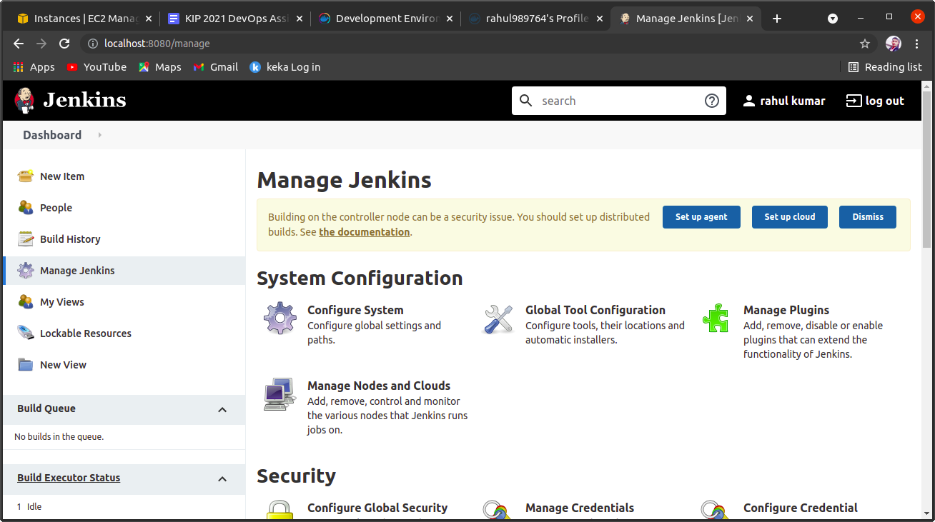
STEP 15
STEP 14:-
IN this window we click manage jenkins and then we manage plugins
After that we manage credentials in next slide

Slide 17
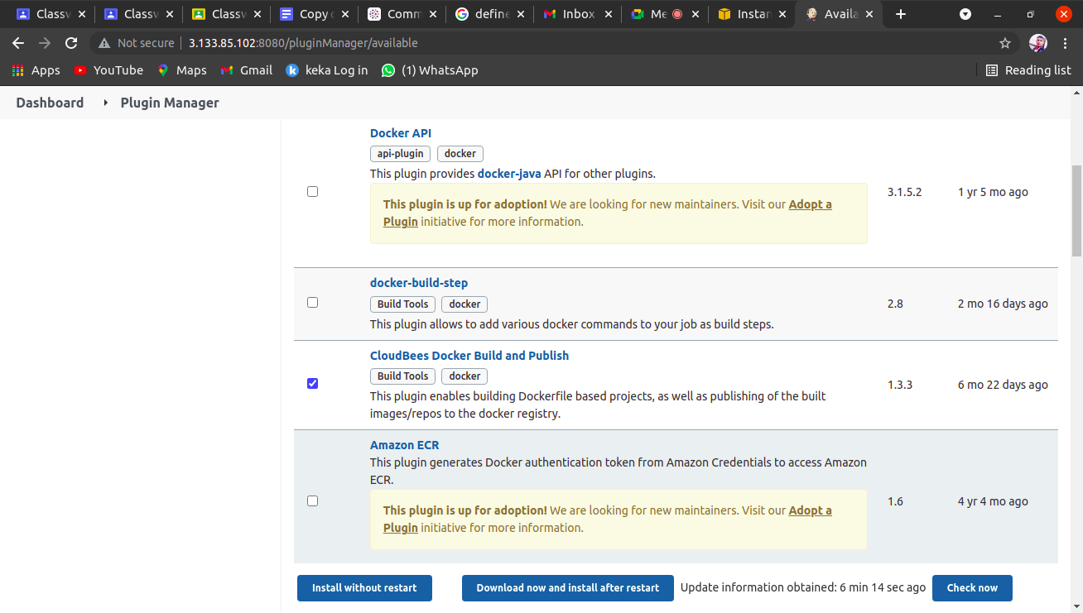
STEP 16
Step 15:-
After start jenkins we manage plugin and we install
Cloudbee docker build and publish
And click on install without restart.

Slide 18
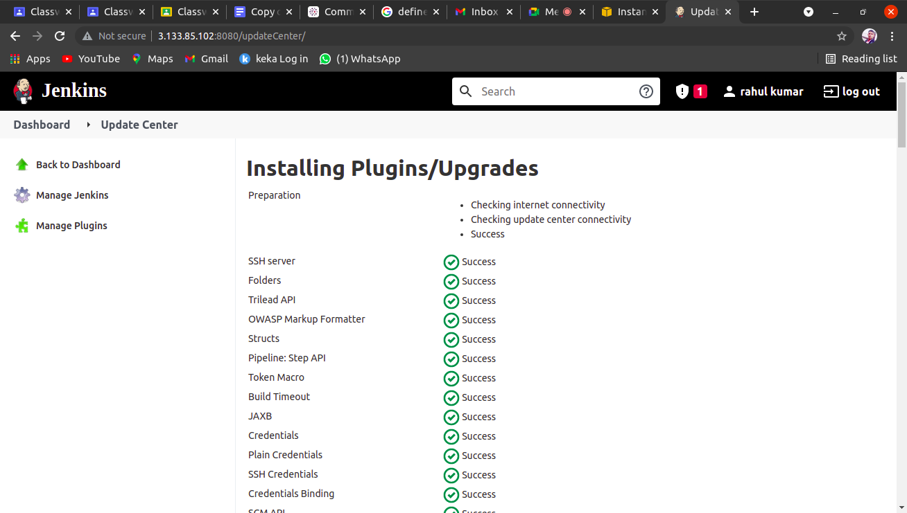
STEP 17

Slide 19
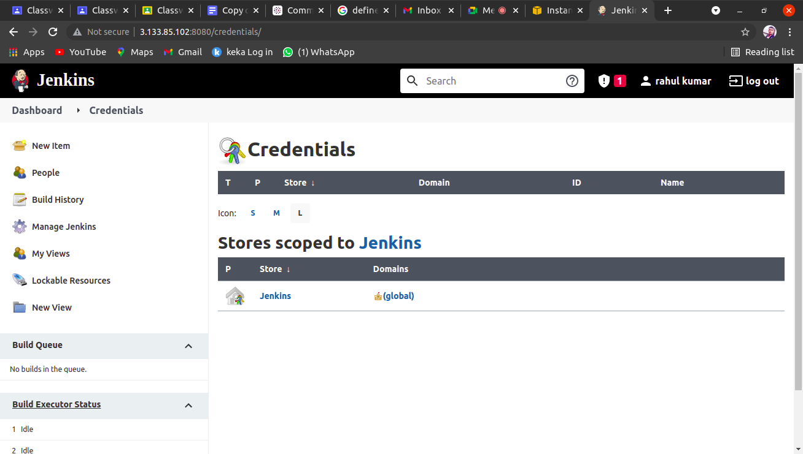
STEP 18
Step 17:-
After install plugin then we manage credentials

Slide 20
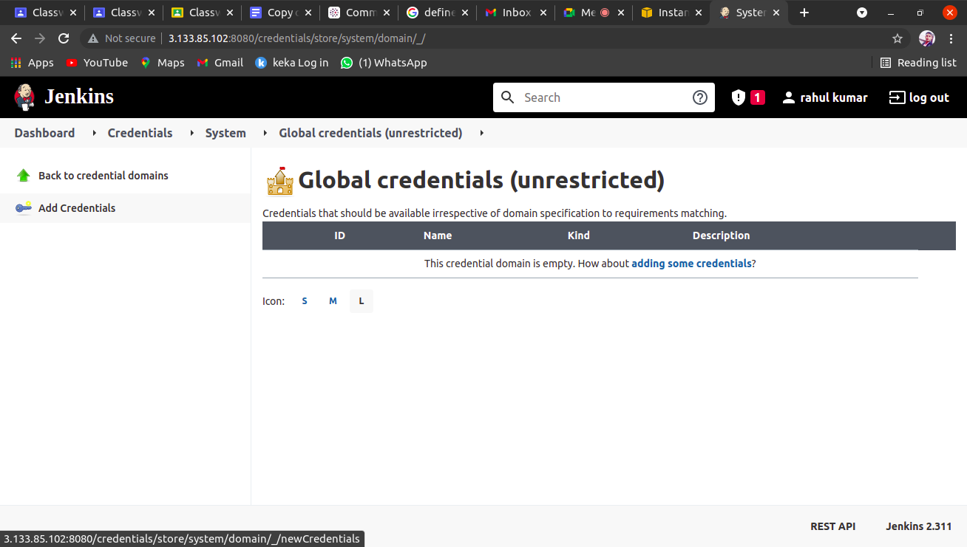
STEP 19

Slide 21
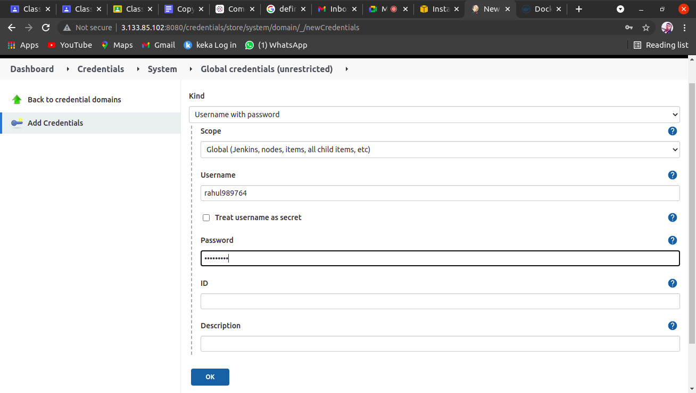
STEP 21
Step 19:-
When we mange global credentials in which we provide our docker hub username as well as password

Slide 22
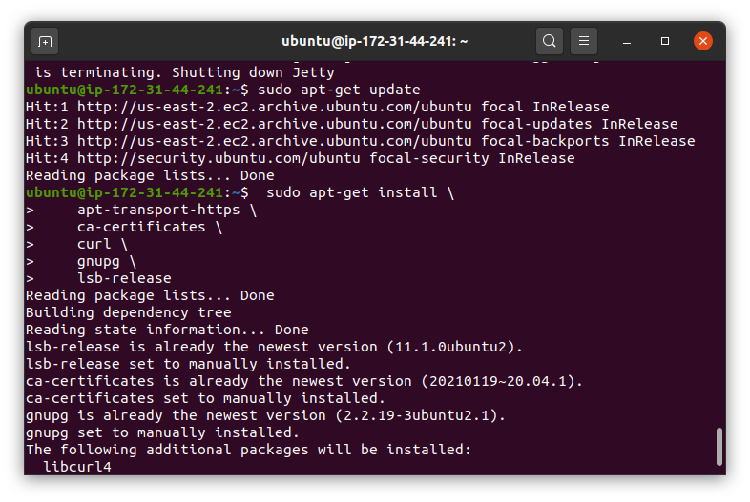
STEP 22
Step 22:-
After this we download docker
In our virtual machne

Slide 23
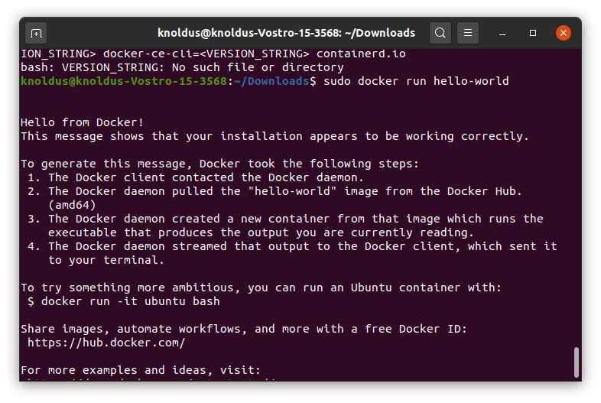
STEP 23
Step 23:-
After download we verfiy the docker that it is proper download or not

Slide 24
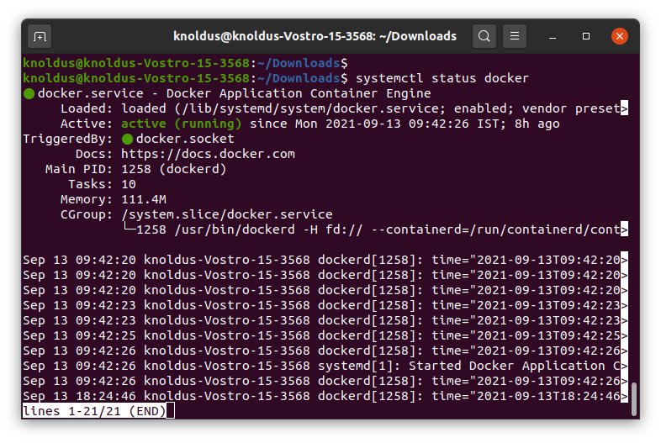
STEP 24

Slide 25
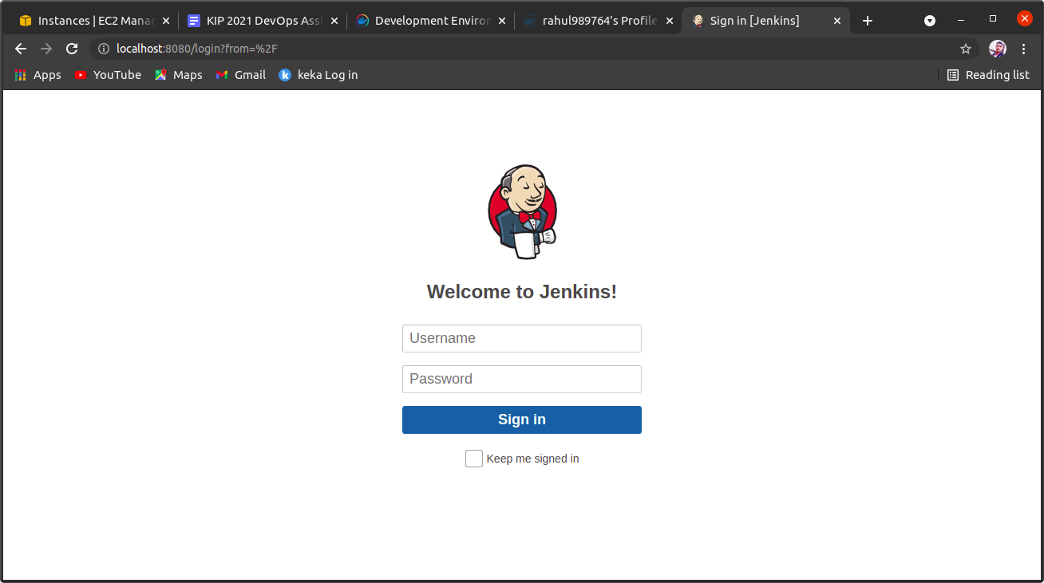
STEP 25
Step 23:-
We go to our browser and type localhost 8080 port number which we create earlier and login it

Slide 26
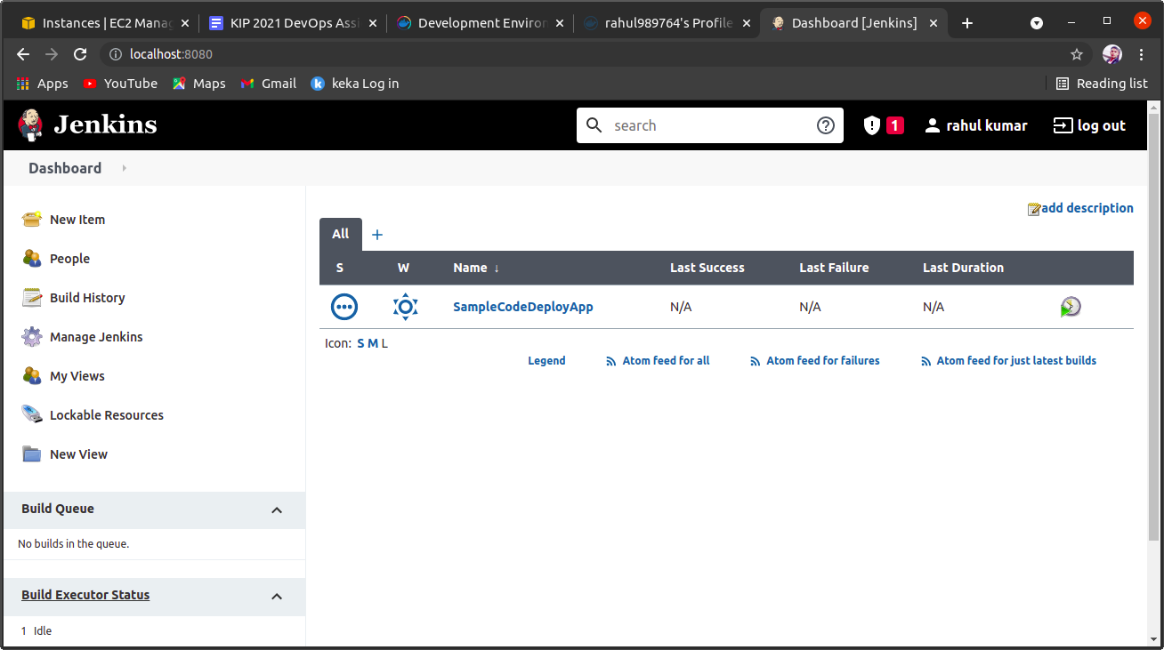
STEP 26
STEP 26:-
After login jenkins account then go to jenkins dashboard and select new item and freestyle mode

Slide 27
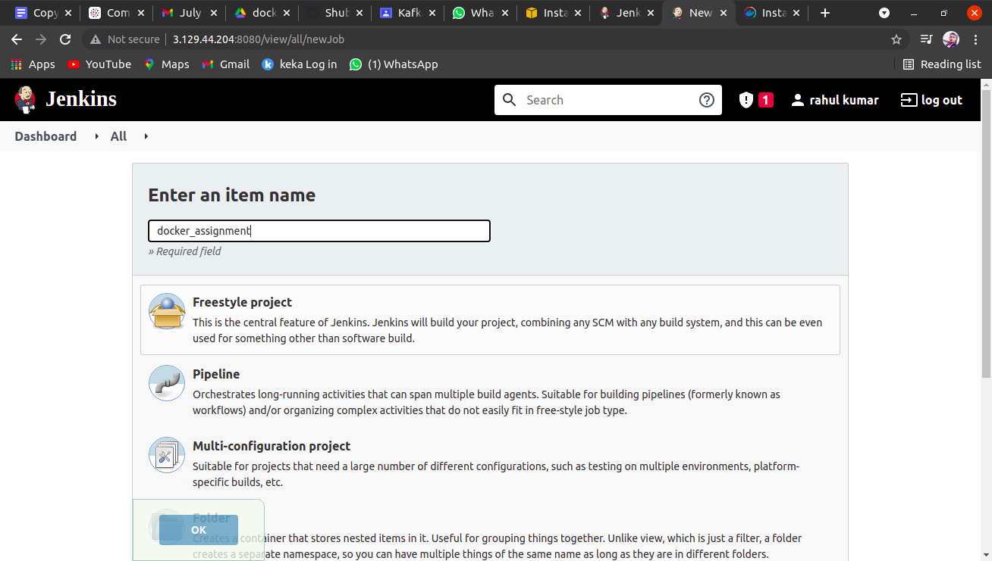
STEP 27
Step 27:-
After login in jenkins then we create new items name called docker_assignment in freestyle project

Slide 28
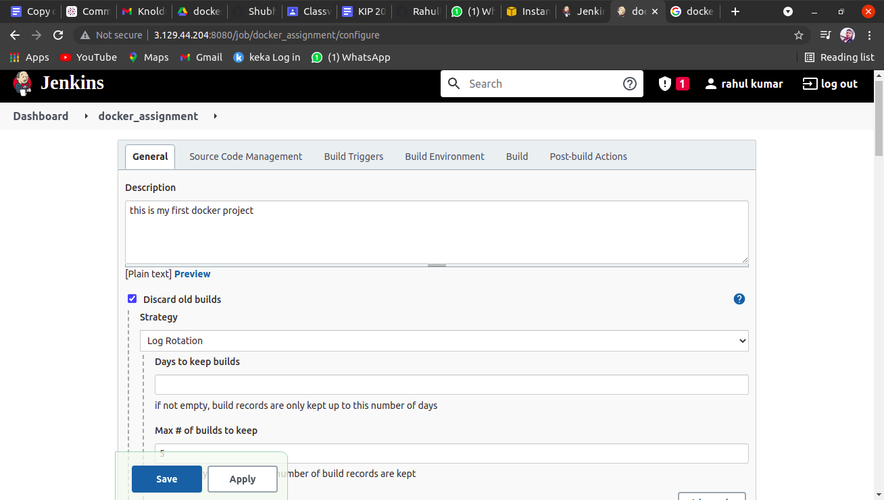
STEP 28

Slide 29
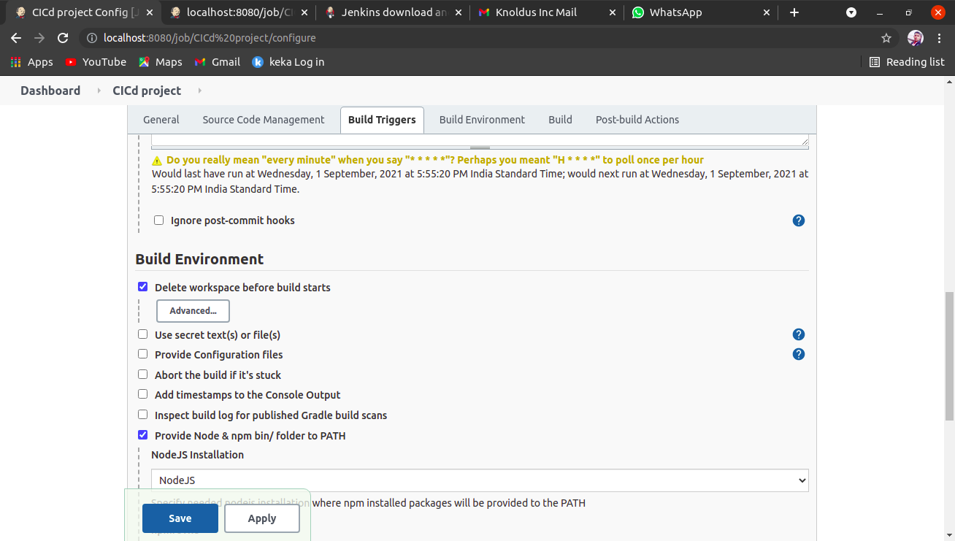
STEP 16

Slide 30
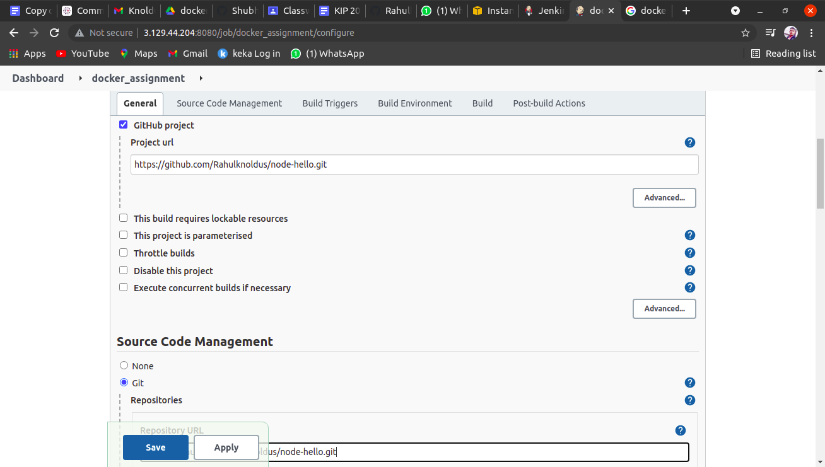
STEP 29

Slide 31
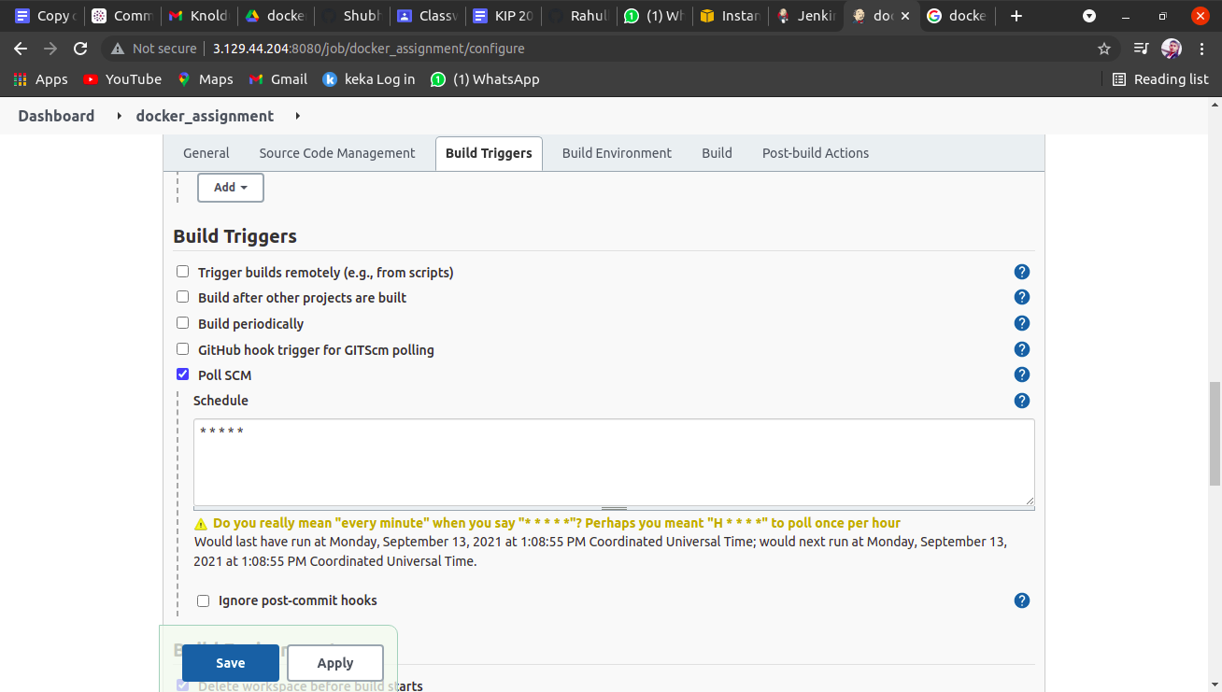
STEP 30
Step 30:-
In this step we bulid triggers in which we choose poll scm
And in schedule we write * * * * * then save it

Slide 32
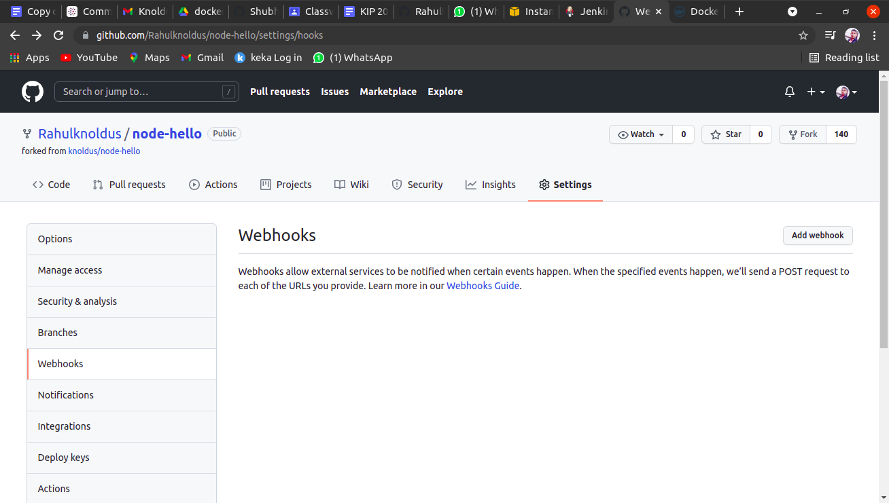
STEP 31
Step 31:-
In this step we create webhooks in the github settings
And paste docker project url in this webhooks

Slide 33
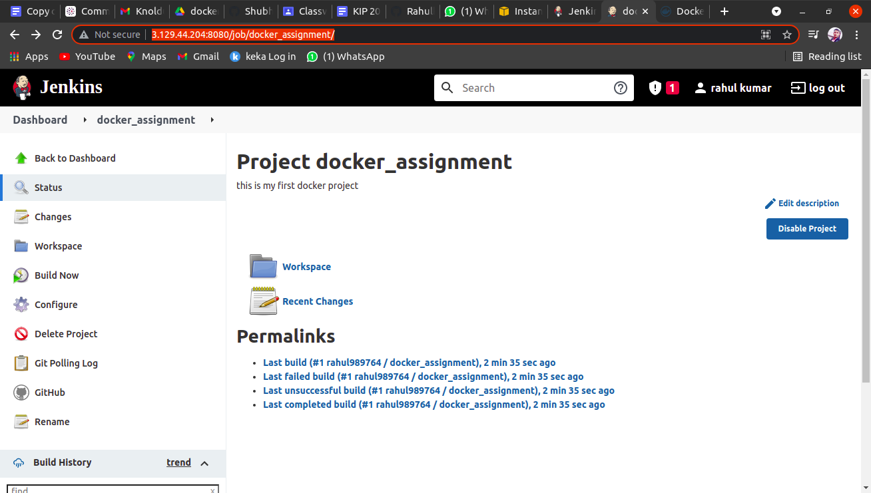
STEP 32

Slide 34
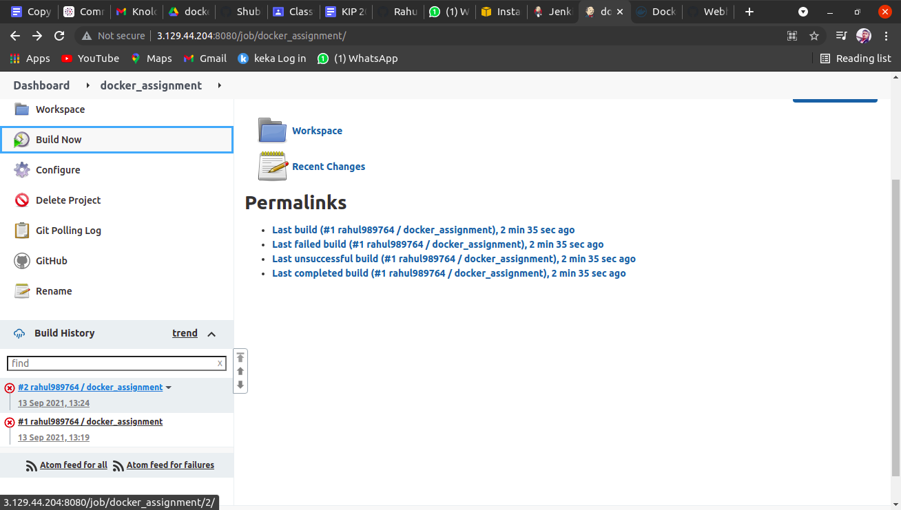
STEP 33
Step 33:-
In this step we build now then we go build history
After that we console output

Slide 35
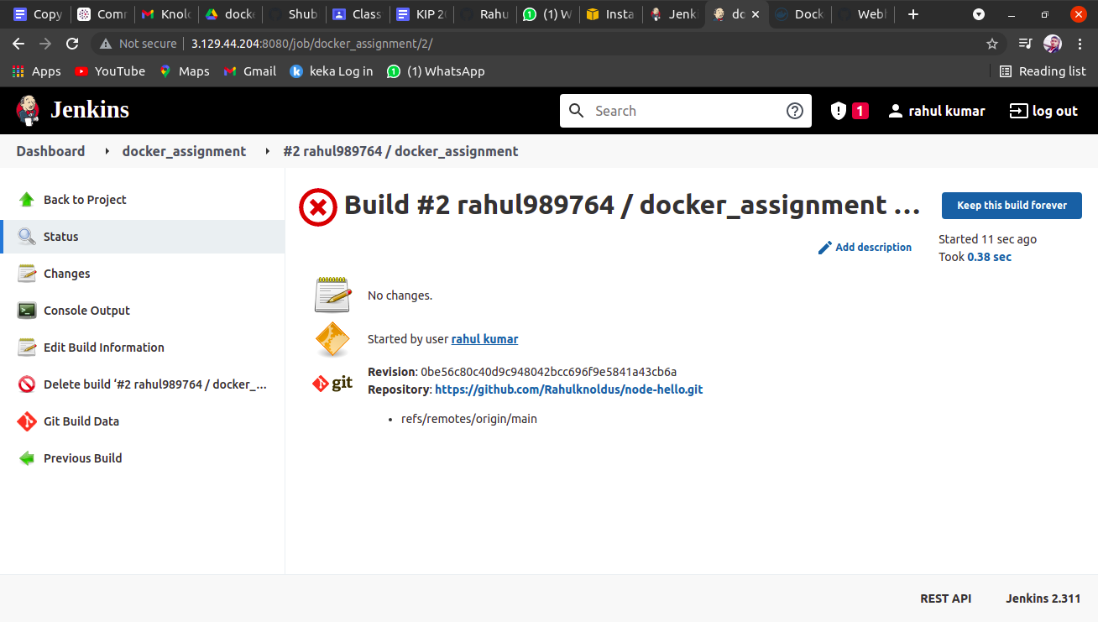
STEP 34

Slide 36
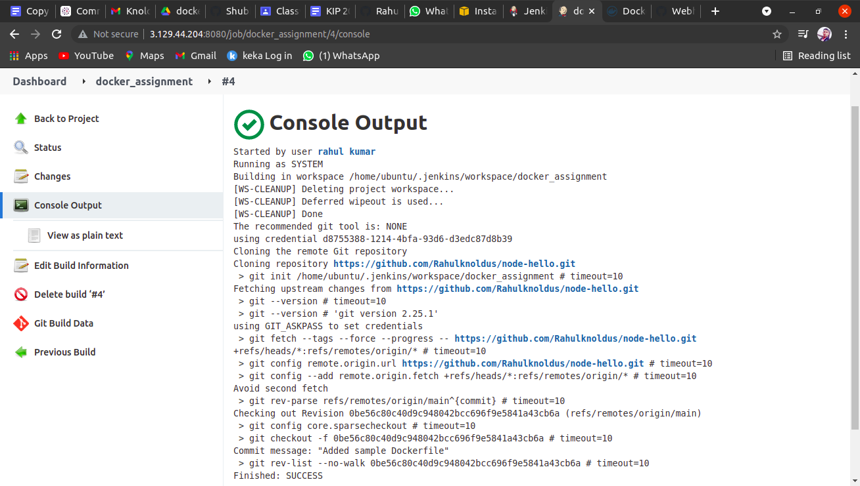
STEP 35

Slide 37
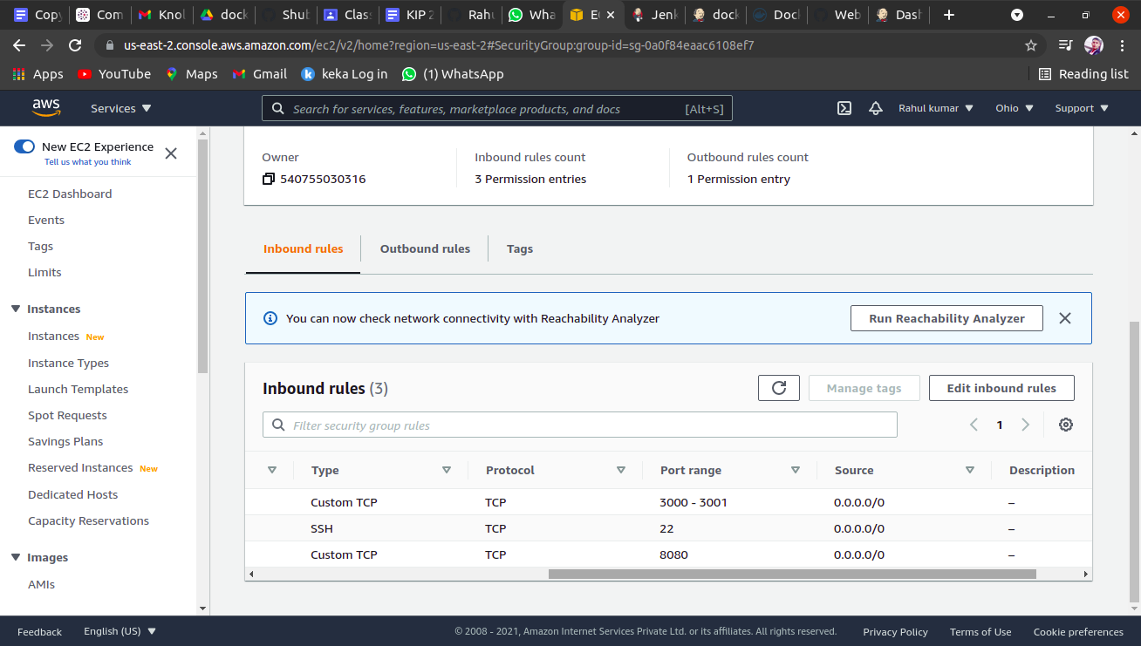
STEP 36
Step 36:-
In this step we create edit inbound rule and we add a new custom TCP
In the range 3000-3001 and save it

Slide 38
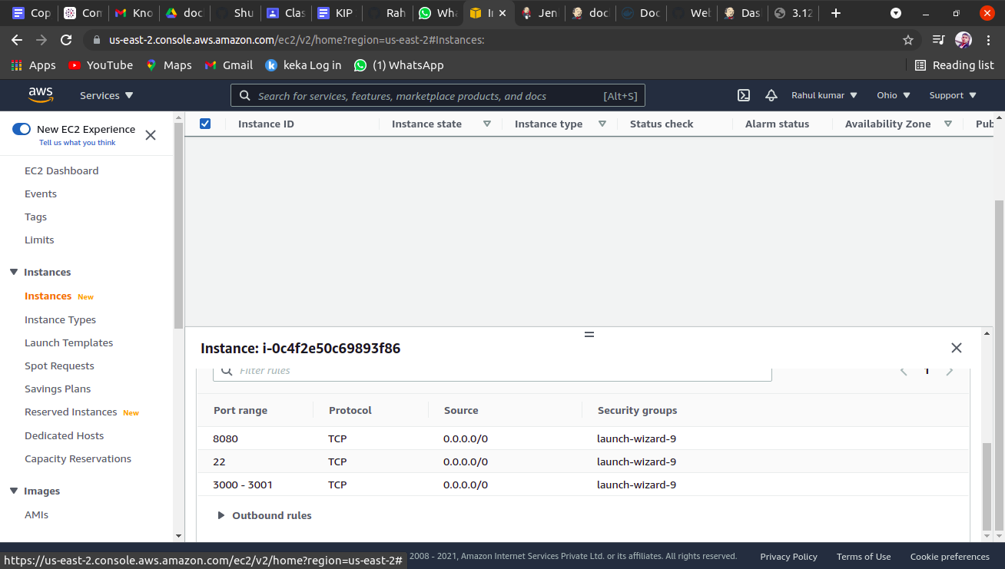
STEP 37
Step 37:-
In this step we see that we create a inbound rule
And verified it

Slide 39
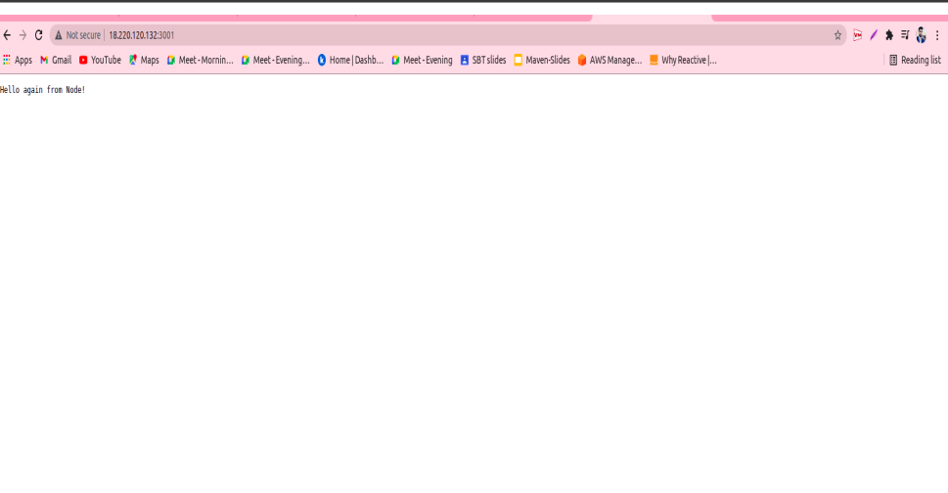
STEP 38
Step 38:-
In this step we copy instance IP-address and paste into browser url with 3001
And we get hello node ... like output

Slide 40


