Slide 1
Git assignment
Presented by
Rahul kumar
INTERN BATCH

Slide 2
Git Reset
The git reset command is a complex and versatile tool for undoing changes. It has three primary forms of invocation. These forms correspond to command line arguments --soft, --mixed, --hard. The three arguments each correspond to Git's three internal state management mechanism, The Commit Tree (HEAD), The Staging Index, and The Working Directory.

Slide 3
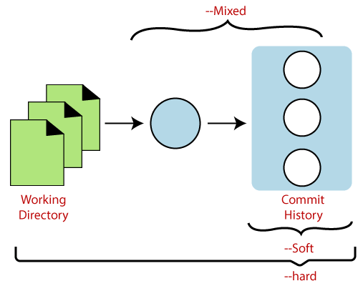
Git reset forms
The git reset command has three core forms of invocation.
Soft
Mixed
Hard

Slide 4
Git Reset Hard
This is the most direct, DANGEROUS, and frequently used option. When passed --hard The Commit History ref pointers are updated to the specified commit. Then, the Staging Index and Working Directory are reset to match that of the specified commit. Any previously pending changes to the Staging Index and the Working Directory gets reset to match the state of the Commit Tree. This means any pending work that was hanging out in the Staging Index and Working Directory will be lost.
To execute hard-reset we simple write :-
$ git reset --hard

Slide 5
Git Hard Perform Operations
It will move the HEAD pointer.
It will update the staging Area with the content that the HEAD is pointing.
It will update the working directory to match the Staging Area.

Slide 6
Git Reset Mixed
A mixed option is a default option of the git reset command. If we would not pass any argument, then the git reset command considered as --mixed as default option. A mixed option updates the ref pointers. The staging area also reset to the state of a specified commit. The undone changes transferred to the working directory.
To execute mixed-reset we simple write :-
$ git reset --mixed

Slide 7
Git Mixed Perform Operations
It will move the HEAD pointer
It will update the Staging Area with the content that the HEAD is pointing to.
It will not update the working directory as git hard mode does. It will only reset the index but not the working tree, then it generates the report of the files which have not been updated.

Slide 8
Git Reset Head (Git Reset Soft)
The soft option does not touch the index file or working tree at all, but it resets the Head as all options do. When the soft mode runs, the refs pointers updated, and the resets stop there. It will act as git amend command. It is not an authoritative command. Sometimes developers considered it as a waste of time.
Generally, it is used to change the position of the Head.
To execute soft-reset we simple write :-
$ git reset --soft

Slide 9


