Slide 1
Introduction to Web Mapping with Leaflet

Slide 2
Agenda
Introduction to Leaflet
Key features of Leaflet
Getting started with Leaflet
Enhancing the web map
Leafletjs plugins
Conclusion

Slide 3
Introduction to Leaflet
Leaflet is an open-source JavaScript library for creating interactive web maps.
It provides a lightweight and flexible framework for displaying map data on websites and mobile applications.
Leaflet is widely used due to its simplicity, versatility, and extensive plugin ecosystem.
It supports various map providers, such as OpenStreetMap, Mapbox, and Google Maps

Slide 4
Key features of leaflet
Lightweight
Cross-platform compatibility
Customizability
Interactivity
Extensibility

Slide 5
Getting Started with Leaflet
Include the Leaflet library in your HTML page.
Create a container element for the map.
Set up the map options, such as initial center coordinates and zoom level.
Initialize the map using the container element and options.
Add layers, markers, and other map components as needed.

Slide 6
Enhancing your leaflet map
Customize the map appearance, such as tile layers and controls.
Leaflet allows you to add various layers and markers to enhance your web map.
Layers: You can overlay additional data, such as GeoJSON, WMS, or tile layers, on top of the base map.
Markers: You can add markers to indicate specific points of interest or locations on the map.

Slide 7
Leaflet plugins
Leaflet has a vibrant ecosystem of plugins that extend its core functionality.
These plugins provide additional features and tools to enhance your web mapping applications.
Some popular Leaflet plugins include:
Leaflet.markercluster: Cluster markers to improve performance and readability.
Leaflet.draw: Enable drawing and editing of shapes on the map.
Leaflet.heat: Display heatmaps based on the intensity of data points.
Leaflet.awesome-markers: Customize markers with icons and colors.
Leaflet.geojson: Load and style GeoJSON data on the map.
Leaflet-routing-machine: Add routing capabilities and directions to your map.
These plugins can be easily integrated into your Leaflet project by including their JavaScript and CSS files.

Slide 8
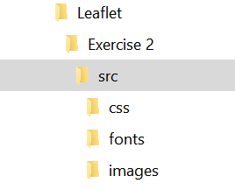
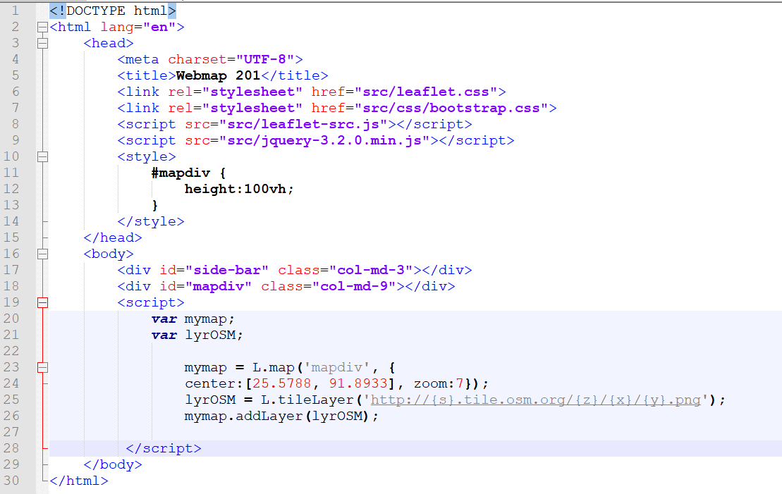
First Web Map Setup
htdocs
Index.html

Slide 9
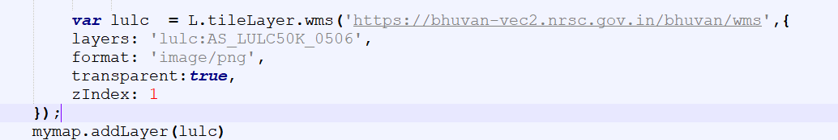
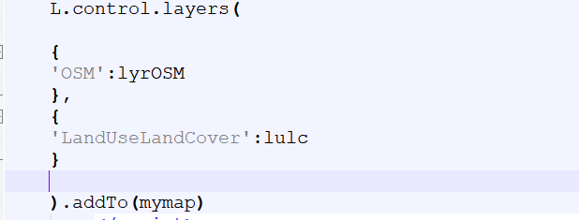
Adding External layer from Bhuvan

Slide 10
Thank you

