Slide 1
ICS 222 Object Oriented Analysis and Design Module -1 (Part 1 and Part 2)

Slide 2
Textbooks/ Reference
1. Grady Booch James Rumbaugh, Ivar Jacobson, The Unified Modeling Language User Guide, Addison Wesley, 2012.
2. Grady Booch, Object Oriented Analysis and Design With Applications, Third Edition, Pearson Education, 2009.
3. Michael Blaha, James Rumbaugh, Object Oriented Modeling and Design with UML, Second Edition, Pearson Education, 2005.

Slide 3
Textbooks/ Reference contd.
4. Martin Fowler, UML Distilled: A Brief Guide to Standard Object Modeling, Third Edition, Addison Wesley, 2015.
5. Brett D. McLaughlin, Gary Pollice, and Dave West,Head First Object-Oriented Analysis and Design, First Edition, O’Reilly, 2006. 6. Elias M Awad, System Analysis and Design, Second Edition, Galgottia Publications Pvt. Ltd, 2015

Slide 4
OOAD – Module 1

Slide 5
What Do Engineers Really Build
Engineers Build Things
Civil →
Mechanical →
Electrical →
Computer Science →

Slide 6
Before We Begin…
Is writing a program the same as building a software system?
Aspect / Topic | Program | Software
Size & Complexity
User Scope
Structure
Documentation
Development Effort

Slide 7
Before We Begin…
Is writing a program the same as building a software system?
Aspect / Topic | Program | Software
Size & Complexity | Small | Large
User Scope | Single user | Multiple users
Structure | Few files | Many modules
Documentation | Little or no documentation | Requires detailed documentation
Development Effort | Written by one person | Developed by a team

Slide 8
Before We Begin…
Which of the following best defines Software Engineering?
A. It mainly focuses on writing correct and efficient code B. It deals only with software testing and debugging C. It includes requirement analysis, design, development, testing, and maintenance D. It focuses on learning programming languages

Slide 9

Software Engineering
Software engineering deals with
requirements analysis
system design
implementation
testing
maintenance
project management

Slide 10
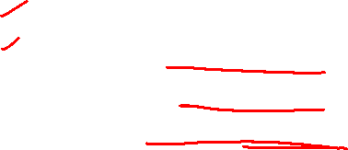
OOAD Focuses On
OOAD concentrates on
understanding the problem domain
identifying objects and classes
defining relationships and interactions
designing system structure before coding

Slide 11
Module 1
Introduction to Systems Concepts: Definition. Characteristics of a System: Organization, Interaction, Interdependence, Integration. Elements of a System: Inputs and Outputs, Processor(s), Control, Feedback, Environment. Types of Systems: Physical/Abstract Systems, Open/Closed Systems, Man-made Information Systems.
System Modelling: The importance of Modelling, Principles of Modelling, Object- Oriented Modelling
Introduction to UML. Best Practices of Software Engineering: Develop Iteratively, Models and visualization, UML, Software Development Life Cycle, SRS, Rational Unified Process: Process, Phases in RUP, RUP Workflows, Process, Lifecycle.

Slide 12
Introduction to System Concepts

Slide 13
Introduction to System Concepts
Definition:
“System is an interrelated set of components used within one unit, working together for some purpose. ”
Example:
A library management system.
A system in the payroll department keeps track of checks.
An inventory system keeps track of supplies.

Slide 14

Example: Air travel system
end-to-end transfer of person plus baggage
ticket (purchase)
baggage (check)
gates (load)
runway takeoff
airplane routing
ticket (complain)
baggage (claim)
gates (unload)
runway landing
airplane routing
airplane routing
How would you define/discuss the system of airline travel?
a series of steps, involving many services

Slide 15
Contd.
ticket (purchase)
baggage (check)
gates (load)
runway takeoff
airplane routing
ticketing service
ticket (complain)
baggage (claim)
gates (unload)
runway landing
airplane routing
baggage service
gate service
runway service
routing service
airplane routing
layers: each layer implements a service
via its own internal-layer actions
relying on services provided by layer below

Slide 16
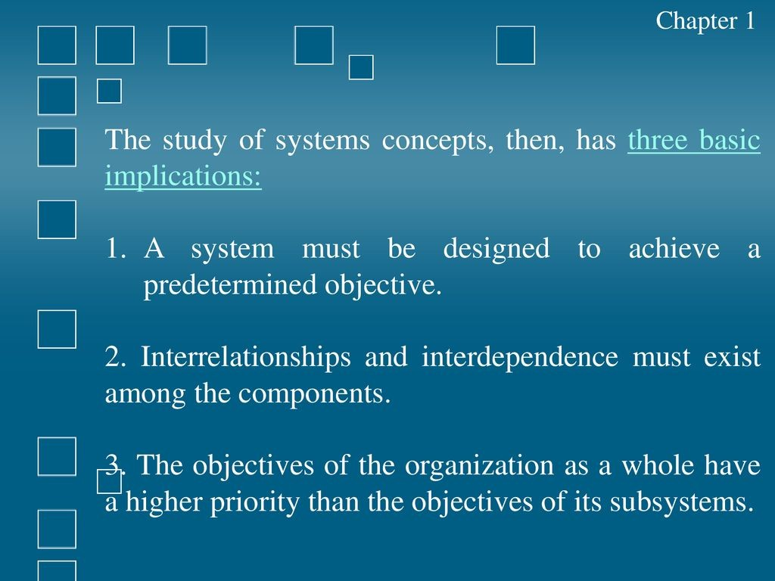
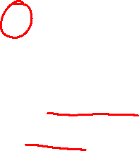
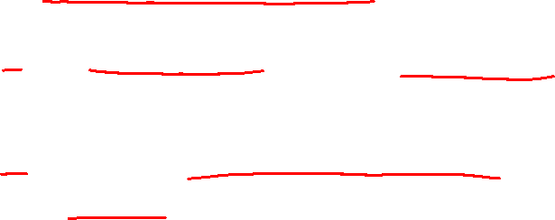

Slide 17
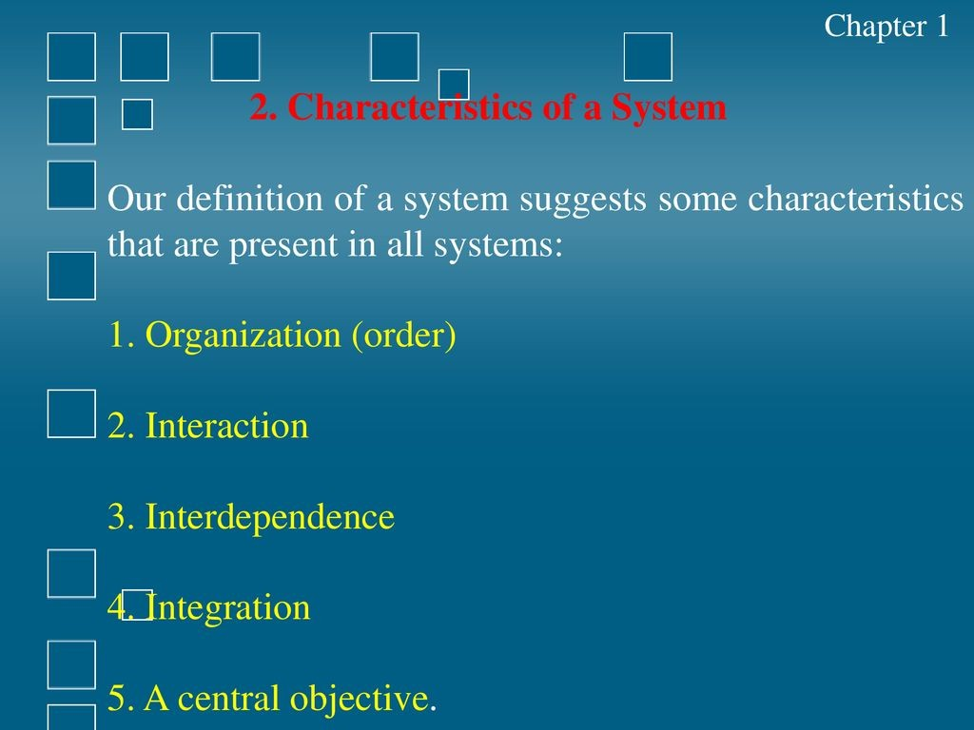
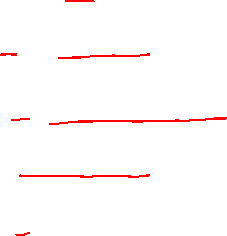


Slide 18
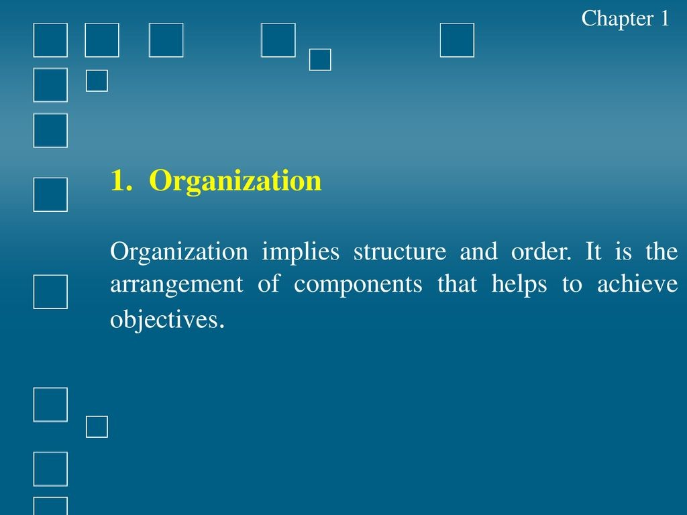
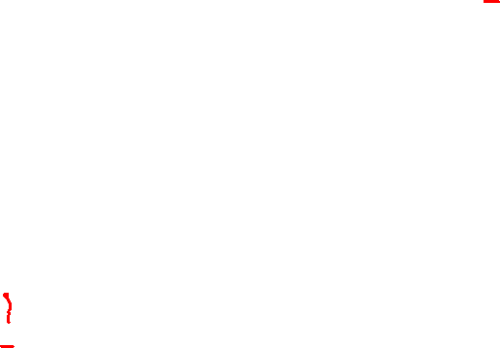
In Object Oriented Analysis and Design, Organization helps us identify
subsystems
responsibilities
interaction order

Slide 19
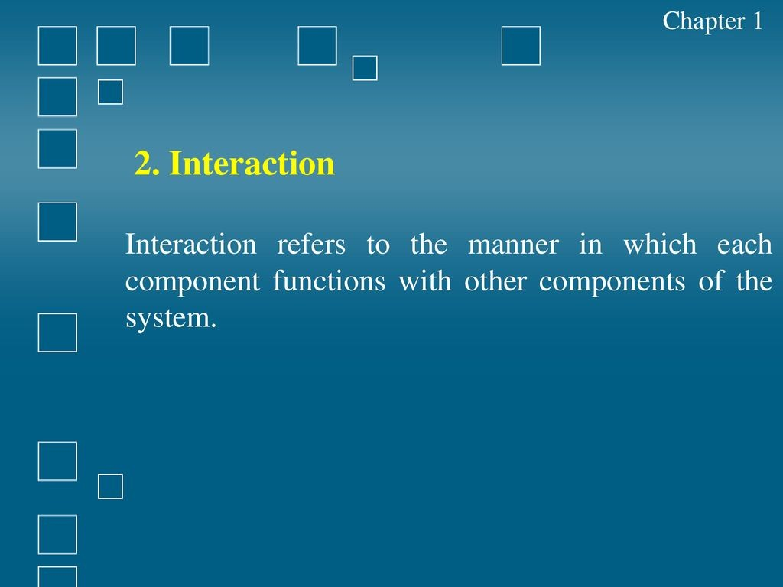
In a system:
- one component depends on input from another
- outputs of one component become inputs to another
- components must coordinate their actions
Without interaction, components remain independent and the system fails.

Slide 20
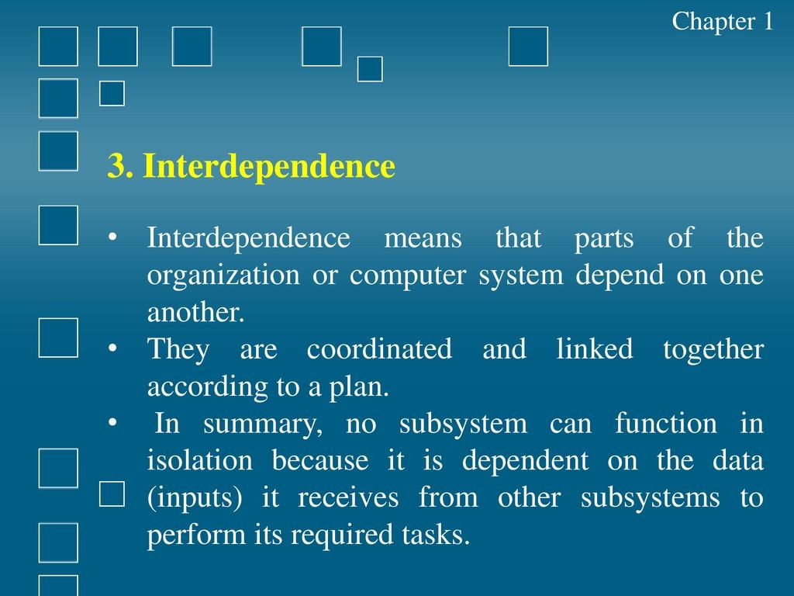

Slide 21
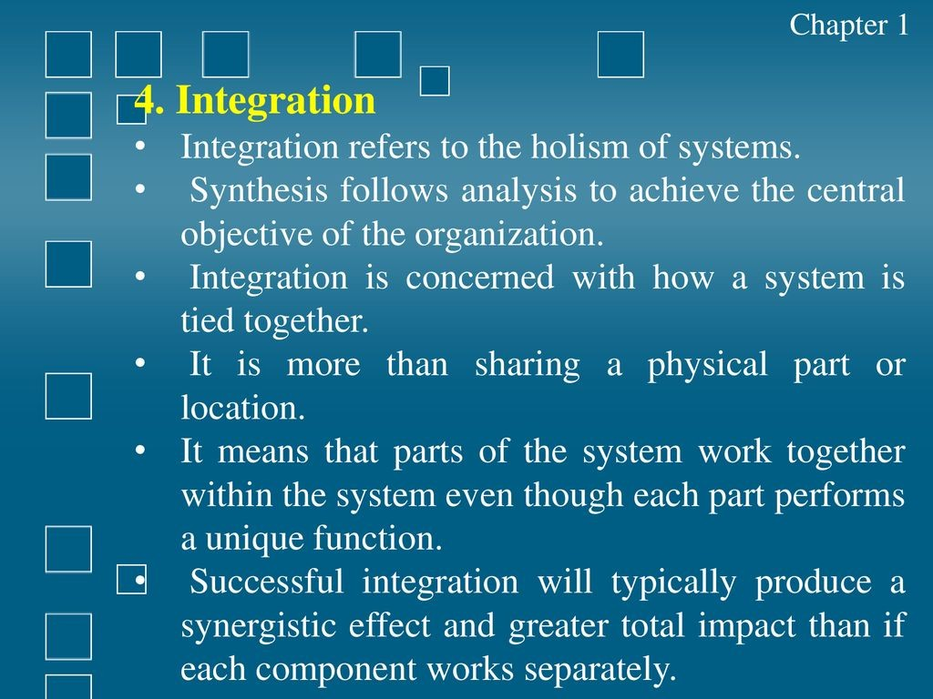

Slide 22
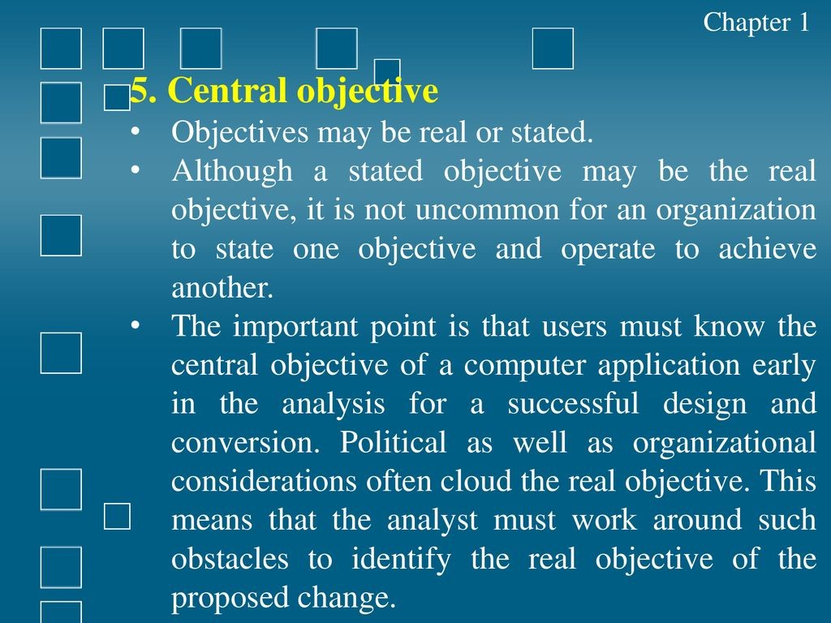

Slide 23
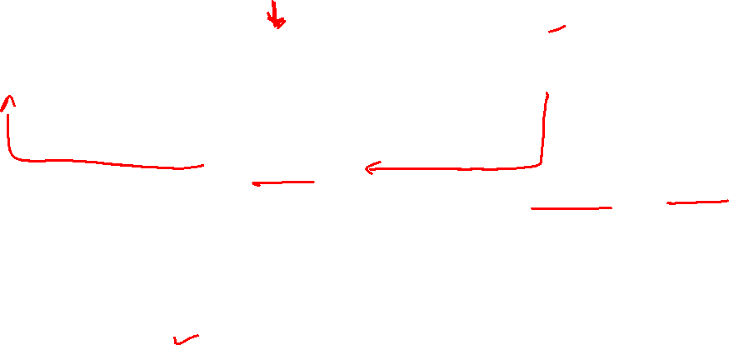
Elements of the System
Boundary and Interface
Environment
Control
Input
Processing
Output
Feedback

Slide 24
Elements of the System
Components : An irreducible part or aggregation of parts that makes up a system; also called a subsystem.
Interrelated components : Dependence of one part of the system on one or more other system parts.
Boundary : The line that marks the inside and outside of a system and that sets off the system from its environment.
Purpose : The overall goal or function of a system.
Environment : Everything external to a system that interacts with the system.
Interfaces : Point of contact where a system meets its environment or where
subsystems meet each other.
Constraints : A limit to what a system can accomplish.
Input : Inputs are the information that enters into the system for processing.
Output : The main objective of a system is to get an output which is helpful for its
user. Output is the final outcome of processing.

Slide 25
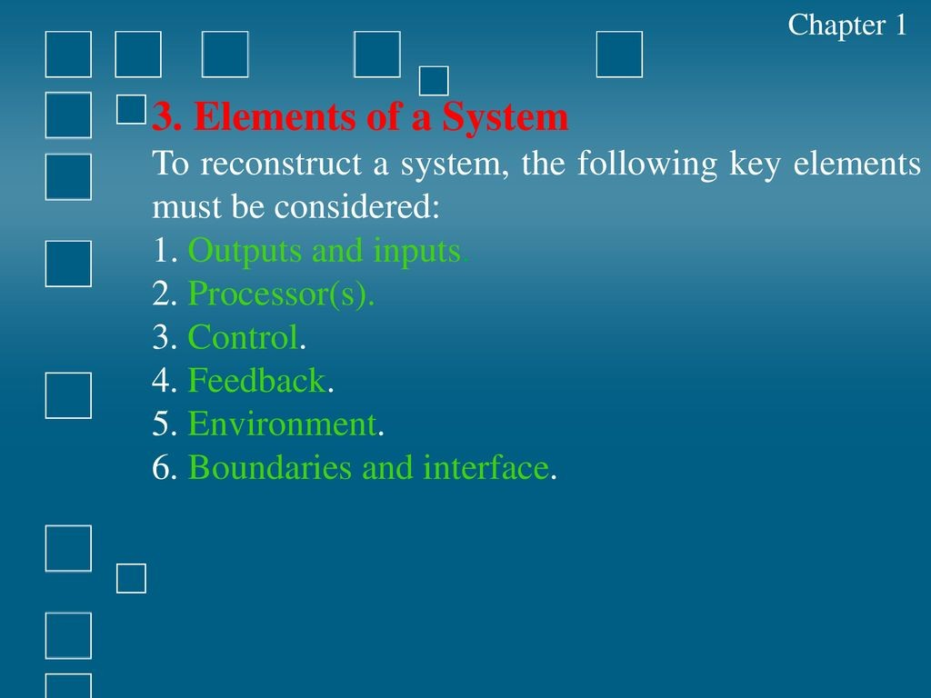

Slide 26
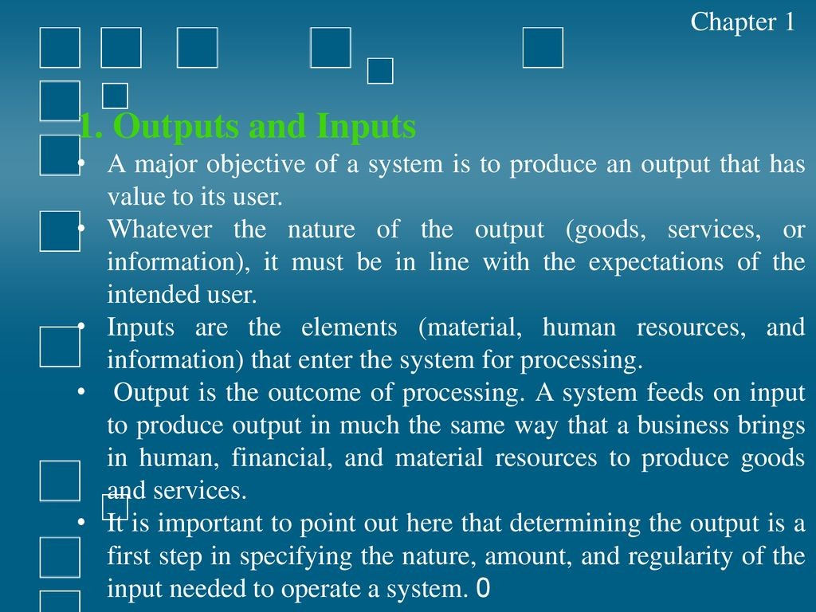

Slide 27
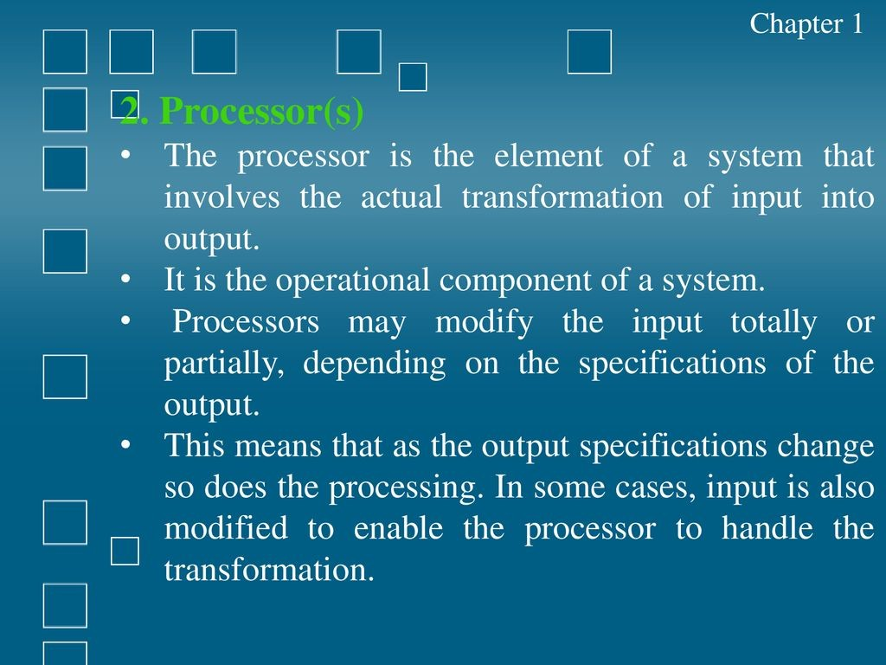

Slide 28
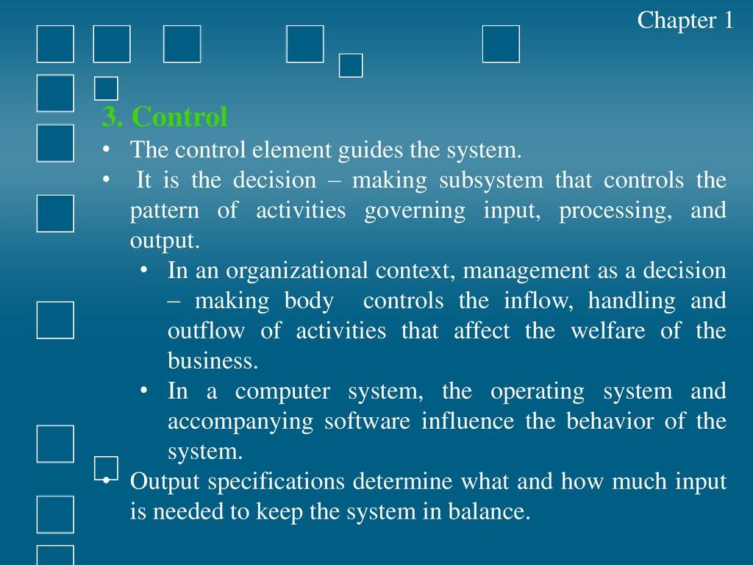

Slide 29
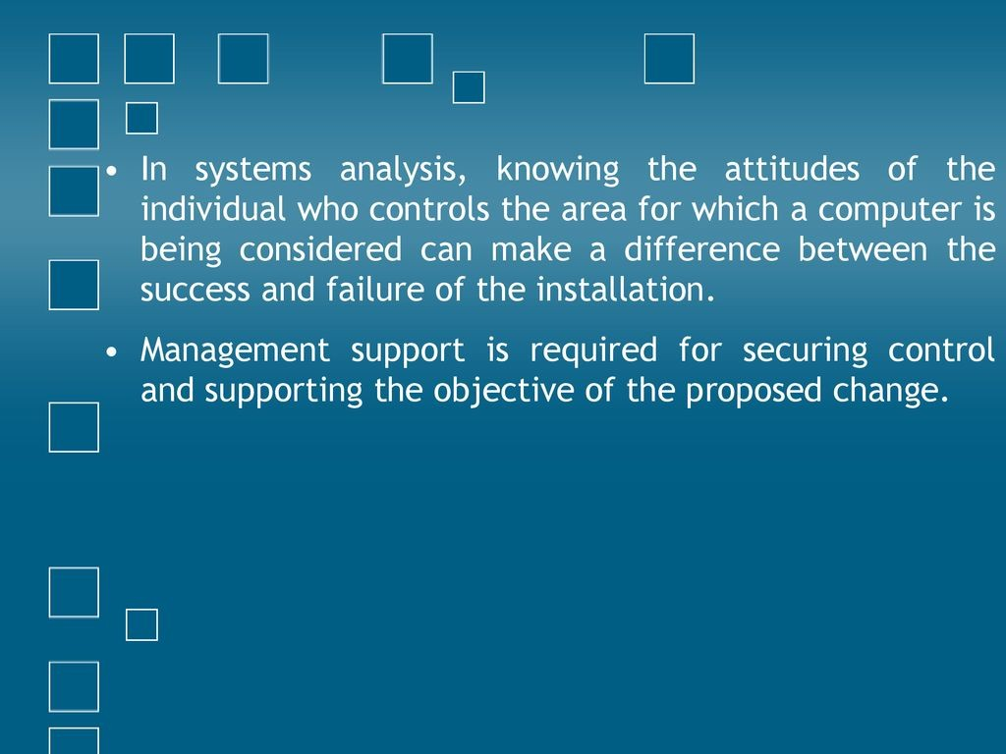

Slide 30
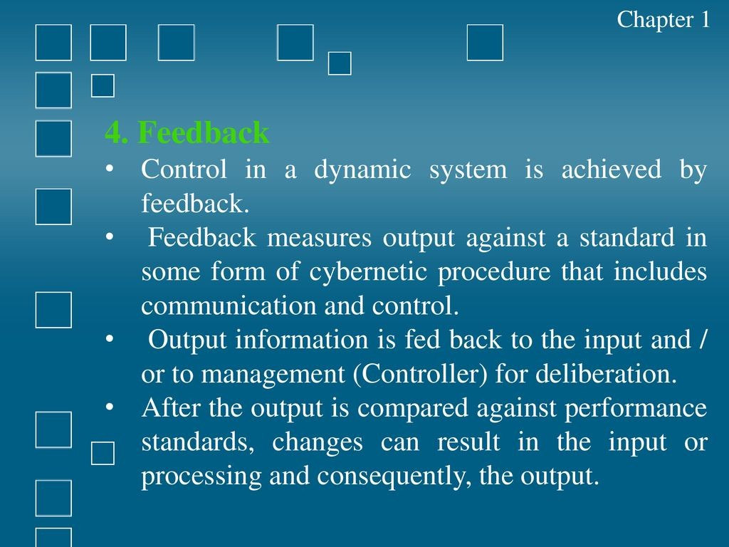

Slide 31
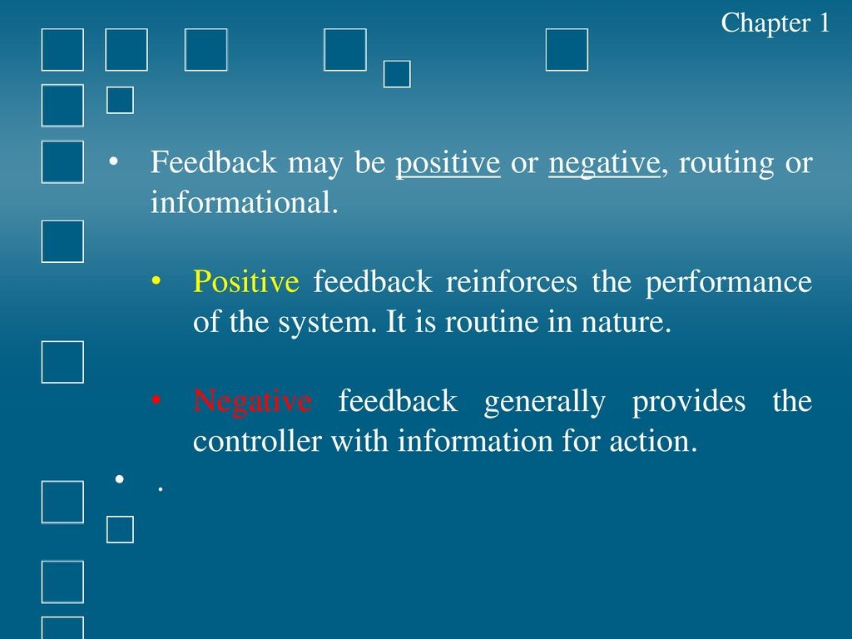

Slide 32
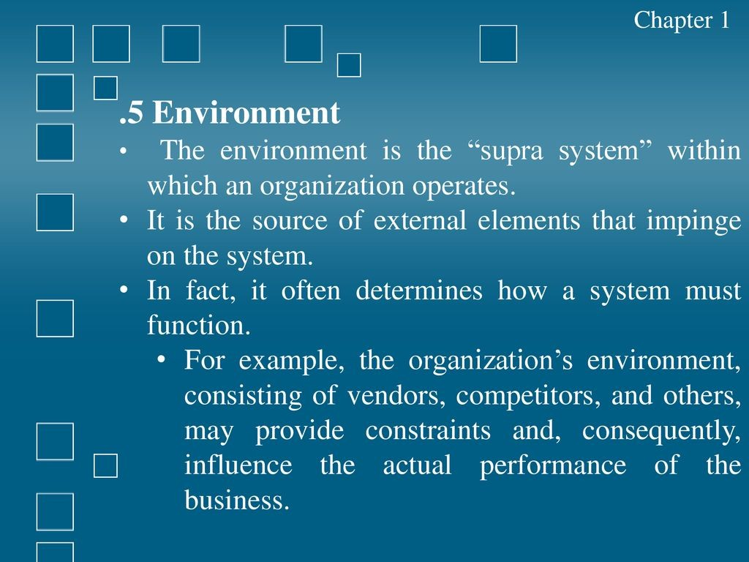

Slide 33
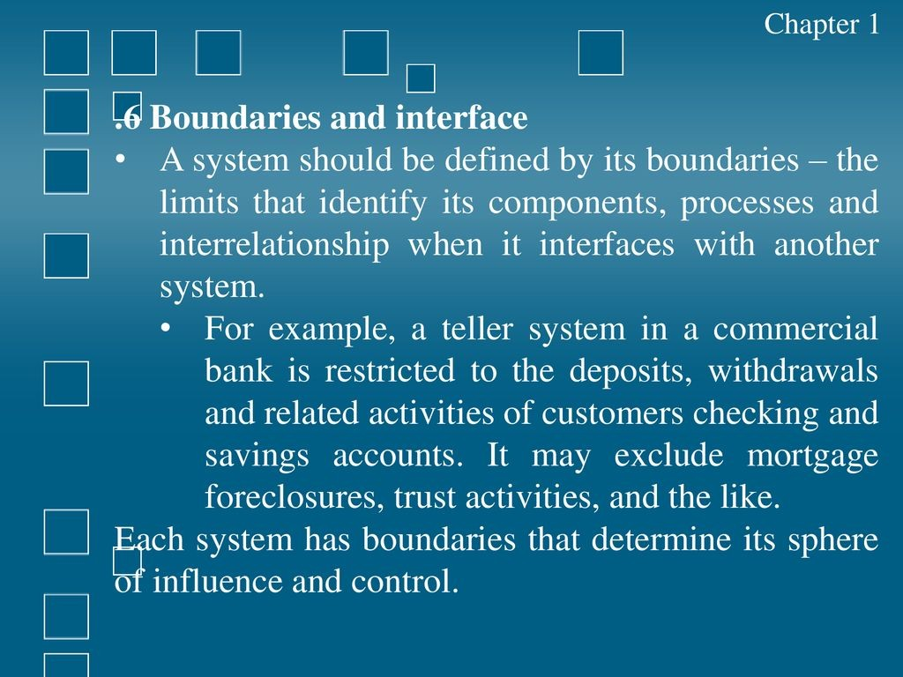

Slide 34
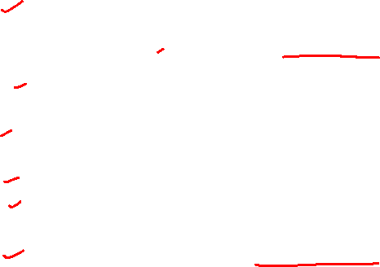
Example
Element | ATM
Input | Card data, PIN, Withdrawal amount
Processing | Verifying PIN, checking balance
Output | Cash, Receipt, Transaction Successful message
Control | Daily limits, Security checks
Feedback | Insufficient Funds or Wrong PIN messages
Interface | The Touch Screen / UI
Environment | The Customer and the Bank’s central server
Boundary - This is the limit of the ATM software. It doesn't own the bank's main database, only interacts with it.

Slide 35
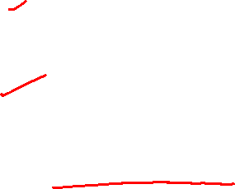
Classification of Systems
Systems have been classified in different ways. Common classifications are:
(1) Physical or abstract
(2) Open or closed
(3) "Man-made" information systems.

Slide 36
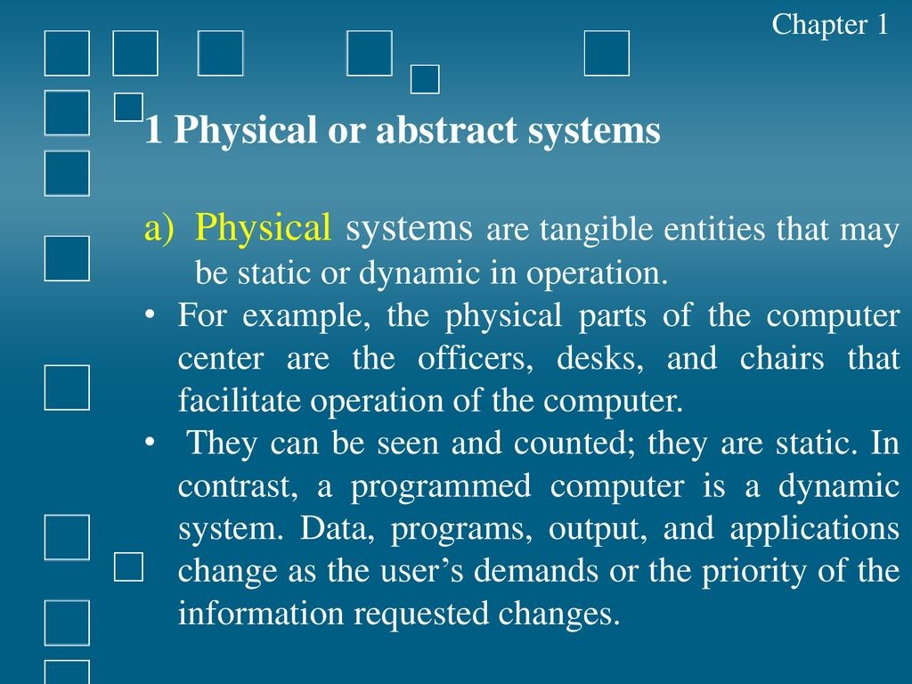

Slide 37
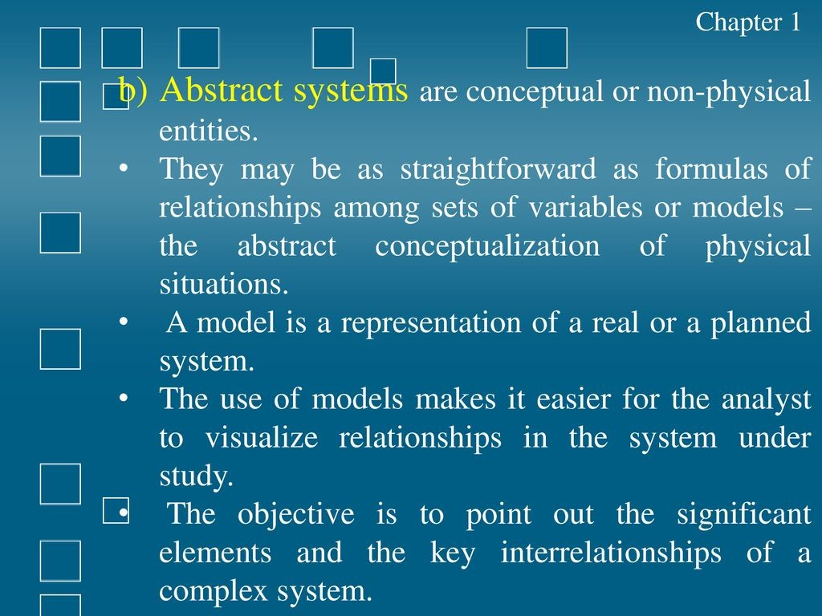

Slide 38
Open v/s Closed Systems
Open system has many interfaces with its environment.
- It permits interaction across its boundary
- It receives inputs from and delivers outputs to the outside world.
An information system falls into this category, since it must adapt to the changing demands of the user.
Closed system is isolated from environmental influences.
- Eg. Standalone Digital Calculator
Notes:
Standalone Digital Calculator

Slide 39
Man-made Information Systems
It is a set of devices, procedures and operating systems designed around user based criteria to produce information and communicate it to the user for planning, control and performance.
Many organizations consider Information systems to be essential to their ability to compete or gain competitive advantage.
A business has several information systems.
Each of this is designed for a purpose and works to accommodate data flow, communications, decision making, control and effectiveness.

Slide 40
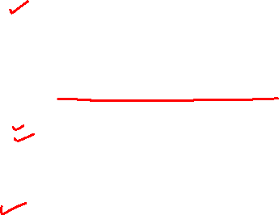
Contd.
Man-made information systems are divided into three types
Formal Information System − It is based on the flow of information in the form of memos, instructions, etc., from top level to lower levels of management.
Informal Information System − This is employee based system which solves the day to day work related problems.
Computer Based System − This system is directly dependent on the computer for managing business applications. For example, automatic library system, railway reservation system, banking system, etc

Slide 41
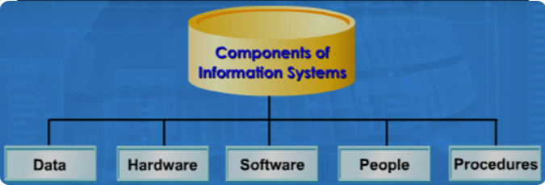

Information System - components
An information system can be defined technically as a set of interrelated components that collect (or retrieve), process, store, and distribute information to support decision making and control in an organization.
They may also help managers and workers analyze problems, visualize complex subjects, and create new products.

Slide 42
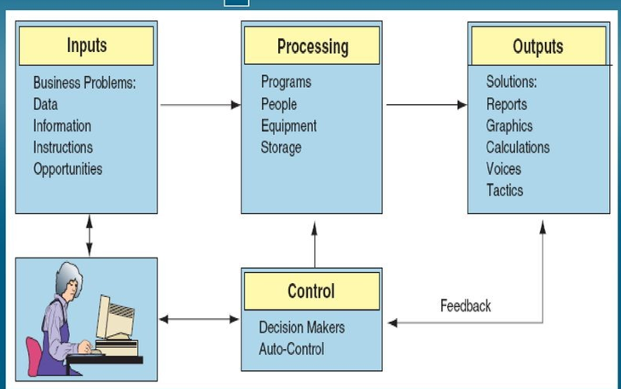
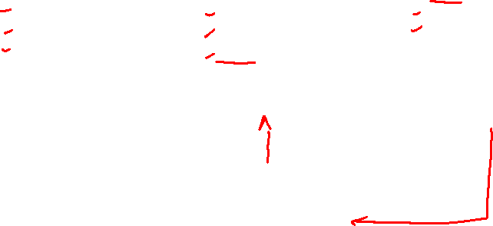
Functions of an Information System

Slide 43
System Modelling

Slide 44
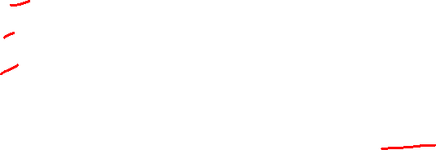
Models
A model is an abstraction of a system
A system that no longer exists
An existing system
A future system to be built.
Eg – constructing a kennel, house, office
Notes:
44

Slide 45
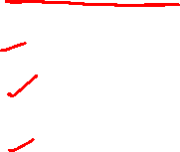
Purpose of Models
A model is an abstraction of something for the purpose of understanding it before building it. Its purpose are:
Testing a physical entity before building it.
Communication with customers.
Visualization.
Reduction of complexity.

Slide 46
Modeling
Develop software rapidly, efficiently, and effectively, with a minimum of software scrap and rework - right people, the right tools, and the right focus.
Modeling is a proven and well-accepted engineering technique
Modeling is a central part of all the activities that lead up to the deployment of good software.

Slide 47
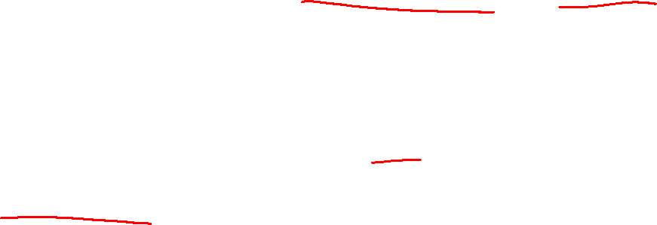
Modeling
1) Build models to communicate the desired structure and behavior of our system.
-what parts the system has (structure)
-how it works (behavior) - Online Food Ordering System
2) Build models to visualize and control the system's architecture. -Models give a high-level view to organize and manage system architecture - E-commerce Website has Separate layers
3) Build models to better understand the system we are building, often exposing opportunities for simplification and reuse
4) Build models to manage risk.
-Eg. Online ticket booking system

Slide 48
Why We Model
The importance of modeling
Four principles of modeling
Object-oriented modeling
5

Slide 49
Importance of modeling
A model is a simplification of reality.
We build models so that we can better understand the system we are developing.
Through modeling, we achieve four aims
Models help us to visualize a system as it is or as we want it to be.
Models permit us to specify the structure or behavior of a system.
Models give us a template that guides us in constructing a system.
4. Models document the decisions we have made.
6

Slide 50
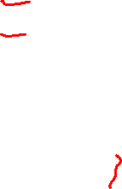
Principles of Modeling
Four principles of modeling:
The choice of what models to create has a profound influence on how a problem is attacked and how a solution is shaped.
Every model may be expressed at different levels of precision.
The best models are connected to reality.
No single model is sufficient. Every nontrivial system is best approached through a small set of nearly independent models.
50

Slide 51
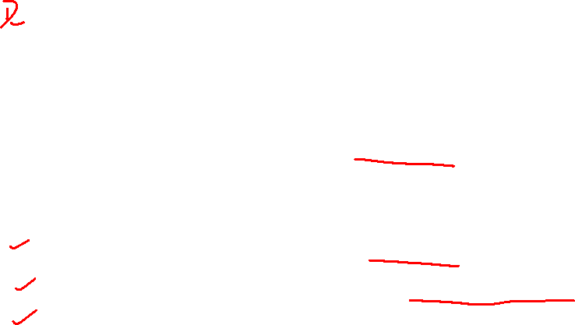
The choice of what models to create has a profound influence on how a problem is attacked and how a solution is shaped
Choose your models well
- Good models help us understand complex problems that are otherwise hard to see.
In software, the models you choose can greatly affect your world view. - Database developer - focus on entity-relationship models
- Structured analyst - models that are algorithmic-centric
- Object-oriented developer - sea of classes and the patterns of interaction

Slide 52
Every model may be expressed at different levels of precision.
Modeling ranges from simple executable user interface prototypes to detailed technical specifications for interfaces and performance issues.
- Good models allow different levels of detail based on who is viewing them and why.
- analyst or an end user - issues of what
- a developer - issues of how.

Slide 53
The best models are connected to reality.
- All models simplify reality
- Be sure that your simplifications don't mask any important details.

Slide 54
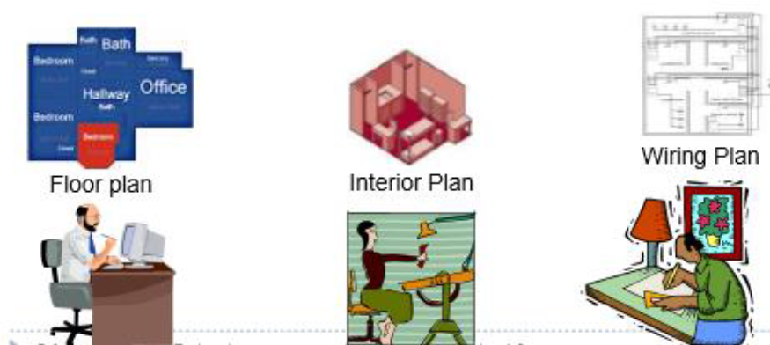

No single model is sufficient. Every nontrivial system is best approached through a small set of nearly independent models.
object-oriented software systems
- a use case view (exposing the requirements of the system)
- a design view (capturing the vocabulary of the problem space and the solution space), - a process view (modeling the distribution of the system's processes and threads)
an implementation view (addressing the physical realization of the system)
deployment view (focusing on system engineering issues).

Slide 55

We use Models to describe Software Systems
Object model: What is the structure of the system?
Functional model: What are the functions of the system?
Dynamic model: How does the system react to external events?
System Model: Object model + functional model + dynamic model
Notes:
55

Slide 56
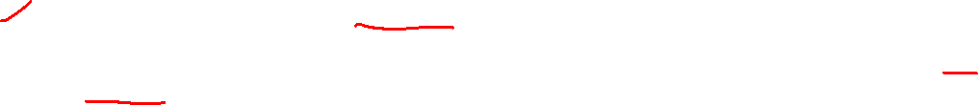
Object Oriented Modeling
Several ways to approach a model.
The two most common ways - an algorithmic perspective and from an object- oriented perspective.
Traditional view - an algorithmic perspective.
Main building block of all software is the procedure or function (readData(), calculateTotal()).
Developers to focus on issues of control and the decomposition of larger algorithms into smaller ones.
As requirements change and the system grows, systems built with an algorithmic focus turn out to be very hard to maintain.

Slide 57
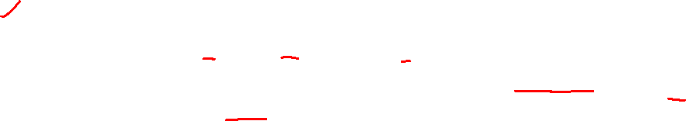
Object Oriented Modeling
The contemporary view - an object-oriented perspective.
Main building block of all software systems is the object or class.
Object is a thing
Class is a description of a set of common objects.
Every object has identity, state, and behavior.
Example: Simple three-tier architecture for a billing system- a user interface, middleware, and a database.

Slide 58
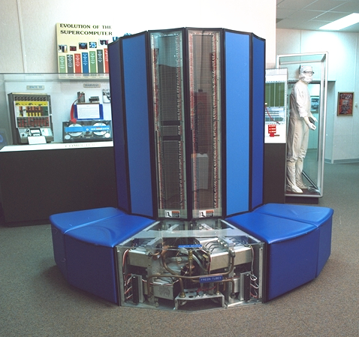
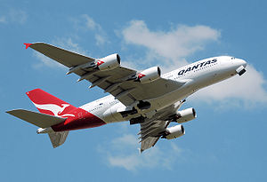
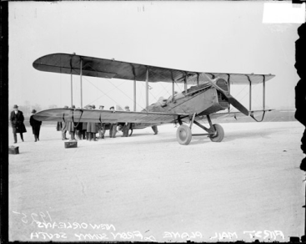

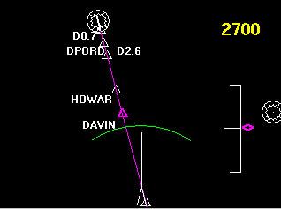


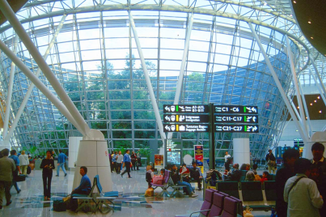
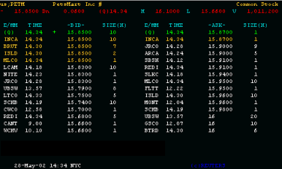

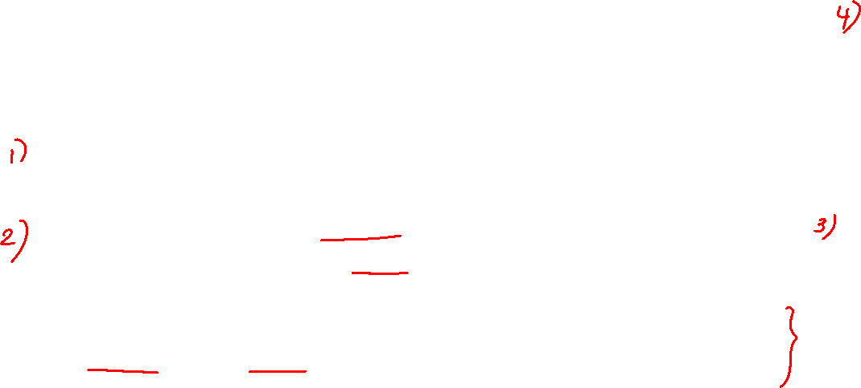
Object-oriented Modeling
Supercomputer
Aircraft's Navigation Display
Application Domain (Phenomena)
Solution Domain (Phenomena)
System Model (Concepts)
(Analysis)
System Model (Concepts)
(Design)
UML
Package
Summary
Display
MapDisplay
TrafficControl
TrafficController
FlightPlanDatabase
Aircraft
TrafficControl
Airport
FlightPlan
Air Traffic Control system
Notes:
58

Slide 59
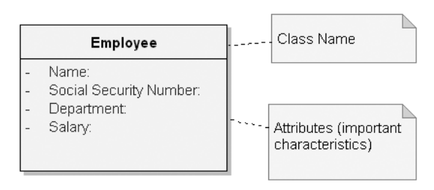
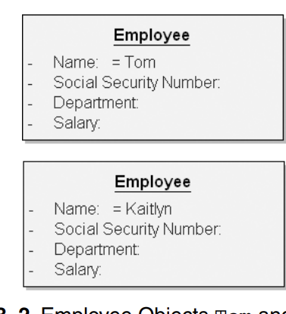
Class vs Object
Fig. 1 shows Employee Class with Attributes
Fig. 2 shows Employee Objects Tom and Kaitlyn
- Object is an instance of a class.
- Objects play many different roles during their lifetimes
- Objects contribute to the behavior of a system by collaborating with one another

Slide 60
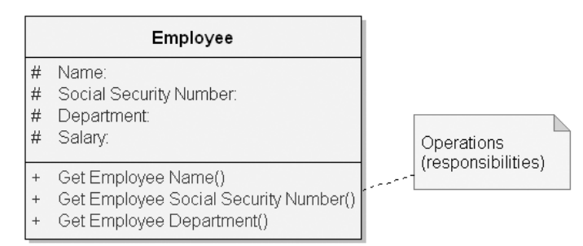
Contd.
It is good engineering practice to encapsulate the state of an object rather than expose it.
Fig. shows Employee Class with Protected Attributes and Public Operations

