Slide 1
OOAD
(Module 1 – Part 3-RUP)

Slide 2
Software Requirement Specification (SRS)
Introduction
Purpose of this document : What
Scope of this document : Why
Document Overview : Summary
General description: Includes objective of user, a user characteristic, features, benefits, about why its importance is mentioned.
Functional Requirements: Includes effects due to operation of program is fully explained.
Interface Requirements: How software program communicates with each other or users.
Performance Requirements: How a software system performs desired functions under specific condition is explained.
Design Constraints: Limitation or restriction are specified and explained for design team.
Non-Functional Attributes : Required by software system for better performance.
Preliminary Schedule and Budget:
Appendices

Slide 3
Benefits of an SRS:
Clear communication: An SRS ensures everyone involved in the project understands the software's requirements. This helps to avoid misunderstandings and rework later in the development process.
Reduced risk of errors: A well-defined SRS can help to identify and mitigate potential risks early on.
Improved project management: An SRS provides a roadmap for the development team, which can help to improve project planning and execution.
Increased quality: A clear understanding of the requirements can help to ensure that the software is built to meet the needs of its users.

Slide 4
Rational Unified Process (RUP)
RUP is a specific framework that provides a structured approach to implementing the SDLC.
A process is a set of partially ordered steps intended to reach a goal.
The UML is largely process-independent. RUP is well-suited to the UML.
Goal: Enable the production of highest quality software that meets end-user needs within predictable schedules and budgets.
Management side: Provides a disciplined approach on how to assign tasks and responsibilities.

Slide 5
Characteristics of Process
RUP is an Iterative process
RUP emphasize the creation and maintenance of Models rather than documents.
Architecture centric - The overall design of s/w is created. The final product is well structured and easy to maintain.
Use Case driven - This helps in prioritizing features and ensuring that the system meets user needs effectively.
Object oriented techniques - It allows for reuse of components and enhances the maintainability of the system.
Configurable process - Because these two projects are very different in size, risk, and complexity, the development process must be configured differently. This is why RUP is called a configurable process.
Quality control and risk management

Slide 6
Small Project Vs Large Project
Aspect | A) College Event App | B) Railway Reservation System
Team size | 2–4 students | 50+ developers, testers, managers
Users | Limited (college students) | Millions of users
Project duration | 1–2 months | 1–2 years or more
Complexity | Low | Very high
Risk | Low | Very high (money, safety, reliability)
Documentation | Minimal | Very detailed and formal
Architecture effort | Simple layered structure | Strong, distributed architecture
Testing | Basic functional testing | Multi-level, rigorous testing
Security | Basic login | Strong authentication, encryption
Performance needs | Normal | High performance, high concurrency
Scalability | Not critical | Very important
Process strictness | Light, flexible | Strict, disciplined
Iterations | Few, short | Many planned releases
Budget control | Informal | Strict planning and tracking
Notes:
Because these two projects are very different in size, risk, and complexity, the development process must be configured differently. This is why RUP is called a configurable process.

Slide 7
Phases and iterations:
A phase is the span of time between two major milestones of the process ,when a well-defined set of objectives are met, artifacts are completed, and decisions are made whether to move into the next phase.
Inception: Establish the business case for the project
Elaboration: Establish a project plan and a sound architecture
Construction: Develop the system
Transition: Supply the system to its end users
An iteration represents a complete development cycle, from requirements capture in analysis to implementation and testing, that results in the release of an executable project.

Slide 8
Phases:
Inception
Establish the business case for the system and delimit the project's scope.
The business case includes success criteria, risk assessment, estimates of the resources needed, and a phase plan showing a schedule of major milestones.
Create an executable prototype that serves as a proof of concept.
At the end, Examine the life cycle objectives of the project and decide whether to proceed with full-scale development.

Slide 9
Elaboration
Goal: Analyze the problem domain, establish a sound architectural foundation, develop the project plan, and eliminate the highest risk elements of the project.
Architectural decisions must be made with an understanding of the whole system
Describe most of the system's requirements.
Verify the architecture: Implement a system that demonstrates the architectural choices(prototypes and models) and executes significant use cases.
At the end, examine the detailed system objectives and scope, the choice of architecture, and the resolution of major risks, and decide whether to proceed with construction.
The development team works with stakeholders to clarify and validate functional and non-functional requirements

Slide 10
Construction
Iteratively and incrementally develop a complete product that is ready to transition to its user community.
Describing the remaining requirements and acceptance criteria, focusing on the low-level design, and completing the implementation and test of the software.
At the end , decide if the software, sites, and users are all ready to go operational.
Transition
Deploy the software to the user community.
Require additional development in order to adjust the system, correct some undetected problems, or finish some features that have been postponed.
Starts with a beta release (test version) of the system, which is then replaced with the production system (live version).
At the end, decide whether the life cycle objectives of the project have been met and determine if you should start another development cycle.

Slide 11
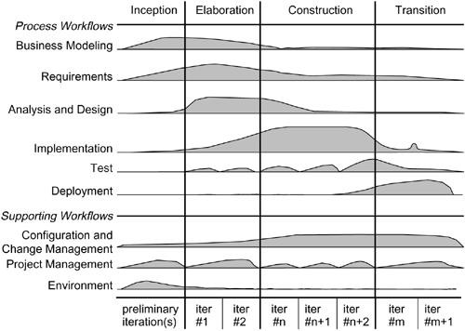

Slide 12
Process Workflows:
The Rational Unified Process consists of nine process workflows.
The process that happens in each phase gives the structured approach to assigning responsibilities and tasks to the team.
Business modeling - model the business and its processes to understand the system requirements so that the s/w can be designed .
Requirements - Establish and maintain agreement with the customers and other stakeholders on what the system should do. Define the boundaries of (delimit) the system.
Analysis and design- how we will build the system to meet the user requirements. Create a model that serves as a blueprint.
Implementation - Components are tested, assembled and tested as a coherence system.
Test- Proper integration of all components and working of full system . Find out the faults. End to end and user acceptance testing happens in transition phase.
Deployment - Packaging , distribution, installation, help, assistance, data migration, acceptance testing and user acceptance.

Slide 13
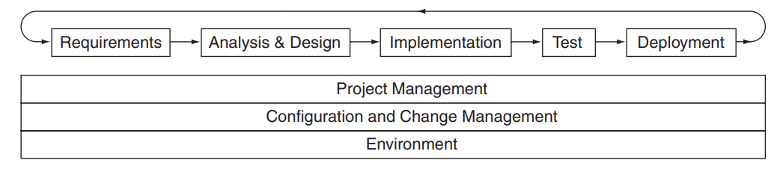
Process Workflows:
The following disciplines are executed throughout the lifecycle.
Project management: Manage the software development project, including planning, staffing, and monitoring the project, as well as managing the risks.
Configuration and change management Identify the configuration items (code, design docs, user docs), control changes to those items, and manage configurations of those items.
Environment - Covers the necessary infrastructure required to develop a system. Provide the software development environment, including both processes and tools that support the development team. Customizing RUP to a specific context.
Figure shows the relative order and iterative nature of the macro process disciplines. Each cycle through the disciplines constitutes an iteration of the macro process.

Slide 14
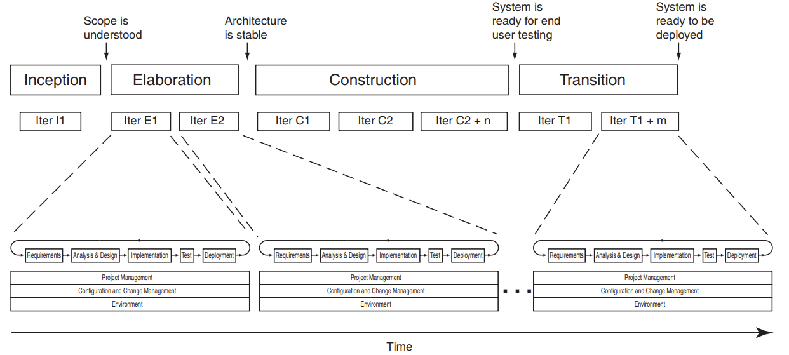
Process Milestones, Phases, and Iterations

Slide 15
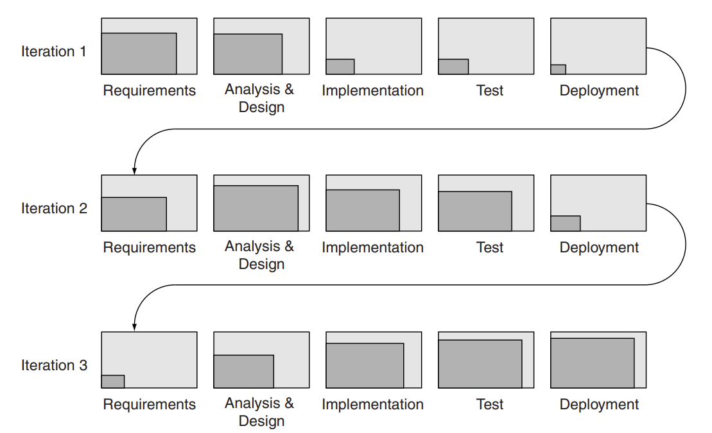
Shifting Focus of Iterations

