Slide 1
OOAD
(Module 1 – Part 3)

Slide 2
Introduction to UML

Slide 3

What is the UML?
“The Unified Modeling Language is a family of graphical notations, backed by a single meta- model, that help in describing and designing software systems, particularly software systems built using the object-oriented style.”
UML first appeared in 1997
Grady Booch, James Rumbaugh, and Ivor Jacobson are the primary contributors to UML.
UML is standardized. Its content is controlled by the Object Management Group (OMG), a consortium of companies.
1

Slide 4
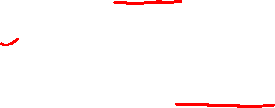
What is the UML?
Language
UML is primarily a graphical language that follows a precise syntax.
UML 2.5.1 is the most recent version
Visit the link https://www.uml.org/
Tools – StarUML, Lucidchart, Microsoft Visio
₂₃ 23

Slide 5
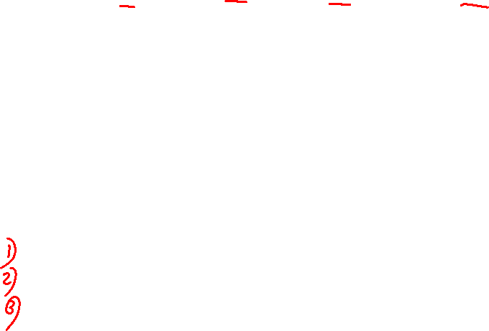
UML – Unified Modeling Language – Graphical language.
Standard language – Software development.
Used to visualize, specify, construct and document.
Ranging from enterprise information systems to distributed Web- based applications and hard real time embedded systems
Addressing all the views needed to develop and then deploy such systems.
Not difficult to understand and to use.
Three major elements:
Basic building blocks
Rules that dictate how these building blocks may be put together
some common mechanisms that apply throughout the language.

Slide 6
Conceptual and physical representation of a system
Modeling yields an understanding of a system.
No one model is ever sufficient.
Need multiple models that are connected to one another in order to understand.
UML tells you how to create and read well defined models.
A well-defined process guide you in deciding what artifacts to produce, what activities and what workers to use to create them and manage them, and how to use those artifacts to measure and control the project

Slide 7
What is the UML?
Unified
UML combined the best from object-oriented software modeling methodologies that were in existence during the early 1990’s.
Grady Booch, James Rumbaugh, and Ivor Jacobson are the primary contributors to UML.

Slide 8
What is the UML?
Modeling
Used to present a simplified view of reality in order to facilitate the design and implementation of object-oriented software systems.
All creative disciplines use some form of modeling as part of the creative process. Eg. Film and animation (Maya or Blender)
UML is a language for documenting design
Provides a record of what has been built.
Useful for bringing new programmers up to speed.

Slide 9
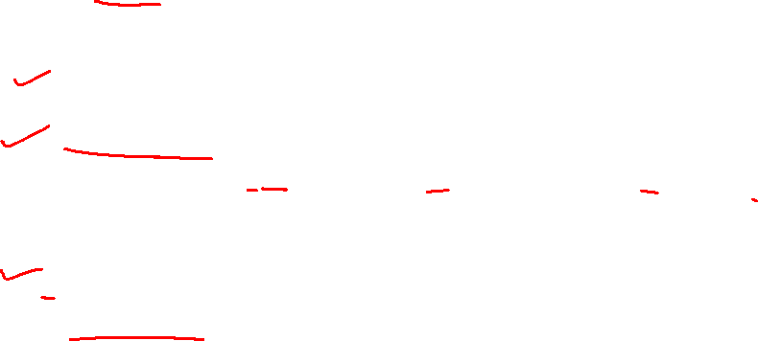
Conceptual Model of the UML
Building Blocks of the UML:
The vocabulary of the UML encompasses three kinds of building blocks:
Things – represent things that make up system.
Relationships - describe how things interact or depend on each other, such as inheritance, realization, composition, aggregation, association, and dependency.
Diagrams - graphical representations of things and relationships, organized into different views of a system.
9

Slide 10
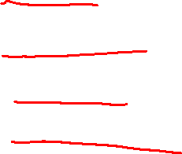
Conceptual Model of the UML - Things
1. Things in the UML – represent the abstraction of elements.
There are four kinds of things in the UML:
1. Structural things
2. Behavioral things
3. Grouping things
4. Annotational things
10

Slide 11

Structural Things
Structural things are the nouns of UML models. These are the mostly static parts of a model, representing elements that are either conceptual or physical. In all, there are seven kinds of structural things.
Classes
Interface
Collaborations
Use cases
Active Classes
Components
Nodes

Slide 12
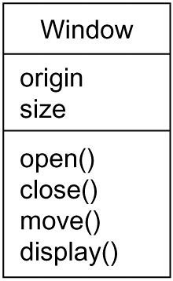
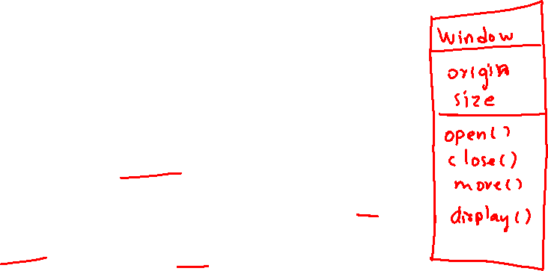
Conceptual Model of the UML
Classes:
A class is a description of a set of objects that share the same attributes, operations, relationships, and semantics.
A class implements one or more interfaces.
Graphically, a class is rendered as a rectangle, usually including its name, attributes, and operations
Figure : Classes
12

Slide 13

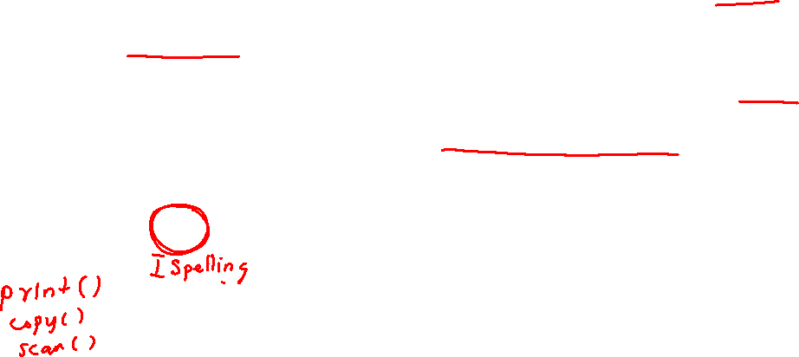
Conceptual Model of the UML
Interface
An interface is a collection of operations that specify a service of a class or component.
It specifies what operations a class should perform, but not how to perform them.
If many classes follow the same interface, they all will have the same method names.
An interface by itself cannot work. A class must implement (realize) it.
Figure :Interfaces
13

Slide 14
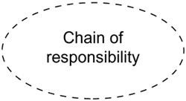
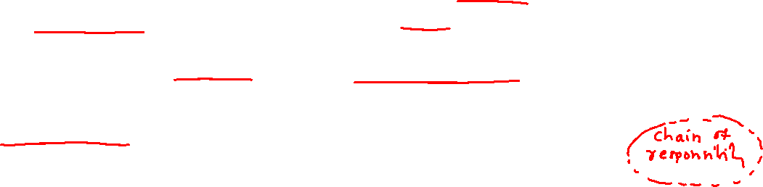
Conceptual Model of the UML
Collaborations
A collaboration defines an interaction.
These collaborations therefore represent the implementation of patterns that make up a system.
Graphically, a collaboration is rendered as an ellipse with dashed lines, usually including only its name.
Eg. if you have a User class and an Authentication class, the User might call methods from the Authentication class (like authenticate()) to log in.
They collaborate by exchanging data and invoking each other's operations to complete the login process.
Figure: Collaborations
14

Slide 15
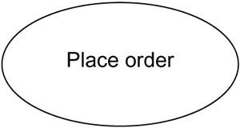
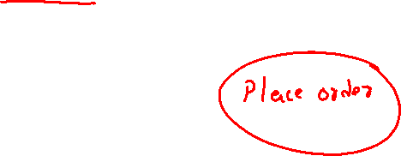
Conceptual Model of the UML
Use Cases:
Use case is a description of set of sequence of actions that a system performs that yields an observable result of value to a particular actor.
A use case is used to structure the behavioral things in a model.
It describes a goal that the system needs to achieve, usually from the perspective of the user.
Example: In an online shopping system, a use case could be Place an Order, where the user (actor) selects items and submits an order.
Graphically, a use case is rendered as an ellipse with solid lines, usually including only its name
Figure: Use Cases
15

Slide 16
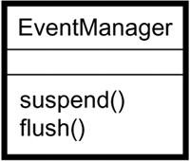
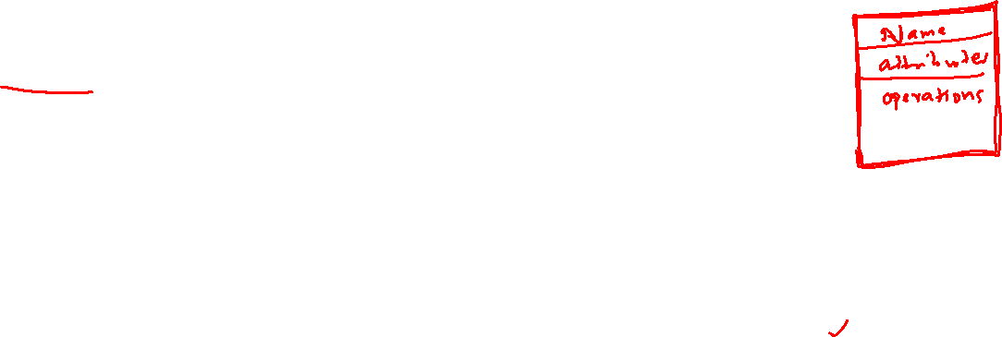
Conceptual Model of the UML
Active Classes:
An Active Class is a special type of class that is capable of initiating its own actions or controlling its own behavior.
An active class represents an entity that has its own thread of control, meaning it can execute independently and concurrently in the system, without waiting for external interactions.
An active class is rendered just like a class, but with heavy lines, usually including its name, attributes, and operations.
The flush() method is used to process all the events in the event queue immediately, without waiting for the normal event processing cycle.
Figure :Active Classes
16

Slide 17
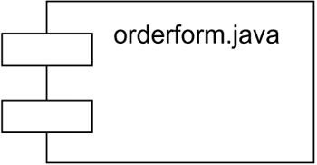
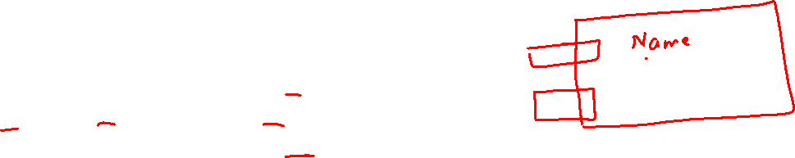
Conceptual Model of the UML
Components:
A component typically represents the physical packaging of otherwise logical elements, such as classes, interfaces, and collaborations.
Component represents a modular, replaceable part of a system that conforms to a set of interfaces.
Graphically, a component is rendered as a rectangle with tabs, usually including only its name.
Figure :Components
17

Slide 18
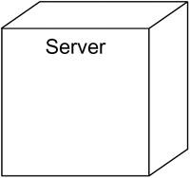
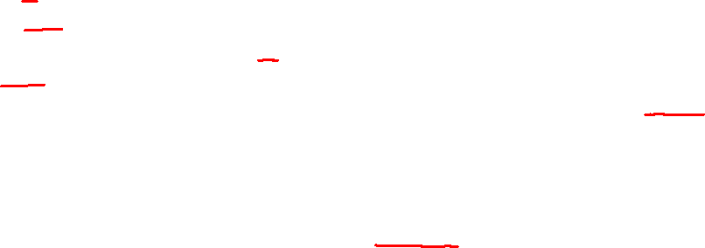
Conceptual Model of the UML
Nodes:
A node is a physical element that exists at run time and represents a computational resource, generally having at least some memory and, often, processing capability.
A set of components may reside on a node and may also migrate from node to node.
Graphically, a node is rendered as a cube, usually including only its name
Figure :Nodes
18

Slide 19
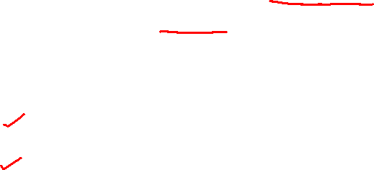
Conceptual Model of the UML
Behavioral Things:
Behavioral things are the dynamic parts of UML models.
- These are the verbs of a model, representing behavior over time and space.
- In all, there are two primary kinds of behavioral things.
Messages
States
19

Slide 20
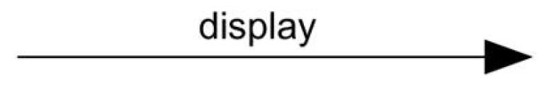
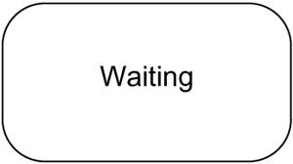
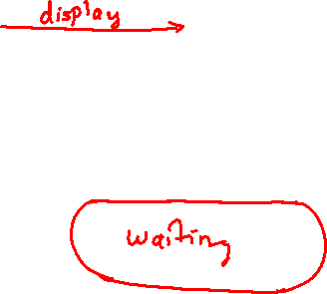
Conceptual Model of the UML
Messages:
An interaction is a behavior that comprises a set of messages exchanged among a set of objects within a particular context to accomplish a specific purpose. Graphically, a message is rendered as a directed line, almost always including the name of its operation.
States:
A state machine is a behavior that specifies the sequences of states an object or an interaction goes through during its lifetime in response to events, together with its responses to those events.
20

Slide 21
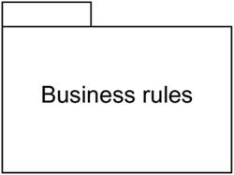
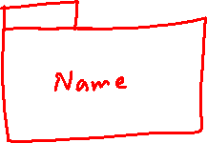
Conceptual Model of the UML
Grouping Things:
Grouping things are the organizational parts of UML models. These are the boxes into which a model can be decomposed. In all, there is one primary kind of grouping thing, namely, packages.
Packages:
A package is a general-purpose mechanism for organizing elements into groups.
Graphically, a package is rendered as a tabbed folder, usually including only its name and, sometimes, its contents
Figure: Packages
21

Slide 22
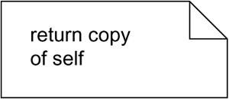
Conceptual Model of the UML
Annotational Things:
Annotational things are the explanatory parts of UML models. These are the comments you may apply to describe, illuminate, and remark about any element in a model.
There is one primary kind of annotation thing, called a note.
A note is simply a symbol for rendering constraints and comments attached to an element or a collection of elements.
Figure: Notes
24

Slide 23
2.Relationships:
A relationship is a connection among things.
In object-oriented modeling, the most important relationships are dependencies, generalizations , associations and realization.

Slide 24
Dependencies
Relationship that states that one thing uses the information and services of another thing , but not necessarily the reverse.
A dependency exists between two classes when one class relies on another, but the relationship is not as strong as association or inheritance. It represents a more loosely coupled connection between classes.
Dependencies are often depicted as a dashed arrow pointing from the dependent (client) to the independent (supplier) element, occasionally including a label

Slide 25
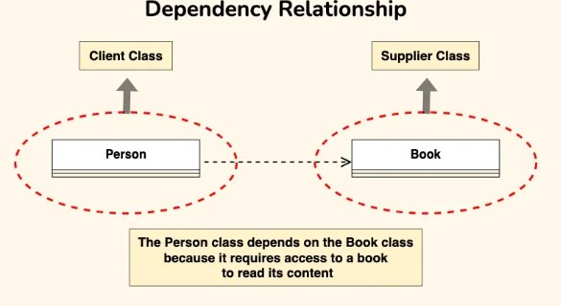
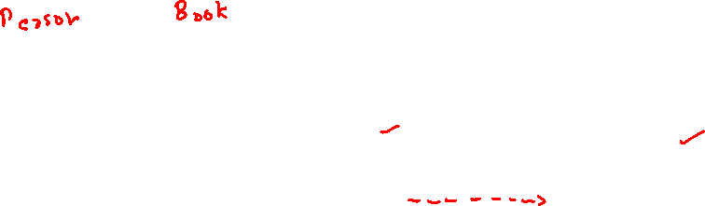
Let’s consider a scenario where a Person depends on a Book.
Person Class: Represents an individual who reads a book. The Person class depends on the Book class to access and read the content.
Book Class: Represents a book that contains content to be read by a person. The Book class is independent and can exist without the Person class.

Slide 26
Generalizations
A generalization is a relationship between a general kind of thing and a more specific kind of thing.
Generalization is sometimes called an "is-a-kind-of" relationship:
one thing (class Journal) is-a-kind-of a more general thing (the class Book).
Graphically, a generalization relationship is rendered as a solid line with a hollow arrowhead pointing to the parent.

Slide 27
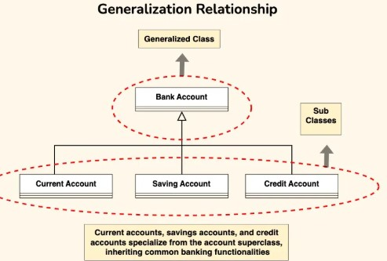
Here one class (the subclass or child) inherits the properties and behaviors of another class (the superclass or parent).
Eg : In bank accounts, we can use generalization to represent different types of accounts such as current accounts, savings accounts, and credit accounts.

Slide 28
Associations
An association is a structural relationship that specifies that objects of one thing are connected to objects of another.
Given an association connecting two classes, you can relate objects of one class to objects of the other class.
An association that connects exactly two classes is called a binary association.
Although it's not as common, you can have associations that connect more than two classes; these are called n-ary associations.
There are four adornments that apply to associations : Name, Role, Multiplicity and Aggregation.
Graphically, an association is rendered as a solid line, possibly directed, occasionally including a label, and often containing other adornments, such as multiplicity and role names

Slide 29
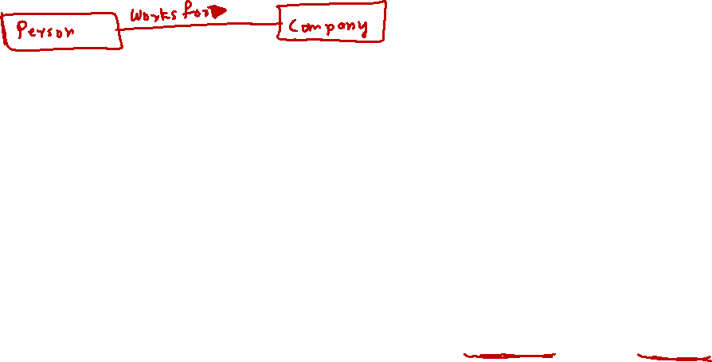
Name:
An association can have a name, which is used to describe the nature of the relationship.
Role :
Class has a specific role that it plays in that relationship; a role is just the face the class at the far end of the association presents to the class at the near end of the association.
Explicitly name the role a class plays in an association.

Slide 30
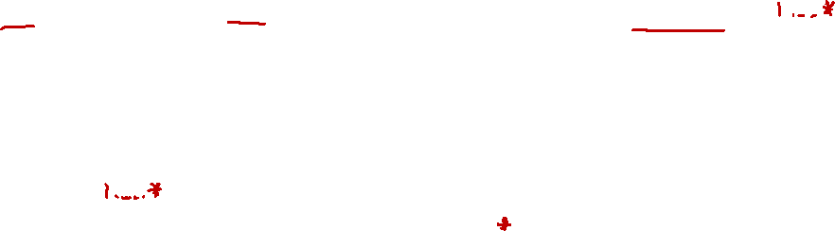
Multiplicity:
Represents a range of integers specifying the possible size of the set of related objects.
It represents how many objects may be connected across an instance of an association.
This "how many" is called the multiplicity of an association's role.
The number of objects must be in the given range-show a multiplicity of exactly one (1), zero or one (0..1), many (0..*), or one or more (1..*).
Integer range (such as 2..5). You can even state an exact number (for example, 3, which is equivalent to 3..3).

Slide 31
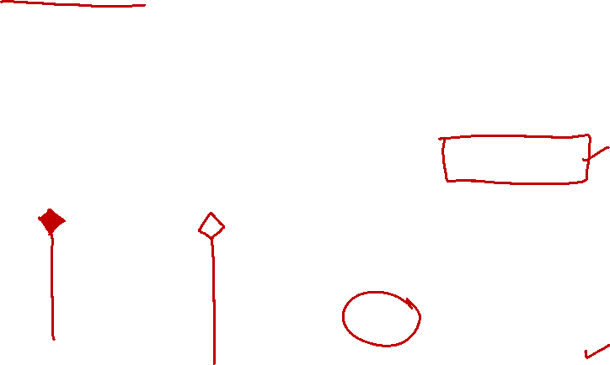
Aggregation:
A plain Association between two classes represents both classes are conceptually at the same level, no one more important than the other.
Model a "whole/part" relationship, in which one class represents a larger thing (the "whole"), which consists of smaller things (the "parts").
This kind of relationship is called aggregation, which represents a "has-a" relationship.
Represented with an open
diamond at the whole end.

Slide 32

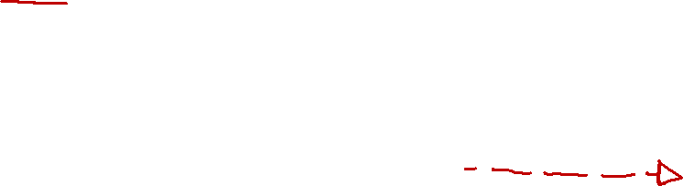
Realization
A realization is a semantic relationship between classifiers, wherein one classifier specifies a contract that another classifier guarantees to carry out.
Realization relationships occurs in two places: (i) between interfaces and the classes or components that realize them.
(ii) between use cases and the collaborations that realize them. Graphically, a realization relationship is rendered as a cross between a generalization and a dependency relationship as in the following figure:

Slide 33
Realization indicates that a class implements the features of an interface.
It is often used in cases where a class realizes the operations defined by an interface.
Example: Let’s consider the scenario where a Person and a Corporation both realizing an “Owner” interface.
Owner Interface: This interface now includes methods such as “acquire(property)” and “dispose(property)” to represent actions related to acquiring and disposing of property.
Person Class (Realization): The Person class implements the Owner interface, providing concrete implementations for the “acquire(property)” and “dispose(property)” methods. For instance, a person can acquire ownership of a house or dispose of a car.
Corporation Class (Realization): Similarly, the Corporation class also implements the Owner interface, offering specific implementations for the “acquire(property)” and “dispose(property)” methods. For example, a corporation can acquire ownership of real estate properties or dispose of company vehicles.

Slide 34
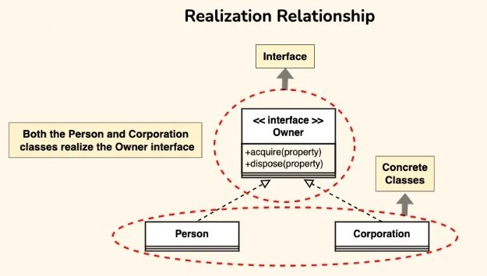
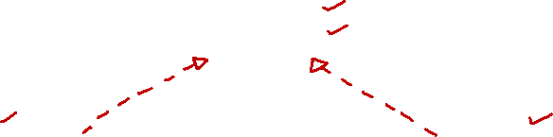

Slide 35
Structural things
Seven things
Class
Interface
Collaboration
Use case
Active class
Component
Node
There are also variations on these seven, such as actors, signals, and utilities (kinds of classes), processes and threads (kinds of active classes), and applications, documents, files, libraries, pages, and tables (kinds of components).

Slide 36
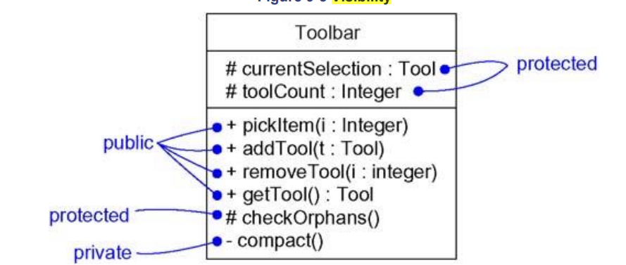
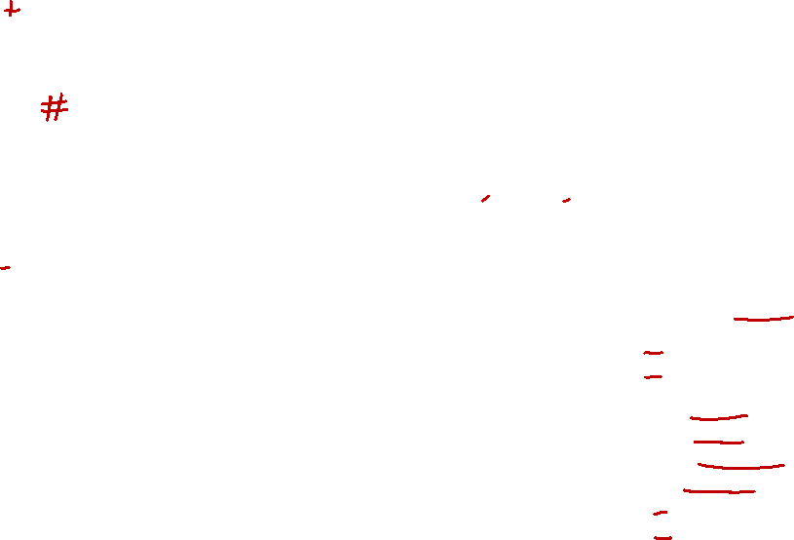
Visibility
Visibility indicates the accessibility of attributes and operations (methods) of a class. Visibility determines how other classes can interact with these elements.
Public (+) - Members with public visibility can be accessed by any other class.
2) Protected (#)- Members with protected visibility can be accessed by
-The class itself.
- Its subclasses.
- Classes in the same package/module (depending on the language).
3) Private (-) - Members with private visibility can only be
accessed by the class itself.

Slide 40
Sequence Diagram

Slide 42
Relationships in the UML
There are four kinds of relationships in the UML:
1. Dependency
2. Association
3. Generalization
4. Realization

Slide 43
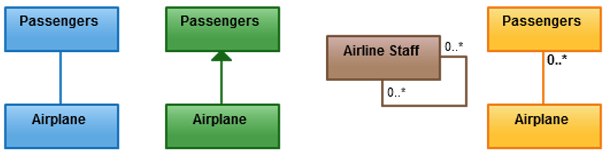
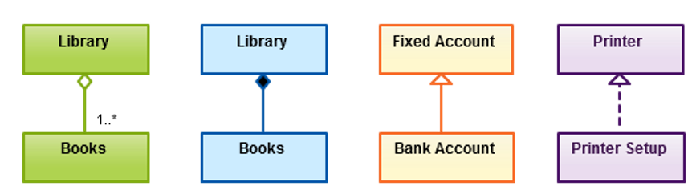
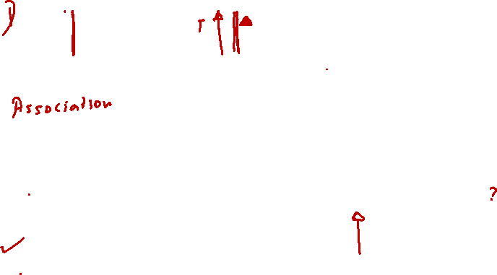
Class Relationship in UML
Any logical connection or relationship between classes
Depicts a container-contained directional flow
Class may have multiple functions or responsibilities
Active logical association when the cardinality of a class in relation to another
Formation of a particular class as a result of one class being aggregated or built as a collection.
Contained class will be obliterated when the container class is destroyed.
Child class is a specific type of the parent class
Implementation of the functionality defined in one class by another class

Slide 44
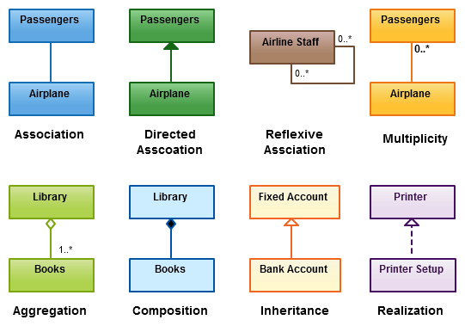
Class Relationship in UML
Any logical connection or relationship between classes
Depicts a container-contained directional flow
Class may have multiple functions or responsibilities
Active logical association when the cardinality of a class in relation to another
Formation of a particular class as a result of one class being aggregated or built as a collection.
Contained class will be obliterated when the container class is destroyed.
Child class is a specific type of the parent class
Implementation of the functionality defined in one class by another class

Slide 45
A reflexive association (also known as a self-referential relationship) occurs when an entity in a relationship is associated with itself.
Composition - A strong form of association where one entity (the whole) owns the other entity (the part), and the parts cannot exist independently of the whole.
Aggregation- A weak form of association where one entity (the whole) is associated with the other entity (the part), but the parts can exist independently of the whole.

Slide 46
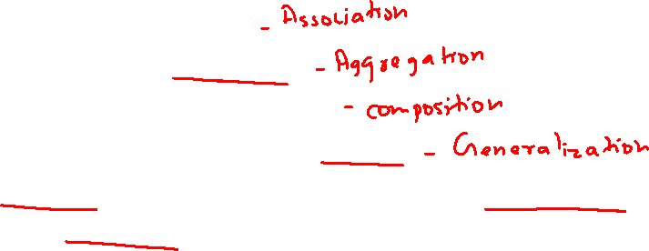
Exercise 1 -16/01/26
For each case below,
- identify the correct relationship
- draw a simple UML diagram using the proper symbol.
A Doctor treats a Patient.
A Department has Professors.
An Order consists of OrderItems.
Car, Bike and Train are types of Vehicle.
An interface called Payment has a method makePayment(). Classes UPIPayment and CardPayment implement it.

Slide 47
3. UML Diagrams
UML supports 13 different types of diagrams
Each diagram may be expressed with varying degrees of detail
Not all diagrams need be used to model a SW system
The UML does not offer an opinion as to which diagrams would be most helpful for a particular type of project
47
25

Slide 48
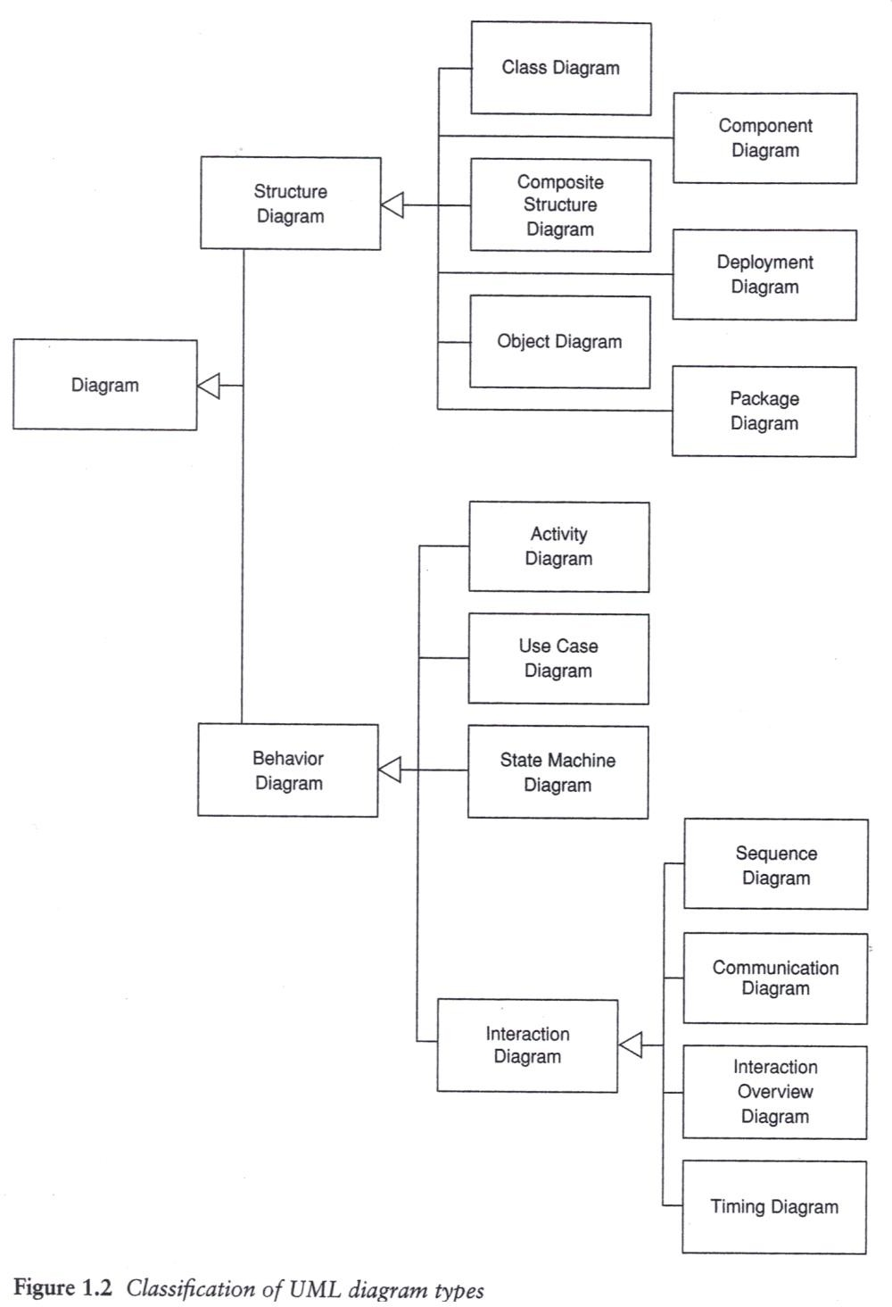
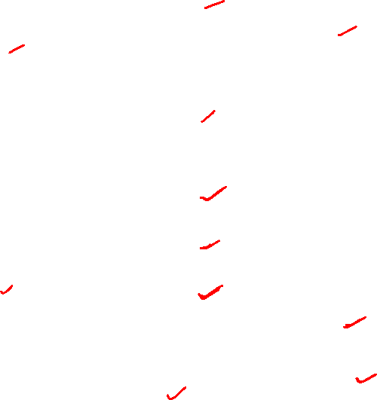
Classification of UML
Diagram types
48
25
Notes:
Collaboration diagram is communication diagram

Slide 49
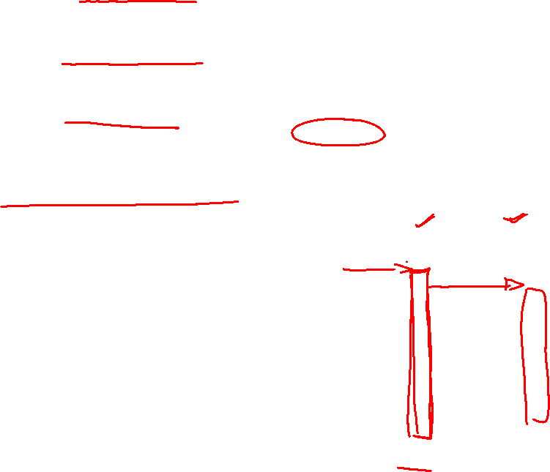
Class diagram: A structural diagram that shows a set of classes, interfaces, collaborations, and their relationships
Object diagram: A structural diagram that shows a set of objects and their relationships
Use case diagram: A behavioral diagram that shows a set of use cases and actors and their relationships
Sequence diagram: A behavioral diagram that shows an interaction, emphasizing the time ordering of messages
Notes:
Collaboration diagram is communication diagram

Slide 50
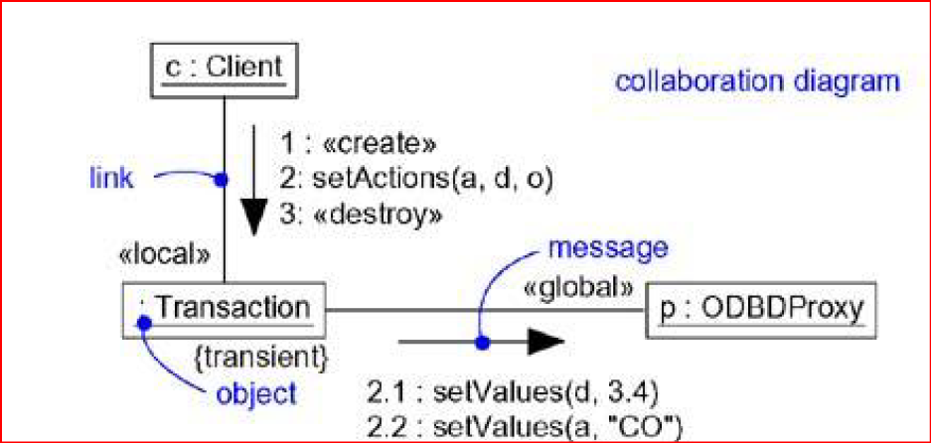
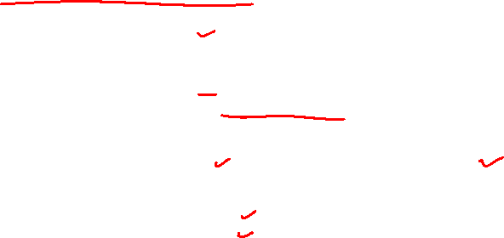
Class diagram: A structural diagram that shows a set of classes, interfaces, collaborations, and their relationships
Object diagram: A structural diagram that shows a set of objects and their relationships
Use case diagram: A behavioral diagram that shows a set of use cases and actors and their relationships
Sequence diagram: A behavioral diagram that shows an interaction, emphasizing the time ordering of messages
Collaboration diagram: A behavioral diagram that shows an interaction, emphasizing the structural organization of the objects that send and receive message

Slide 51
6. Statechart diagram: A behavioral diagram that shows a state machine, emphasizing the event ordered behaviour of an object
Notes:
Collaboration diagram is communication diagram

Slide 52
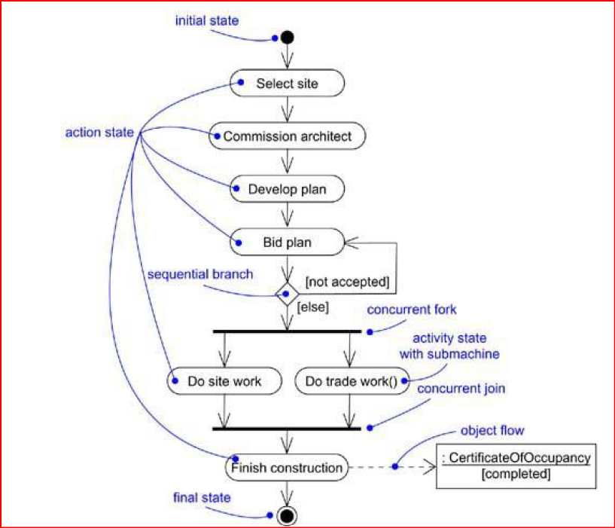
7. Activity diagram: A behavioral diagram that shows a state machine, emphasizing the flow from activity to activity
Notes:
Collaboration diagram is communication diagram

Slide 53
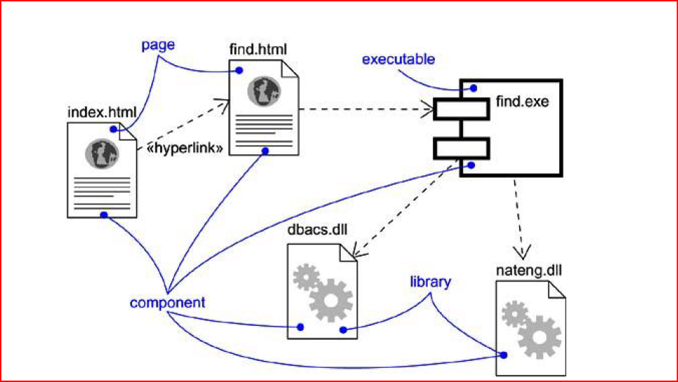
8. Component diagram: A structural diagram that shows a set of components and their relationships. It focuses on how the components (e.g., software modules, libraries, services) interact to form a complete system.
Notes:
Collaboration diagram is communication diagram

Slide 54
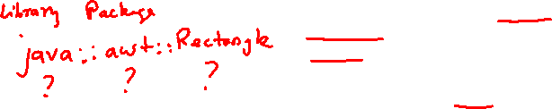
Structural Modeling: Classes, Relationships, Common mechanism and Diagrams
1. Classes:
A class is a description of a set of objects that share the same attributes, operations, relationships, and semantics.
Names
Every class must have a name that distinguishes it from other classes.
A name is a textual string.
Name alone is known as a simple name; a qualified name is the class name prefixed by the name of the package in which that class lives.
A class may be drawn showing only its name

Slide 55
Attributes
An attribute is a named property of a class that describes a range of values that instances of the property may hold.
A class may have any number of attributes or no attributes at all.
An attribute represents some property of the thing you are modeling that is shared by all objects of that class.
For example, every wall has a height, width, and thickness; you might model your customers in such a way that each has a name, address, phone number, and date of birth

Slide 56
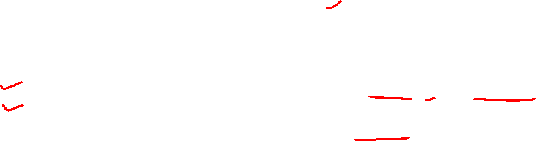
Operations
An operation is the implementation of a service that can be requested from any object of the class to affect behavior.
An operation is an abstraction of something you can do to an object that is shared by all objects of that class.
A class may have any number of operations or no operations at all.
Invoking an operation on an object changes the object's data or state.
Specify an operation by stating its signature, which includes the name, type, and default value of all parameters and (in the case of functions) a return type

Slide 57
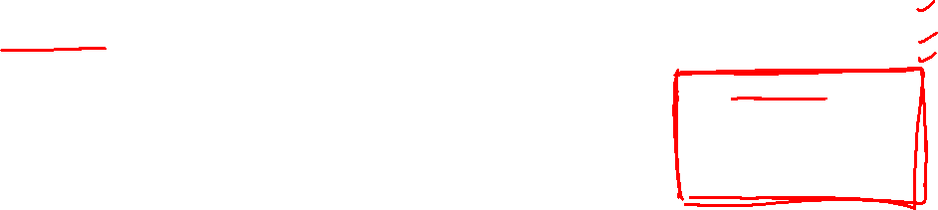
Responsibilities
A responsibility is a contract or an obligation of a class.
At a more abstract level, these corresponding attributes and operations are just the features by which the class's responsibilities are carried out.
A Wall class is responsible for knowing about height, width, and thickness
FraudAgent class, as you might find in a credit
card application, is responsible for processing
orders and determining if they are legitimate,
suspect, or fraudulent
Notes:
TemperatureSensor class is responsible for measuring temperature and raising an alarm if the temperature reaches a certain point.

Slide 58

Rules of the UML
The UML's building blocks can't simply be thrown together in a random fashion. Like any language, the UML has a number of rules that specify what a well-formed model should look like.
A well-formed model is one that is semantically self-consistent and in harmony with all its related models.
The UML has semantic rules for
Names - What you can call things, relationships, and diagrams
Scope - The context that gives specific meaning to a name
Visibility - How those names can be seen and used by others
Integrity - How things properly and consistently relate to one another
Execution - What it means to run or simulate a dynamic model

Slide 59
Rules in detail
Name rule dictates what names can be used for different elements in a UML model. For example, class names, attribute names, operation names, and relationships (like associations or generalizations) must follow certain conventions.
Scope refers to the context in which a name is valid and can be understood. In UML, the scope of a name can be defined at various levels, such as class-level, package-level, or system-level.
Visibility rule governs how names can be accessed and seen from other parts of the system. UML defines various visibility modifiers, such as: private, public and protected
Integrity ensures that relationships between elements in a UML model are consistent and correctly defined. It also ensures the correctness of the model's structure, such as ensuring that inheritance relationships are correct or that class associations make sense.
Execution semantics ensure that the system behaves as expected when modeled entities interact, whether in terms of object creation, message passing, or event handling.

Slide 60
Common mechanisms in UML
UML is made simpler by the presence of four common mechanisms that apply consistently throughout the language.
1) Specifications : provides a textual statement of the syntax and semantics of that building block.
2) Adornments
3) Common divisions
4) Extensibility mechanism

Slide 61


Adornments - Adornment refers to the additional visual elements or annotations that can be added to a diagram to convey extra information about the model. These adornments enhance the understanding of the diagram without changing its fundamental structure. Adornments can include symbols, text, or labels that provide further context or details about the elements within the diagram.
Transaction is an abstract class

Slide 62



Common divisions
In modeling object-oriented systems, the world often gets divided in at least a couple of ways.
First, there is the division of class and object. A class is an abstraction; an object is one concrete manifestation of that abstraction. In the UML, you can model classes as well as objects.
Second, there is the separation of interface and implementation.

Slide 63
Extensibility mechanism
UML is opened-ended, making it possible for you to extend the language in controlled ways.
- Stereotypes
- Tagged values
- Constraints

Slide 64


A stereotype extends the vocabulary of the UML, allowing you to create new kinds of building blocks that are derived from existing ones but that are specific to your problem.
A tagged value extends the properties of a UML building block, allowing you to create new information in that element's specification.
A constraint extends the semantics of a UML building block, allowing you to add new rules or modify existing ones.

Slide 65
Best Practices of Software Engineering

Slide 66

Architecture
Architecture refers to the different perspectives from which a complex system can be viewed.
The architecture of a software-intensive system is best described by five interlocking views:
Use case view: system as seen by users, analysts and testers.
Design view: classes, interfaces and collaborations that
make up the system.
Process view: active classes (threads).
Implementation view: files that comprise the system.
Deployment view: nodes on which SW resides.
66
25

Slide 67
Architecture
Most important artifact that can be used to manage these different viewpoints and so control the iterative and incremental development of a system throughout its life cycle.
Architecture is the set of significant decisions about
The organization of a software system
The selection of the structural elements and their interfaces by which the system is composed
Their behavior, as specified in the collaborations among those elements
The composition of these structural and behavioral elements into progressively larger subsystems
The architectural style that guides this organization: the static and dynamic elements and their interfaces, their collaborations, and their composition

Slide 68

Software architecture is not only concerned with structure and behavior, but also with usage, functionality, performance, resilience, reuse, comprehensibility, economic and technology constraints.
Vocabulary functionality
System assembly configuration management
Design View
Implementation View
Use case view
Behavior
Process View
Deployment View
System topology Distribution Delivery installation
Performance Scalability throughput

Slide 69
Use case view
System encompasses the use cases that describe the behavior of the system as seen by its end users, analysts, and testers.
Doesn’t really specify the organization of a software system.
Use cases describe requirements that strongly influence the design.
Static aspects of this view are captured in use case diagrams
Dynamic aspects of this view are captured in interaction diagrams, statechart diagrams, and activity diagrams.
Design view
System encompasses the classes, interfaces, and collaborations that form the vocabulary of the problem and its solution.
Supports the functional requirements of the system (the services that the system should provide to its end users)
Static aspects of this view are captured in class diagrams and object diagrams
Dynamic aspects of this view are captured in interaction diagrams, statechart diagrams, and activity diagrams.

Slide 70

Process view
System encompasses the threads and processes that form the system’s concurrency and synchronization mechanisms.
Addresses the performance, scalability, and throughput of the system.
Static and dynamic aspects - captured in the same kinds of diagrams as for the design view, but with a focus on the active classes that represent these threads and processes.

Slide 71
Implementation view
System encompasses the components and files (modules, code, libraries, and configuration files) that are used to assemble and release the physical system.
Addresses the configuration management of the system's releases, made up of somewhat independent components and files
Static aspects of this view are captured in component diagrams;
the dynamic aspects of this view are captured in interaction diagrams, statechart diagrams, and activity diagrams.

Slide 72
Deployment view
System encompasses the nodes that form the system's hardware topology on which the system executes.
Addresses the distribution, delivery, and installation of the parts that make up the physical system.
Static aspects of this view are captured in deployment diagrams; the dynamic aspects of this view are captured in interaction diagrams, statechart diagrams, and activity diagrams

Slide 73

Software Development Life Cycle
UML is involved in each phase of the software development life cycle.
The UML development process is
Use case driven
Architecture-centric
Iterative and incremental
73

Slide 74

Software Development Life Cycle

Slide 75
Software Development Life Cycle
UML is largely process-independent, meaning that it is not tied to any particular software development life cycle.
Use case driven : use cases are used as a primary artifact for establishing the desired behavior of the system, for verifying and validating the system's architecture, for testing, and for communicating among the stakeholders of the project.
Architecture-centric: System's architecture is used as a primary artifact for conceptualizing, constructing, managing, and evolving the system under development.
Iterative process: Managing a stream of executable releases. Continuous integration of the system's architecture to produce these releases, with each new release embodying incremental improvements over the other.

Slide 76

Software Requirement Specification (SRS)
Introduction
Purpose of this document : What
Scope of this document : Why
Document Overview : Summary
General description: Includes objective of user, a user characteristic, features, benefits, about why its importance is mentioned.
Functional Requirements: Includes effects due to operation of program is fully explained.
Interface Requirements: How software program communicates with each other or users.
Performance Requirements: How a software system performs desired functions under specific condition is explained.
Design Constraints: Limitation or restriction are specified and explained for design team.
Non-Functional Attributes : Required by software system for better performance.
Preliminary Schedule and Budget:
Appendices

Slide 77

Benefits of an SRS:
Clear communication: An SRS ensures everyone involved in the project understands the software's requirements. This helps to avoid misunderstandings and rework later in the development process.
Reduced risk of errors: A well-defined SRS can help to identify and mitigate potential risks early on.
Improved project management: An SRS provides a roadmap for the development team, which can help to improve project planning and execution.
Increased quality: A clear understanding of the requirements can help to ensure that the software is built to meet the needs of its users.

