Slide 1
Behavioral Patterns

Slide 2
Syllabus
  Behavioral Patterns
  Chain of Responsibility
  Command
  Iterator
  Mediator
  Memento
  Observer
  Discussion of Behavioral Patterns
Reference:
  Erich Gamma, Richard Helm, Ralph Johnson, John Vlissides Design Patterns: Elements of Reusable Object oriented Software Addison-Wesley
  State
  Strategy
  Template Method
  Visitor
Implementation in various languages like Python, Java
Notes:
How should objects communicate and share responsibilities with each other?"

Slide 3
Introduction
Behavioral patterns are concerned with algorithms and the assignment of responsibilities between objects.
Behavioral patterns describe not just patterns of objects or classes but also the patterns of communication between them.
These patterns characterize complex control flow that's difficult to follow at run-time. Focus shifts from flow of control to “on the way objects are interconnected”.
Behavioral class patterns use inheritance to distribute behavior between classes.
Notes:
Objects become too tightly connected — changing one breaks others
Logic gets scattered everywhere — hard to find and maintain
Code becomes rigid — adding new behavior means rewriting existing code
Objects try to do too much — taking on responsibilities they shouldn't have

Slide 4
Introduction … Contd.
Behavioral object patterns use object composition rather than inheritance. Some describe how a group of peer objects cooperate to perform a task that no single object can carry out by itself.
An important issue here is how peer objects know about each other.
Peers could maintain explicit references to each other, but that would increase their coupling.
In the extreme, every object would know about every other.

Slide 5
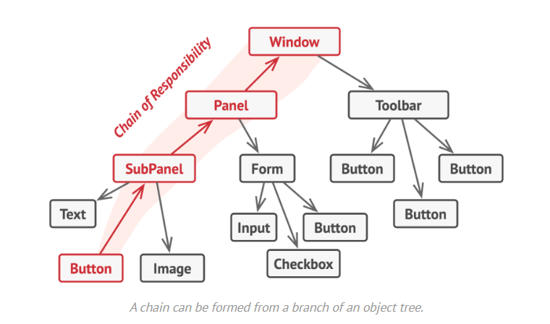
Chain of Responsibility
Chain of Responsibility provides even looser coupling. It lets you send requests to an object implicitly through a chain of candidate objects. Any candidate may fulfill the request depending on run-time conditions. The number of candidates is open-ended, and you can select which candidates participate in the chain at run-time.
Notes:
A request passes through a chain of handlers, and each one decides to handle it or pass it on.
Like a customer complaint going from support agent → supervisor → manager until someone resolves it.

Slide 6
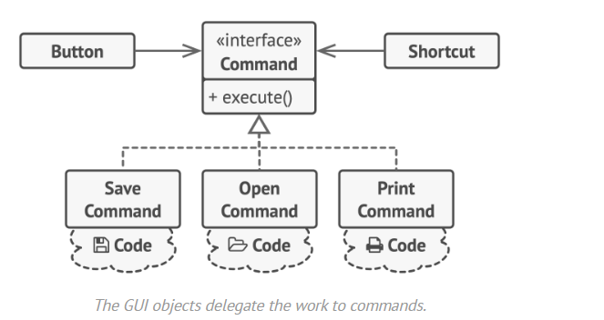
Command pattern
The Command pattern encapsulates a request in an object so that it can be passed as a parameter, stored on a history list, or manipulated in other ways.
Notes:
Wraps a request as an object, so you can queue, undo, or log it.
Like a TV remote — each button is a "command" object that triggers an action, and you can undo/redo.
The Button and Shortcut don't do the work themselves. They just say execute! — and the assigned Command object handles it.

Slide 7
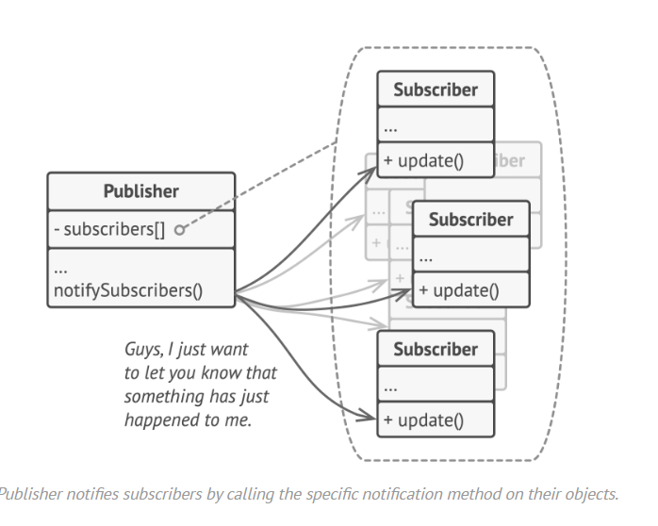
Observer pattern
The Observer pattern defines and maintains a dependency between objects. The classic example of Observer is in Smalltalk Model View Controller.
Notes:
When one object changes, all its dependents get notified automatically.
Like a YouTube subscription — when a channel uploads, all subscribers get a notification.

Slide 8
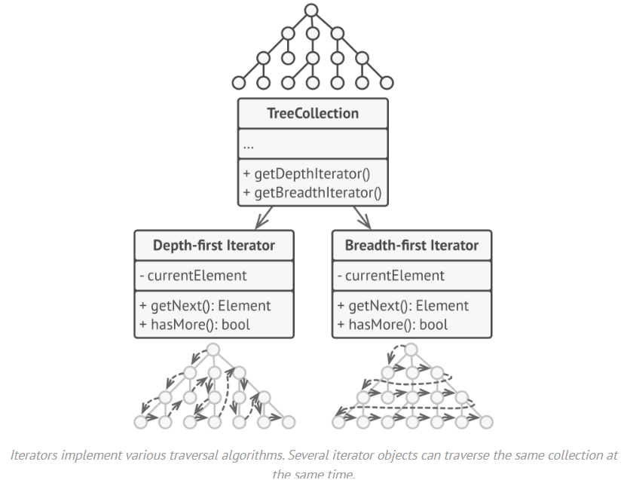
Iterator Pattern
Iterator abstracts the way you access and traverse objects in an aggregate.
Notes:
Lets you loop through a collection without knowing how it's stored internally.
Like flipping through a playlist — you just press "next," you don't care if it's a list, shuffle, or queue.
you could run a depth-first and breadth-first traversal simultaneously on the same tree, no conflict.

Slide 9
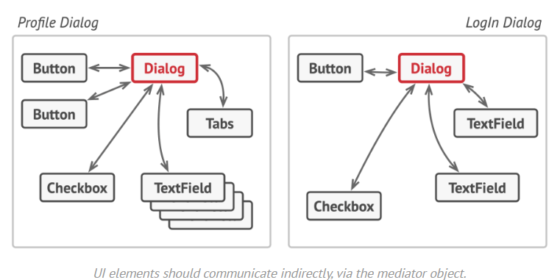
Mediator pattern
The Mediator pattern avoids this by introducing a mediator object between peers. The mediator provides the indirection needed for loose coupling.
Notes:
Objects don't talk to each other directly — they go through a central mediator.
Like an air traffic controller — planes don't coordinate with each other, they all talk to the tower.
A Button doesn't tell the TextField to clear itself.
The Checkbox doesn't directly enable/disable the Button.
Instead — Button tells Dialog → Dialog tells TextField, etc.

Slide 10
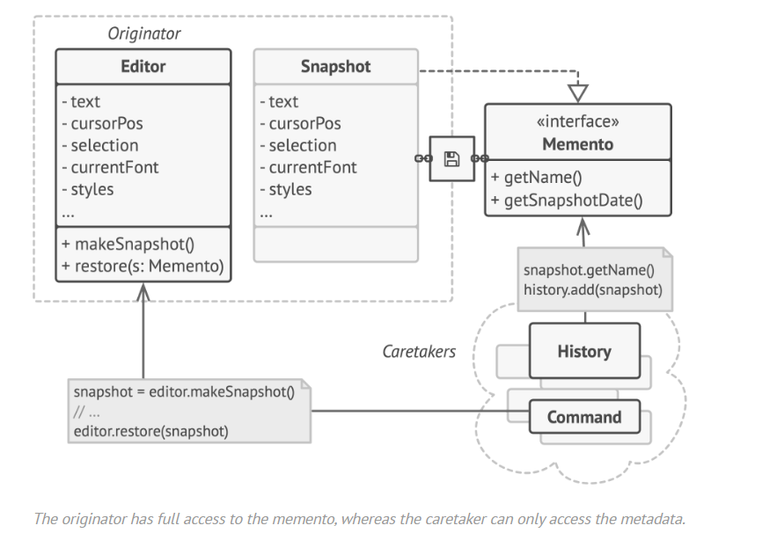
Memento Pattern
Memento is a behavioral design pattern that lets you save and restore the previous state of an object without revealing the details of its implementation.
Notes:
Memento Saves a snapshot of an object's state so you can restore it later. Like Ctrl+Z (undo) — the app saved your previous state and can roll back to it.
The Editor can read/write everything inside the snapshot (text, cursor, font...).
The History/Command can only see basic info like the name and date — not the actual content inside.

Slide 11
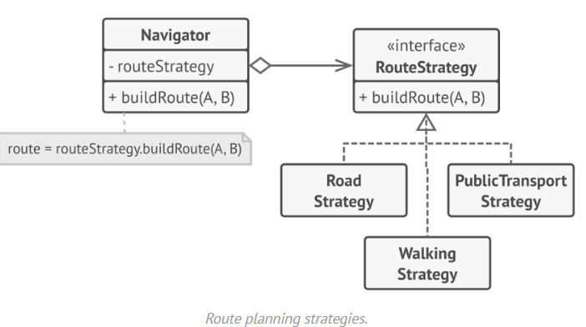
Strategy pattern
The Strategy pattern encapsulates an algorithm in an object. Strategy makes it easy to specify and change the algorithm an object uses.
Notes:
Swap out the algorithm/behavior of an object at runtime without changing the object itself.
Like a navigation app letting you choose between fastest, shortest, or scenic route — same app, different strategy.

Slide 12
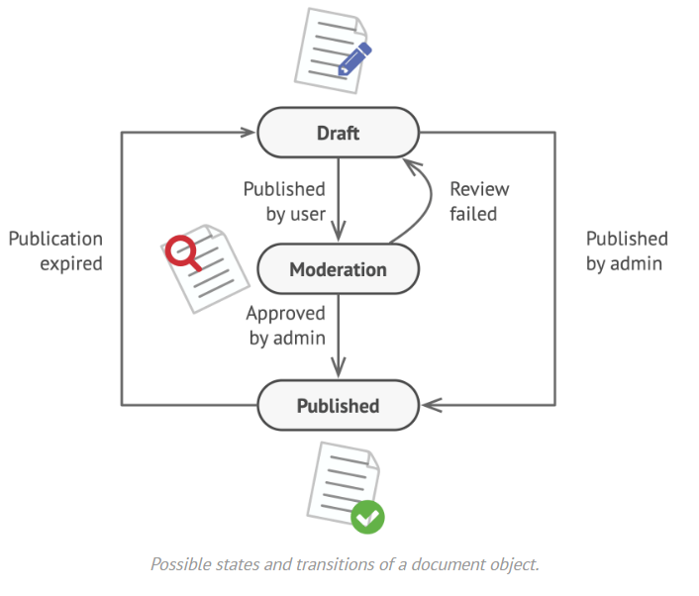
State pattern
The State pattern encapsulates the states of an object so that the object can change its behavior when its state object changes.
Notes:
An object changes its behavior based on its current state — as if it became a different object.
Like a traffic light — same light, but behaves completely differently depending on whether it's Red, Yellow, or Green.
Draft- Document is being written
Moderation- Document is under review
Published- Document is live/visible

Slide 13
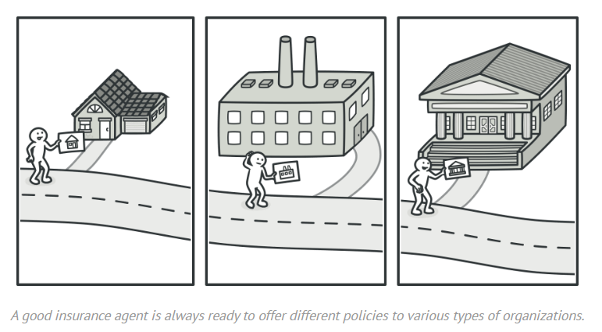
Visitor Pattern
Visitor encapsulates behavior that would otherwise be distributed across classes
Notes:
Add new operations to existing objects without modifying them — by putting the new logic in a separate "visitor" object. Like a tax inspector visiting different types of buildings — the buildings don't change, but the inspector applies different rules to each one.

Slide 14
Template Method
Template Method is the simpler and more common method, an abstract definition of an algorithm.
Each step invokes either an abstract operation or a primitive operation. A subclass fleshes out the algorithm by defining the abstract operations.
Notes:
Like a recipe template — the steps are always "prep → cook → plate → serve."
A chef can change how they cook, but they can't skip plating or serve before cooking.

Slide 15
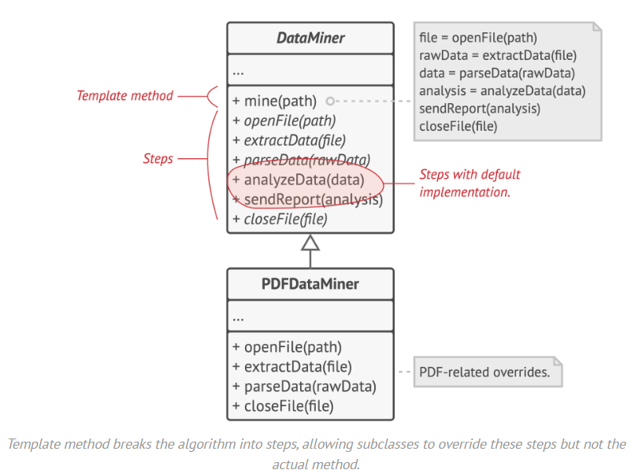
Template Method

