Slide 1
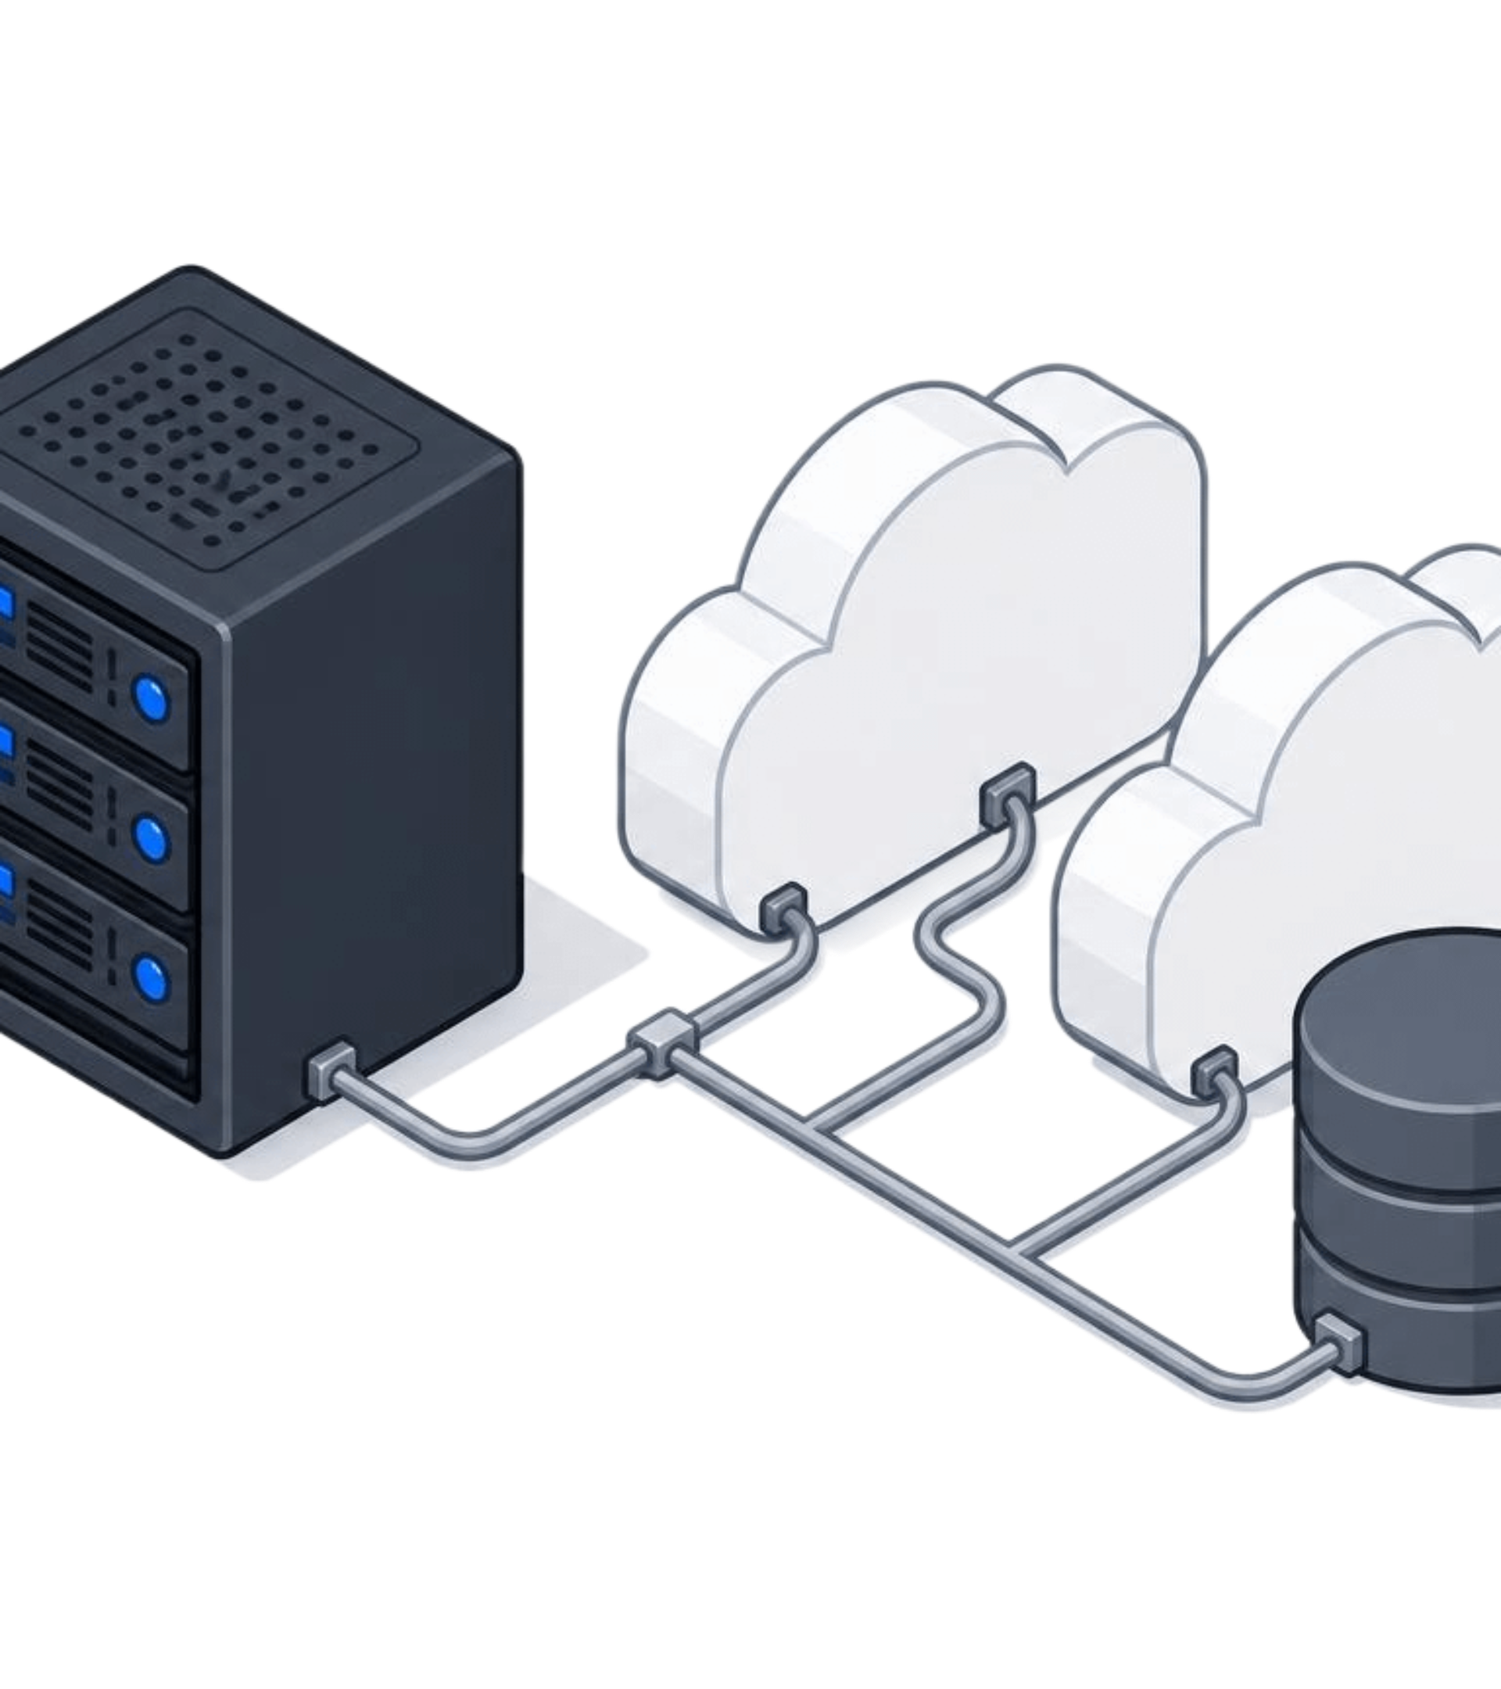
CloudSync
A secure multi-cloud file storage and management platform
25MCC20050 – Anshu · Database
1
25MCC20051 – Rahul · Frontend
2
25MCC20023 – Hemant · Backend
3
Project review
Cloud computing & DevOps
Notes:
Open with the project name and the one-line promise, then introduce the three of us and the part each one owns.

Slide 2
PROBLEM
OBJECTIVES
Files live in too many places
One app, many clouds
Centralized file management
Support for multi-cloud storage
Secure authentication and file sharing
File version and activity tracking
Demonstrate cloud computing and DevOps concepts
Managing files across different cloud platforms is difficult.
Users need one centralized place to manage their files.
Sharing, searching, versioning and security all matter.
Depending on a single cloud provider creates limitations.
Notes:
Name the four problems on the left, then turn to the right and read the five objectives — every later slide answers one of them.

Slide 3
Proposed solution and key features
CloudSync sits as one centralized web app between users and multiple cloud storage providers.
1
2
3
4
User
CloudSync web app
Backend / API
Database + cloud storage
Signs in from the browser.
Upload, download, rename, move, folders, search, versions, sharing, activity.
Auth, permissions and routing of every request.
Metadata in the database, files in the cloud buckets.
Admin features
Security
User management, storage statistics, activity logs, cloud provider configuration.
Registration and login, secure sharing links, activity history per file.
Notes:
Read the flow left to right: user, web app, backend and API, then database plus cloud storage. Then name the user features quickly and the four admin features underneath.

Slide 4




Technology stack and architecture
Frontend
Backend
Database
Cloud & DevOps
React.js
Spring Boot
PostgreSQL
Azure Blob Storage
TypeScript
Java
Users, files, versions and activity records.
Google Cloud Storage
Tailwind CSS
Spring Security
React Router
REST APIs
Docker
Axios
Spring Data JPA
Git / GitHub
GitHub Actions
Azure App Service
The blue-bordered chip in each column is the choice we would defend to a reviewer.
Notes:
Walk the four layers left to right and name the one component in each we would defend: React with TypeScript, Spring Boot, PostgreSQL, and Azure Blob with Google Cloud Storage behind Docker and GitHub Actions.

Slide 5
Team contributions
Rahul – Frontend
Built the React and TypeScript frontend: responsive UI, routing and app pages, the file-management interface, the Axios-based API service structure, and the login and register screens.
25MCC20051
Anshu – Database
Backend development with Spring Boot REST APIs, authentication and server-side logic, and backend integration with the frontend.
25MCC20050
Hemant – Backend
Backend development, backend services and APIs, database and backend integration, and support for cloud-storage integration.
25MCC20023
Backend and cloud integration are still in progress, not yet complete.
Notes:
Name each person and their part, then say plainly that backend and cloud integration are still in progress.

Slide 6
Current progress and demonstration
Completed
In progress
Planned
Frontend UI and React components. File-management interface. Authentication UI. API service structure. Frontend functionality running on mock data.
Spring Boot backend. PostgreSQL database. Azure and GCP cloud integration. Frontend–backend integration. Testing.
Docker deployment. GitHub Actions CI/CD. Azure App Service deployment. Advanced security features.
DONE
IN PROGRESS
PLANNED
The current frontend demonstration uses mock data — the full backend and real cloud storage integration are not yet live.
Notes:
Read the three columns left to right and keep them separate: the frontend is done, the backend and cloud work are in progress, deployment and CI/CD are planned. State clearly that today's demo runs on mock data.

Slide 7

Future scope and conclusion
End-to-end file encryption
Real-time collaboration
Advanced storage analytics
Two-factor authentication
AI-based file organization
Complete multi-cloud deployment
Mobile application
CI/CD automation
CloudSync aims to provide a secure, centralized platform for managing files across multiple cloud providers — combining web development, cloud computing, database management, security, Docker and DevOps concepts.
Notes:
Read the eight future enhancements as two quick groups, land the closing sentence about what CloudSync aims to do, then invite questions.

