Slide 1
FedEx Logistics Optimization Analysis
Analyzing delivery delays and route performance across FedEx’s global network
Prepared by : Rahul Kumar
Tools: MYSQL, POWERBI

Slide 2
Dataset overview
Five relational tables capturing FedEx's order-to-delivery pipeline
(1,380 total records).
Shipments (1,000 rows) — the central tracking table: pickup & delivery timestamps, delivery status, delay hours, and delay reason.
Orders (300 rows) — order-level details: order date, delivery type (Express/Standard), payment mode.
Routes (20 rows) — source & destination cities/countries, distance, and planned transit time.
Warehouses (10 rows) — hub location and daily handling capacity.
Delivery Agents (50 rows) — assigned zone, years of experience, and customer rating.
Shipments is the central table — it links to Orders, Routes, Warehouses, and Agents through their ID keys, which is what lets us analyze delay across every dimension.

Slide 3
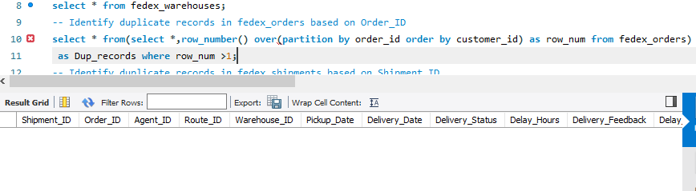
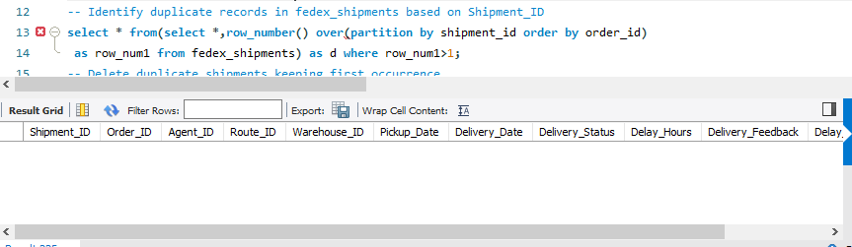

Slide 4
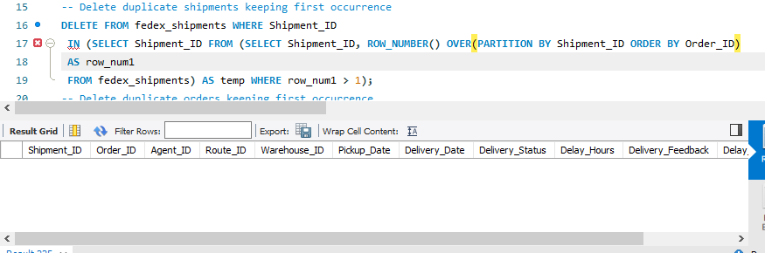

Slide 5
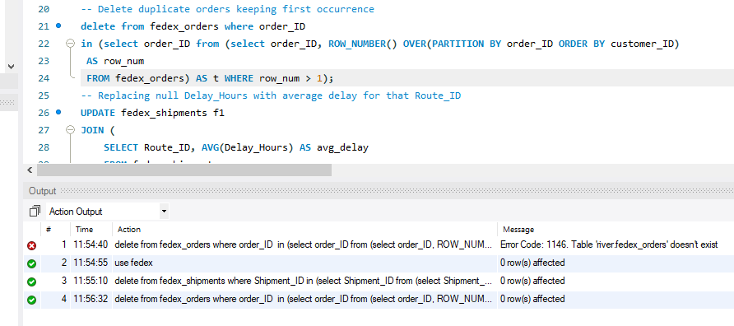

Slide 6
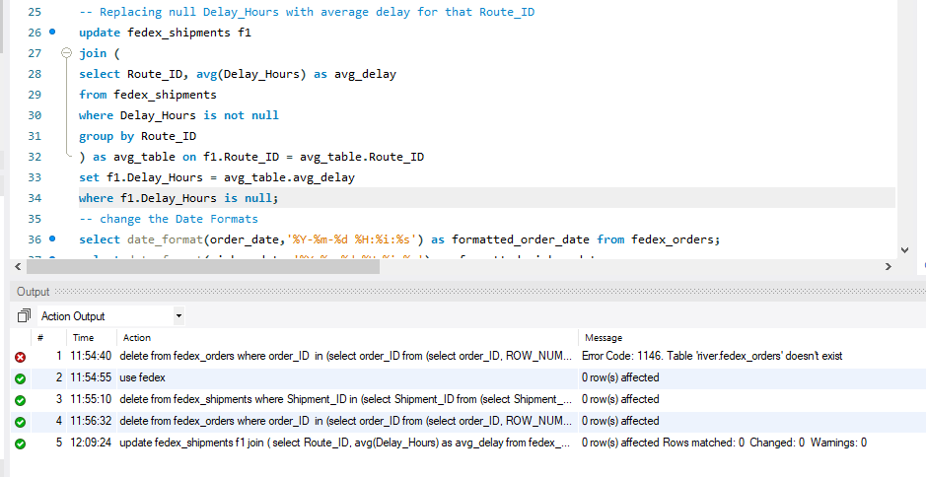
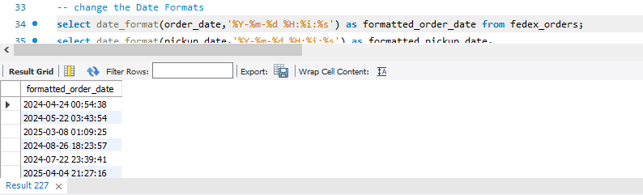

Slide 7
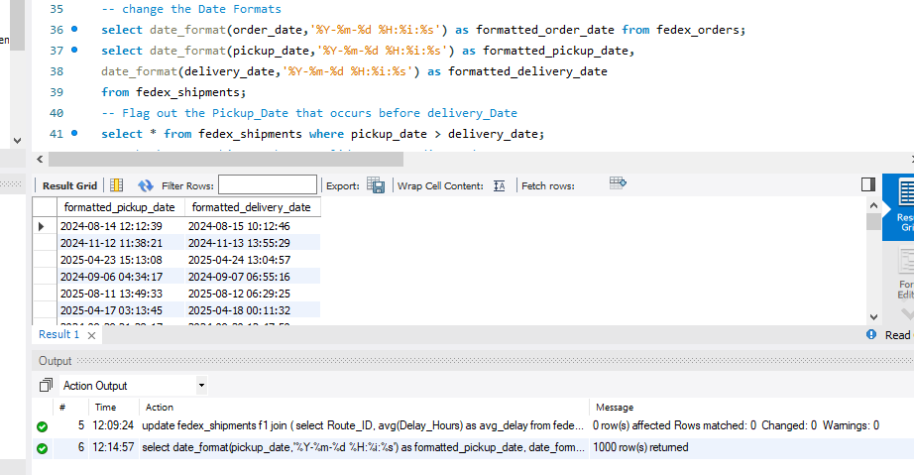

Slide 8
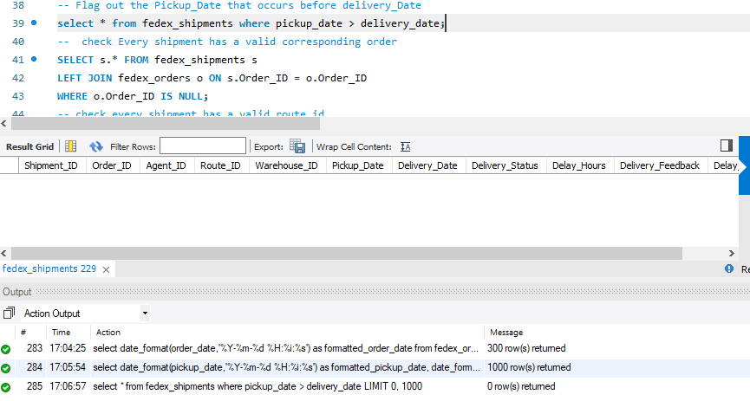

Slide 9
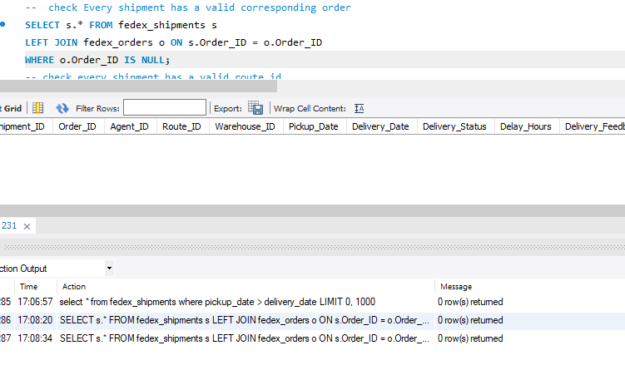

Slide 10
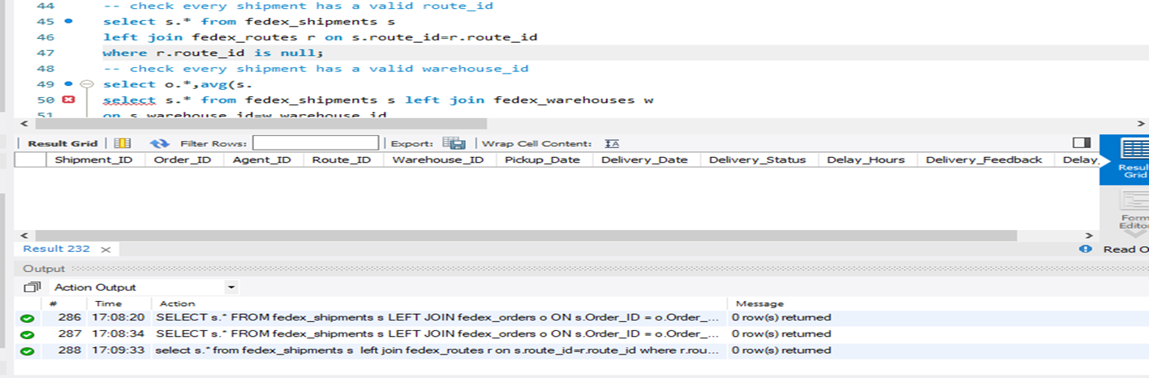

Slide 11
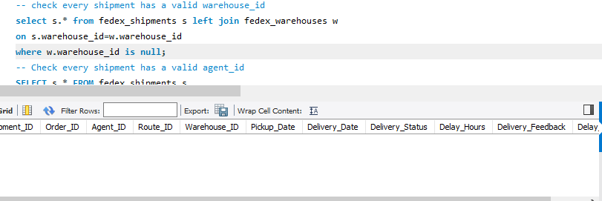
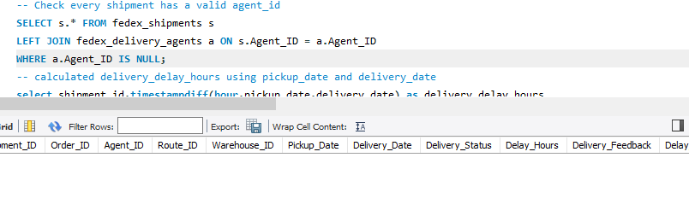

Slide 12
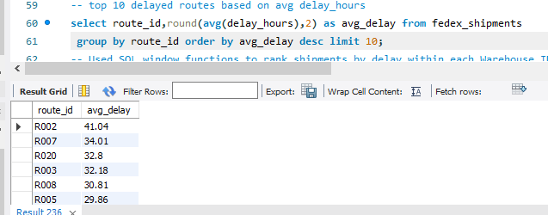

Slide 13
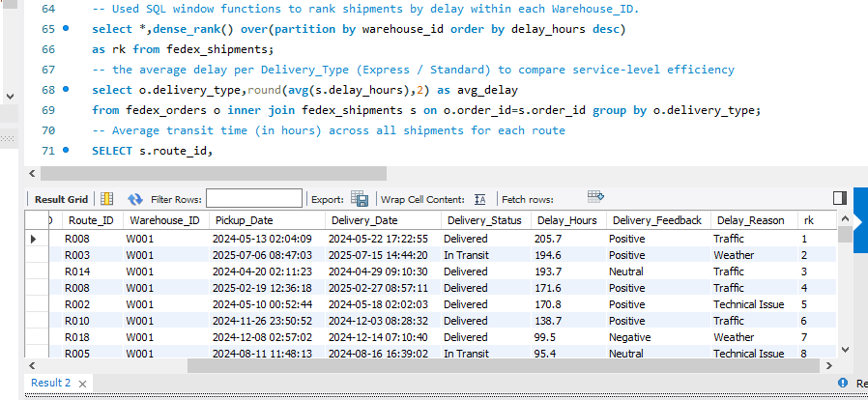

Slide 14
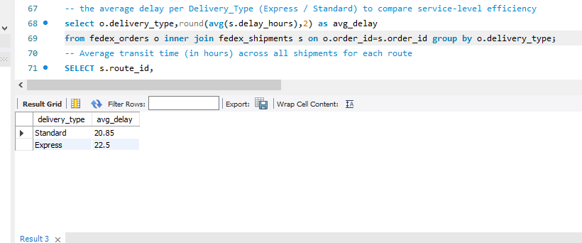

Slide 15
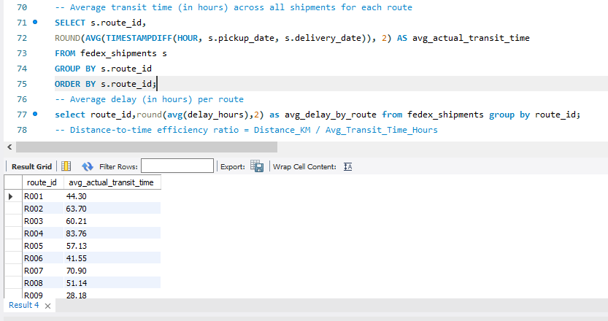

Slide 16
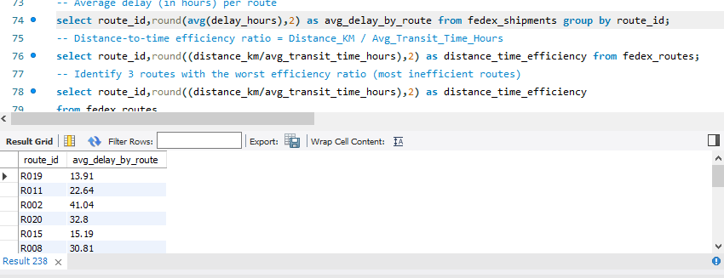
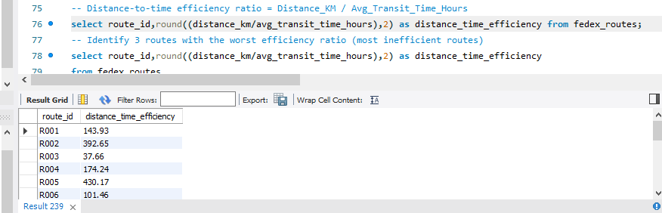

Slide 17
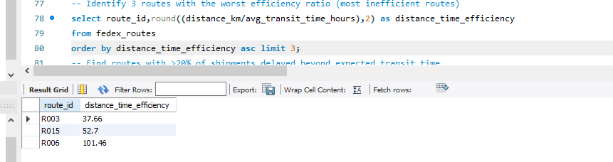
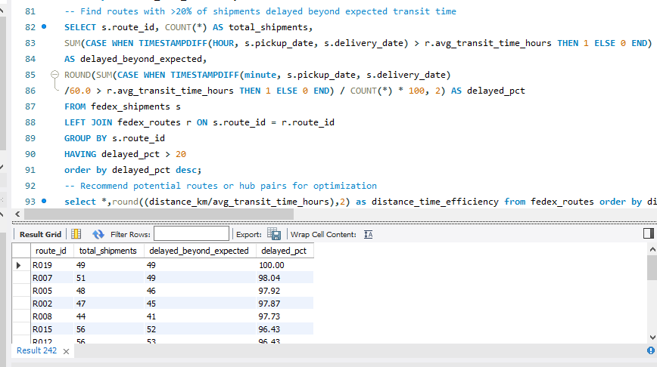

Slide 18
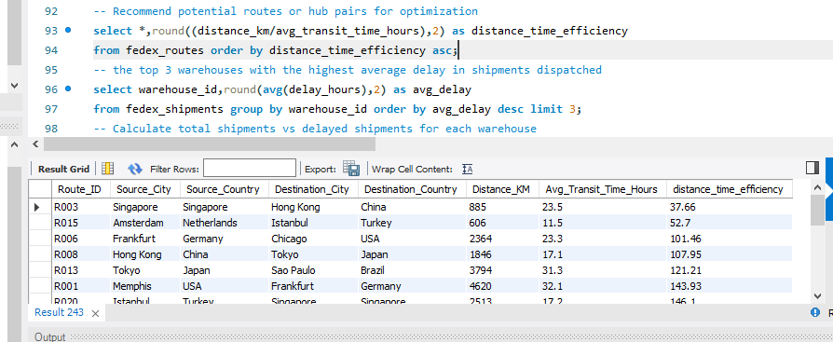

Slide 19
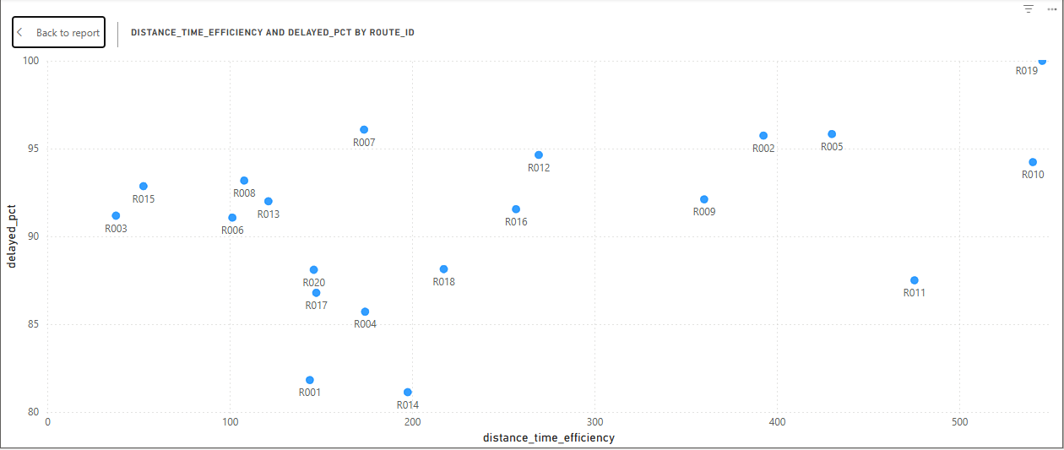
Route R019,R010 have the best efficiency yet its shipments are delayed . The Route design is perfect but execution completely fails . That is a pure operational problem. We should focus on scheduling , capacity and agent issue.
Meanwhile R003,R0015 are both poorly designed and delayed , needing structural re-routing.

Slide 20
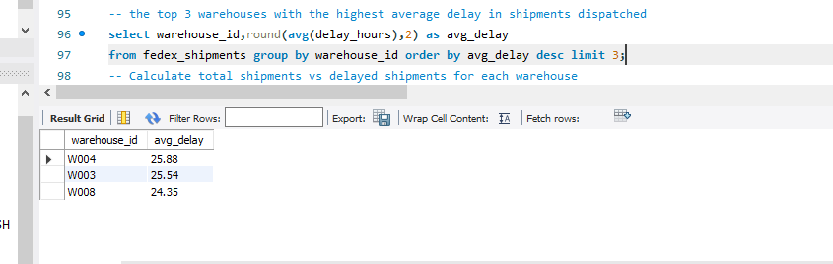
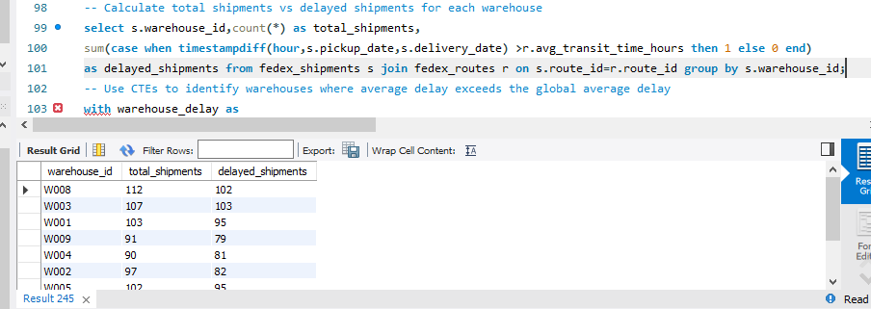

Slide 21
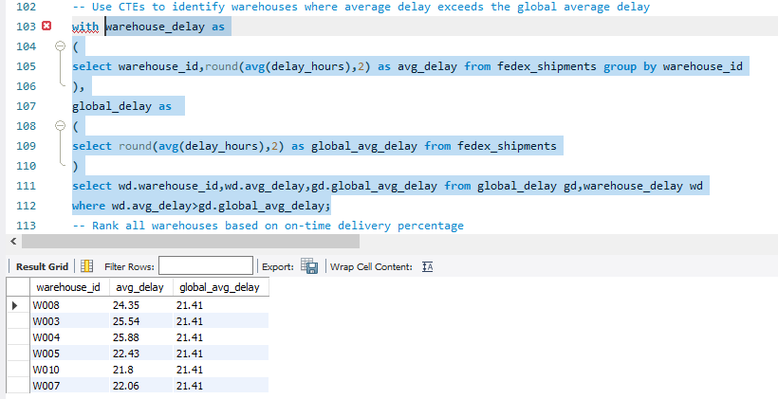

Slide 22
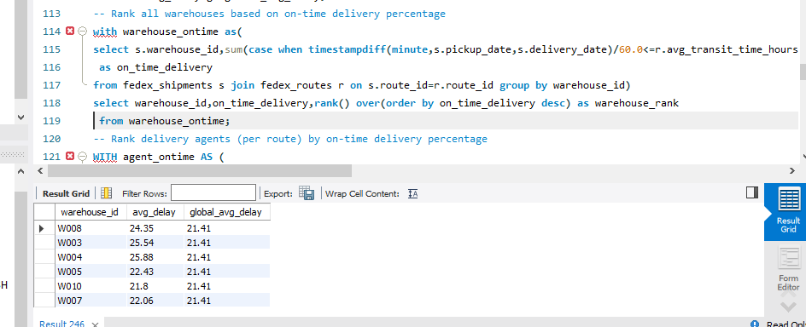

Slide 23
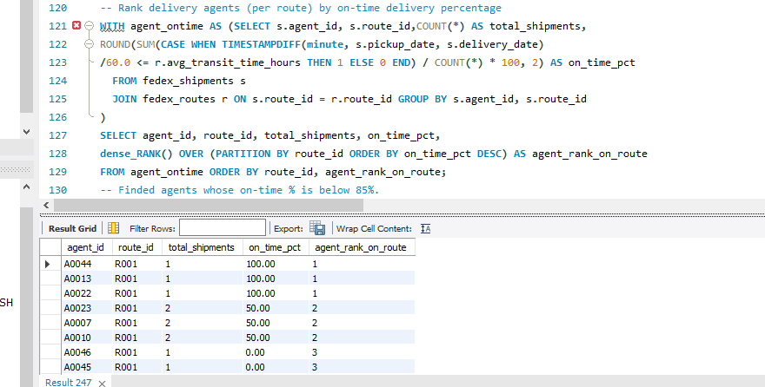

Slide 24
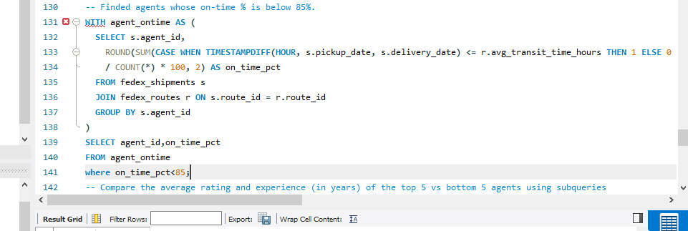

Slide 25
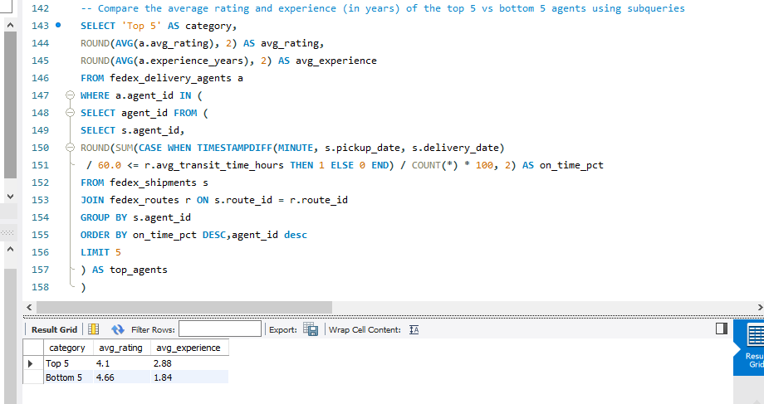

Slide 26
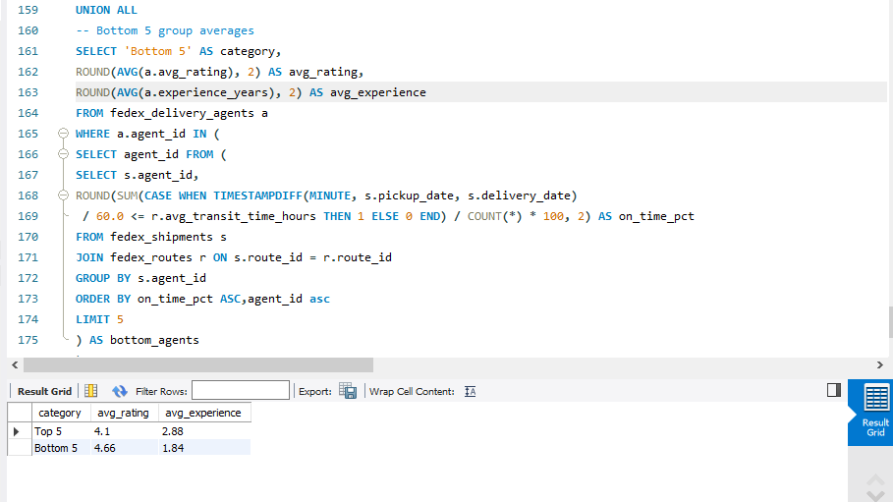

Slide 27
Based on the findings
Bottoms performers are rated higher than top performers and slightly less experienced
Neither rating nor experience predicts on time performance
Delays are definitely systematic
Recommendations
Do not invest in agent training or replacement
Investigate operational bottlenecks like routes , warehouses , expected transit times
Recalibrate baseline expectations(if 80% of shipments are delayed network wide expected times are unrealistic)

Slide 28
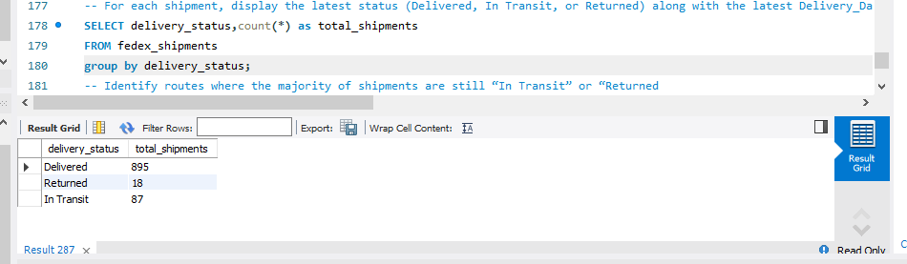

Slide 29
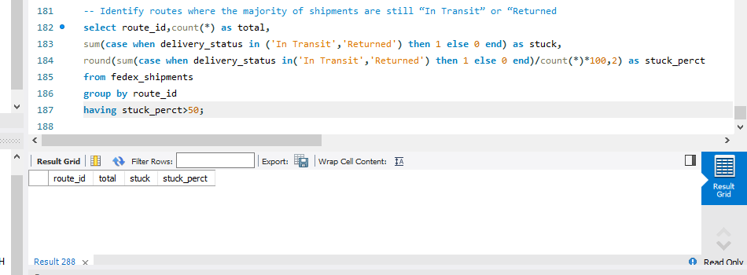
No route has a majority of shipments stuck in 'In Transit' or 'Returned' status. The network reliably completes deliveries — the problem is they arrive late, not that they fail to arrive.

Slide 30
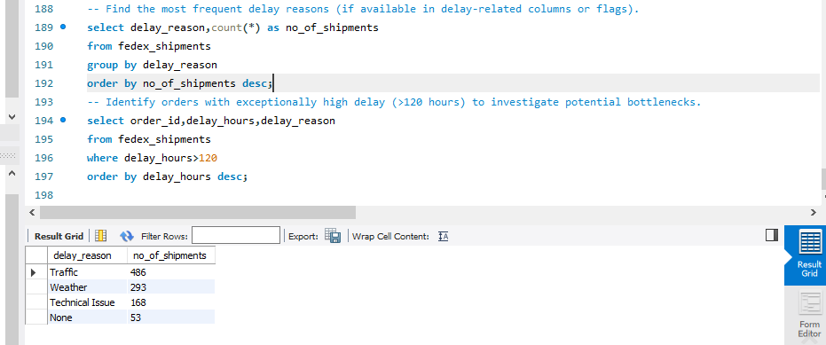

Slide 31
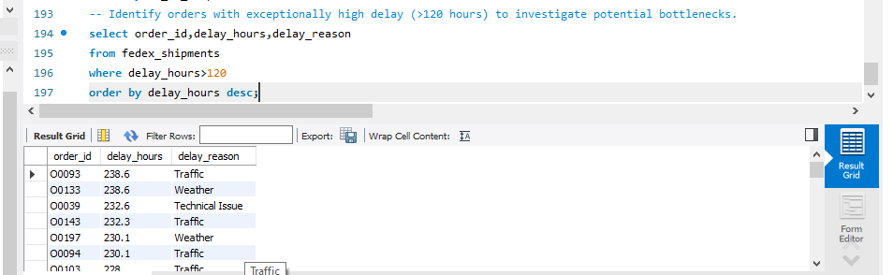

Slide 32
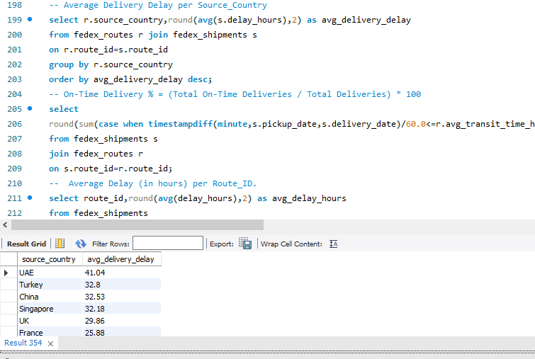

Slide 33
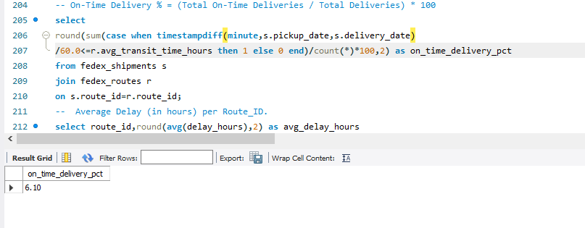

Slide 34
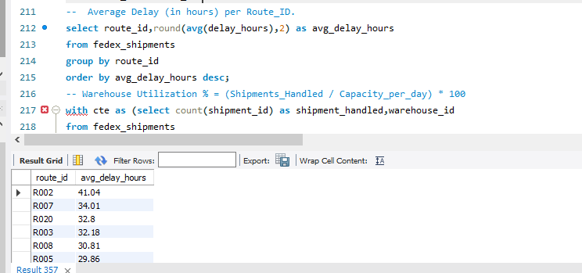

Slide 35
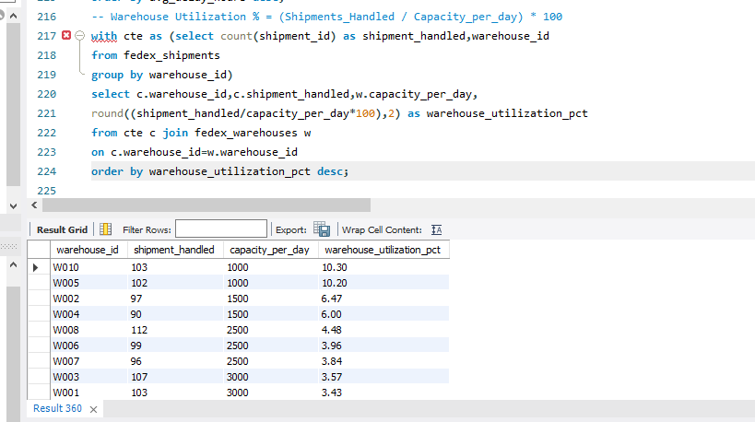

Slide 36
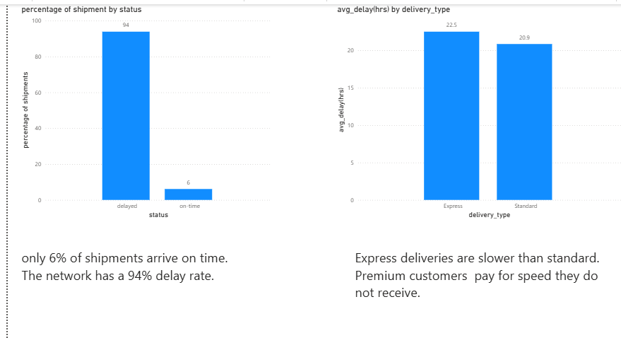

Slide 37
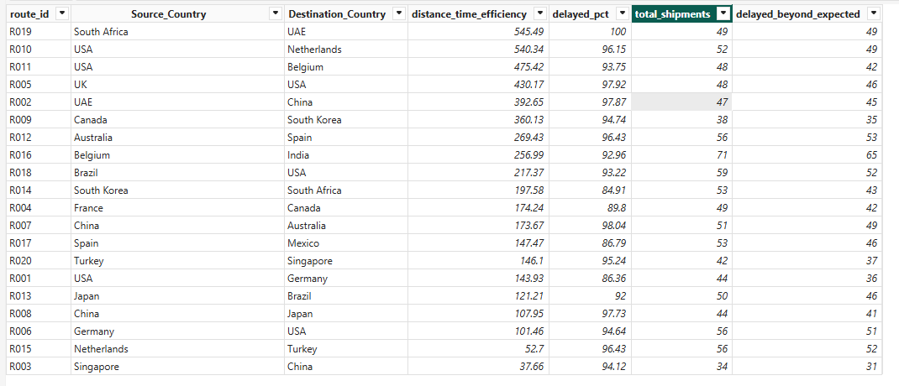
High efficiency route still has > 95% delay that means routing efficiency is not the cause , the delays are affecting the entire system.

Slide 38
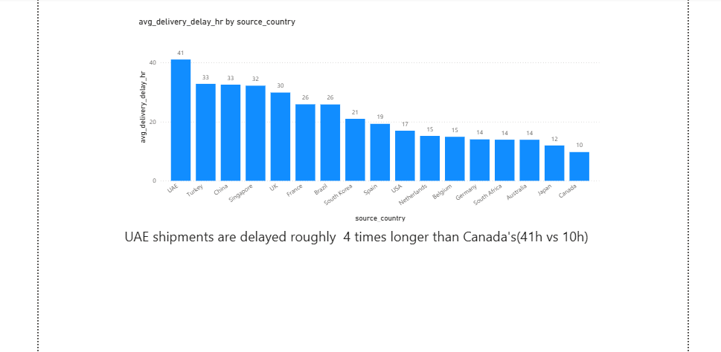

Slide 39
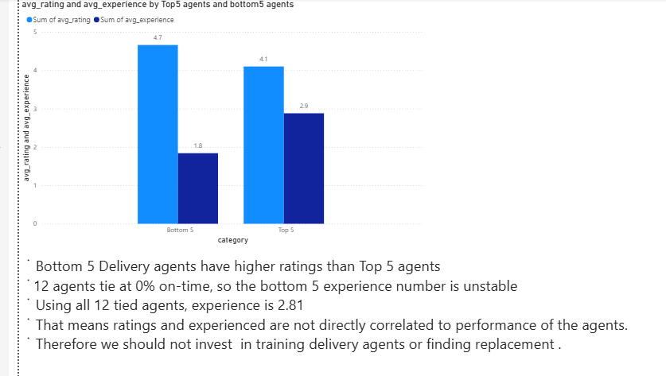

Slide 40
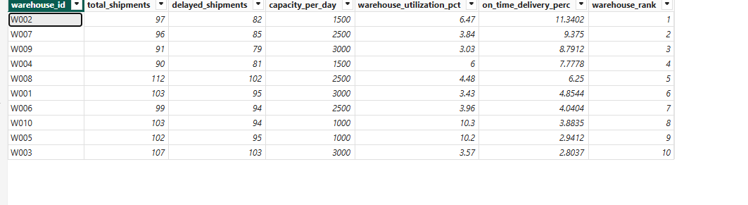
No warehouse exceeds 12% on time delivery despite running under 11% capacity.
The problem is not warehouse throughput , it is what happens after dispatch.

Slide 41
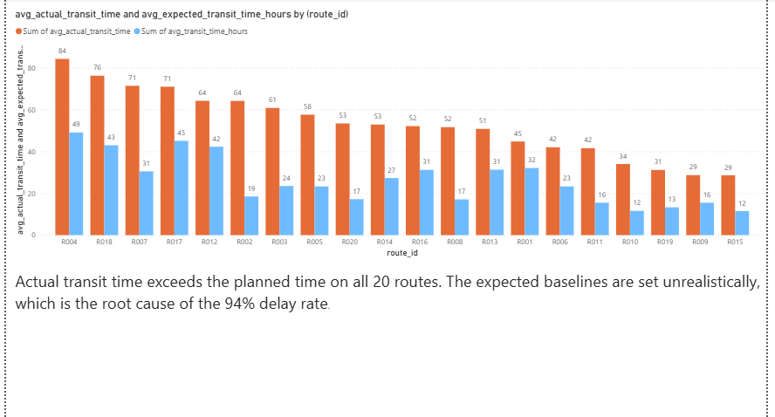

Slide 42
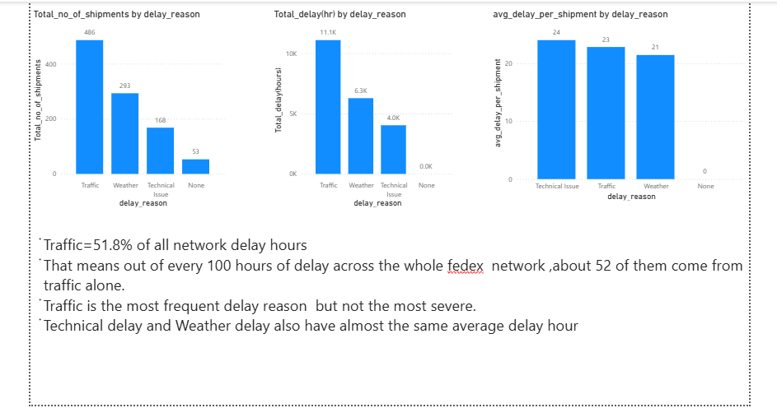

Slide 43
Key Insights
Only 6% of shipments arrive on time — a near-total breakdown of on-time delivery.
The network runs a 94% delay rate — systemic, not isolated to a few routes
Express deliveries are slower than Standard (22.5h vs 20.9h avg delay) — the premium option underperforms
Bottom-5 agents are rated higher than the Top 5 with nearly identical experience — neither rating nor seniority predicts performance.
No warehouse exceeds 12% on-time delivery, despite all running under 11% of capacity.
Actual transit time exceeds planned time on all 20 routes — expected times are unrealistic network-wide.
Traffic accounts for 51.8% of all delay hours — congestion is the single biggest lever.

Slide 44
Recommendation
Recalibrate expected transit times across the network — actual transit runs ~2.2× the planned time on all 20 routes, so the current baselines are unachievable and distort every other KPI. Fix the targets first.
Investigate the highest-delay origin countries (UAE, Turkey, China, Singapore) — these origins show 3–4× the delay of the best performers (UAE 41h vs Canada 10h).
Redesign the 3 structurally weakest routes (R003, R015, R006) — lowest distance-to-time efficiency and heavily delayed.
Do not invest in agent training or replacement — agent rating and experience show no link to on-time performance.
Capture where delays occur (air, customs, or last-mile) — the data logs "Traffic" as the top cause (51.8% of delay hours) but not its location, so we can’t fix it until we know where it is happening.
Investigate operational throughput at the worst warehouses (W004, W003, W008) — though note all warehouses underperform, so the real problem is the unrealistic expected times across the whole network.

Slide 45
Video Presentation Link
https://drive.google.com/file/d/1H4lXWbWKn3K5LXg0WKLbUIbQXHPaAG9Z/view?usp=sharing

