Slide 1
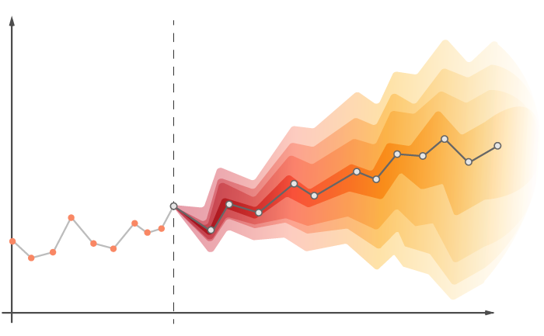
COMPARATIVE ANALYSIS BETWEEN DIFFERENT TIME-SERIES FORECASTING MODELS
ABDUL KARIM ALI (A20507119)
ARYAN THAKRAN (A20512626)
RAHUL POOJARI (A20508553)
SHRAYAN CHAUDHURI (A20518703)

Slide 2
AGENDA
Brief discussion about the project
A look at ARIMA model
Overview of Recurrent Neural Network
Live demo
Challenges faced during the process
References
Thank you

Slide 3
BRIEF DISCUSSION ABOUT THE PROJECT
Aim: - Our major goal in this research is to use sophisticated time series forecasting algorithms to accurately estimate store sales. Because the retail industry is dynamic and ever-changing, firms face obstacles on a regular basis. A comprehensive understanding of sales patterns is necessary for making important choices about personnel, inventory management, and overall business strategy. Like guiding stars, accurate sales estimates give merchants the crucial information they need to negotiate this challenging environment.
Dataset: - The Dataset on which the model will be trained and tested consists of 1048575 rows.
The dataset consists of the following CSV files:
● holidays_events.csv: Information about holidays and events.
● oil.csv: Historical oil prices.
● stores.csv: Details about different stores.
● transactions.csv: Historical transaction data.
● train.csv: We will use train.csv as our main dataset and divide this into training and testing sets in order to make our predictions and evaluations of the predictions.
The size of the data varies across files, with the train.csv file being the largest and the test.csv file being the one on which we will make predictions. The main target variable is 'sales' in the train.csv file.

Slide 4
BRIEF DISCUSSION ABOUT THE PROJECT
SUMMARY OF THE TASK: -
Completing the necessary preprocessing steps on the dataset.
Combining the several CSV files that hold information about the primary train dataset, holiday events, store information, and transaction data.
Model preparations using different time-series models e.g., ARIMA and RNN using LSTM.
Fitting models for time series forecasting to the training set of data.
OUTCOMES: -
The following results are what we hope to accomplish:
Precise sales projections for the test dataset that include information on how holidays and other events affect sales.
Determination and modeling of in-store sales seasonal patterns.
A deeper comprehension of the connection between sales and transactions.
Examining several forecasting models to see which is best for the job.

Slide 5
A LOOK AT ARIMA MODEL
ARIMA (AutoRegressive Integrated Moving Average) is a popular time series forecasting model that combines autoregression (AR), differencing (I for Integrated), and moving averages (MA). Trend, seasonality, and abnormalities are among the several elements of time series data that the ARIMA model effectively captures.
The orders of the AR, I, and MA components are represented by the letters p, d, and q, respectively, in the ARIMA model, which is written as ARIMA(p, d, q).
AutoRegressive (AR): The correlation between the current value and its historical values is represented by the AR component. The number of previous observations that are taken into account is indicated by the order of the AR component (p).
Integrated (I): The time series data's differencing to make it steady is represented by the I component. The number of times that differencing is done is indicated by the order (d).
Moving Average (MA): In a moving average model, the MA component shows the relationship between the current value and a residual error. The number of historical residual mistakes that are taken into account is indicated by the order of the MA component (q).
DRAWBACKS: -
ARIMA requires the dataset to be stationary. If the dataset is not stationary, then differencing or some other techniques should be applied to make it stationary.
In case of basic seasonality ARIMA works fine. However, in terms of irregular seasonal patterns we must introduce Seasonal ARIMA (SARIMA).
ARIMA doesn’t perform well in case of nonlinear patterns and picking the incorrect values of “p”, “d”, “q” affects the accuracy of the model heavily.

Slide 6
OVERVIEW OF RECURENT NEURAL NETWORK
A Recurrent Neural Network (RNN) is a tool for handling data that comes in a sequence, like words in a sentence or steps in a process. Unlike simpler tools, RNNs remember what happened before, using a hidden memory, and this helps them understand the context and order of things. They are useful for understanding languages, recognizing speech, analyzing time-based data, and more.
DRAWBACKS: -
Problems with vanishing and gradient explosion.
The challenge of training an RNN is quite challenging.
Processing lengthy sequences is hindered when Tanh or Relu is used as an activation feature.
RNN modifications such Gated Recurrent Units (GRUs) and Long Short-Term Memory (LSTM) networks have been proposed to solve some of these shortcomings. These designs are intended to better capture long-term interdependence and lessen the effects of the vanishing gradient issue.

Slide 7
Code Presentation

Slide 8
CHALLENGES FACED DURING THE PROCESS

Slide 9
REFERENCES
https://www.scaler.com/topics/deep-learning/rnn/
https://www.youtube.com/watch?v=2XGSIlgUBDI&t=293s
https://www.youtube.com/watch?v=Y2wfIKQyd1I
https://www.educba.com/recurrent-neural-networks-rnn/

Slide 10
THANK YOU

