Slide 1
Failed Banking Transaction Analysis
Project Overview and Workflow
P.V.Rahul Chandra

Slide 2
Project Objective
Ingest and process banking transaction data from multiple cities and branches.
Clean, merge, and filter for failed transactions using PySpark.
Store the results in Cloud SQL and visualize using BigQuery.

Slide 3
Tools & Services Used
• Google Cloud Storage
• Google Cloud Dataproc
• PySpark
• Cloud SQL (MySQL)
• BigQuery
• IAM Roles & Permissions

Slide 4
Step 1: Data Ingestion
• Daily transaction CSV files from 3 cities (5 branches each).
• Uploaded to Cloud Storage bucket (rahool_bucket/transactions).
• Each file contains 7 days of data with status: passed, failed, or empty.

Slide 5
Step 2: PySpark Data Processing
• Create a Dataproc single-node cluster.
• Run PySpark job to clean null/blank rows and merge data.
• Output a single cleaned CSV file.

Slide 6
Step 3: Filter Failed Transactions
• Run another PySpark job on cleaned CSV.
• Extract rows where transaction status is 'failed'.
• Store results in Cloud SQL (MySQL) under `failed_transactions` table.

Slide 7
Step 4: Cloud SQL to BigQuery
• Create external connection in BigQuery.
• Grant Cloud SQL Client role to BigQuery service account.
• Query Cloud SQL directly from BigQuery.
• Visualize and export results.

Slide 8
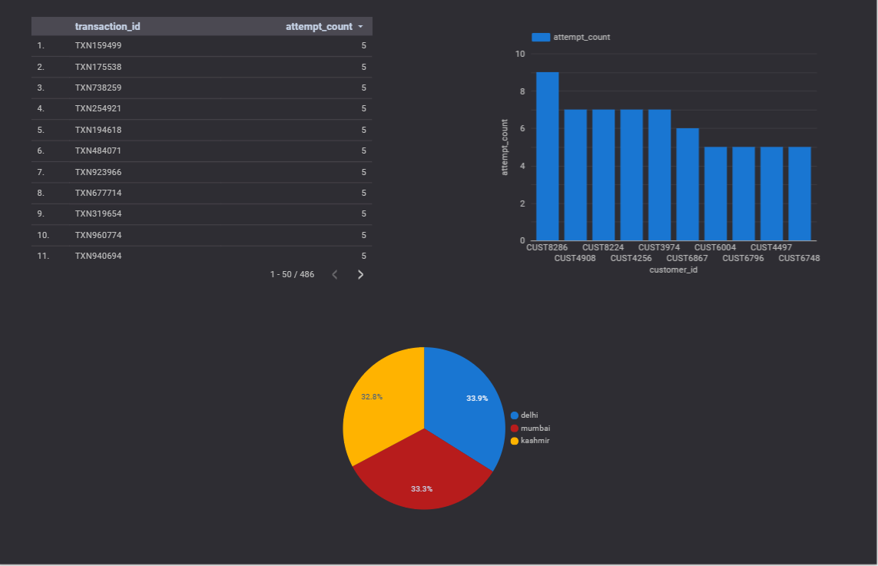
Output Structure

Slide 9
Conclusion
This project addresses a critical real-world issue faced by banks—monitoring and reducing the rate of failed transactions across widespread branches. By leveraging Google Cloud’s scalable infrastructure, we designed an end-to-end data pipeline that automates the ingestion, cleaning, and analysis of multi-branch transactional data. Using PySpark on Dataproc, Cloud Storage, Cloud SQL, and BigQuery, we created a reliable system for identifying transaction failures. This empowers stakeholders with timely insights to improve customer experience, strengthen operational efficiency, and make data-driven decisions for financial growth and risk reduction.

