Slide 1

National Institute of Technology , Patna
COVID-19 Analysis, Visualization, Comparison and Predictions
Presented by :-
Name :- Rahul Kumar
Roll no. :- 1704031
B.Tech (E.C.E.)
Name :- Rajeev Ranjan
Roll no. :- 1704026
B.Tech (E.C.E.)
Project Supervisior :- Dr. Rajarshi Bhattacharya

Slide 2

COVID-19 Analysis, Visualization, Comparison and Predictions

Slide 3
OutliNe :
Introduction of project work.
Objective of the project.
Literature Review.
Approach(s) to the problem.
Experimental Setup.
Experimental Result and Verification.
Conclusion.

Slide 4
Introduction to COVID-19
Coronavirus is a family of viruses that can cause illness, which can vary from common cold and cough to sometimes more severe disease.
Middle East Respiratory Syndrome (MERS-CoV) and Severe Acute Respiratory Syndrome (SARS-CoV) were such severe cases with the world already has faced.
SARS-CoV-2 (n-coronavirus) is the new virus of the coronavirus family, which first discovered in 2019, which has not been identified in humans before. It is a contiguous virus which started from Wuhan in December 2019.
It is later declared as Pandemic by WHO due to high rate spreads throughout the world.

Slide 5
OBJECTIVE OF THE PROJECT
Currently (on the date 25 July 2020), Covid-19 leads to a total of 650K+ Deaths across the globe.
Pandemic is spreading all over the world; it becomes more important to understand about this spread.
This project is an effort to analyze the cumulative data of confirmed, deaths, and recovered cases over time.
In this project, the main focus is to analyze the spread trend of this virus all over the world.

Slide 6
LITERATURE REVIEW
As we have to predict the future cases of corona in upcoming days with the help of it’s trend and behaviour.
.Predictions are made for new data when the actual outcome may not be known until some future date, which is called as Time Series Forecasting.
Moving average, SVM and Bayesian Ridge Polynomial Regression models can be used for this purpose.

Slide 7
APPROACH(S) TO THE PROBLEM
Data Collection
2019 Novel Coronavirus COVID-19 (2019-nCoV) Data Repository by Johns Hopkins CSSE. It includes four different dataset for the no. of confirmed, recovered, death and latest cases with their respective country.
This dataset is updated on daily basis by Johns Hopkins CSSE.
Link to dataset: https://github.com/CSSEGISandData/COVID-19

Slide 8
Data Preprocessing
There are four different dataset are available for confirmed cases, Recovered cases, Death cases and Latest cases.
Join all the table taking date as the primary key.
Check for null value, if any then remove it.
3. Models
Two different models are used in the prediction of future cases of corona.
Support Vector Regression (SVR)
Bayesian Ridge Polynomial Regression
4. Evaluation Metrics
Mean absolute error

Slide 9
Experimental setup
Support vector Regressor
It is the combination of a Support Vector Machines and Regression.
Linear Regression won’t work on our data because our data has many fluctuations and a linear line of best fit would give poor predictions on time series data.
Using regression we try to minimize the cost function using something like gradient descent.
With SVMs we try to draw a hyperplane between 2 different classes. So SVR is the combo of the 2, we try to minimize the error within a certain threshold.

Slide 10
Bayesian Ridge Polynomial Regression:
when working with time series models the main issue is over-fitting particularly when estimating models with large numbers of parameters over relatively short time periods.
One solution to the over-fitting problem, is to take a Bayesian approach which allows us to impose certain priors on our variables.
But, Here main reason to use this model is to compare it’s performance in terms of Mean absolute error with SVR.

Slide 11
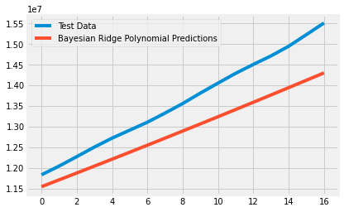
Bayesian Regression polynomial Prediction

Slide 12
EXPERIMENTAL RESULT AND VERIFICATION :
The data sets used in the experiments contains data of 135 days from 22nd of January 2020. Among the data of 135 days, 118 of them are randomly chosen to be in the training set, the other 17 days are in the testing set. No hold out set is used for simplicity.
Mean absolute error for bayesian Regression model is 704085.54.
Mean absolute error for SVR model is 217097.5.
The following two charts show the error rates on the test data for support Vector regression and Bayesian Ridge Regression model.

Slide 13
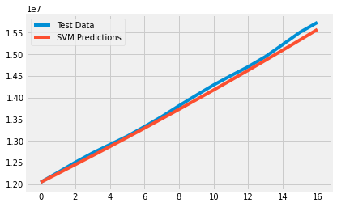
SVR Forecasting

Slide 14
Conclusion
The novel coronavirus is spreading so rapidly that it has changed the rhythm of the globe. Whether from the perspective of a single country or multilateral levels, the solidity of international relations has been put under test.
The most obvious consequences include economic recession, a crisis of global governance, trade protectionism and increasing isolationist sentiment.
. People-to-people, cultural and travel exchanges have all been restricted. Nonetheless, this is just a tip of the iceberg.
from our model, on taking future forecasting of 14 days data from the day of running the model we only conclude that it is increasing rapidly and there is no sign of decreasing or flattening the curve.

Slide 15
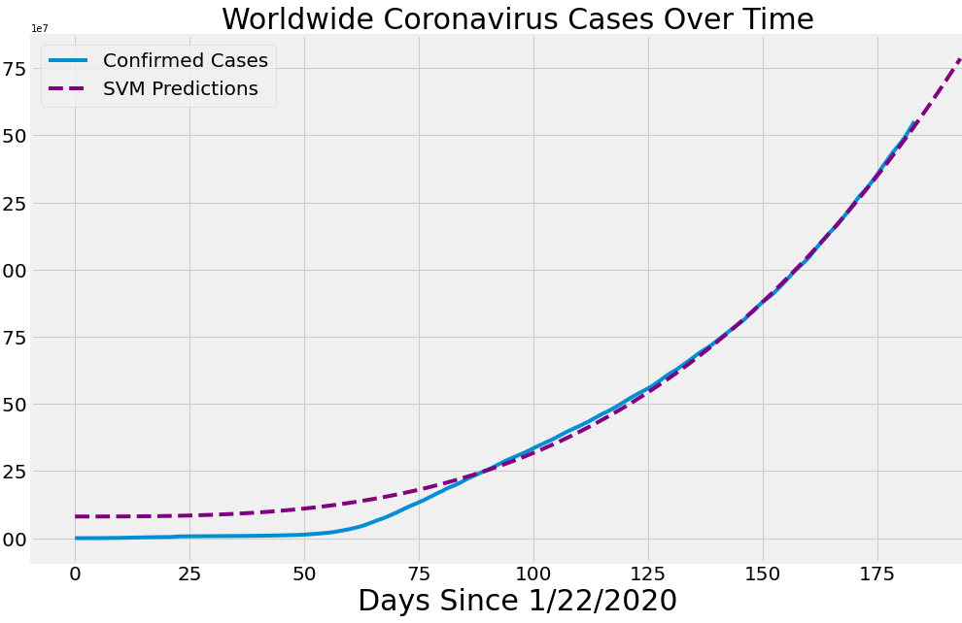
14 days forcasting

