Slide 1
Apache Storm
Team 07

Slide 2



Team members
Millindar Reddy Maligireddy | Pradeepkumar Theegala | Sunil Mundru

Slide 3
Contents
Introduction
Storm vs Hadoop
Use cases
Storm Architecture
Five key abstractions help Strom processes data
Topology
Workflow
Benefits
Demo

Slide 4
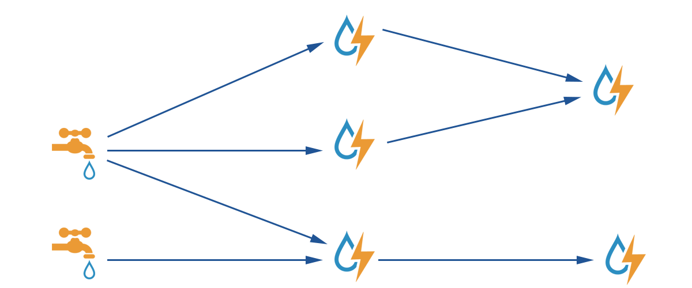
Introduction
Open source distributed real-time big data-processing system
Easy to reliably process unbounded streams of data
Simple, can be used with any programming language
Fast, scalable, fault-tolerant, guarantees data will be processed
Easy to setup and operate
http://storm.apache.org/

Slide 5
Storm vs Hadoop
Storm | Hadoop
Real-time stream processing | Batch processing
Stateless | Stateful
Master/Slave architecture with Zookeeper based coordination | Master-slave architecture with/without Zookeeper based coordination
Master node called as nimbus and slaves are supervisors | Master node called as job tracker and slave node is task tracker
A Storm streaming process can access tens of thousands messages per second on cluster | Hadoop Distributed File System (HDFS) uses Map Reduce framework to process vast amount of data that takes minutes or hours
Storm topology runs until shutdown by the user or an unexpected unrecoverable failure. | Map Reduce jobs are executed in a sequential order and completed eventually

Slide 6
Use cases
Twitter:
Storm is used to power a variety of Twitter systems
Such as real-time analytics, personalization, search, revenue optimization, etc.,
Flipboard:
uses storm for a wide range of services
Such as content search, real-time analytics, custom magazine feeds, etc.,

Slide 7
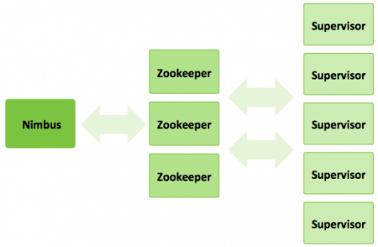
Storm Architecture
A storm cluster has 3 sets of nodes:
Nimbus:
Master node
Uploads computations for execution
Distributes code across the cluster
Launches workers across the cluster
Monitors computation and reallocates workers as needed
Zookeeper nodes:
Coordinates the Strom cluster
Supervisor node:
Communicates with Nimbus through Zookeeper
https://www.cloudera.com/products/open-source/apache-hadoop/apache-storm.html

Slide 8
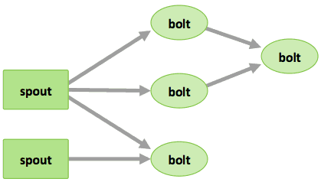
Five key abstractions help Strom processes data
Tuples:
Ordered list of elements
Streams:
Unbounded sequence of tuples
Spouts:
Sources of streams in a computation
Bolts:
Process input streams and produce output streams
Topologies
Overall calculation
http://storm.apache.org/

Slide 9
Topology
Spouts and bolts are connected, and they form a topology
Storm keeps the topology always running, until you kill the topology
Apache Storm’s main job is to run the topology and will run any number of topology at a given time

Slide 10
Workflow
Process and gather all the tasks that are to be carried out
The order in which the task is to be executed
Then nimbus will evenly distribute the tasks to all the available supervisors
At a time interval, all supervisors will send heartbeats to the nimbus to inform that they are still alive
When a supervisor dies and doesn’t send a heartbeat to the nimbus, then the nimbus assigns the tasks to another supervisor.
When the nimbus itself dies, supervisors will work on the already assigned task without any issue.
Notes:
Once a topology is submitted, it will process and gather all the tasks that are to be carried out and the order in which the task is to be executed
Then, the nimbus will evenly distribute the tasks to all the available supervisors
At a time interval, all supervisors will send heartbeats to the nimbus to inform that they are still alive

Slide 11
Modes in a Storm cluster
Local mode:
Used for development, testing, and debugging
Because it is the easiest way to see all the topology components working together
Production mode:
Submit our topology to the working storm cluster
Which is composed of many processes, usually running on different machines

Slide 12
Benefits
Storm performs data refresh and end-to-end delivery response in seconds or minutes depends upon the problem
It has very low latency
Storm has operational intelligence
Storm provides guaranteed data processing even if any of the connected nodes in the cluster die or messages are lost

Slide 13
Demo

Slide 14
Conclusion
Storm is unbelievably fast because it has enormous power of processing the data and can keep up the performance even under increasing load by adding resources linearly and it is highly scalable

Slide 15
References
https://www.tutorialspoint.com/apache_storm/apache_storm_introduction.htm
http://storm.apache.org/
https://www.cloudera.com/products/open-source/apache-hadoop/apache-storm.html

Slide 16
Thank You 😊

