Slide 1

DEPARTMENT OF COMPUTER ENGINEERING
Decentralized File Storage using Blockchain and IPFS (BE20)
Student name:Rahul Mane Roll no:37 Division:BE Comps
Student name:Yashovardhan Sarda Roll no:57 Division:BE Comps
Student name:Vidhi Jain Roll no:28 Division:BE Comps
Student name: Simran Singh Roll no:72 Division:BE comps
Under the Guidance of: Dr.Rahul Ambekar

Slide 2
Problem statement
Storing data is one of the major concerns in today’s world. According to a research the minimal data generated is 2.5 quintillion bytes of data produced by humans every day and storage is a major concern. Most of the centralized storage out there stores the data but is it a safe approach? It’s still questionable that the data stored in these storages are safe or won’t be lost. To maintain the CIA of data most of the big companies are trying to move on a more secure approach of storage i.e Decentralized storage to secure their data and get a fast accessibility of it.

Slide 3
Objective
The basic idea of the project is to build a system to implement on Decentralized File Storage using Blockchain and IPFS:
The innovative cryptography feature of Blockchain Technology will help in encrypting and verifying the data. In this manner, the data is less likely to be attacked or altered without authorization
The distributed/decentralized security feature of Blockchain will make cloud storage more protected and robust against hacking as the data on a centralized server is exposed to hacking, loss of data, or human error.
Scope
The project aims to build a Decentralized File Storage using Blockchain and IPFS:
Decentralized storage is used to improve the security of data transactions between two entities through blockchain.
In centralized storage one's you delete the file it is still saved in the server but in decentralized, there is no third party to access your data.
Data is encrypted and stored across multiple locations or nodes that are run by individuals or organizations.
To save data as Large organizations store data centralized in a cloud storage system. Hackers and other potential threats can have access to such information.

Slide 4
Literature Survey
Sr.No | Title | Authors | Publication | Salient feature | Limitation
1 | Blockchain for Cloud Storage Security | Aamir Mughal and Alex Joseph | IEEE International Conference on Intelligent Computing and Control Systems June 28,2020 | Blockchain is used to provide more security to cloud storage | NA
2 | Enhancing Security of Data in Cloud Storage using Decentralized Blockchain | Mrs. Rohini Pise, Dr. Sonali Patil | IEEE Xplore The Third International Conference on Intelligent Communication Technologies and Virtual Mobile Networks, 2021 | CIAis achieved using SHA-512 Advanced Encryption Standard (AES) is used to encrypt and decrypt the data | Deciphering is slower than the process of enciphering. Addition of the last round excluding mix-column has no benefit in increasing security, insertion and deletion of it can have no effect on security stated by authors of AES.
3 | Blockchain-based System for Secure Data Storage with Private Keyword Search | Hoang Giang Do, Wee Keong Ng | IEEE 13th World Congress on Services, 2017 | It provides the data owner a capability to grant permission for others to search on her data. The system supports private keyword search over the encrypted dataset. | NA

Slide 5
Sr.No | Title | Authors | Publication | Salient feature | Limitation
4 | Decentralized secure cloud storage using blockchain | Subarna Shakya, Sagar Bhusal, Anish Shrestha, | Researchgate | Their propose is to experiment and demonstrate a working secure file storage system for a small credential file based upon the cryptography and blockchain technology They have used Shamir’s secret sharing algorithm that divides the secret into two shares. Secret is a secret message or number that you want to share with others securely. Share is a piece of Secret. | NA
5 | Blockchain-Based, Decentralized Access Control for IPFS | Mathis Steichen, Beltran Fiz, Robert Norvill, Wazen Shbair and Radu State University of Luxembourg | IEEE Confs on Blockchain Issue on 2018 | To achieve that, access control features are integrated into IPFS, an open source file sharing platform, that can be used as off chain storage. | It is inefficient to store huge files on the blockchain. Due to block size restrictions, files must be divided and reassembled off-blockchain. It would also be necessary to keep additional information related to reassembling files, necessitating either additional storage space or a separate system that offers the reassembly info.
6 | A Comprehensive Study of Decentralized Cloud Storage Platforms-A Review | Parminder Pal Kaur1 , Dr. Rini Saxena2 and Rohini Mahajan | IJCRT Volume 9, Issue 3 March 2021 | InterPlanetary file storage for P2P protocol & Merkle DAG for cryptographic hash. Content addressing, Distributed, Decentralized, Faster, Reliable, Low cost service, Peer to peer approach | Content resolution and gateway performance. Consumes more bandwidth.

Slide 6
Sr.No | Title | Authors | Publication | Salient feature | Limitation
7 | Blockchain based Data Security and Access Control System using Cloud | Sagar Gangwani, Prof. Reetika Kerketta MIT School of Engineering MIT ADT University Pune, India | IJERT Vol. 11 Issue 08 August 2022 | Comparison of Encryption Algorithm DES, AES, and Blowfish. offers a secure cloud storage system prototype built on a blockchain. The suggested method safeguards data held in an unreliable setting. A few security techniques with the right level of time complexity, usability, and effectiveness were selected for the system's implementation. | The biggest concern of keeping and moving sensitive information online, when it is no longer limited within physical borders, is security.
8 | Decentralized Cloud Storage Using Blockchain | Meet Shah, Mohammedhasan Shaikh | IEEE Fourth International Conference on Trends in Electronics and Informatics July 18,2020 | System uses the AES 256 bit encryption algorithm to encrypt the data ensuring the confidentiality of the user's data. Encrypted data is then distributed and stored across peers in the network using the IPFS protocol. Peers can rent their underutilized storage and earn cryptocurrency in return thereby, maximizing the storage resource utilization. | the architecture of hyper ledger blockchain fabric, limitations of electronic coins, working of hyper ledger fabric, and proof of work consensus algorithm. Hyperledger Fabric is a permissioned blockchain network that allows only limited nodes that have permission to add new blocks in the blockchain.
9 | B-Box - A Decentralized Storage System Using IPFS, Attributed-based Encryption, and Blockchain | Van-Duy Pham∗ Hanoi University of Science and Technology Hanoi, Vietnam | IEEE University of Birmingham Issue on 2020 | develop a decentralized, secure, To this end, we first analyze related approaches for decentralized storage, data encryption, We then develop a storage system, addition, we also plan to analyze and apply recent researches on encryption technologies to enhance security aspect of this | Migration-related concerns, Needs time to go mainstream.

Slide 7
Sr.No | Title | Authors | Publication | Salient feature | Limitation
10 | Design a decentralized secure access control network using blockchain on a cloud platform | RAVIKUMAR-CH | Research-square Lovely Professional University Issue on 2022 | demonstrates distributed data for cloud data storage by applying near-time for distributed file storage. The proposed access control mechanism will help solve multidimensional authentication as well as data sharing systems. | improving the performance of access control decisions by optimizing rule management.
Table. Literature review Table

Slide 8
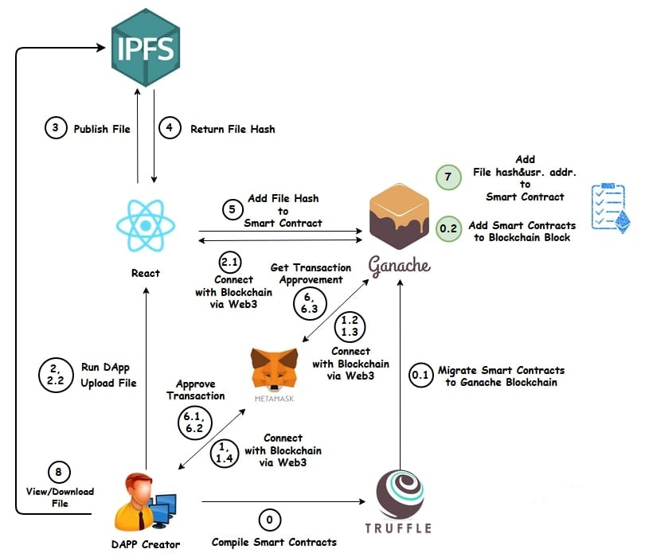
Proposed System
Figure: Architecture Diagram

Slide 9
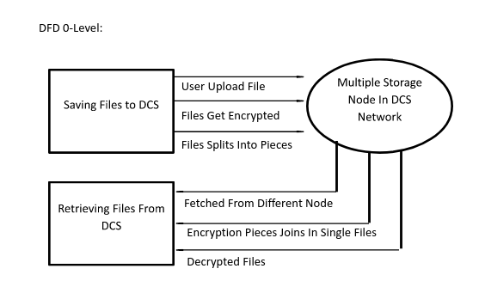
UML Diagrams
Data Flow Diagram - level 0

Slide 10
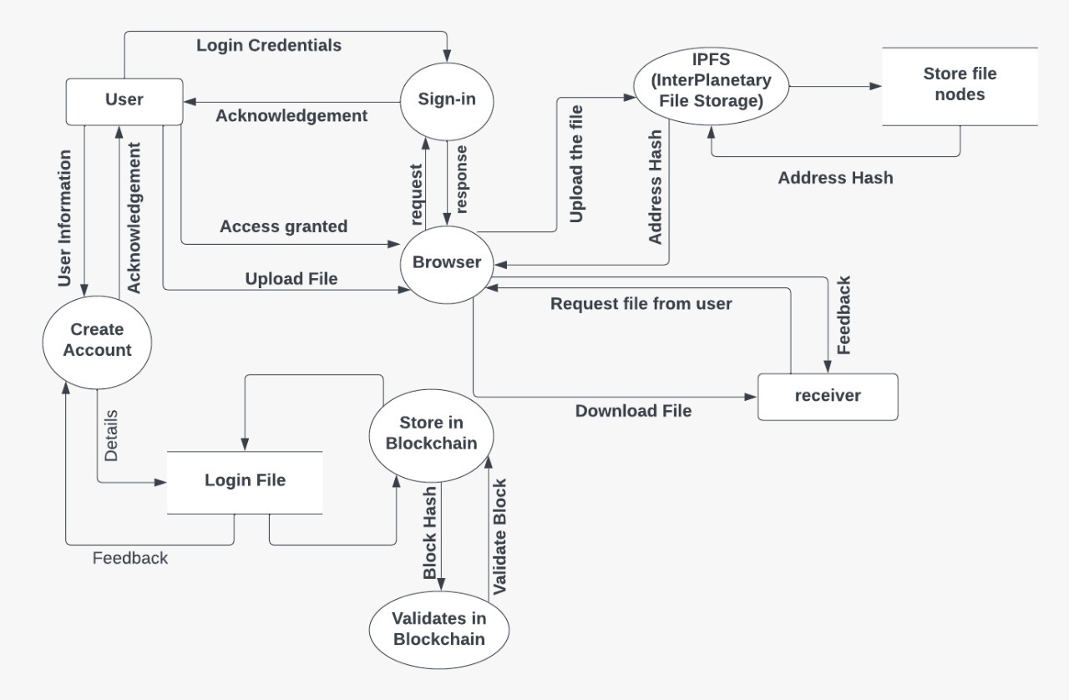
Data Flow Diagram - level 1

Slide 11
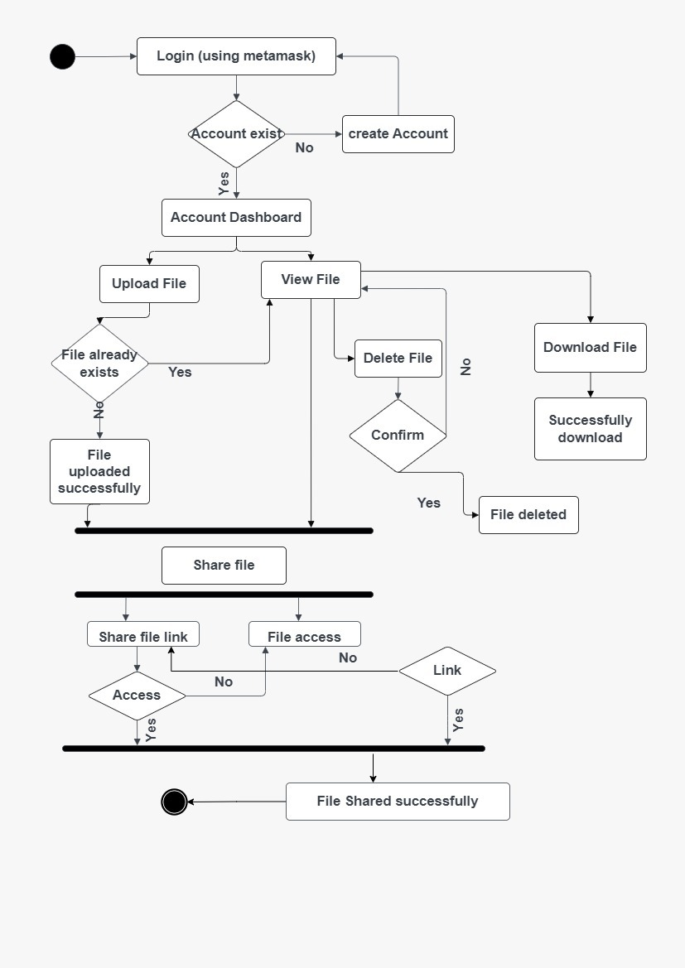
Activity Diagram

Slide 12
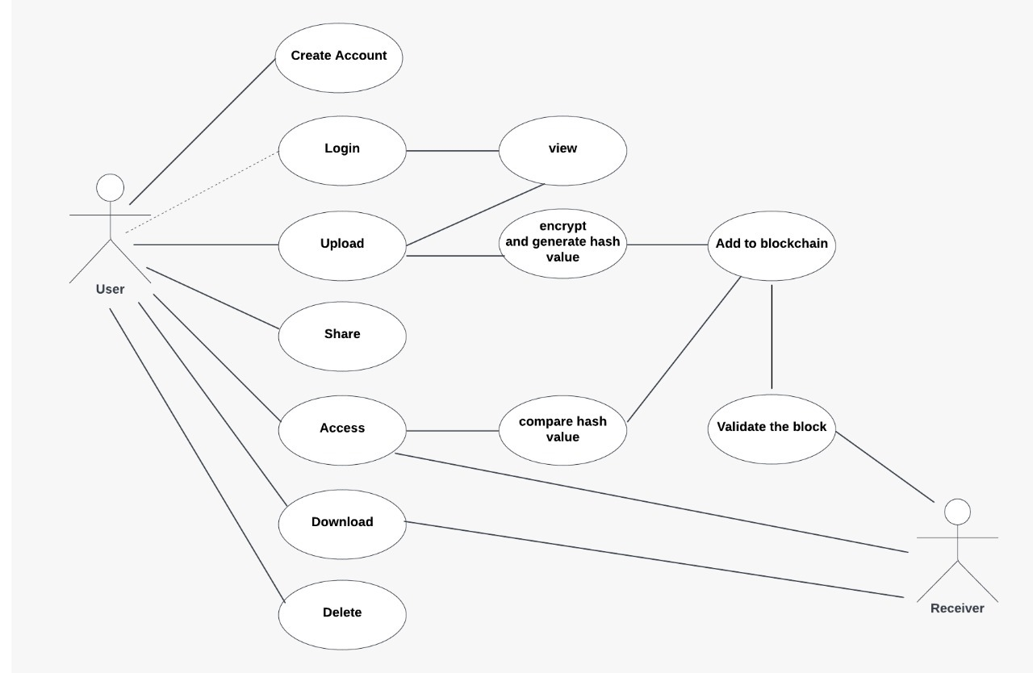
Use case Diagram

Slide 13
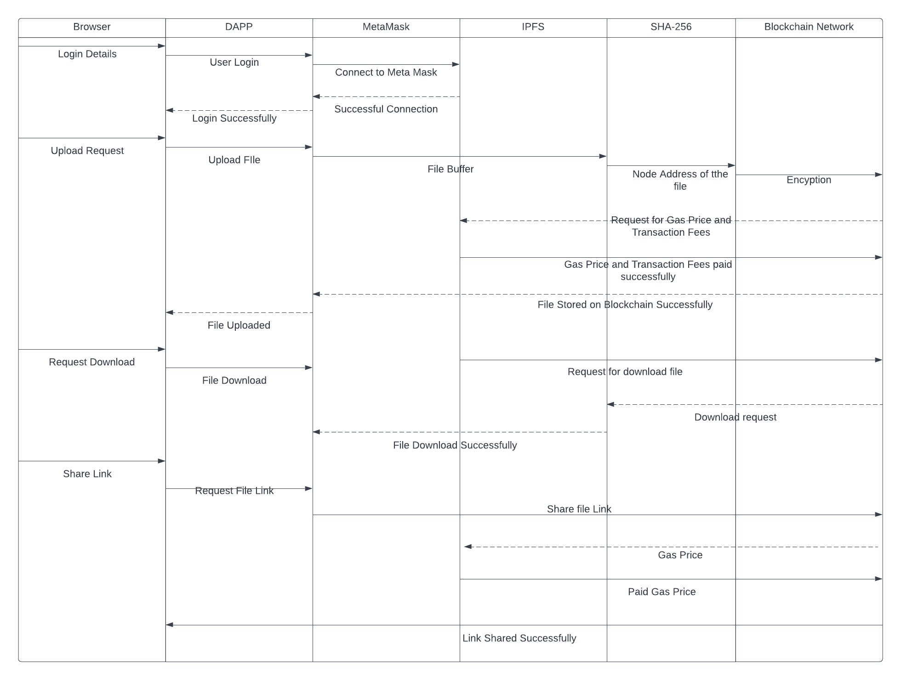
Sequence Diagram

Slide 14
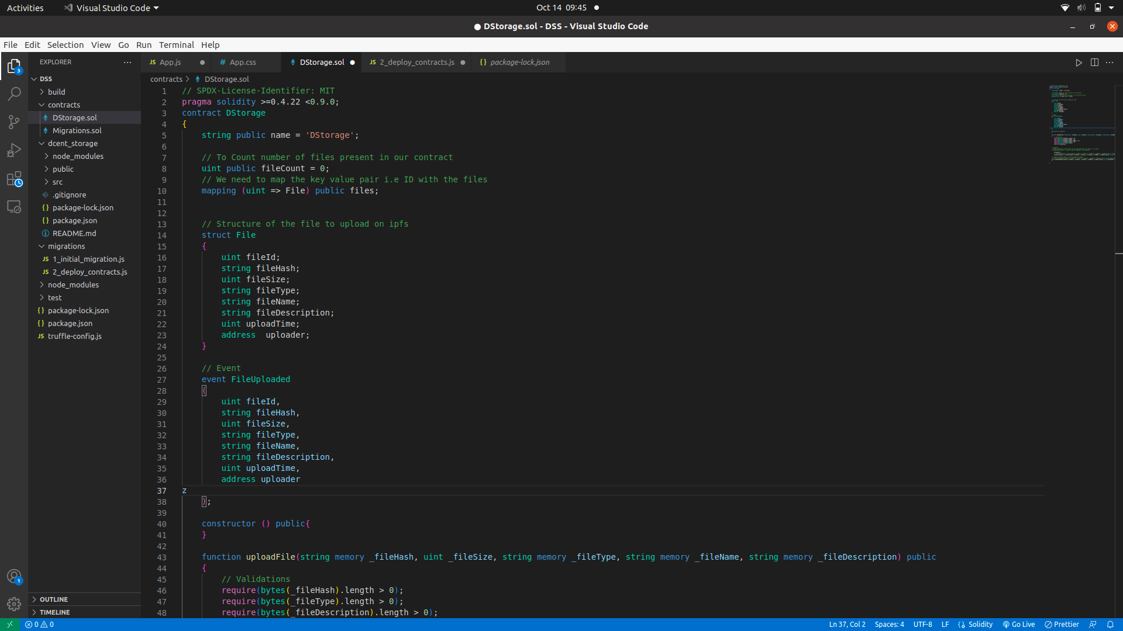
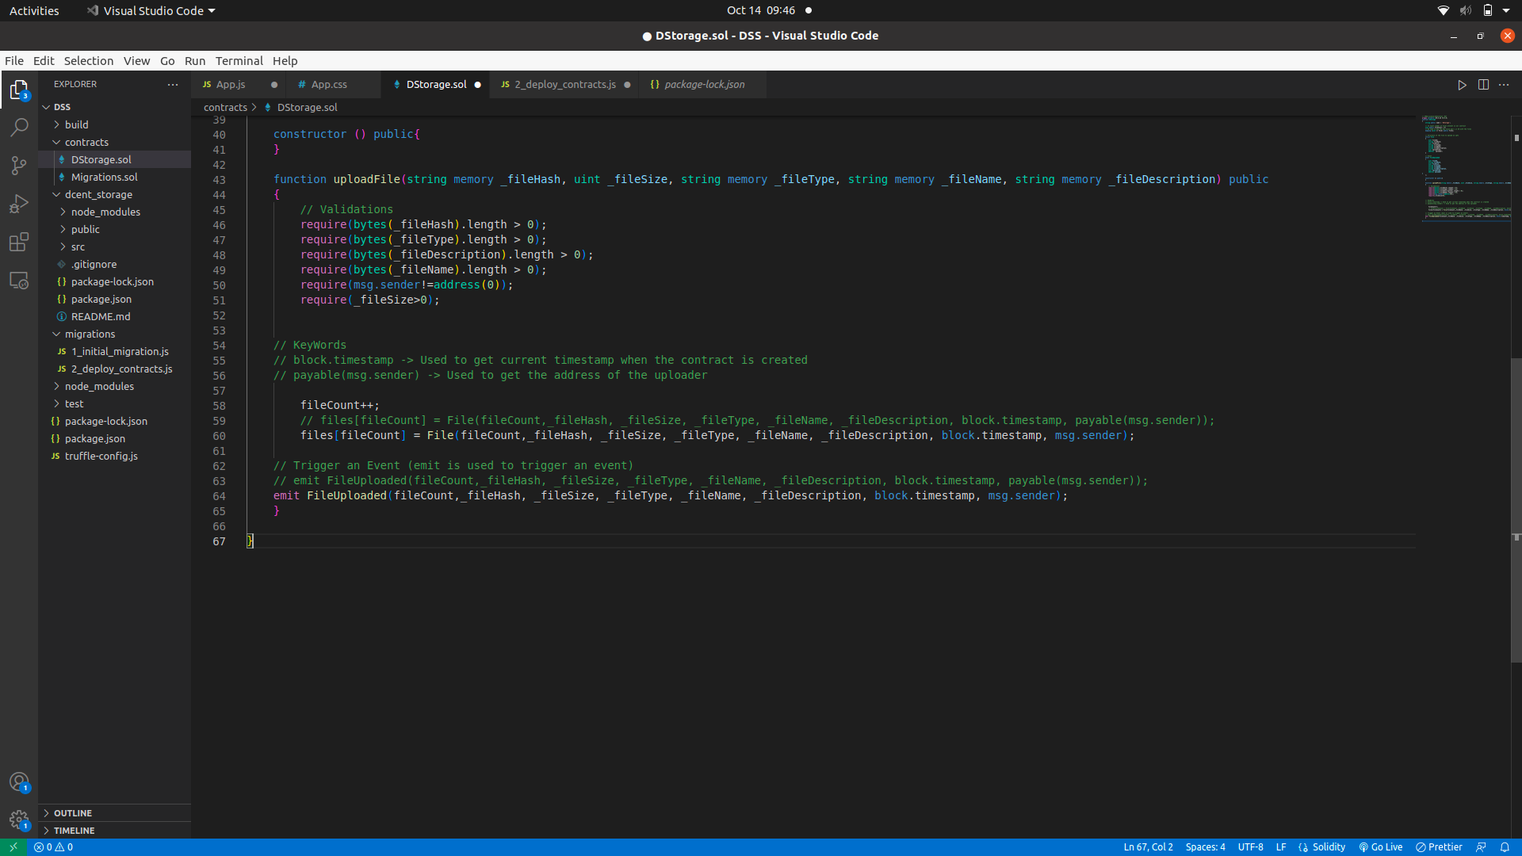
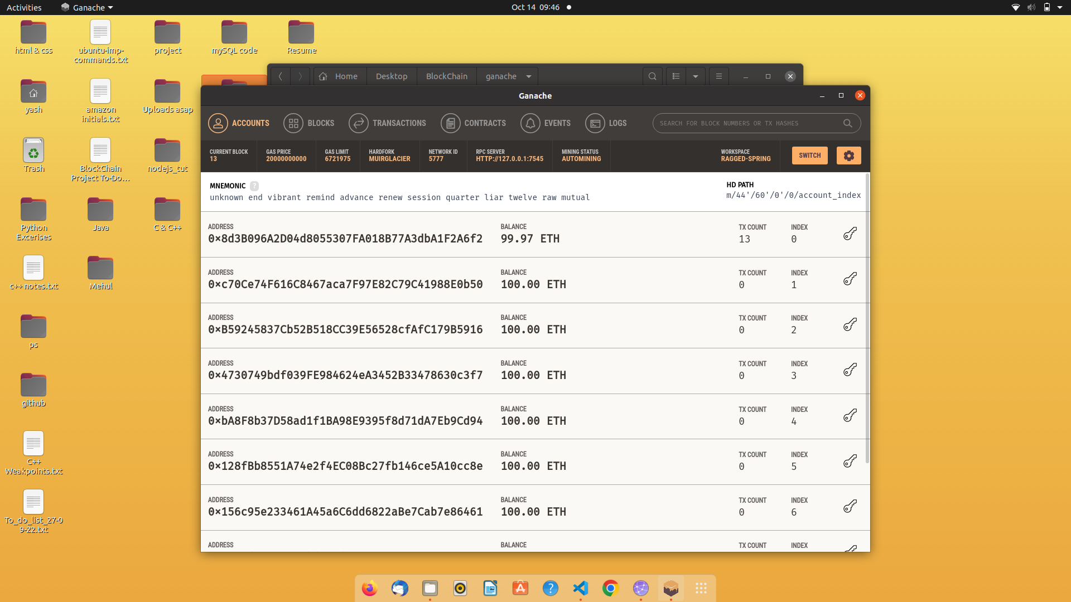
Implementation

Slide 17
Project Plan

Slide 18
Work Pending for Next Semester
Front-end
Connection setup for the Browser
Overcome Errors in existing Smart-contract.
Make the new test cases for our contract.

Slide 19
Benefits for Society
Enhanced Security
Cost efficient
Data cannot be tampered
Fast data transfer
Collision Resistant

Slide 20
Conclusion
We created the design and architecture of an advanced as well as secured web application for storing and sharing the data. A simple, affordable, easy to use and most secured system is proposed to solve the data security issues like integrity, authenticity and data unavailability.

Slide 21
References
whitepaper,
[1] Bitcoin: A Peer-to-Peer Electronic Cash System by Satoshi Nakamoto
Article,
[2] by Robert Sheldon and Brien Posey published on 05 Jan 2020
Journal Paper,
[3] Blockchain-Based, Decentralized Access Control for IPFS, University of Luxembourg, SnT, by Mathis Steichen, Beltran Fiz, Robert Norvill, Wazen Shbair and Radu State published on 2018
Journal Paper,
[4] International Journal of Engineering and Advanced Technology (IJEAT) by G. Abinaya, Preksha Kothari, Alex Pavithran KP, Manasi Biswas, Farheen Khan published in , April 2019
Journal Paper,
[5] “Peer-to-Peer Distributed Storage Using InterPlanetary File System” by A.Manoj Athreya, Ashwin A. Kumar, S.M.Nagarjath, Gururaj H. L in 2021
Journal Paper,
[6] Decentralized Blockchain Based System for Secure Data Storage in Cloud by S. Uthayashangar T. Dhanya S. Dharshini R. Gayathri published in september 2021

Slide 22
Book,
[7] Solidity documentation
Journal Paper,
[8] Efficient-way of Data Storage on Decentralized Cloud using Blockchain Technology by Nandini K and Girisha G.S published in February 2022
Journal Paper,
[9] A Study And Analysis Of Decentralized Cloud Based Platform by Sonali Sharma, Shilpi Sharma, Tanupriya Choudhury published in March 2022.
Journal Paper,
[10] Blockchain based Data Security and Access Control System using Cloud
Journal Paper,
[11] Blockchain-based trust management in cloud computing systems: a taxonomy, review and future directions.
Proceeding paper,
[12] Decentralized Consensus Blockchain and IPFS-Based Data Aggregation for Efficient Data Storage Scheme
Article,
[13] Top 10 Most Trusted Blockchain Development Companies in India 2022
Article,
[14] “What is Storj”

Slide 23
Blog,
[15] David Dalrymple, Irene Giacomelli, Karola Kirsanow in 2020
Article,
[16] “Blockchain on AWS”
Journal Paper,
[17] B-Box - A Decentralized Storage System Using IPFS, Attributed-based Encryption, and Blockchain
Article,
[18] Blockchain Techniques for Secure Storage of Data in Cloud Environment.
Article,
[19] Cloud computing, decentralized access control, Blockchain technique, CP-ABE, Data Integrity.
Article,
[20] Decentralized Consensus Blockchain and IPFS-Based Data Aggregation for Efficient Data Storage Scheme.
Article,
[21] Blockchain based Data Security and Access Control System using Cloud.
Thesis,
[22] DECENTRALIZED SECURE CLOUD STORAGE USING BLOCKCHAIN

