Slide 1

DEPARTMENT OF COMPUTER ENGINEERING
Decentralized File Storage using Blockchain and IPFS (BE20)
Student name:Rahul Mane Roll no:37 Division:BE Comps
Student name:Yashovardhan Sarda Roll no:57 Division:BE Comps
Student name:Vidhi Jain Roll no:28 Division:BE Comps
Student name: Simran Singh Roll no:72 Division:BE comps
Under the Guidance of: Dr.Rahul Ambekar

Slide 2
Problem statement
Storing data is one of the major concerns in today’s world. According to a research the minimal data generated is 2.5 quintillion bytes of data produced by humans every day and storage is a major concern. Most of the centralized storage out there stores the data but is it a safe approach? It’s still questionable that the data stored in these storages are safe or won’t be lost. To maintain the CIA of data most of the big companies are trying to move on a more secure approach of storage i.e Decentralized storage to secure their data and get a fast accessibility of it.

Slide 3
Objective
The basic idea of the project is to build a system to implement on Decentralized File Storage using Blockchain and IPFS:
The innovative cryptography feature of Blockchain Technology will help in encrypting and verifying the data. In this manner, the data is less likely to be attacked or altered without authorization
The distributed/decentralized security feature of Blockchain will make cloud storage more protected and robust against hacking as the data on a centralized server is exposed to hacking, loss of data, or human error.
Scope
The project aims to build a Decentralized File Storage using Blockchain and IPFS:
Decentralized storage is used to improve the security of data transactions between two entities through blockchain.
In centralized storage one's you delete the file it is still saved in the server but in decentralized, there is no third party to access your data.
Data is encrypted and stored across multiple locations or nodes that are run by individuals or organizations.
To save data as Large organizations store data centralized in a cloud storage system. Hackers and other potential threats can have access to such information.

Slide 4
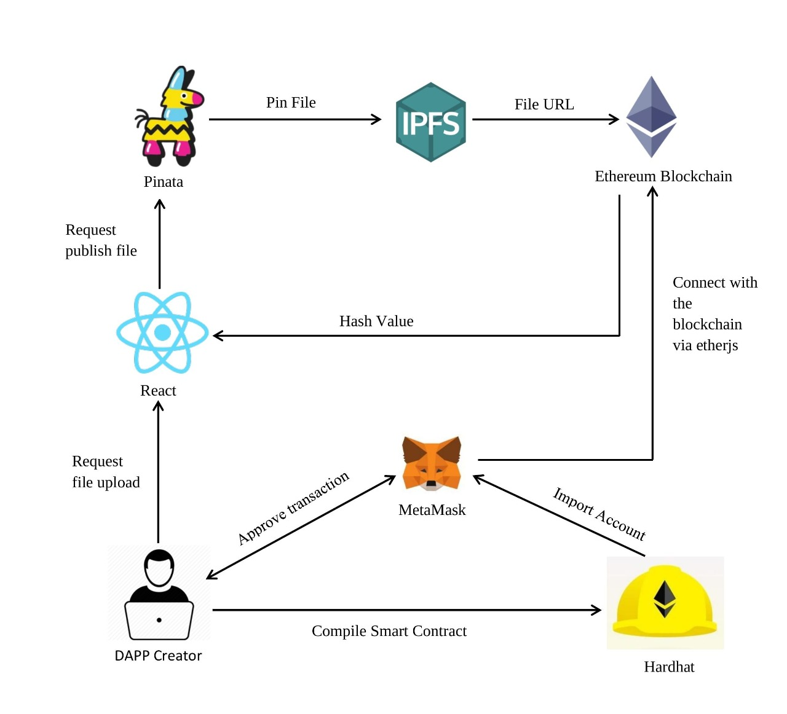
Proposed System
Figure: Architecture Diagram

Slide 5
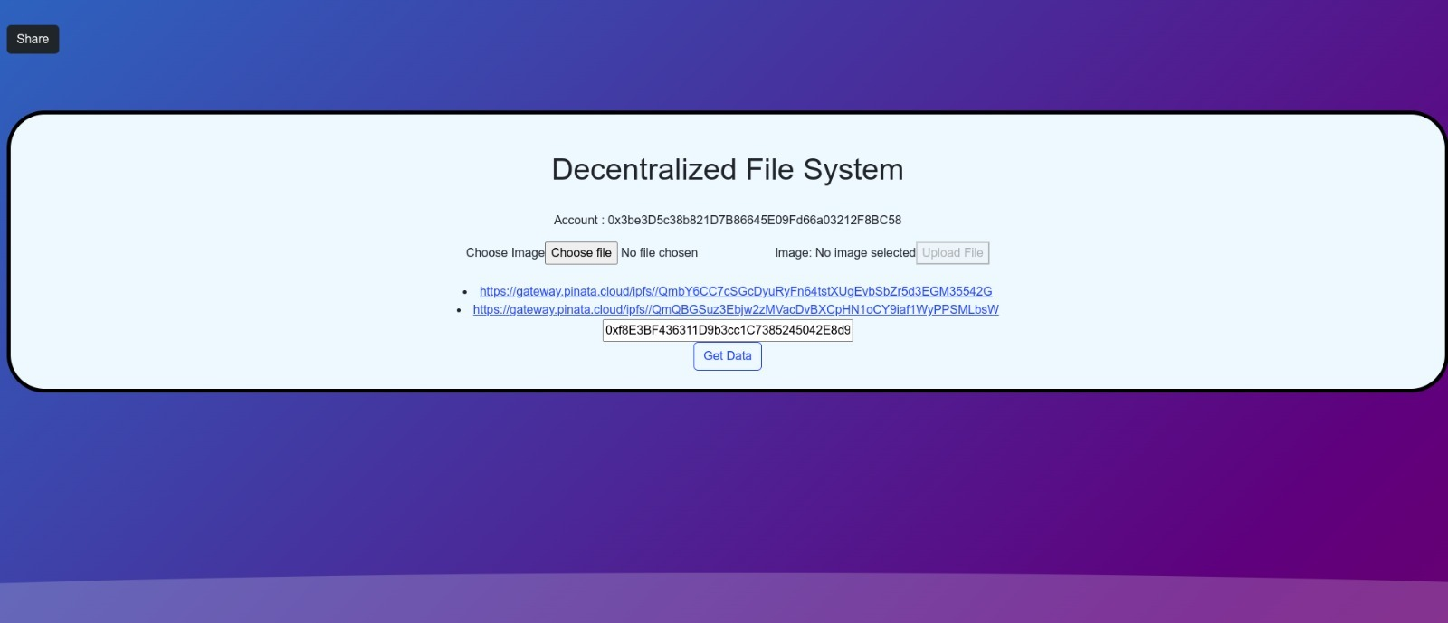
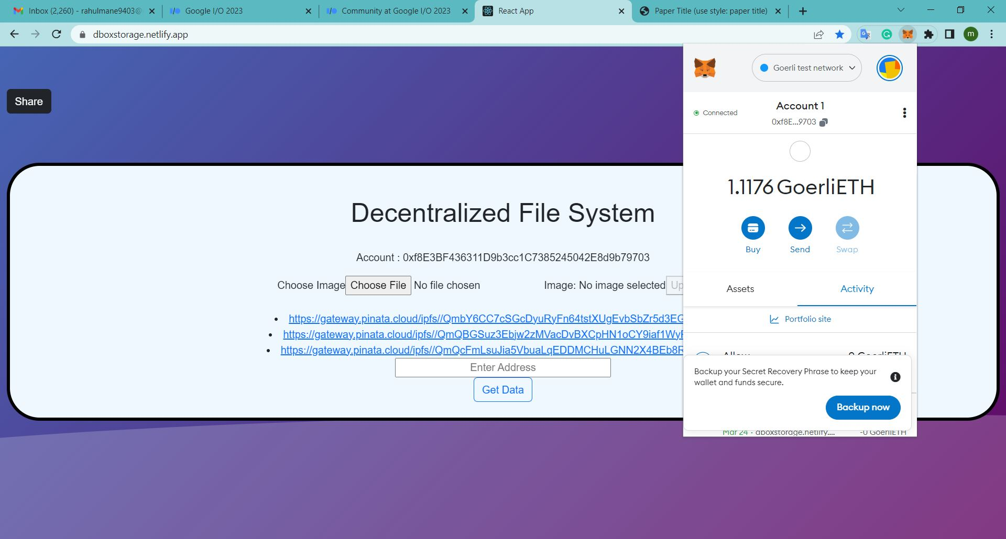
Implementation

Slide 6
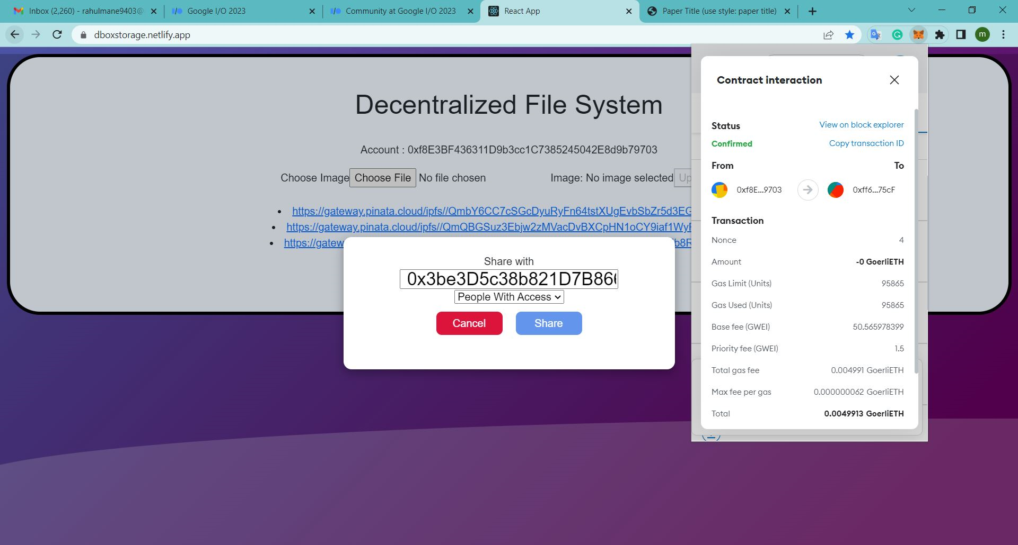

Slide 7

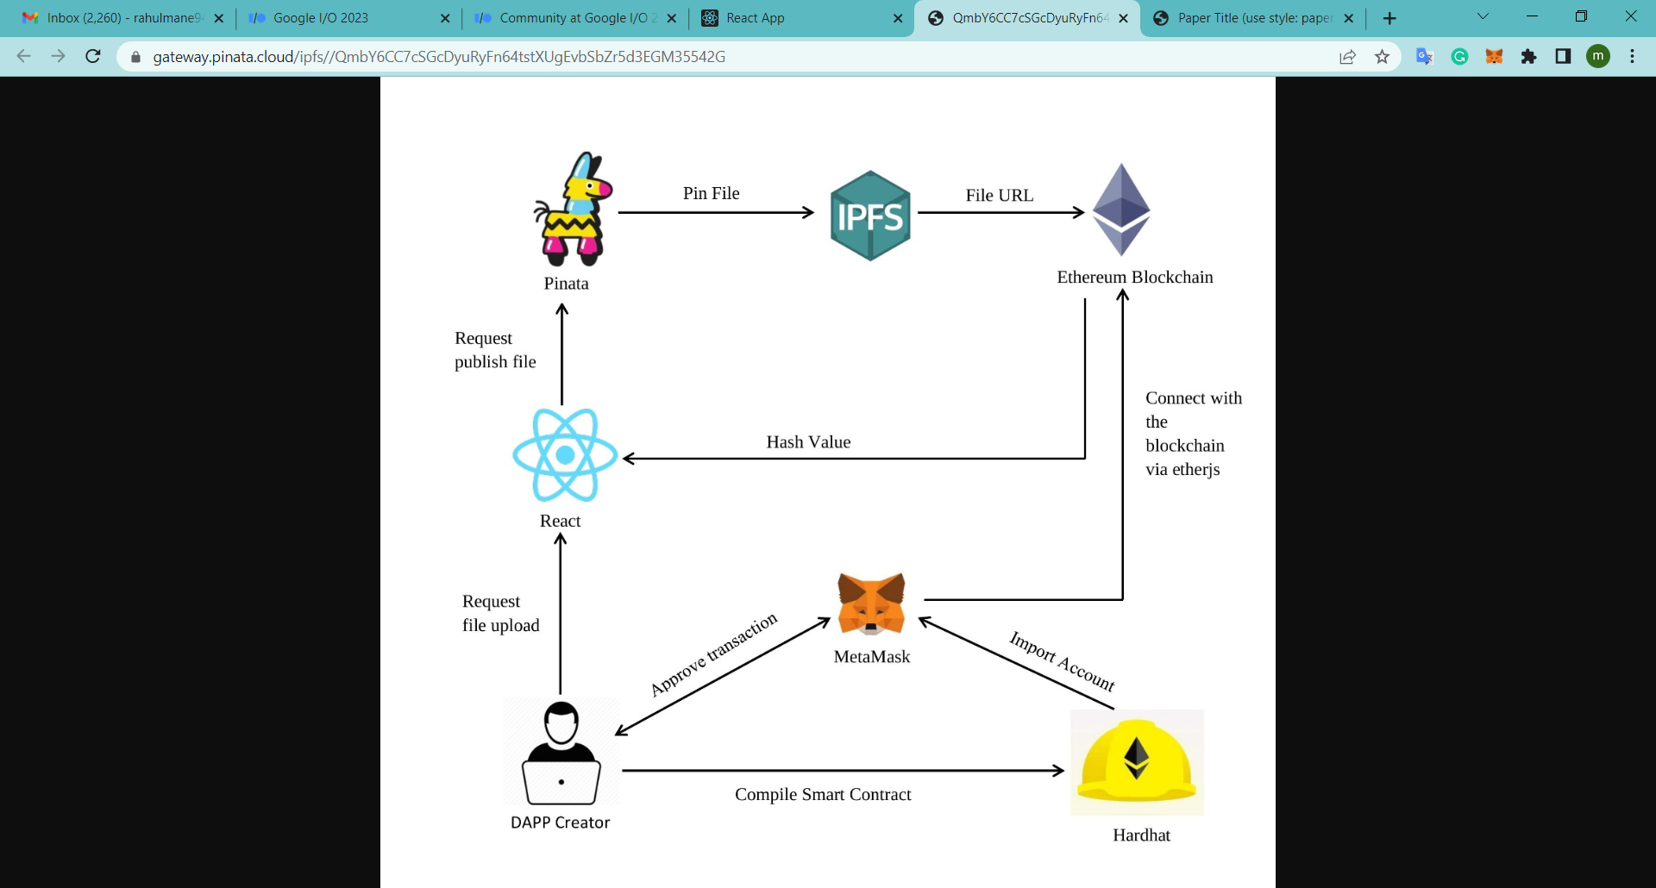
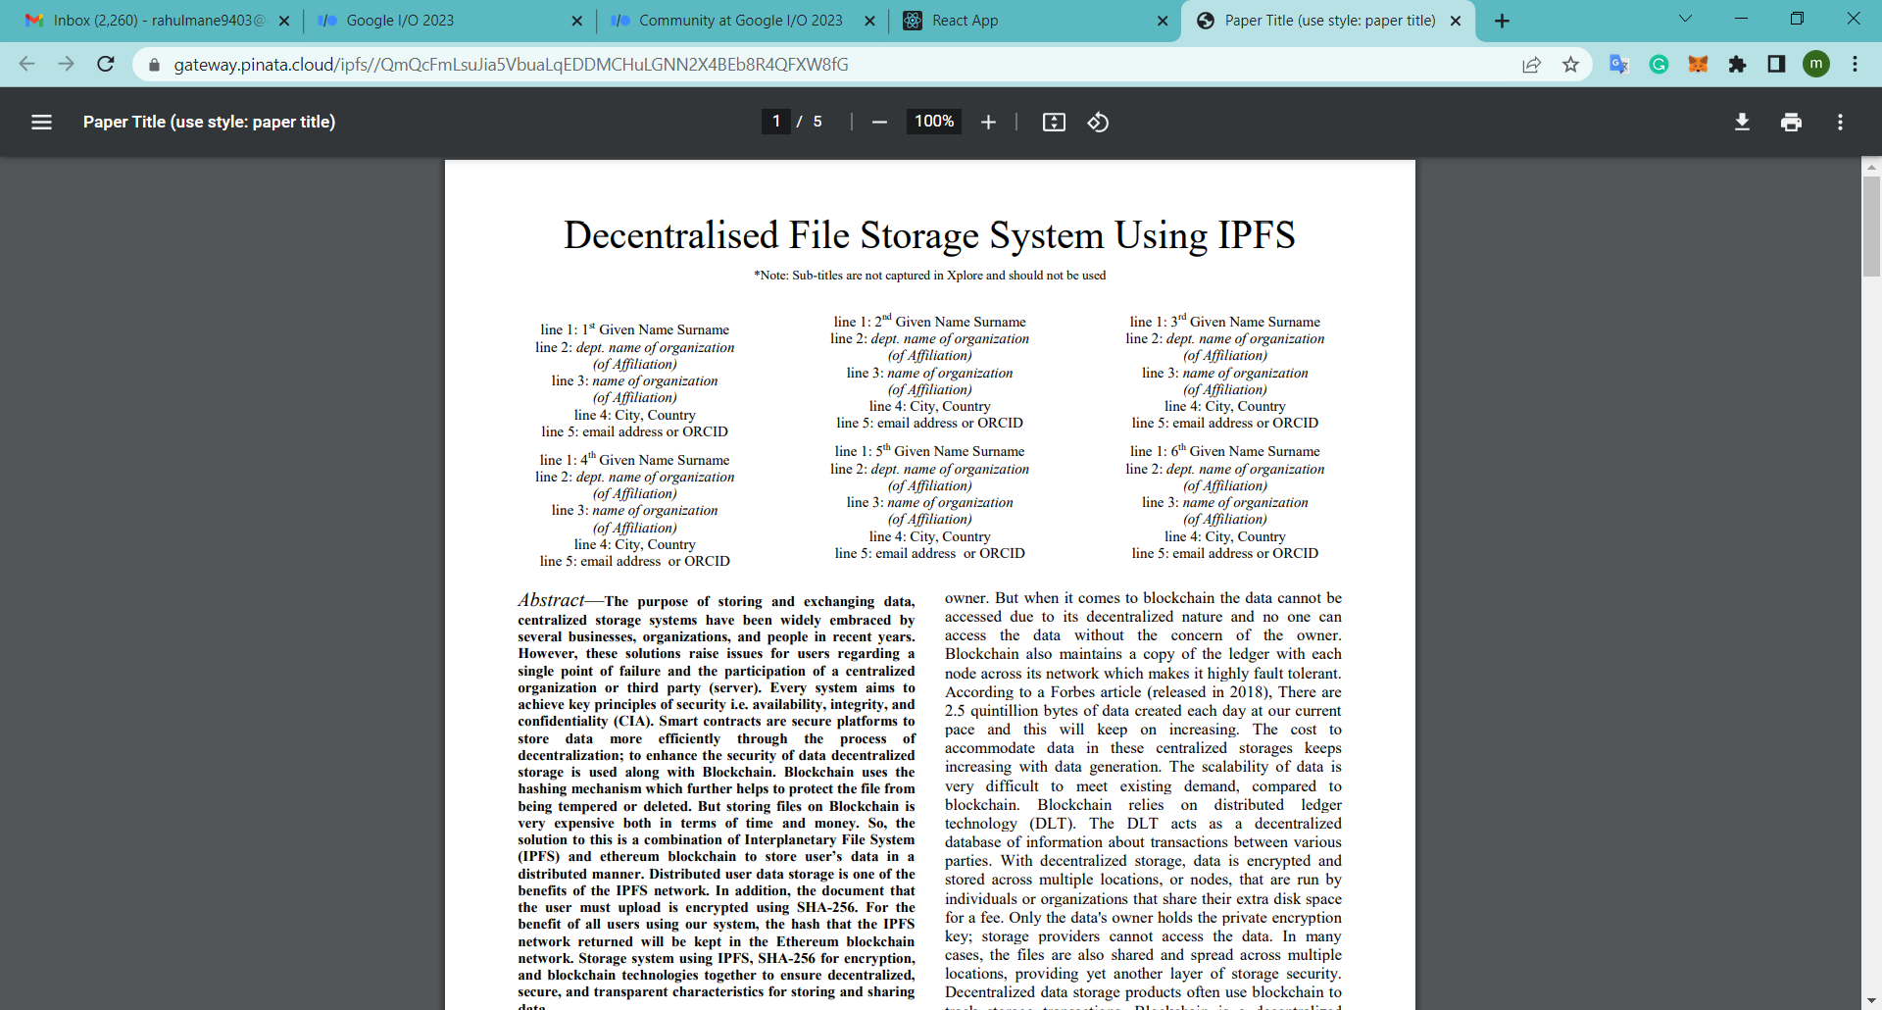
Video
Image

Slide 8
References
whitepaper,
[1] Bitcoin: A Peer-to-Peer Electronic Cash System by Satoshi Nakamoto
Article,
[2] by Robert Sheldon and Brien Posey published on 05 Jan 2020
Journal Paper,
[3] Blockchain-Based, Decentralized Access Control for IPFS, University of Luxembourg, SnT, by Mathis Steichen, Beltran Fiz, Robert Norvill, Wazen Shbair and Radu State published on 2018
Journal Paper,
[4] International Journal of Engineering and Advanced Technology (IJEAT) by G. Abinaya, Preksha Kothari, Alex Pavithran KP, Manasi Biswas, Farheen Khan published in , April 2019
Journal Paper,
[5] “Peer-to-Peer Distributed Storage Using InterPlanetary File System” by A.Manoj Athreya, Ashwin A. Kumar, S.M.Nagarjath, Gururaj H. L in 2021
Journal Paper,
[6] Decentralized Blockchain Based System for Secure Data Storage in Cloud by S. Uthayashangar T. Dhanya S. Dharshini R. Gayathri published in september 2021

Slide 9
Book,
[7] Solidity documentation
Journal Paper,
[8] Efficient-way of Data Storage on Decentralized Cloud using Blockchain Technology by Nandini K and Girisha G.S published in February 2022
Journal Paper,
[9] A Study And Analysis Of Decentralized Cloud Based Platform by Sonali Sharma, Shilpi Sharma, Tanupriya Choudhury published in March 2022.
Journal Paper,
[10] Blockchain based Data Security and Access Control System using Cloud
Journal Paper,
[11] Blockchain-based trust management in cloud computing systems: a taxonomy, review and future directions.
Proceeding paper,
[12] Decentralized Consensus Blockchain and IPFS-Based Data Aggregation for Efficient Data Storage Scheme
Article,
[13] Top 10 Most Trusted Blockchain Development Companies in India 2022
Article,
[14] “What is Storj”

Slide 10
Blog,
[15] David Dalrymple, Irene Giacomelli, Karola Kirsanow in 2020
Article,
[16] “Blockchain on AWS”
Journal Paper,
[17] B-Box - A Decentralized Storage System Using IPFS, Attributed-based Encryption, and Blockchain
Article,
[18] Blockchain Techniques for Secure Storage of Data in Cloud Environment.
Article,
[19] Cloud computing, decentralized access control, Blockchain technique, CP-ABE, Data Integrity.
Article,
[20] Decentralized Consensus Blockchain and IPFS-Based Data Aggregation for Efficient Data Storage Scheme.
Article,
[21] Blockchain based Data Security and Access Control System using Cloud.
Thesis,
[22] DECENTRALIZED SECURE CLOUD STORAGE USING BLOCKCHAIN

