Slide 1

CREDIT RISK PROJECT
Python
PYTHON
Project title: Build a data model to predict the probability of default.

Slide 2
CONTENT
Python
Introduction
Objective
Problem Statement
Informative (Data & Business Sense).
Data Transformation.
Steps Performed.
Data Visualization
Key Findings
Recommendation and Conclusion

Slide 3
INTRODUCTION
Python
We have to strive towards the solution and achieve the objective, this would help us understand the nitty-gritties of credit industry and the analytics and data science applications that would be applied on the same.
OBJECTIVE
To build a data model which will predict the probability of default, and choose a cut-off based on suitability.
Alternatively a modelling technique can be used which gives binary output.
Why Python??

Slide 4
PROBLEM STATEMENT
Python
In this project we have to put ourselves in the shoes of a loan issuer and manage credit risk by using the past data and deciding whom to give the loan to in the future.
INFORMATIVE
Data Summary
Variables - 73
Observations - 855,969
Critical Attributes
Business Sense
Data Dictionary would help us understand the dataset.
The column ‘Default Indicator’ is the target variable, which stands for the customers’ loan behaviours.

Slide 5
DATA TRANSFORMATION
Python
Data Interpretation.
Import dataset on Python.
STEPS PERFORMED
Data Pre-Processing
Missing Values.
Handling Outliers.
Irrelevance and Redundancy.
Conversion of Categorical
data to Numerical.
Exploratory Data analysis.
- Data Post-Processing
Split the data in train and test.
Fitting Model to Data.
Logistic Regression.
Model validation.
Predicting new data.

Slide 6
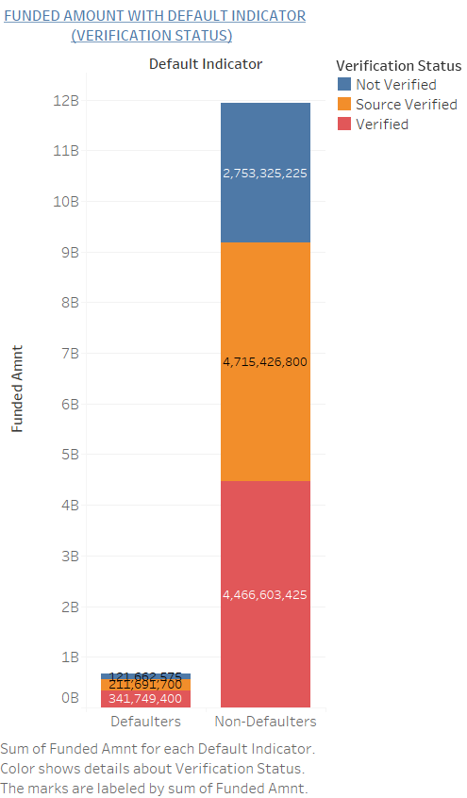
DATA VISUALIZATION
Python
Stacked bars:
This basically depicts the sum of amount that is funded for each class.
Most of the defaulters were verified, which contributed approx. 34 Crs to the loss.

Slide 7
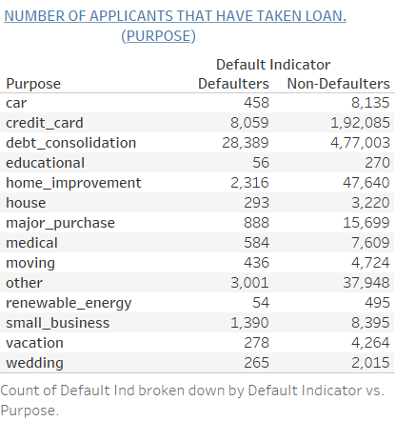
Contd..
Python
Text tables:
We can see that almost half of the applicants have taken the loan for debt consolidation and 28k defaulters - which is a major chunk of this category belongs to it.

Slide 8
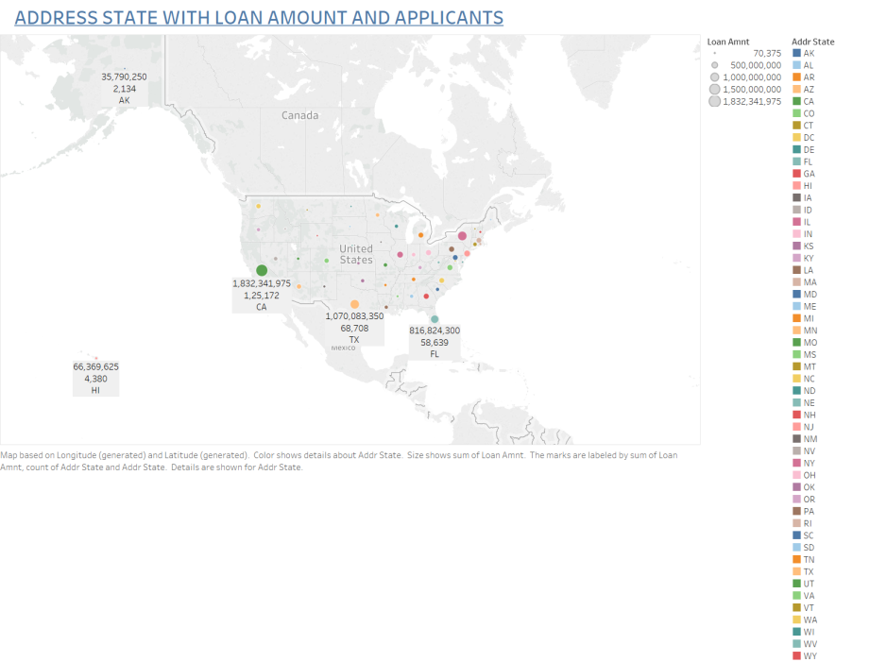
Contd..
Python
Symbol Map:
This symbol map tells us about the loan amount and the applicants that are located in different States of US.
Max. Loan Amt. & Applicants:
CA: California
Min. Loan Amt. & Applicants:
IA: Iowa

Slide 9
KEY FINDINGS
Python
Accuracy - 99.96%
Confusion Matrix:
Type 1 Error: 33
Type 2 Error: 63
Classification:
Precision, Recall, F1-scroe and support.
AUC - We have plotted only 1 Model and this would work when we have Multiple Models in Place.
ROC - This would basically depict the area that the data has covered.

Slide 10
RECOMMENDATION AND CONCLUSION
Python
Model would help the bank to revisit the default indicator based
on the confusion matrix.
Cut-off: If we use the threshold as .4 the type 1 and type 2 errors
turn out to be the best.
Stats based on the test data of Final Model
Loss to the bank based on type 1: $843,250
Loss to the bank based on type 2: $958,925

Slide 11

THANK YOU !!!
Python
PRESENTED BY:
- Kalyani Dhamankar
- Shraddha Wala
- Rahul Mahadik
- Rohan Gama

