Slide 1
Smart Traffic Management: Leveraging AI and ML for Real-Time Traffic Flow Optimization in Urban Environment
Submitted in the partial fulfillment for the award of the degree of
BACHELOR OF ENGINEERING
IN
CSE-AIML
Submitted by:
MRINAL BHATT - 21BCS9076
HARSH HARSHIT- 21BCS9622
RAHUL YADAV – 21BCS9479
BRIJESH KISHORE- 21BCS8816
Under the Supervision of:
SUPERVISORS NAME: Dr. Preet Kamal
Department of AIT-CSE
DISCOVER . LEARN . EMPOWER

Slide 2
Outline
Introduction to Project
Problem Formulation
Objectives
Methodology
Results
Conclusion
Future Scope
References

Slide 3
Introduction to Project
This project aims to develop an intelligent system capable of dynamically analyzing traffic patterns, predicting congestion, and optimizing traffic signals. By incorporating real-time data from sensors, cameras, and GPS systems, the proposed solution will empower cities to proactively manage traffic, enhance road safety, and reduce environmental impacts.
Through this project, we aspire to build a scalable, efficient, and sustainable traffic management framework that aligns with the smart city initiatives of the future.

Slide 4
Problem Formulation
Urban areas are increasingly plagued by traffic congestion, which adversely affects commuters, businesses, and the environment.
Key Challenges
Congestion: Inefficient signal management leading to delays.
Safety: Slow accident detection and response.
Environmental Impact Increased carbon emissions and fuel wastage caused by vehicles idling in traffic.
Resource Inefficiency Suboptimal utilization of existing road infrastructure and traffic control systems.

Slide 5
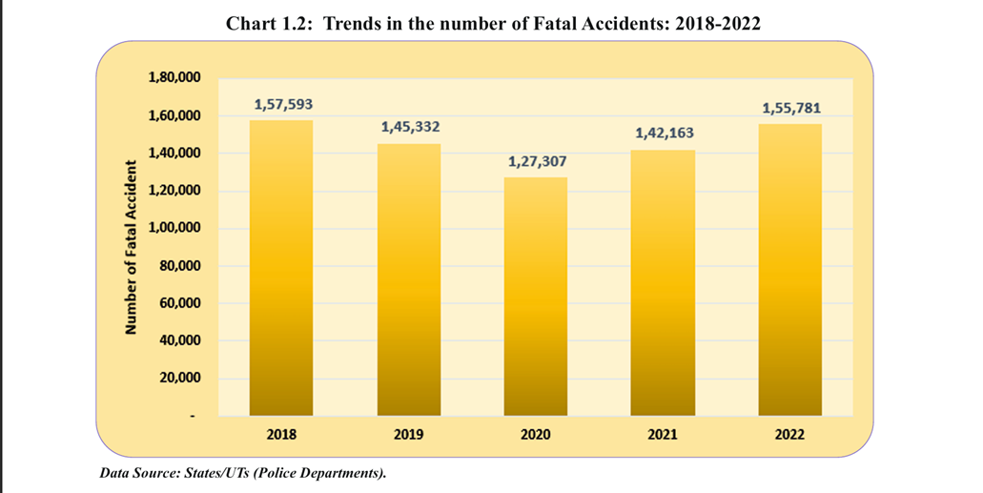


Slide 6
Objectives of the work
Predict Traffic Patterns: To use machine learning models for forecasting traffic trends based on historical and real-time data, enabling proactive traffic management.
Optimize Traffic Signal Timings: To design an adaptive system that dynamically adjusts traffic signals in real time, reducing congestion and improving vehicle flow.
Enhance Road Safety: To incorporate computer vision techniques for accident detection and obstacle identification, enabling quicker responses to emergencies.
Minimize Environmental Impact: To reduce vehicle idling and travel times, which in turn lowers fuel consumption and carbon emissions, promoting sustainable urban mobility.
Provide Route Optimization: To offer drivers the most efficient routes based on real-time traffic conditions, ensuring quicker and smoother commutes.

Slide 7
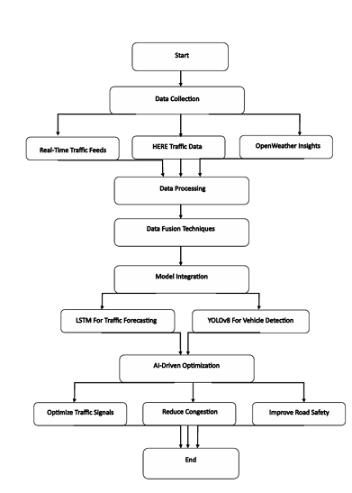
Methodology
Data Collection: Collect a diverse dataset of real time and past traffic information from several origins.
Data Preprocessing: Data Standardization, Outlier Removal, Feature Selection
Feature Engineering: Extract relevant features from the preprocessed real time data that are essential for identifying signs of traffic system. Involves Traffic Density Estimation, Speed and Flow Analysis, Weather Impact Modeling and pattern recognition.

Slide 8
Methodology used
Labeling: The labeling process should be in accordance with the prescribed standard rules of traffic management so that accuracy and dependability are sustained within the system's forecasts..
Data Splitting: Divide the dataset into three subsets for model development and testing 70% of the data for training the LSTM model 30% (21% testing & 9% validation) of the data for tuning hyperparameters and preventing overfitting.
Model Evaluation: In this we would have define the accuracy of the model by training and testing the data and then using maps and matrix we will have the model final output.

Slide 9
Results and Outputs
Real-Time Traffic Optimization: Dynamically adjusts traffic flow by responding to current conditions at intersections and roadways.
Adaptive Driving Strategies: Promotes smarter driving decisions based on live traffic analysis.
Congestion Detection and Rerouting: Identifies potential congestion points on highways and busy routes
Integration of Predictive Models : Uses computer models to simulate and forecast future traffic conditions
AI and ML Algorithm Application: Applies intelligent algorithms to analyze incoming data and make decisions in real time..
Proactive Traffic Control: Predictive models will allow traffic authorities to anticipate congestion and implement measures before issues arise.

Slide 10
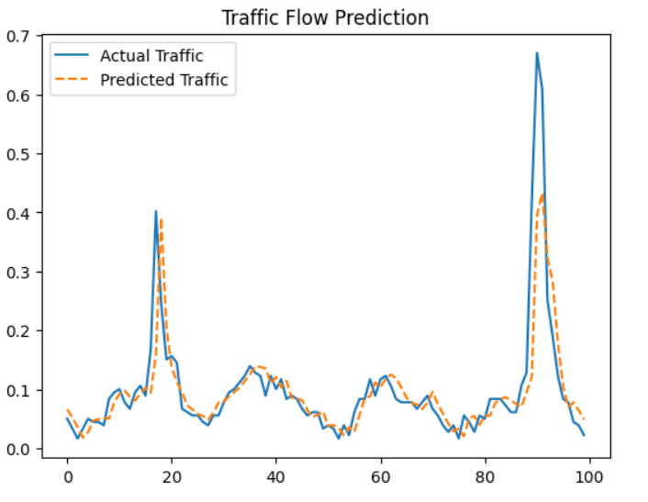
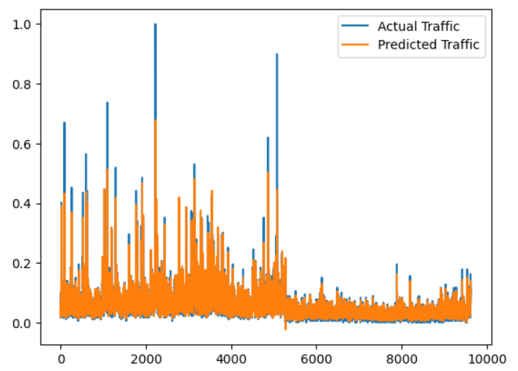

Slide 11
Conclusion
Addressing Urban Transportation Challenges
Tackles critical issues such as traffic congestion and inefficiencies in urban transport systems.
Utilization of AI and Machine Learning
Leverages real-time data and intelligent algorithms to analyze and predict traffic behavior.
Optimization of Traffic Signals
Uses AI to adjust signal timings based on current traffic conditions.
Integration of IoT Devices
Connects sensors, cameras, and other IoT-enabled devices to collect and process live traffic data.
Sustainability and Environmental Impact
Reduces vehicle idle time, lowering fuel consumption and greenhouse gas emissions.
Scalability and Smart City Integration
Compatible with existing smart city infrastructure for seamless deployment.

Slide 12
Future Scope
Advancements in Deep Learning Models: Improved neural network architectures and hybrid algorithms will enhance prediction accuracy.
Integration with Real-Time Data Sources: Real-time data fusion will enable highly accurate short-term and long-term traffic flow forecasting.
Development of Multimodal Traffic Systems: Future traffic systems will account for the dynamics of not just vehicles but also pedestrians, cyclists, and public transportation.
Adaptive Traffic Signal Control: Develop features for managing large public events, where traffic patterns are unpredictable, by integrating event-specific traffic control strategies.
Enhanced Safety and Sustainability: Continuously improve traffic prediction models using deep learning techniques to handle more complex traffic scenarios and provide more accurate forecasts.

Slide 13
References
Smart Traffic Control and Prediction Model Empowered with 5G Technology, Artificial Intelligence and Machine Learning, Vaishnav Datey; Sandeep Prabhu 2023 International Conference on Ambient Intelligence, Knowledge Informatics and Industrial Electronics (AIKIIE)https://doi.org/10.1109/AIKIIE60097.2023.10389965
The Role of Blockchain, AI and IoT for Smart Road Traffic Management System Ashish Sharma; Yogesh Awasthi; Sunil Kumar 2020 IEEE India Council International Subsections Conference (INDISCON) https://doi.org/10.1109/INDISCON50162.2020.00065
Transformative Horizons: Pioneering the Future of Smart Cities with AI&ML Vanshika Pal; Narinder Yadav; Abhishek Sharma; Suhani Nayak; Sunny Dhaliwal; Sanjay Singla 2024 International Conference on Emerging Innovations and Advanced Computing (INNOCOMP) https://doi.org/10.1109/INNOCOMP63224.2024.000 7
Smart Traffic Control System for Dubai: A Simulation Study Using YOLO Algorithms Rabia Emhamed Al Mamlook; Mohammad Zahrawi; Hasan Gharaibeh; Ahmad Nasayreh; Sujeet Shresth 2023 IEEE International Conference on Electro Information Technology (eIT) https://doi.org/10.1109/eIT57321.2023.10187271.
A Management of Food Supply Chain in Sustainable Smart Cities using Fire Hawk Optimization B Girirajan; B. Raveendra Naick; Hassan M. Al Jawahry; Revanasiddappa; Rana Veer Samara Sihman Bharattej R 2024 Second International Conference on Data Science and Information System (ICDSIS) https://doi.org/10.1109/ICDSIS61070.2024.1059458 7

Slide 14
References
RealTime Traffic Management System Using Object Detection based Signal Logic Murthy Jonnalagadda; Sashank Taduri; Rachana Reddy 2020 IEEE Applied Imagery Pattern Recognition Workshop (AIPR) https://doi.org/10.1109/AIPR50011.2020.9425070.
Intelligent Decision Support Systems: Transforming Smart Cities Management Zeinab E. Ahmed; Aisha H. A. Hashim; Rania A. Mokhtar; Mamoon M. Saeed 2024 1st International Conference on Emerging Technologies for Dependable Internet of Things (ICETI) https://doi.org/10.1109/ICETI63946.2024.10777112.
The Novel use of AI and ML System Integration in Developing Spruce Metropolis Rahul Singh; K Maheswari; G Sridevi; Laith H. Alzubaidi; Mahalakshmi Shetty 2024 4th International Conference on Advance Computing and Innovative Technologies in Engineering (ICACITE) https://doi.org/10.1109/ICACITE60783.2024.106174 41.
Intelligent transportation systems trusted user’s security and privacy Priyanka Kaushik; Saurabh Pratap Singh Rathore; Lakshay Sachdeva; Minakshi Poonia; Dipti Singh; Lovish Bir 2024 IEEE International Conference on Interdisciplinary Approaches in Technology and Management for Social Innovation (IATMSI) https://doi.org/10.1109/IATMSI60426.2024.1050287 3
Smart Road Surveillance: An AI and ML-Based System for Automatic Accident Detection and Emergency Response Shreyash Singh Kushawah; Amit Gupta; Richa Gupta 2024 International Conference on Cybernation and Computation (CYBERCOM) https://doi.org/10.1109/CYBERCOM63683.2024.108 03237

