Slide 1


Department of Information Technology
V R Siddhartha Engineering College
An Explainable Hybrid Deep Learning Approach for Multi-Class Brain Disease Detection Using MRI Images
Application Field : Medical Imaging, Healthcare Diagnostics, and Cancer Screening.
B.Tech in Information Technology
Major Project Review Presentation
Presented by
RAHUL PUDI (228W1A1251)
PAVAN KUMAR KOLLIPATI (228W1A1228)
Under the guidance of
K. Madhavi
Assistant Professor

Slide 2
Agenda
Introduction and Problem Statement
Objectives and Outcomes of the Project
Literature Review and Summary
Datasets and Requirements
Algorithms used in the Project
Architecture Diagram
Implementation Steps and Execution
Results Obtained
Result Analysis
Conclusion and Future Work
References

Slide 3
Introduction
Brain tumors, Alzheimer’s disease, and multiple sclerosis require early and accurate detection to reduce severe neurological complications and improve patient outcomes.
Traditional CNN-based MRI classification processes the entire image, which may reduce accuracy due to background noise and lack of precise lesion localization.
Segmentation models such as U-Net and U-Net++ focus on disease-affected regions, enabling more relevant and discriminative feature extraction.
Hybrid frameworks combining DenseNet201 and EfficientNetV2-S with LightGBM and XGBoost can improve classification accuracy and robustness.
The best-performing hybrid model will be selected and further integrated with Grad-CAM techniques to visualize important MRI regions, enhancing transparency and clinical reliability.

Slide 4
Problem Statement
The diagnosis of brain tumors, Alzheimer’s disease, and multiple sclerosis from MRI scans is complex due to subtle and overlapping imaging patterns.
Manual MRI interpretation is time-consuming and dependent on expert radiologists, leading to possible variability and delayed diagnosis.
Existing CNN-based methods often analyze the full image without precise lesion segmentation, which may reduce classification accuracy.
There is a need for an automated hybrid framework integrating U-Net / U-Net++ with deep feature extractors and boosting classifiers for improved performance.
This project aims to compare two hybrid architectures and select the best-performing model for accurate multi-brain disease detection and GRADCAM integration.

Slide 5
Objectives | Outcomes
Develop an accurate hybrid framework for detecting brain tumors, Alzheimer’s disease, and multiple sclerosis from MRI scans by integrating segmentation and deep feature extraction. Compare U-Net + DenseNet201 + LightGBM and U-Net++ + EfficientNetV2-S + XGBoost under identical preprocessing and dataset splits to identify the best-performing model. Select the optimal model and apply Grad-CAM to visualize the MRI regions influencing predictions, improving transparency and clinical trust. | A trained and validated hybrid framework capable of accurately classifying MRI images into brain tumor, Alzheimer’s disease, and multiple sclerosis categories using segmentation and deep feature extraction. A detailed performance comparison demonstrating which hybrid architecture—U-Net + DenseNet201 + LightGBM or U-Net++ + EfficientNetV2-S + XGBoost—achieves superior accuracy, precision, recall, and F1-score under identical experimental conditions. A Grad-CAM–based visual explanation highlighting the specific MRI regions influencing the model’s predictions, improving interpretability, transparency, and clinical reliability.

Slide 6
Literature Review and Summary
S.No | Title | Authors | Dataset | Key Results | Limitations
1 | Hybrid CNN-Based Transfer Learning Enhances Brain Tumor Classification on MRI Image, 2025, IEEE Research Journal Article | Rizal dwi prayogo, Nur hamid, Hidetaka nambo | Kaggle MRI dataset | Achieved ~98% accuracy using ResNet50V2 + MobileNetV2+ DenseNet121 with deep feature fusion | The hybrid model increases computational complexity and may lead to overfitting due to multiple deep feature extractors, especially with limited training data
2 | Brain Tumor Classification using Hybrid Super-Resolution and CNN, 2023, IEEE Research Journal Article | Saeed Mohsen, Anas M. Ali, El-Sayed M. El-Rabaie, Ahmed Elkaseer, Steffen G. Scholz, Ashraf | Kaggle Brain MRI dataset | Achieved 96–99% accuracy using GAN-based enhancement with ResNeXt101 and VGG19 | Focused on binary classification with limited dataset generalization and increased computational complexity due to GAN-based preprocessing
3 | Hybrid Deep Learning Architecture for Brain Tumor classification 2025, IEEE Conference paper (ICVADV) | R Bhuvaneswari, Madhan B,Mohamed Basman M | MRI tumor dataset | Achieved ~95% accuracy using VGG16 and InceptionV3 with transfer learning | Limited to binary classification with performance affected by noise, subtle features, and class imbalance
4 | Deep Learning for Alzheimer’s Disease Detection,2025,IEEE Conference Paper (ICCPCT) | Krishna Murari Chaudhary, Inderdeep Kaur ,Bhaskar Kumar ,Sneha Yadav, Shreyansh Suman | MRI Alzheimer dataset | Achieved ~90% accuracy using hybrid ResNet + VGG model | Performance is affected by noise, lower accuracy in detecting MCI, and requires larger diverse datasets for better generalization
5 | Alzheimer’s Disease Prediction using VGG16 Transfer Learning,2025,IEEE Conference Paper (IDCIoT) | Maharth Monish Uprit, Pranav Khattar, Malhar Brahmbhatt, | Alzheimer MRI dataset | Achieved ~97% accuracy with fine-tuned VGG16 | Limited to MRI-based detection with high computational complexity and requires further validation for real-world generalization

Slide 7
Literature shows that hybrid CNN-based models achieve around 90–95% accuracy in MRI-based brain disease detection.
Most existing studies focus on single-disease detection (Brain Tumor, Alzheimer’s, or Multiple Sclerosis) rather than a unified multi-disease framework.
High performance often depends on extensive preprocessing, and challenges such as overfitting, dataset imbalance, and high computational cost still exist.
Although accuracy is high, many research papers do not integrate Explainable AI techniques, limiting clinical interpretability and trust in real-world hospital settings.
Based on this gap, this work proposes a hybrid deep learning model for combined detection of Brain Tumor, Alzheimer’s, and Multiple Sclerosis, along with LIME-based Explainable AI for better transparency and decision support.

Slide 8
Datasets and Requirements
Alzheimer’s Disease Dataset Contains ~33,984 MRI images categorized into four stages: Mild Demented, Moderate Demented, Non-Demented, and Very Mild Demented. This dataset helps in identifying the progression stages of Alzheimer’s disease.
Brain Tumor Dataset Includes 21,700 high-quality MRI images divided into four classes: Glioma, Meningioma, Pituitary Tumor, and Normal. It is used for accurate tumor detection and classification.
Multiple Sclerosis (MS) Dataset Comprises 3,427 MRI images collected from patients and healthy individuals, categorized into Control (Axial & Sagittal) and MS (Axial & Sagittal) classes
Requirements:
Hardware: GPU-enabled environment (such as Kaggle Notebooks) for efficient segmentation and hybrid model training.
Software: The system uses Python with TensorFlow and Keras for deep learning, along with LightGBM and XGBoost for classification. Preprocessing is done using OpenCV, NumPy, and Pandas. Scikit-learn handles evaluation, while Matplotlib and Grad-CAM are used for visualization and explainability.

Slide 9
Algorithms used in the Project
1.EfficientNet-B7
Input images (244×244×3) are normalized using EfficientNet preprocessing for stable training.
A pretrained EfficientNet-B7 model with fine-tuning extracts deep hierarchical features from MRI images.
Global pooling, dropout, and Softmax layer perform final multi-class classification.
2.EfficientNet-B3
Input images (244×244×3) are normalized to ensure consistent learning.
Pretrained EfficientNet-B3 with partial fine-tuning extracts relevant spatial features.
Global pooling, dropout, and Softmax layer generate final predictions.
3.AlexNet
Input images (227×227×3) are processed through convolution and pooling layers to extract features.
Features are flattened and passed through fully connected layers with dropout.
Softmax layer outputs probability distribution across brain disease classes.

Slide 10
4.Hybrid Model- 1 (U-Net++ + EfficientNetV2-S + XGBoost):
Step 1 – Input MRI images are resized to 224×224×3, converted to RGB, and normalized using ImageNet statistics for stable training.
Step 2 – Images are passed through U-Net++, which is trained using Dice Loss and Binary Cross-Entropy to learn accurate brain region segmentation.
Step 3 – U-Net++ generates a pseudo mask highlighting important brain regions while suppressing background noise.
Step 4 – The mask is applied to the original image to obtain a region-focused image containing disease-relevant features.
Step 5 – The masked image is fed into EfficientNetV2-S, initialized with pretrained weights for deep feature extraction.
Step 6 – The classification head is removed, and a high-dimensional feature vector is extracted from the network.
Step 7 – The extracted features are given to XGBoost, which learns complex decision boundaries using gradient boosting.
Step 8 – The model outputs class probabilities, and the class with the highest probability is selected as the final prediction.

Slide 11
5.Hybrid Model- 2 (U-Net + DenseNet201 + LightGBM):
Step 1 – Input MRI images are resized to 224×224×3, converted to RGB, and normalized using ImageNet preprocessing for stable training.
Step 2 – Images are passed through U-Net segmentation, trained using Dice Loss and Binary Cross-Entropy to learn brain region segmentation.
Step 3 – U-Net generates a binary mask highlighting important brain regions while removing background noise.
Step 4 – The mask is applied to the original image to obtain a region-focused image containing disease-relevant features.
Step 5 – The masked image is fed into DenseNet201, initialized with pretrained weights for deep feature extraction.
Step 6 – The classification layer is removed, and a high-dimensional feature vector is extracted from the network.
Step 7 – The extracted features are passed to LightGBM, which learns complex decision boundaries using gradient boosting.
Step 8 – The model outputs class probabilities, and the class with the highest probability is selected as the final prediction.

Slide 12
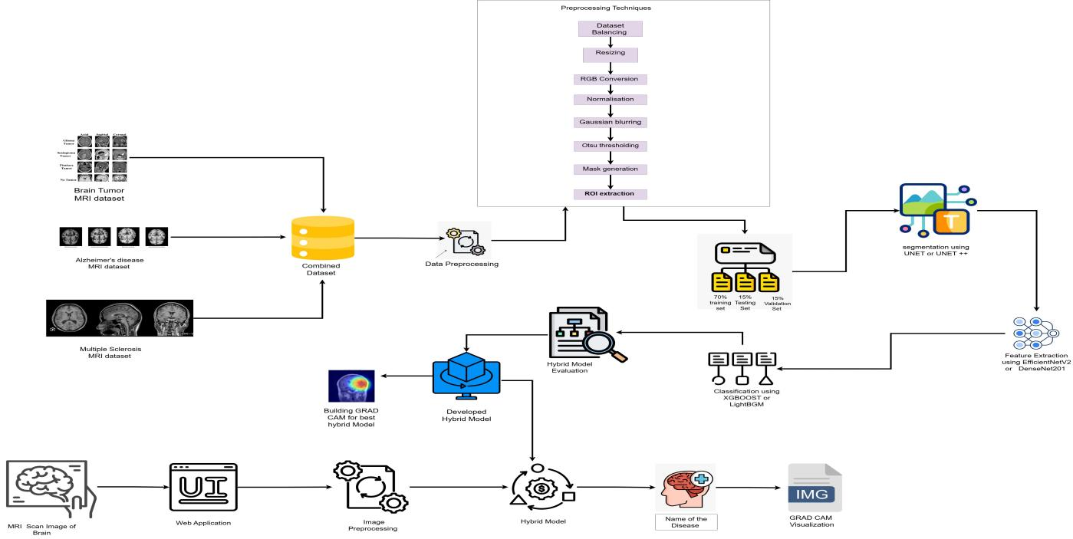
Architecture Diagram

Slide 13
Implementations Steps and Execution
Dataset Preparation : Three MRI datasets (Brain Tumor, Alzheimer’s, Multiple Sclerosis) are combined into a single dataset. The dataset is balanced to 1000 images per class to avoid class imbalance.
Data Preprocessing : Images are resized to 224 × 224 and converted from BGR to RGB format. Pixel normalization is applied to scale values between 0 and 1.
Pseudo Mask Generation : Otsu thresholding is used to generate pseudo segmentation masks. Morphological operations are applied to refine the region of interest.
Segmentation using U-Net++ : U-Net++ is trained using pseudo masks to learn spatial features. The model generates refined segmentation maps of brain regions.
ROI Extraction : The predicted segmentation mask is applied to the input image. Background noise is removed and only disease-relevant regions are retained.

Slide 14
Feature Extraction : EfficientNetV2-S is initialized with pretrained ImageNet weights and fine-tuned on MRI data. The model extracts high-dimensional feature vectors of size 1280.
Classification : Extracted features are provided as input to XGBoost. The classifier performs multi-class prediction by learning complex decision boundaries.
Training and Evaluation : The dataset is divided into training, validation, and testing sets. The model is evaluated using accuracy, precision, recall, F1-score, and confusion matrix.
Model Deployment : The best-performing model is integrated into a web application. It allows real-time prediction of brain diseases from MRI images.
Model Interpretation : Grad-CAM is applied to visualize important regions in MRI images. It helps in understanding the model’s decision-making process.

Slide 15
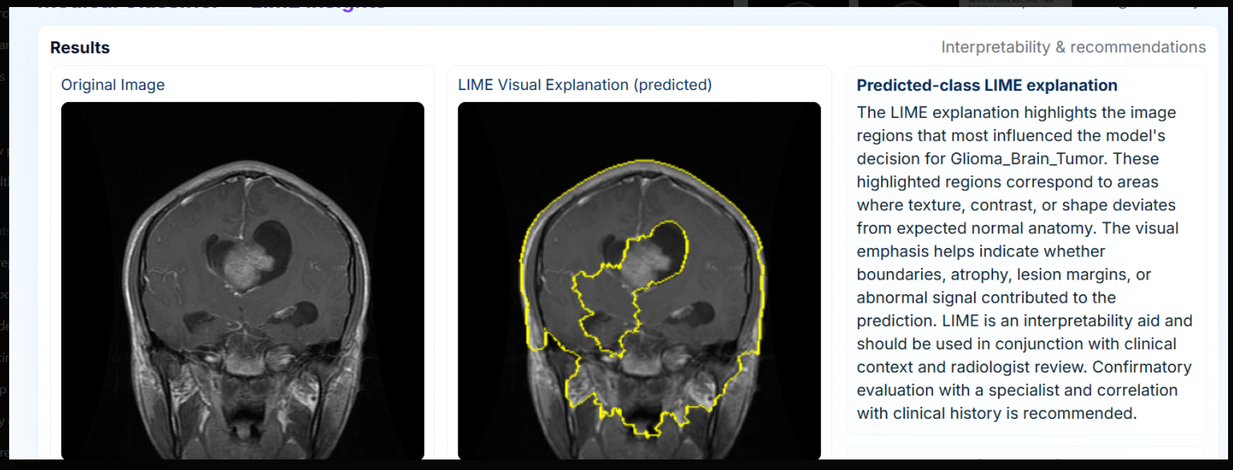
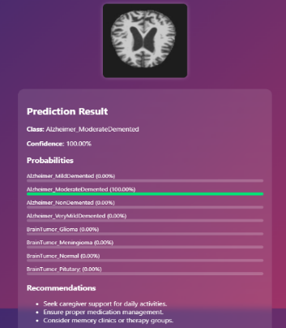
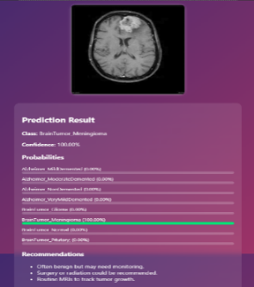
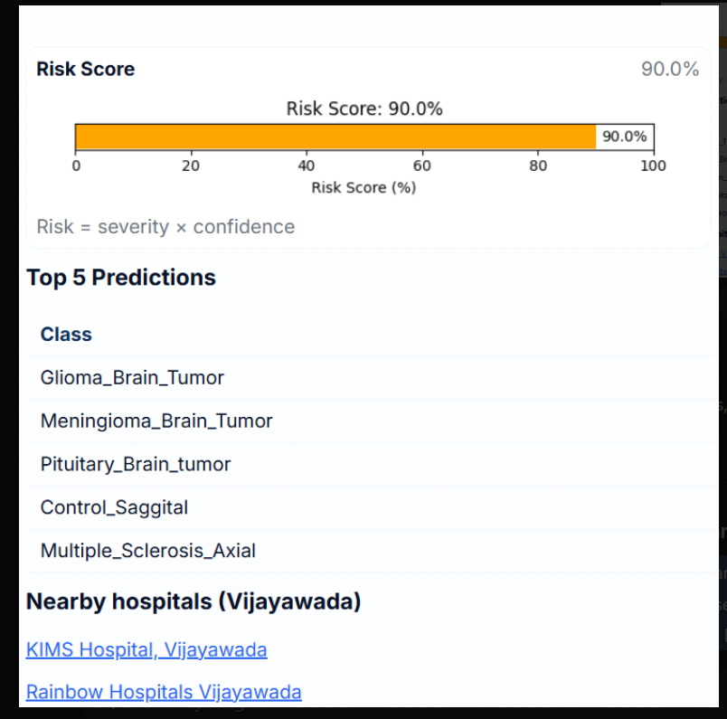
Results Obtained
Web Application :
EfficientNet-B3 detected as Tumor along with LIME Visualization
EfficientNet-B7 detected as Alzheimer
EfficientNet-B7 detected as Tumor
Risk Score

Slide 16
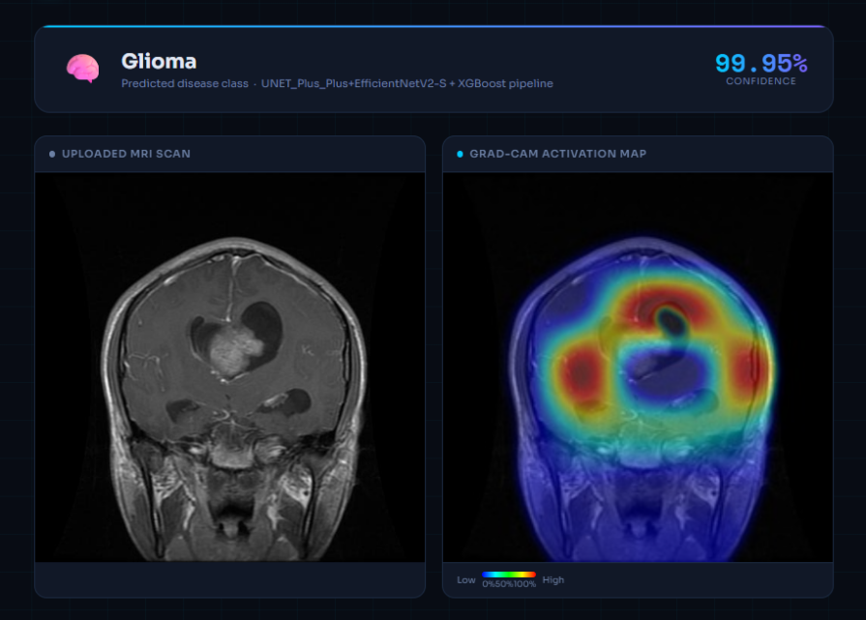
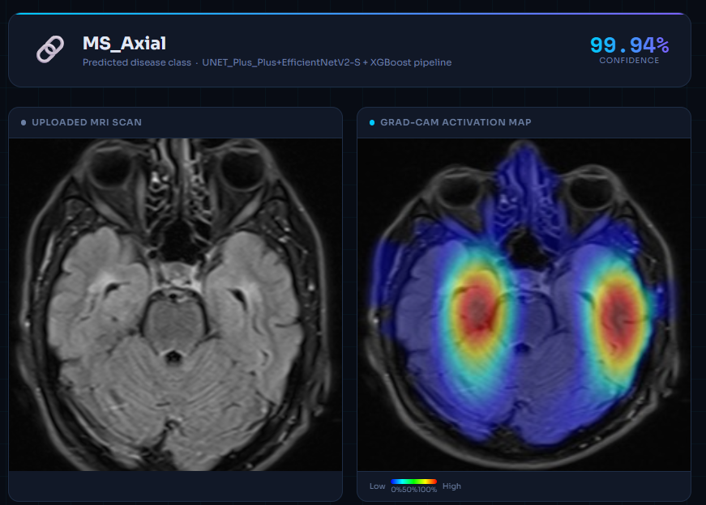
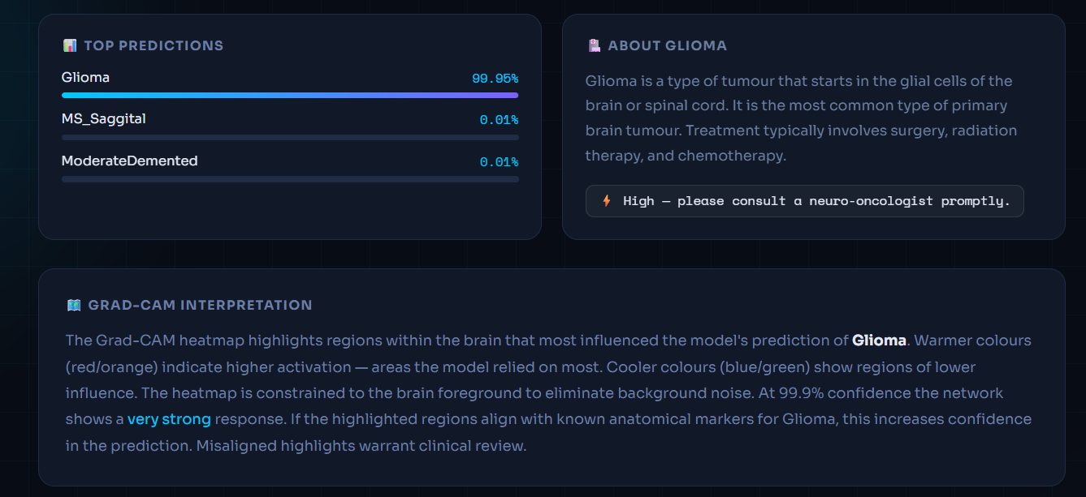
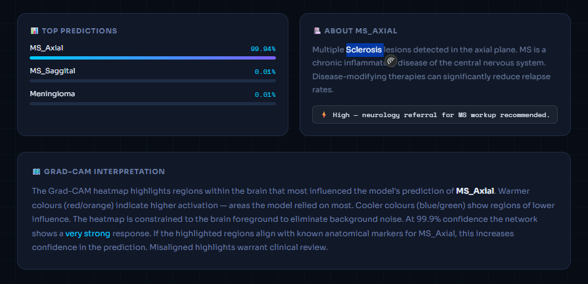
Hybrid Model -1 detected as tumor along with Grad-CAM Visulization
Hybrid Model -1 detected as Multiple Sclerosis along with Grad-CAM Visulization
Top Predictions along with explanation for Brain tumor
Top Predictions along with explanation for Multiple Sclerosis

Slide 17
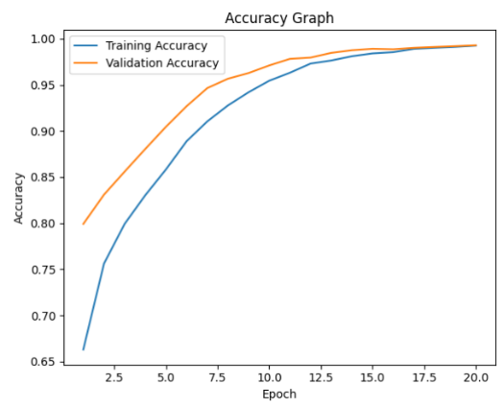
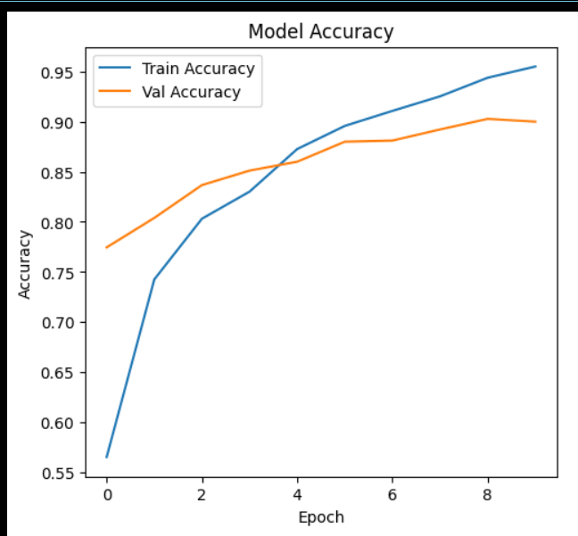
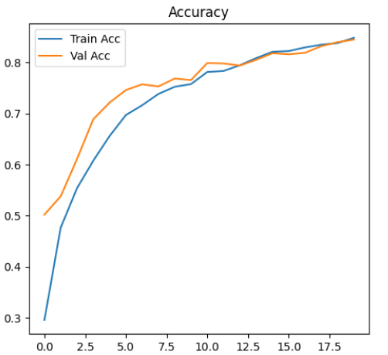
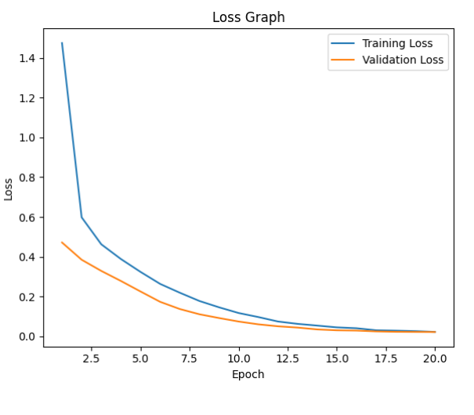
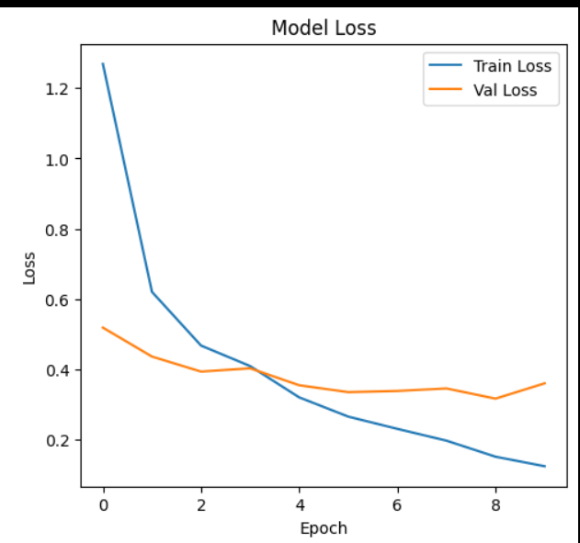
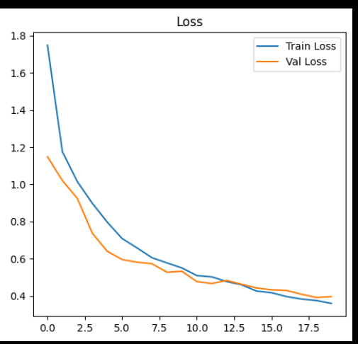
Result Analysis
Training and Validation Accuracy
Graph of EfficientNet-B7
Training and Validation Accuracy
Graph of EfficientNet-B3
Training and Validation Accuracy
Graph of Alex Net
Training and Validation Loss
Graph of EfficientNet-B7
Training and Validation Loss
Graph of EfficientNet-B3
Training and Validation Loss
Graph of Alex Net

Slide 18
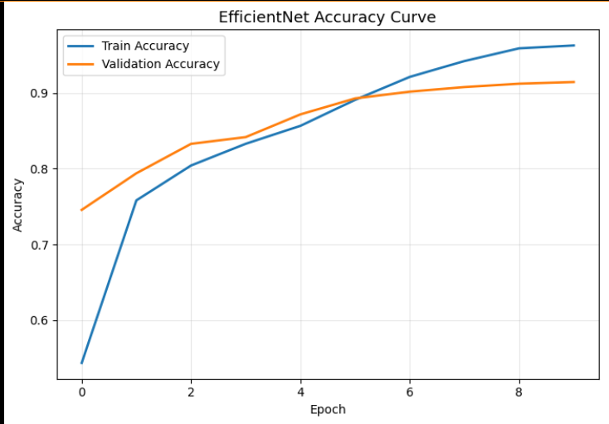
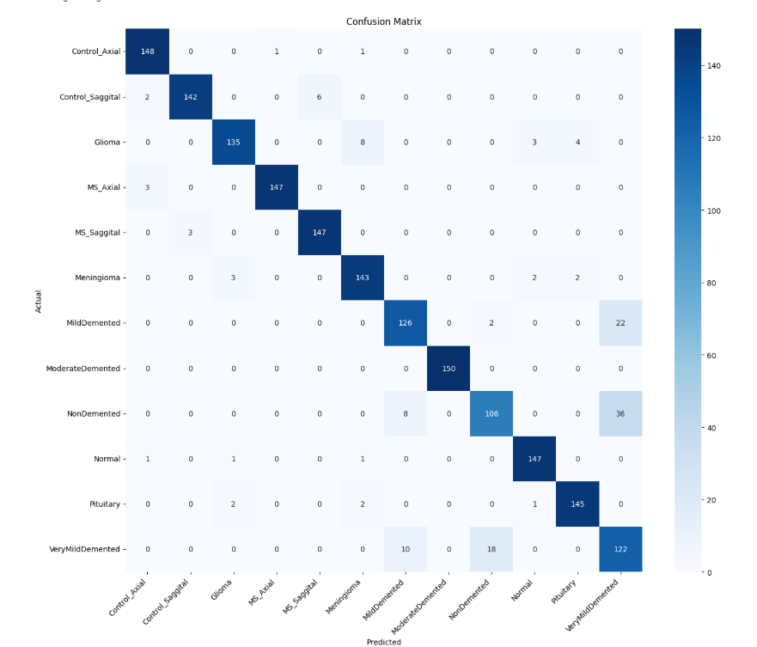
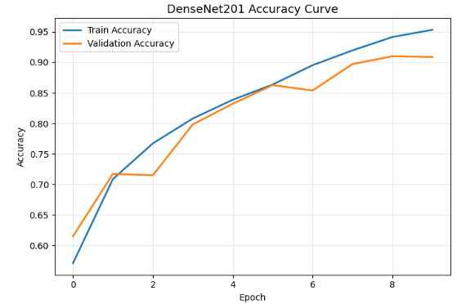
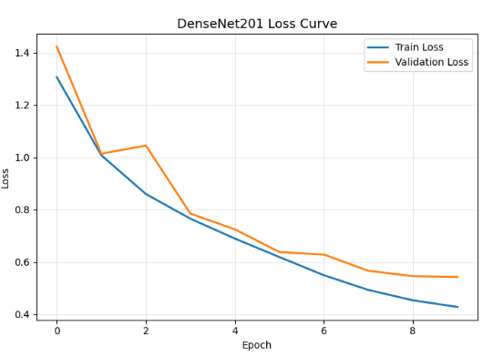
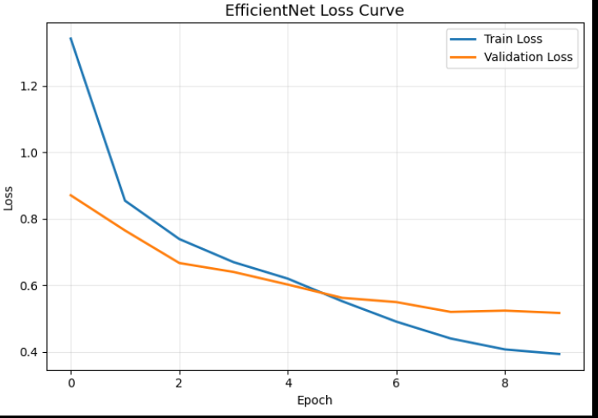
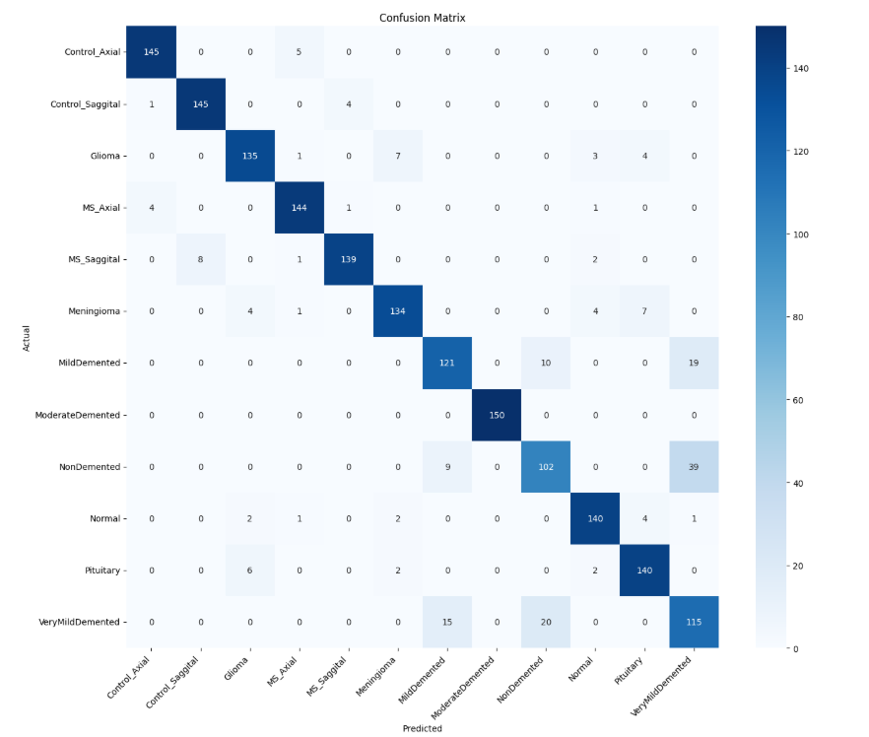
Training and Validation Accuracy
Graph of Hybrid Model- 1 (U-Net++ + EfficientNetV2-S + XGBoost)
Confusion Matrix Hybrid Model- 1 (U-Net++ + EfficientNetV2-S + XGBoost)
Training and Validation Accuracy
Graph (U-Net + DenseNet201 + LightGBM)
Training and Validation Loss
Graph Hybrid Model- 1 (U-Net++ + EfficientNetV2-S + XGBoost)
Confusion Matrix of Hybrid Model- 2 (U-Net + DenseNet201 + LightGBM)
Training and Validation Loss
Graph of Hybrid Model- 2 (U-Net + DenseNet201 + LightGBM)

Slide 19
Class | U-Net++ + EfficientNetV2-S + XGBoost |  |  | U-Net + DenseNet201 + LightGBM
 | Precision | Recall | F1-Score | Precision | Recall | F1-Score
Control_Axial | 0.96 | 0.97 | 0.96 | 0.96 | 0.96 | 0.96
Control_Saggital | 0.95 | 0.96 | 0.96 | 0.94 | 0.94 | 0.95
MS_Axial | 0.95 | 0.96 | 0.96 | 0.94 | 0.95 | 0.95
MS_Saggital | 0.96 | 0.96 | 0.96 | 0.92 | 0.96 | 0.94
Mild_Demented | 0.91 | 0.90 | 0.91 | 0.89 | 0.84 | 0.87
Moderate_Demented | 0.94 | 0.96 | 0.95 | 0.88 | 0.99 | 0.87
Very Mild Demented | 0.93 | 0.91 | 0.92 | 0.81 | 0.88 | 0.84
Non Demented | 0.94 | 0.91 | 0.92 | 0.93 | 0.91 | 0.91
Glioma | 0.99 | 0.99 | 0.99 | 1.0 | 1.0 | 1.0
Meningioma | 0.75 | 0.78 | 0.77 | 0.79 | 0.74 | 0.76
Pitutary | 0.71 | 0.72 | 0.72 | 0.61 | 0.76 | 0.61
Normal | 0.91 | 0.87 | 0.89 | 0.89 | 0.78 | 0.83
Overall Accuracy | 0.9122 |  |  | 0.8856
The U-Net++ + EfficientNetV2-S + XGBoost model performs better than U-Net + DenseNet201 + LightGBM because it extracts and understands features more effectively.

Slide 20
Conclusion and Future Work
Conclusion:
A hybrid deep learning framework was developed for multi-brain disease detection by integrating segmentation, feature extraction, and boosting-based classification
The system accurately classifies brain tumor, Alzheimer’s disease, and multiple sclerosis using a unified dataset, with improved performance through ROI-based learning
Overall, the model provides reliable and interpretable predictions using Grad-CAM, supporting real-time clinical decision-making
Future Work:
3D MRI datasets and larger, fully annotated datasets can be utilized to improve detection accuracy, segmentation quality, and overall model robustness in real-world scenarios
Integration of additional disease classes, large language models (LLMs), and hospital systems can extend the system for automated reporting, decision support, and practical clinical deployment

Slide 21
⁠References
[1] Rizal dwi prayogo, Nur hamid, Hidetaka nambo, “ Hybrid CNN-Based Transfer Learning Enhances Brain Tumor Classification on MRI Images”2025(IEEE Research Journal Article)
[2] Saeed Mohsen, Anas M. Ali, El-Sayed M. El-Rabaie, Ahmed Elkaseer, Steffen G. Scholz, Ashraf “Brain Tumor Classification Using Hybrid Single Image Super-Resolution Technique With ResNext101_32×8d and VGG19 Pre-Trained Models using Hybrid models”2023(IEEE Research Journal Article)
[3] R Bhuvaneswari, Madhan B, Mohamed Basman M,” Hybrid Deep Learning Architecture for Accurate Brain Tumor Classification” 2025( IEEE Conference- (ICVADV) )
[4] Krishna Murari Chaudhary, Inderdeep Kaur ,Bhaskar Kumar ,Sneha Yadav, Shreyansh Suman “Deep Learning Approaches for Early Detection of Alzheimer’s Disease Using MRI Scans” 2025(IEEE Conference -(ICCPCT)
[5] Maharth Monish Uprit, Pranav Khattar, Malhar Brahmbhatt, Preethiya.T “Alzheimer's Disease Prediction using VGG16 and Transfer Learning” 2025 (IEEE Conference – IDCIoT))
[6] S.Dhanasekar, K.Harini S.Hariharan, L.Charu Leela, A.Bharathi “Hybrid Model for Brain Tumor Detection, Classification & Segmentation” 2025 (IEEE Conference –(ICONAT))

Slide 22


