Slide 1


Department of Information Technology
V R Siddhartha Engineering College
Brain Tumors and Alzheimer’s Disease Detection Using Deep Learning
Application Field : Medical Imaging, Healthcare Diagnostics, and Cancer Screening.
B.Tech in Information Technology
Mini-1 Project Review Presentation
Presented by
RAHUL PUDI (228W1A1251)
PAVAN KUMAR KOLLIPATI (228W1A1228)
Under the guidance of
K. Madhavi
Assistant Professor

Slide 2
Contents
Introduction and Problem Statement
Objectives and Outcomes of the project
Literature Review and Summary
Datasets and Requirements
Algorithms used in the project
Architecture Diagram
Implementation steps and Execution
Results Obtained
Results Analysis
Conclusion
References

Slide 3
Introduction
Brain tumors and Alzheimer’s disease are critical neurological disorders affecting millions of people worldwide.
Brain tumors can cause severe headaches, seizures, and cognitive impairments, while Alzheimer’s disease leads to progressive memory loss and mental decline.
Early detection is essential for effective treatment and to slow disease progression, but traditional diagnostic methods rely on expert interpretation, which can be slow and costly.
Recent advancements in deep learning, particularly CNN models like EfficientNet-B7, have shown great potential in medical image analysis.

Slide 4
Problem Statement
The diagnosis of brain tumors and Alzheimer’s disease is complex and requires specialized medical expertise.
Traditional methods based on MRI scan interpretation can be time-consuming, expensive, and prone to human errors, leading to delayed or incorrect diagnoses.
There is a need for an automated system that can analyze MRI scans efficiently and accurately to assist healthcare professionals.
This project aims to develop a deep learning-based model using EfficientNet-B7 to enhance the detection process, reducing dependency on manual interpretation.

Slide 5
Objectives | Outcomes
Develop a model with accurate classification of brain tumors and Alzheimer’s disease using MRI scans. Improve diagnostic consistency and enhance accuracy with AI-driven analysis. Assist healthcare professionals with AI-powered tools for efficient disease detection. | High accuracy in detecting brain tumors and Alzheimer’s disease using the EfficientNetB7 model. A reliable AI-assisted system to support medical professionals. Potential to enhance early diagnosis and improve patient care.

Slide 6
Literature Review
S.NO | PUBLICATION DETAILS | DATASETS USED | ALGORITHMS USED AND RESULTS | REMARKS
1. | Title: TLEABLCNN: Brain and Alzheimer's Disease Detection Using Attention-Based Explainable Deep Learning and SMOTE Using Imbalanced Brain MRI Authors: Erol Kina Publication Year: 2025 Type: Journal(MDPI (Multidisciplinary Digital Publishing Institute)) | OASIS Brain MRI dataset(Open Access Series of Imaging Studies) | The TLEABLCNN model achieved an accuracy of 95% in detecting brain tumor and Alzheimer’s diseases. This shows that the model correctly identified most of the disease cases. It also performed better than other commonly used models like MobileNet, VGG16 etc. | Although the model performs well on the OASIS dataset, it may not maintain similar accuracy on real-world clinical datasets due to limited data variability. SMOTE introduces synthetic samples, which may not reflect true medical anomalies, possibly affecting model robustness. The model also depends on extensive preprocessing, which could limit its use in real-time clinical settings. Finally, while it's called lightweight, deploying it on extremely low-resource devices might still pose challenges.
2. | Title: Machine Learning and Deep Learning Approaches for the Detection of Alzheimer’s Disease: A Review Authors: Gargi Pant Shukla, Santhosh Kumar, Saroj Kumar , Rohit Agarwal, Neeraj Varshney , Ankit kumar Publication Year: 2023 Type: Journal (TUP) | Alzheimer's Disease Neuroimaging Initiative (ADNI), Minimal Interval Resonance Imaging in Alzheimer's Disease (MIRIAD), Alzheimer’s Kaggle | The review concluded that deep learning models, especially CNNs, achieve high accuracy (85%–99%) in detecting Alzheimer’s disease. CNNs outperform traditional machine learning models in learning spatial features from MRI scans and other imaging data. | Deep learning models often suffer from overfitting due to limited and imbalanced datasets. Many datasets lack diversity in terms of ethnicity and age groups, which reduces model generalizability. Differences in preprocessing across studies make it hard to compare results. Some datasets also lack complete annotations, which limits supervised learning effectiveness.

Slide 7
3. | Title: A Novel Approach to Multi-Disease Detection in Healthcare using CNN, Random Forest & XGBoost Authors: Mubarizuddin Mohammed, Rajat Mongia, Anand M. Publication Year: 2023 Type: IEEE Conference (International Conference on Intelligent Systems and Computer Vision - ISCV) | Combined multiple open-source healthcare datasets | CNN achieved 96.5% accuracy in brain tumor detection, Random Forest achieved 94.5% accuracy for diabetes, XGBoost achieved 95.2% accuracy for lungs related disease. | The paper lacks precise details about the datasets used, making the study hard to reproduce. There is no strategy mentioned for dealing with class imbalance or rare diseases, which can affect prediction accuracy. Additionally, the models were not tested on external datasets, so their performance in real-world applications remains uncertain.
4. | Title: Alzheimer’s Disease (AD) Diagnosis from Brain MRI Image using Neural Network Algorithm. Authors: Ramesh L, P.S.Pooja, S. Raasika, B.Rithika shree. Prof. Deepak S. Chaudhari. Publication Year: 2023 Type: IEEE Conference | Kaggle Alzheimer’s Disease MRI Dataset, OASIS dataset. | Convolutional Neural Network (CNN) and Artificial Neural Network (ANN) algorithms are used. The model achieved an accuracy of 92.85% using CNN. The ANN-based model achieved slightly lower performance compared to CNN. | The model may not work well on MRI images from different hospitals because the image quality can vary. It also needs a powerful computer to run, so it’s hard to use in places with limited resources. The model only uses images and doesn’t include patient history or medical details, which could help make better predictions.
5. | Title: Automated Brain Disease Diagnosis and Patient Support System Authors: Vani Lavanya N, Santhosh B,Sai Shree Ram Balaji. Publication Year: 2023 Type: IEEE Conference | Alzheimer's dataset (MRI scans) Brain Tumor dataset (MRI scans) from Kaggle. | The model accurately classified healthy and diseased brain MRIs, including various Alzheimer’s stages and brain tumor types. CNN achieved 91% accuracy, VGG16 reached 94%, while EfficientNet outperformed both with 95% accuracy. | If the MRI images come from different hospitals or machines not covered in the training data, the model may not perform well. It also requires high processing power, making it difficult to run on simple or portable devices. Early detection is still a problem because minor changes in the brain may not be captured clearly by the model.

Slide 8
6. | Title: Multi Disease Detection And Diagnosis Through Ensemble Learning Authors: Athira K P, Maya Mohan. Publication Year: 20224 Type: IEEE Conference | COVID-19 Radiography Database (Kaggle), APTOS 2019 Blindness Detection Dataset (Kaggle), Brain MRI Images Dataset (Kaggle). | COVID-19 Detection Accuracy: 97% using VGG16 with CNN classifier, Brain Tumor Detection Accuracy: 94% using custom CNN model, Diabetic Retinopathy Detection Accuracy: 85% using CNN model. | The model is accurate but uses multiple CNNs, making it slow and hard to run on mobile or real-time systems. Some datasets are small and unbalanced, so the model may not perform well on new or rare cases. It also lacks advanced image cleaning and doesn't clearly explain its results, which is important for medical professionals.
7. | Title: An Advanced and Ideal Method for Tumor Detection and Classification from MRI Image Using Gaussian Mixture and RCNN Authors: Ganesh Karthikeyan, Saravana, Asif Tamboli, Kumari Lipi, D.Vijaya Lakshmi , S. Anthoniraj Publication Year: 2024 Type: IEEE Conference (International Conference on Computational Intelligence for Security, Communication and Sustainable Development). | MRI brain images (Dataset source not explicitly named in the paper). | Gaussian Mixture Model (GMM) for segmentation and Region-based Convolutional Neural Network (RCNN) for classification. Using the GMM + RCNN hybrid model, the proposed method achieved an accuracy of 95.6%, precision of 93.1%, recall of 92.5%, and F1-score of 92.8% in tumor classification. | The model depends on manually selected features, which makes it hard to adapt to different kinds of MRI images. It does not perform well on blurry or noisy scans, which are common in real hospitals. The preprocessing steps, like histogram equalization and denoising, may also remove important image details along with noise, which can affect accuracy.

Slide 9
Literature Summary
Based on recent literature, EfficientNet-B7 has emerged as the most effective deep learning model for detecting brain tumors and Alzheimer’s disease from MRI scan images.
Its compound scaling approach enables superior feature extraction and classification performance compared to models like VGG16, ResNet50, and DenseNet.
The algorithm achieved an impressive 95.25% accuracy in brain tumor classification and over 95% accuracy in Alzheimer’s detection, as shown in multiple comparative studies.
EfficientNet-B7 also demonstrated high precision, recall, and F1-scores, indicating strong generalization and minimal overfitting. It excels in multiclass classification, accurately distinguishing between glioma, meningioma, and pituitary tumors, as well as stages of Alzheimer’s such as NC, MCI, and AD.
Overall, the literature supports that EfficientNet-B7 offers the best performance among contemporary models for MRI-based brain disorder diagnosis.

Slide 10
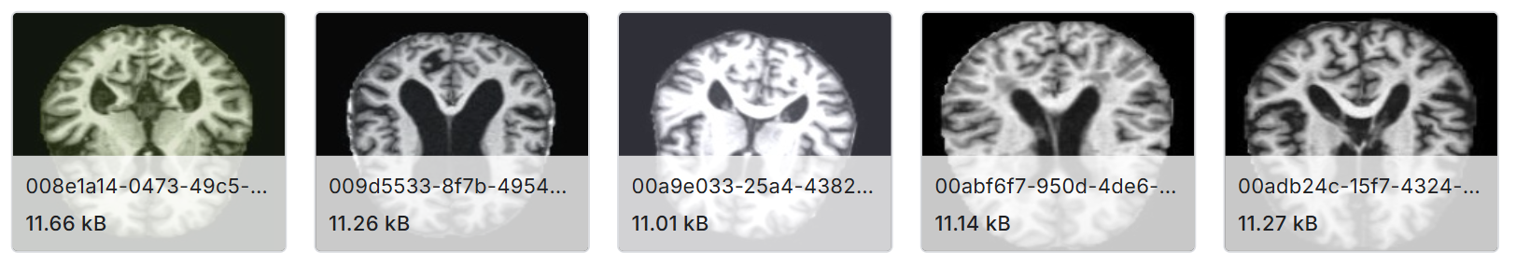
Datasets and Requirements
Dataset for Alzheimer’s disease :
The Augmented Alzheimer MRI Dataset, sourced from Kaggle, contains MRI scans categorized into different stages of Alzheimer’s disease. The Augmented Alzheimer MRI Dataset comprises approximately 33,984 MRI images. The dataset includes four classes:
Mild Demented class will consists of 8960 images.
Moderate Demented class will consists of 6464 images .
Non-Demented class will consists of 9600 images .
Very Mild Demented class will consists of 8960 images.
Source : https://www.kaggle.com/datasets/uraninjo/augmented-alzheimer-mri-dataset

Slide 11
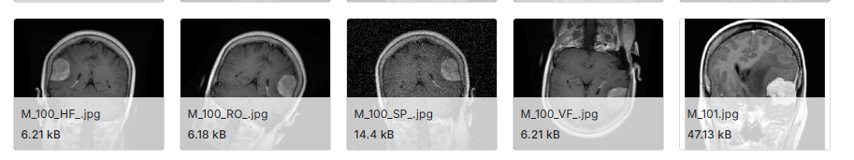
Dataset for Brain tumors :
Crystal Clean: Brain Tumors MRI Dataset, available on Kaggle. This dataset comprises approximately 21,700 MRI images. These high-quality images are instrumental in training deep learning models to accurately detect brain tumor .This dataset categorized into four classes:
Pituitary Tumor class will consists of the 5908 images
Glioma Tumor class will consists of the 6307 images
Meningioma Tumor class will consists of the 6391 images
Normal class will consists of the 3066 images.
Source : https://www.kaggle.com/datasets/mohammadhossein77/brain-tumors-dataset

Slide 12
Requirements:
Hardware:
GPU-enabled system for faster training (e.g. Google Colab )
Minimum 16GB RAM
Software & Frameworks:
Deep Learning: TensorFlow, Keras
Preprocessing: OpenCV, NumPy, Pandas
Programming Language : Python
Scikit-learn: Utilized for model evaluation metrics such as accuracy and dataset splitting.

Slide 13
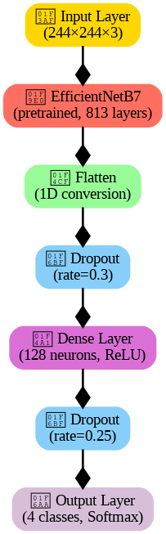
Algorithms Involved
Algorithm :
For this project, we use EfficientNet-B7, a deep convolutional neural network known for its high efficiency and accuracy. Unlike traditional CNN-based architectures, EfficientNet-B7 employs compound scaling, which optimally balances network depth, width, and resolution, allowing it to achieve state-of-the-art performance with fewer parameters. As the most powerful variant in the EfficientNet family, EfficientNet-B7 offers enhanced feature extraction, making it highly effective for medical image classification tasks such as Alzheimer’s disease detection and brain tumor classification.
EfficientNet-B7:
A highly scalable deep learning model that maintains superior accuracy while optimizing computational efficiency.
Utilizes compound scaling to effectively adjust model dimensions, ensuring optimal performance without excessive parameters.

Slide 14
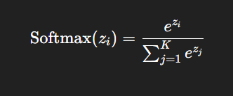
Formulas :
1.Convolution Operation :
(I∗K)(x,y)=m∑​n∑​I(x+m,y+n)⋅K(m,n)
2. Activation Function (ReLU):
f(x)=max(0,x)
3. Pooling Operation :
P(x,y)=(i,j)∈pool windowmax​I(i,j)
4. Fully Connected Layer (Dense Layer):
Y=f(Wx+b)
5.Output Layer (Softmax Activation):

Slide 15
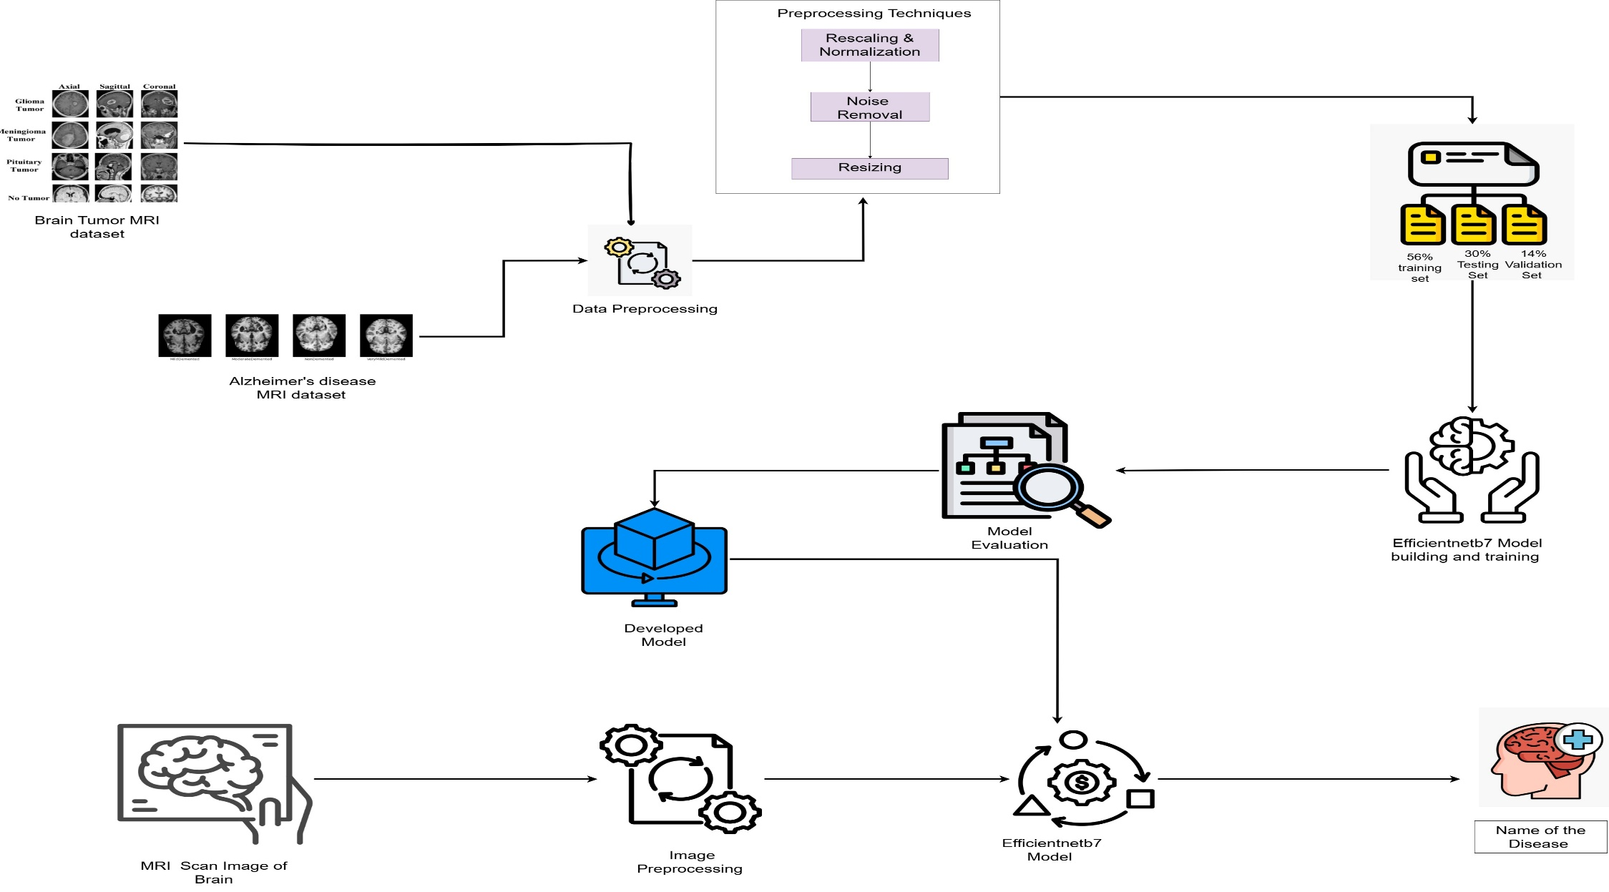
Architecture Diagram

Slide 16
Implementation steps and Execution
1. Dataset Collection:
Used Kaggle datasets for Brain Tumor Detection and Alzheimer’s Disease Detection.
The datasets contain MRI scan images categorized into different classes.
2. Data Preprocessing:
Normalization: Scaled pixel values to a standard range to stabilize training.
Rescaling: Adjusted image intensity values for better convergence.
Resizing: Resized all images to 244×244 pixels to maintain uniform input dimensions.
Dataset spli t: Training-56%,Testing-30%,Validation-14%.
3. Model Selection and Architecture:
Used EfficientNet-B7, a highly efficient deep learning model.
Fine-tuned the pre-trained model with custom dense layers for classification.
Unfroze selected layers for transfer learning to improve accuracy.

Slide 17
4.Training Process:
Used Adamax optimizer and categorical cross-entropy loss function.
Implemented early stopping and learning rate scheduling for optimization.
Trained the model for 20 epochs with validation.
Execution :
Two separate Kaggle Notebooks were maintained for training and model development: one for Brain Tumor Detection and another for Alzheimer’s Disease Detection. The execution was carried out using Kaggle's cloud-based platform, leveraging its GPU acceleration for efficient model training and performance optimization.

Slide 18
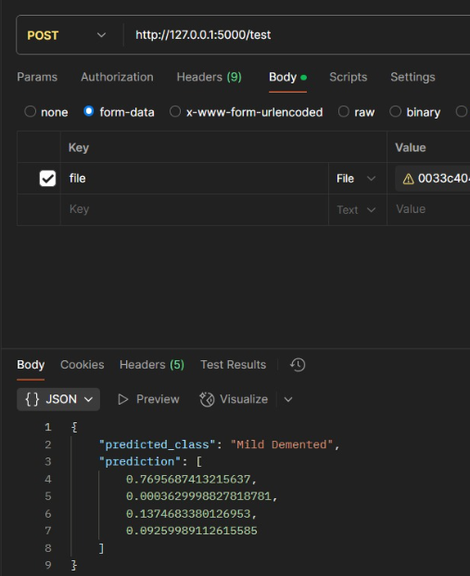
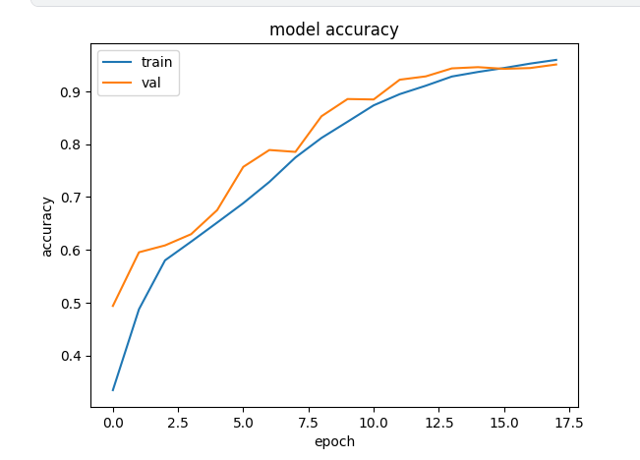
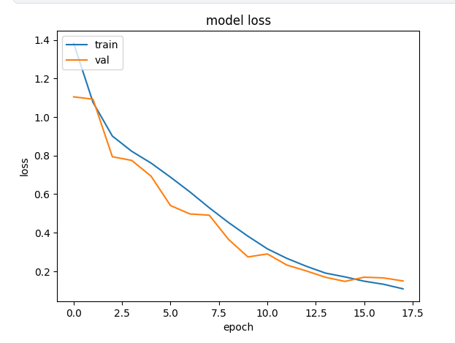
Results Obtained
Alzheimer’s Disease Detection :
Training and Validation Accuracy graph
Training and Validation Loss graph
Model Testing in Postman

Slide 19
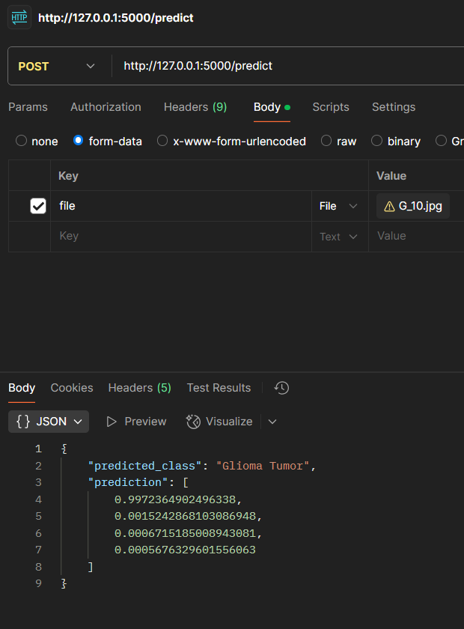
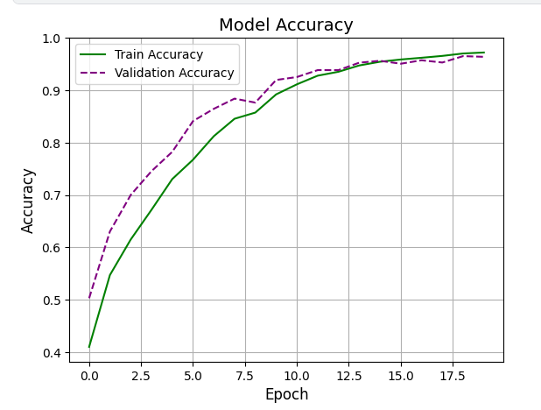
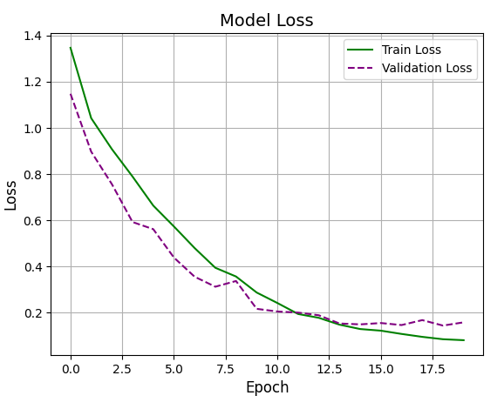
Brain tumor detection :
Training and Validation Accuracy graph
Training and Validation Loss graph
Model Testing in Postman

Slide 20
Results Analysis
Alzheimer’s Disease Detection:
The model achieved an accuracy of 95.96%, demonstrating its ability to accurately classify different stages of Alzheimer's disease.
The accuracy curve shows a steady increase, with training and validation accuracy converging closely, indicating a well-generalized model.
The loss function decreases smoothly, proving the model learns effectively and minimizes errors.
Observations:
The model effectively differentiates between different stages of Alzheimer’s (Mild, Moderate, Severe, and Normal).
Minimal overfitting, as training and validation accuracies remain closely aligned.
The model leverages EfficientNet-B7's optimized architecture, leading to high performance with fewer computational resources.

Slide 21
Brain Tumor Detection:
The model achieved an accuracy of 96.95%, showing high reliability in distinguishing between tumor types and normal cases.
The accuracy curves illustrate steady improvement, confirming effective learning across epochs.
The loss curves show a significant decline, indicating that the model successfully minimizes classification errors.
Observations:
EfficientNet-B7’s compound scaling enhances feature extraction from MRI scans, improving accuracy.
The model successfully classifies brain tumors with high precision, reducing false positives and false negatives.
Well-balanced learning, as indicated by smooth accuracy and loss curves without major fluctuations.

Slide 22
Conclusion
This project successfully developed deep learning models using EfficientNet-B7 for detecting Alzheimer’s disease and brain tumors from MRI scans, achieving high accuracy and reliability.
The Alzheimer’s detection model attained 95.96% accuracy, while the brain tumor detection model reached 96.95%, proving the effectiveness of EfficientNet-B7 in medical image classification.
By leveraging MRI-based AI models, the dependency on manual diagnosis is reduced, minimizing human error and enabling early disease detection and treatment planning.
The models were trained and evaluated using Kaggle’s cloud-based GPUs, ensuring fast processing, scalability, and efficient training.
This deep learning approach serves as an advanced clinical decision support system, assisting radiologists and healthcare professionals in making precise diagnoses.

Slide 23
⁠References
[1] Mubarizuddin Mohammed, Rajat Mongia, Anand M., "A Novel Approach to Multi-Disease Detection in Healthcare using CNN, Random Forest & XGBoost," 2023, Conference(IEEE).
[2] V. Ganesh Karthikeyan, S. Saravana, Asif Tamboli, Kumari Lipi, D. Vijaya Laskshmi, S. Anthoniraj, "An Advanced and Ideal Method for Tumor Detection and Classification from MRI Image Using Gaussian Mixture and RCNN," 2024, Conference( IEEE).
[3] Ramesh L, P.S.Pooja, S. Raasika, B.Rithika shree,” Alzheimer’s Disease (AD) Diagnosis from Brain MRI Image using Neural Network Algorithm,”2023, Conference(IEEE).
[4] Athira K P, Maya Mohan, "Multi Disease Detection And Diagnosis Through Ensemble Learning," 2024, Conference(IEEE).
[5] Vani Lavanya N, Santhosh B,Sai Shree Ram Balaji, “Automated Brain Disease Diagnosis and Patient Support System,”2023,Conference(IEEE).

Slide 24


