Slide 1


Department of Information Technology
V R Siddhartha Engineering College
An Explainable Deep Learning Framework for Multi-Brain Disease Detection from MRI Images
Application Field : Medical Imaging, Healthcare Diagnostics, and Cancer Screening.
B.Tech in Information Technology
Presentation
Presented by
RAHUL PUDI
Under the guidance of
K. Madhavi
Assistant Professor

Slide 2
Contents
Problem Statement
Objectives and Outcomes of the project
Literature Survey
Datasets and Requirements specifications
Methodology and Algorithms involved
Architecture Diagram
Complete Results Obtained
Result Analysis
Conclusion
References

Slide 3
Problem Statement
The diagnosis of brain tumors, Alzheimer’s disease, and multiple sclerosis is complex and requires specialized medical expertise.
Traditional methods based on MRI scan interpretation can be time-consuming, costly, and prone to human errors, potentially leading to delayed or inaccurate diagnoses.
There is a need for an automated system capable of analyzing MRI scans efficiently and accurately to assist healthcare professionals.
This project aims to compare two deep learning models—AlexNet and EfficientNet—to improve detection accuracy, reduce reliance on manual interpretation, and provide visual explanations through LIME for better clinical trust.

Slide 4
Objectives | Outcomes
Develop an accurate classification model for brain tumors, Alzheimer’s disease, and multiple sclerosis using MRI scans. Compare AlexNet and EfficientNet architectures under identical preprocessing, augmentation, and dataset splits. Show which parts of the MRI image the model used to make its decision using LIME. | A trained and validated deep-learning model capable of accurately classifying MRI images into brain tumor types, Alzheimer’s stages, or MS conditions. A performance comparison showing which model (AlexNet or EfficientNet) performs better, based on accuracy, loss, confusion matrix, and other metrics under the same experimental settings. A LIME visual explanation highlighting the exact MRI regions that influenced the model’s predictions, improving explainability and model transparency.

Slide 5
Literature Survey
S.NO | PUBLICATION DETAILS | DATASETS USED | ALGORITHMS USED AND RESULTS | REMARKS
1. | Title: MRI Based Multiple Brain Disease Detection using Lightweight Deep Neural Network Authors: Mohammad Sarosh Basit, Adeeba Khan, Omar Farooq, Izharuddin, Ibne Ahmad Publication Year: 2023 Type: Conference Paper (IEEE – International Conference on Computer, Electronics & Electrical Engineering and their Applications (IC2E3)) | Brain Tumor dataset (combined from Figshare, SARTAJ, Br35H) & Alzheimer MRI Preprocessed Dataset (Kaggle) – 6400 MRI images, 4 classes. | The study proposed a 12-layer lightweight CNN with around 2 million trainable parameters and compared it against AlexNet, which has 18 layers and about 8 million parameters. The lightweight CNN achieved superior performance, reaching 98.9% accuracy on the test dataset, compared to AlexNet’s 96.9%. | The model achieves very high accuracy while using fewer parameters, making it more efficient than AlexNet. However, since it was trained on Kaggle datasets, it may not perform as well on real hospital data, and its reliance on preprocessing makes real-time use difficult. Although called “lightweight,” it still needs more optimization for low-power devices, and future work could include detecting other brain diseases.
2. | Title: Machine Learning and Deep Learning Approaches for the Detection of Alzheimer’s Disease: A Review Authors: Gargi Pant Shukla, Santhosh Kumar, Saroj Kumar , Rohit Agarwal, Neeraj Varshney , Ankit kumar Publication Year: 2023 Type: Journal (TUP) | Alzheimer's Disease Neuroimaging Initiative (ADNI), Minimal Interval Resonance Imaging in Alzheimer's Disease (MIRIAD), Alzheimer’s Kaggle | The review concluded that deep learning models, especially CNNs, achieve high accuracy (85%–95%) in detecting Alzheimer’s disease. CNNs outperform traditional machine learning models in learning spatial features from MRI scans and other imaging data. | Deep learning models often suffer from overfitting due to limited and imbalanced datasets. Many datasets lack diversity in terms of ethnicity and age groups, which reduces model generalizability. Differences in preprocessing across studies make it hard to compare results. Some datasets also lack complete annotations, which limits supervised learning effectiveness.

Slide 6
3. | Title: Detection of Multiple Sclerosis Using Deep Learning Authors: Ajitesh Singh, Aarthy S.T, Subham Saha, Alok Kumar Publication Year: 2025 Type: Conference Paper (IEEE – International Conference on the Data Science and Business Systems (ICDSBS)) | Kaggle MRI dataset for classification (classes: Control Axial, Control Sagittal, MS Axial, MS Sagittal) | The study combines U-Net for segmentation of MS lesions and EfficientNet with CBAM (Convolutional Block Attention Module) for classification. The integrated approach achieved 99.6% accuracy in lesion segmentation. | The model works really well, giving high accuracy in finding and classifying MS. But it sometimes misses early MS signs and was trained on small datasets, so it may not work the same on real hospital data. It also needs a lot of preprocessing, and even though a web app was made, more testing on real patients is needed to fully trust it.
4. | Title: Alzheimer’s Disease (AD) Diagnosis from Brain MRI Image using Neural Network Algorithm. Authors: Ramesh L, P.S.Pooja, S. Raasika, B.Rithika shree. Prof. Deepak S. Chaudhari. Publication Year: 2023 Type: IEEE Conference | Kaggle Alzheimer’s Disease MRI Dataset, OASIS dataset. | Convolutional Neural Network (CNN) and Artificial Neural Network (ANN) algorithms are used. The model achieved an accuracy of 92.85% using CNN. The ANN-based model achieved slightly lower performance compared to CNN. | The model may not work well on MRI images from different hospitals because the image quality can vary. It also needs a powerful computer to run, so it’s hard to use in places with limited resources. The model only uses images and doesn’t include patient history or medical details, which could help make better predictions.
5. | Title: Automated Brain Disease Diagnosis and Patient Support System Authors: Vani Lavanya N, Santhosh B,Sai Shree Ram Balaji. Publication Year: 2023 Type: IEEE Conference | Alzheimer's dataset (MRI scans) Brain Tumor dataset (MRI scans) from Kaggle. | The model accurately classified healthy and diseased brain MRIs, including various Alzheimer’s stages and brain tumor types. CNN achieved 91% accuracy, VGG16 reached 94%, while EfficientNet outperformed both with 95% accuracy. | If the MRI images come from different hospitals or machines not covered in the training data, the model may not perform well. It also requires high processing power, making it difficult to run on simple or portable devices. Early detection is still a problem because minor changes in the brain may not be captured clearly by the model.

Slide 7
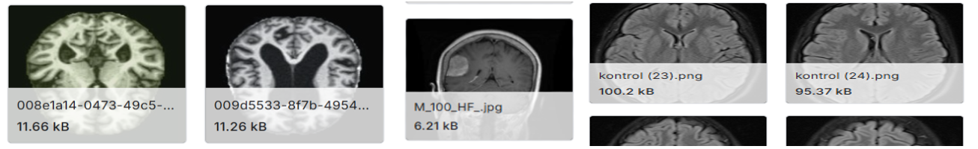
Datasets
This project utilizes three publicly available MRI datasets from Kaggle for multi-disease brain classification:
Alzheimer’s Disease Dataset Contains ~33,984 MRI images categorized into four stages: Mild Demented, Moderate Demented, Non-Demented, and Very Mild Demented. This dataset helps in identifying the progression stages of Alzheimer’s disease.
Brain Tumor Dataset Includes ~21,700 high-quality MRI images divided into four classes: Glioma, Meningioma, Pituitary Tumor, and Normal. It is used for accurate tumor detection and classification.
Multiple Sclerosis (MS) Dataset Comprises 3,427 MRI images collected from patients and healthy individuals, categorized into Control (Axial & Sagittal) and MS (Axial & Sagittal) classes

Slide 8
Methodology
1.Dataset Collection : MRI datasets for Brain Tumor, Alzheimer’s, and Multiple Sclerosis were collected from Kaggle and balanced to ensure equal representation of all classes.
2.Data Preprocessing :Images were resized (224×224 / 227×227), normalized (0–1 range), and converted from grayscale to RGB to match model input requirements.
3.Model Development
EfficientNet-B3 (Primary Model): Used for high accuracy and efficient feature extraction through compound scaling, enabling better performance with fewer parameters.
AlexNet (Baseline Model): Used for performance comparison as a traditional CNN architecture, helping evaluate improvements achieved by EfficientNet.
4.Training & Evaluation : Dataset split into Training (70%), Validation (15%), and Testing (15%). Models trained using Adamax optimizer and categorical cross-entropy loss.
5.Explainable AI (LIME) :LIME generates heatmaps to highlight important regions in MRI scans, improving interpretability and trust.
6.Deployment :Integrated into a Flask-based web application for MRI upload, prediction, and result visualization.

Slide 9
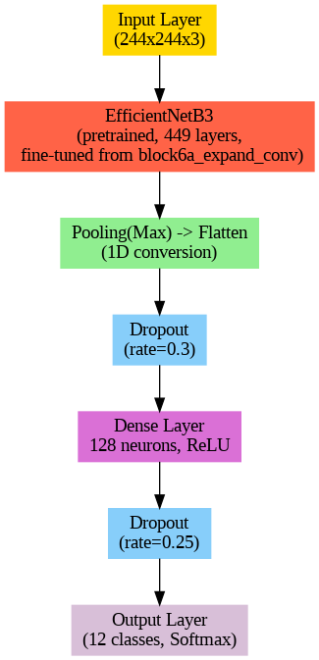
Algorithms Involved
EfficientNet-B3:
Step 1 – The model takes 244×244×3 RGB images, normalized using EfficientNet’s preprocessing for faster convergence.
Step 2 – A pretrained EfficientNetB3 (ImageNet, 449 layers) serves as a feature extractor. Fine-tuning starts from block6a_expand_conv, enabling adaptation of learned features to brain disease patterns while reducing training time.
Step 3 – Global Max Pooling reduces spatial dimensions, then the features are flattened into a 1D vector for dense layers.
Step 4 – Dropout (0.3) randomly deactivates neurons to prevent overfitting and improve generalization.
Step 5 – Dense layer with 128 neurons and ReLU captures complex patterns for better class separation.
Step 6 – Dropout (0.25) further reduces overfitting after the dense layer.
Step 7 – The final layer has 12 neurons with Softmax activation, producing a probability distribution across brain disease classes, enabling the model to make confident, interpretable predictions.

Slide 10
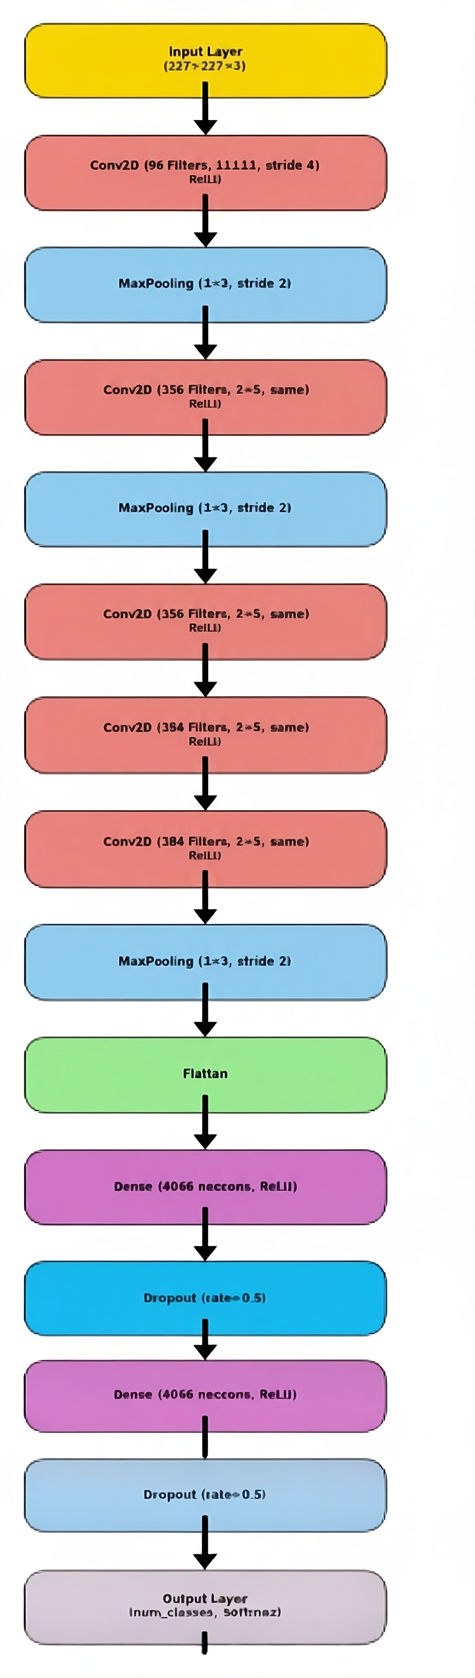
AlexNet:
Step 1 – Input Layer
The model accepts an input image of size 227 × 227 × 3 (RGB).
Step 2 – Feature Extraction (Convolution + Pooling Layers)
Conv Layer 1: Extracts basic low-level features (edges, textures) using 96 filters (11×11 kernel, stride 4) followed by MaxPooling (3×3, stride 2) to reduce spatial dimensions.
Conv Layer 2: Learns more complex patterns with 256 filters (5×5 kernel, same padding) followed by another MaxPooling (3×3, stride 2).
Conv Layers 3, 4, 5: Further extract high-level features using multiple Conv2D layers (384 → 384 → 256 filters, all with 3×3 kernels, same padding).
Final MaxPooling (3×3, stride 2) reduces feature map size for efficient processing.
Step 3 – Flatten Layer
This will Converts the final 3D feature maps into a 1D feature vector, preparing the data for the fully connected layers.
Step 4 – Fully Connected Layers
First Dense Layer: 4096 neurons + ReLU activation + Dropout (0.5) → Helps prevent overfitting.
Second Dense Layer: 4096 neurons + ReLU activation + Dropout (0.5) → Improves model generalization.
Step 5 – Output Layer
A final dense layer with 12 neurons (representing the 12 disease classes) and Softmax activation. Outputs a probability distribution over all classes, indicating the likelihood of each disease type.

Slide 11
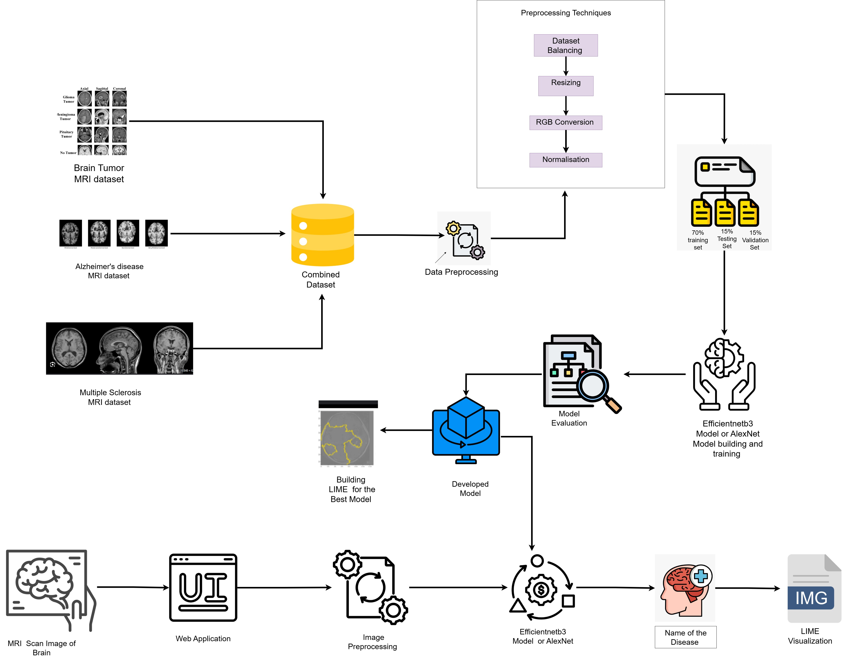
Architecture Diagram

Slide 12
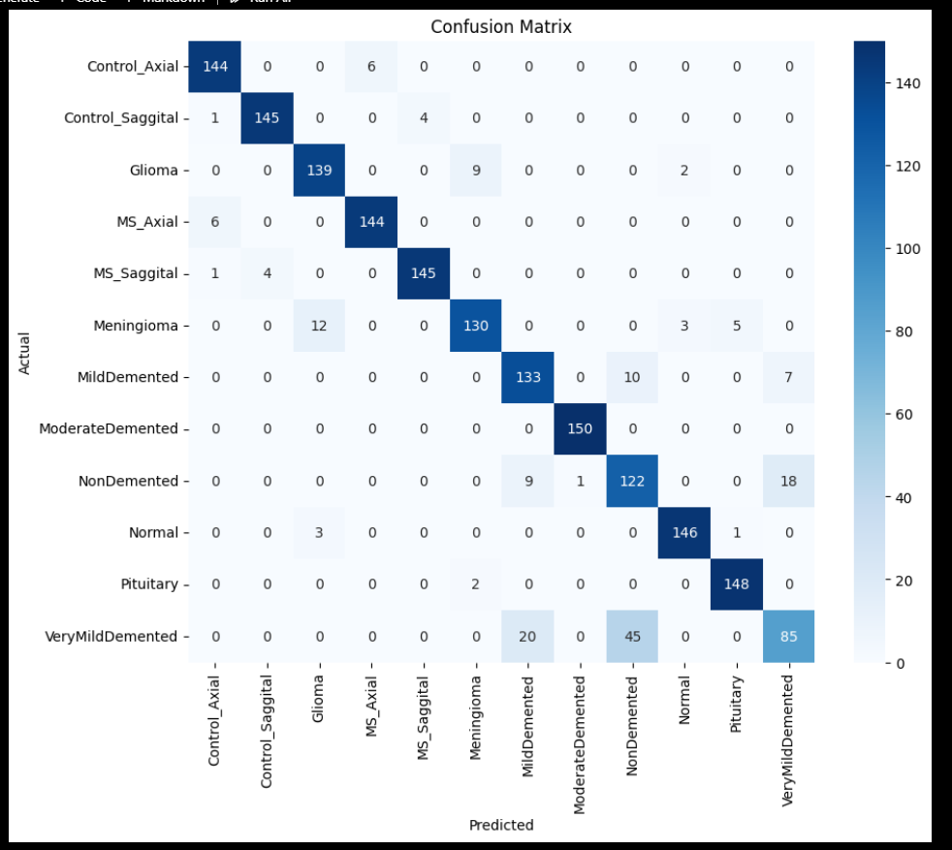
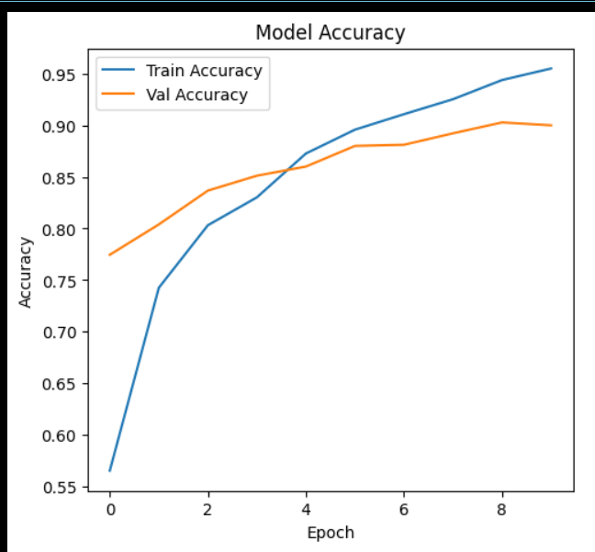
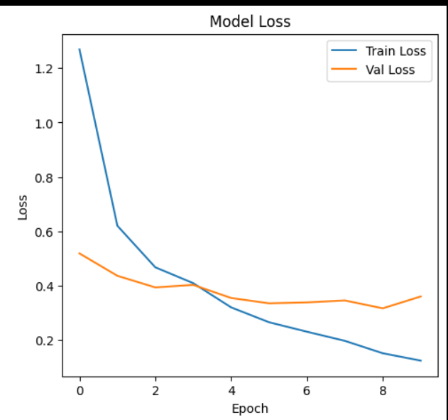
Results obtained
EfficientNetB3 model :
Training and Validation Accuracy Graph
Training and Validation Loss Graph
Confusion Matrix

Slide 13
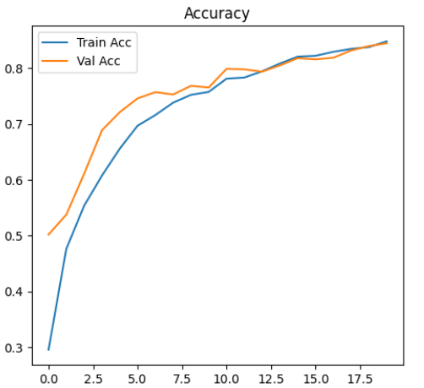
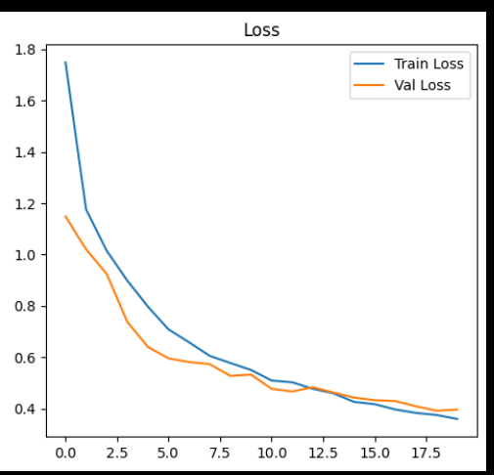
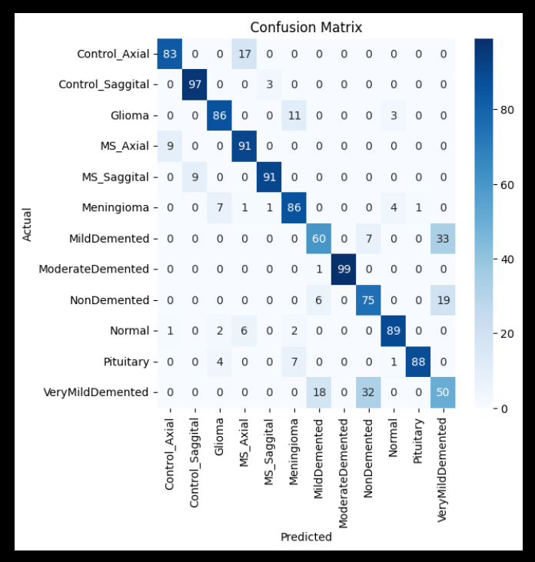
AlexNet Model:
Training and Validation Accuracy
Graph
Training and Validation Loss
Graph
Confusion Matrix

Slide 14
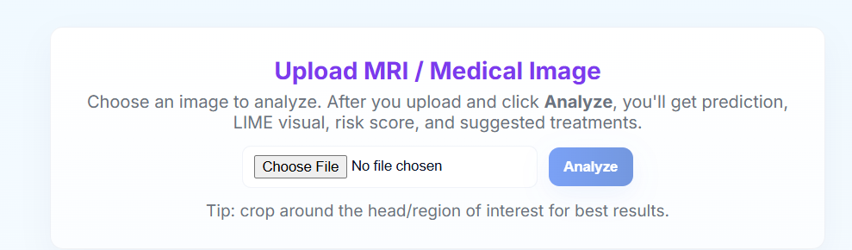
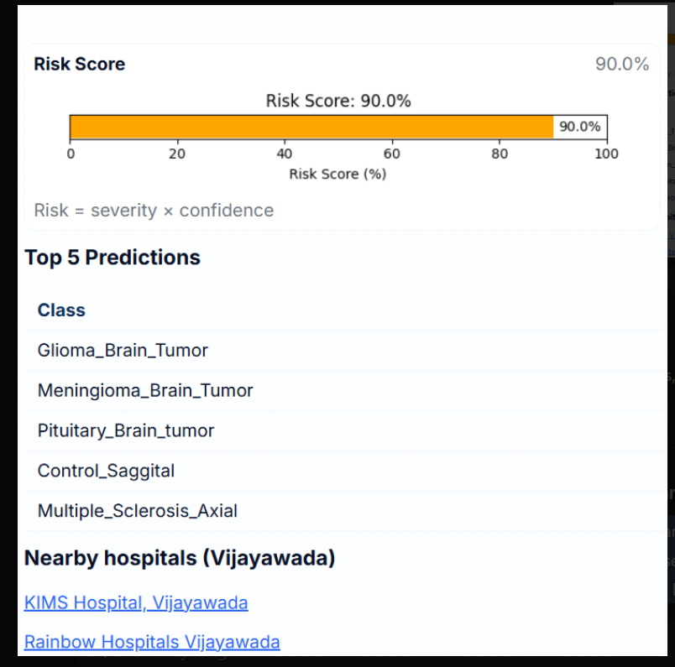
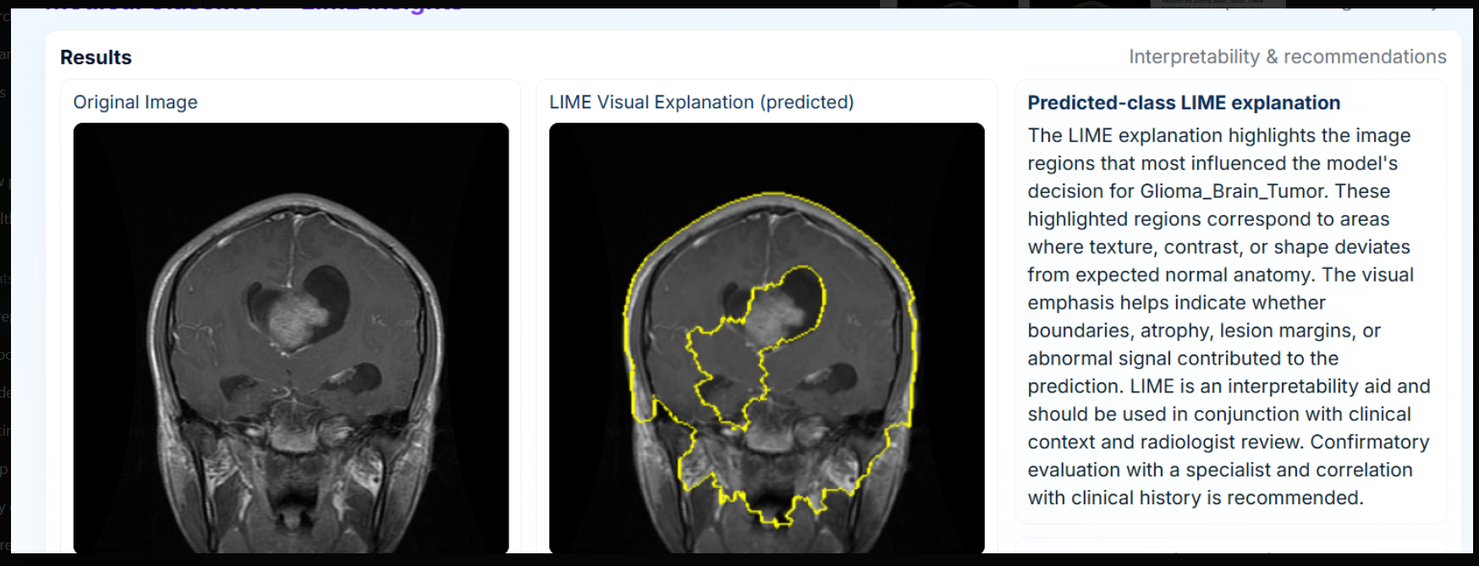
Web Application :

Slide 15
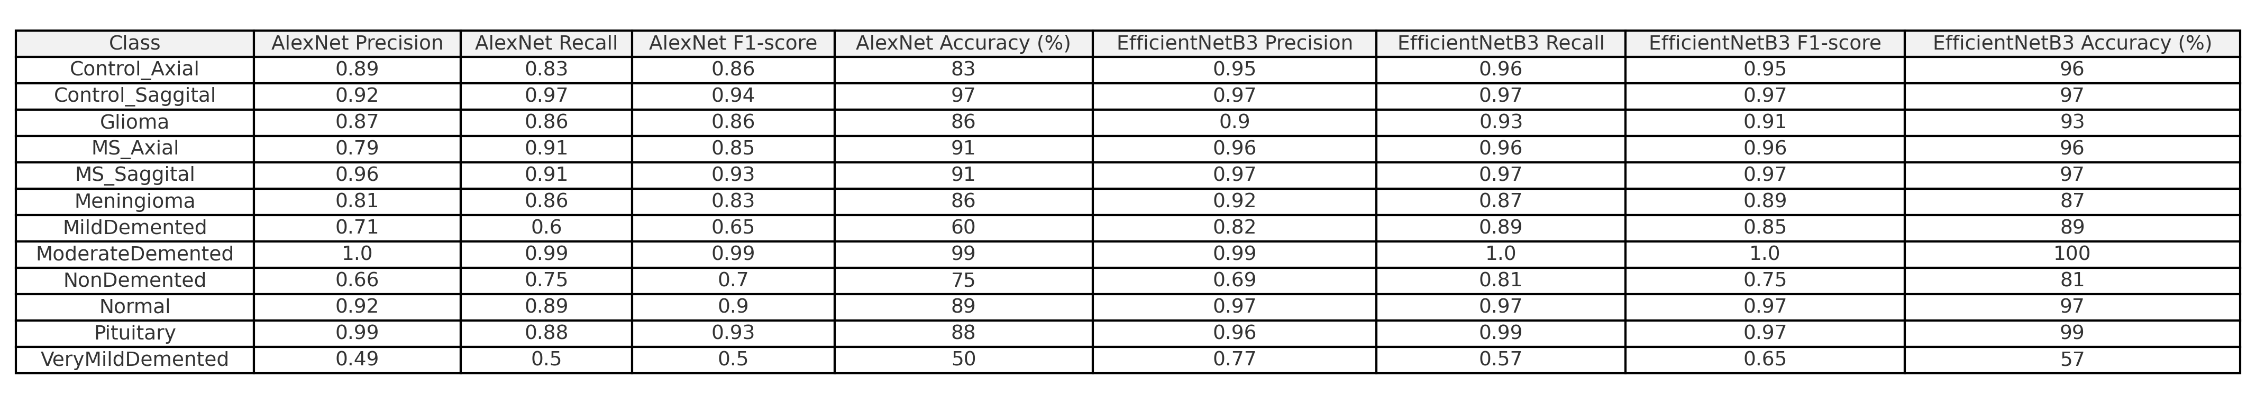
Result Analysis
EfficientNetB3 clearly outperforms AlexNet in almost every class across precision, recall, F1-score, and accuracy.
Tumor classes show major improvement with EfficientNetB3, especially Pituitary (99% vs 88%).
Alzheimer’s stages (Mild & VeryMild) are detected much better by EfficientNetB3 (89% vs 60% for Mild).
Normal & Non-Demented cases also see accuracy boosts (up to 97% with EfficientNetB3).
Overall, EfficientNetB3 is more stable, reliable, and suitable for clinical use than AlexNet.

Slide 16


