Slide 1
Bollywood Movie Analysis
Identifying and Reducing Gender Stereotypes in Scripts and Posters

Slide 2
Objective
1. Analyze Bollywood movies for gender stereotypes in scripts and posters.
2. Quantify gender roles and biases in text and visuals.
3. Propose actionable solutions to eliminate stereotypes.

Slide 3
Methodology
1. Text Analysis:
- Use NLP techniques to identify male and female roles in scripts.
- Categorize roles into aspirations, professions, and dependencies.
2. Visual Analysis:
- Evaluate posters for gender representation based on size, prominence, and placement.

Slide 4
Findings
1. Male roles are often associated with aspirations and professions.
2. Female roles frequently depict dependency or lack of career ambitions.
3. Visual analysis reveals male dominance in poster design (size and placement).

Slide 5
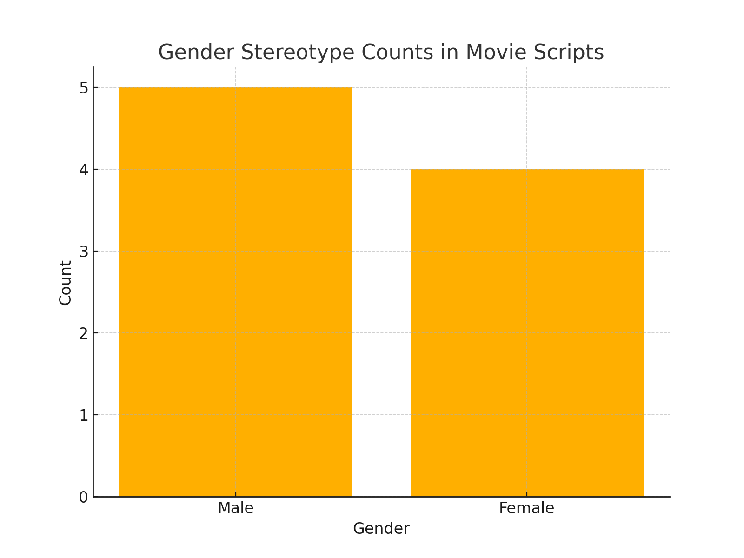
Gender Stereotype Counts in Scripts

Slide 6

Male Roles Word Cloud

Slide 7

Female Roles Word Cloud

Slide 8
Recommendations
1. For Scripts:
- Introduce more female characters with aspirations and professions.
- Avoid defining female characters solely by their relationships.
2. For Posters:
- Ensure equal prominence for male and female characters.
- Represent female characters in empowering poses and roles.

Slide 9
Github Link
https://github.com/Rahulpy164/Semusiproject

