Slide 1
E-commerce Sales Report Analysis

Slide 2
Summary
The analysis reveals significant sales trends and patterns. Notably, November emerges as the peak month for sales, likely influenced by seasonal factors and promotional events that stimulate consumer spending. Weekly patterns indicate that Thursdays are the most favored days for placing orders, suggesting a strategic opportunity for targeted marketing and effective inventory management.
Additionally, the United Kingdom stands out as the leading market in both order volume and total expenditure. This presents a prime opportunity for focused marketing efforts aimed at capitalizing on this strong market presence. Overall, these insights can guide strategic decisions to optimize sales performance.

Slide 3
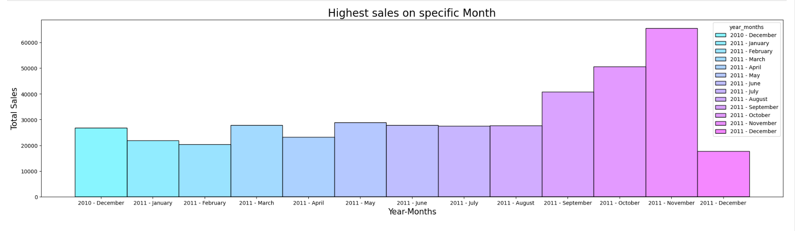
Sales Monthly wise There is a huge peak during the month of November; most sales happened in that month. This could be due to seasonal factors, promotions, or events that may trigger consumer spending.

Slide 4
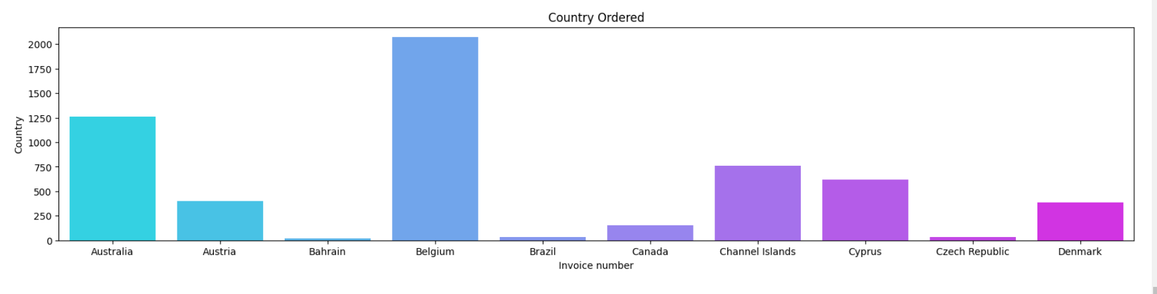
Money Spent by each Countary
The united kingdom is shown to be the most dominant in terms of the number of orders and total spend. this is a significant market, and thus could be used as a basis for focused marketing that could be capitalized on this trend.

Slide 5
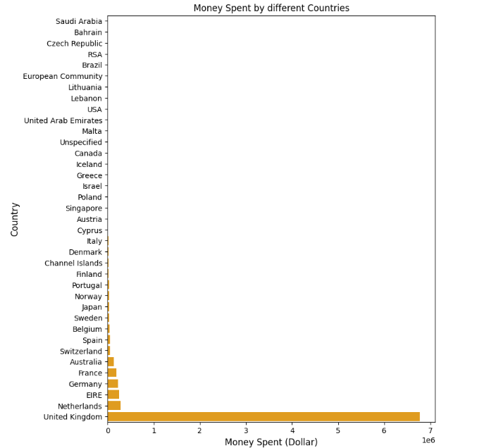

Slide 6
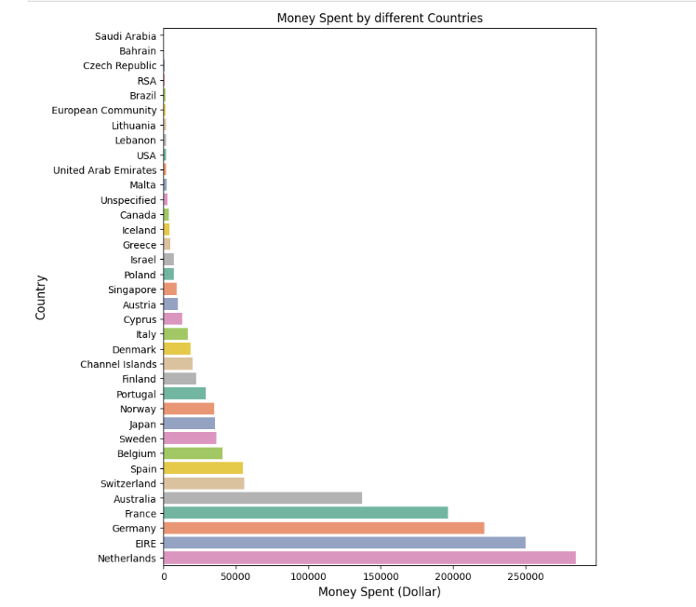

Slide 7
Conclusion:
Sales Trends: There is a huge peak during the month of November; most sales happened in that month. This could be due to seasonal factors, promotions, or events that may trigger consumer spending.
Weekly Sales Patterns: A weekly analysis shows that Thursdays are the most popular days for orders, indicating that customers like to shop on this particular day more than on any other day. This would help in the marketing and inventory management strategies.
Geographical Insights: The United Kingdom is shown to be the most dominant in terms of the number of orders and total spend. This is a significant market, and thus could be used as a basis for focused marketing that could be capitalized on this trend.

