Slide 1
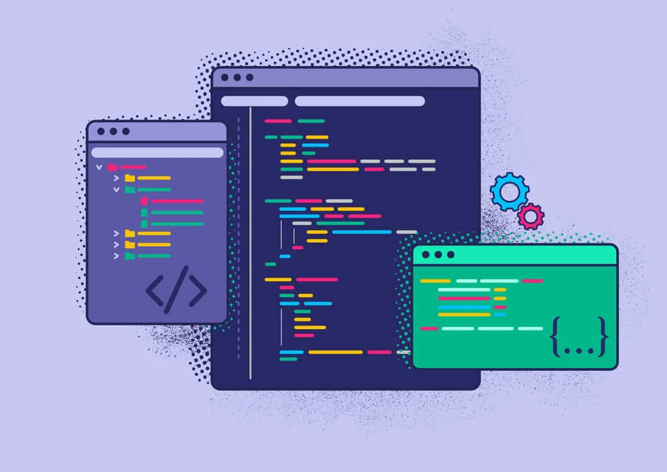
VIT Industrial Internship
Presenter:
Rahul Sandireddy (20BCE1001) Sandireddyrahul.rayudu2020@vitstudent.ac.in
Submitted to:
Dr. Ilakiyaselvan N
Dr. Abishi Chowdhury

Slide 2
CONTENT PLAN
AI Project
Google Cloud

Slide 3
Artificial Intelligence

Slide 4
Introduction
This project aims to assist farmers through the development of an AI chatbot integrated with a crop disease classification system
The agricultural sector plays a crucial role in ensuring food security and economic stability. This project addresses challenges faced by farmers, including limited access to information and expert guidance.
AI technologies can revolutionize agriculture by providing instant access to information, enabling crop disease identification, and offering real-time weather updates.

Slide 5
Theoretical Analysis
Hardware Requirements: A computer system, sufficient storage, and a stable internet connection are necessary to run the project effectively.
Software Requirements: The project relies on various software components, including operating systems, development environments, TensorFlow for machine learning, and React for UI development.

Slide 6
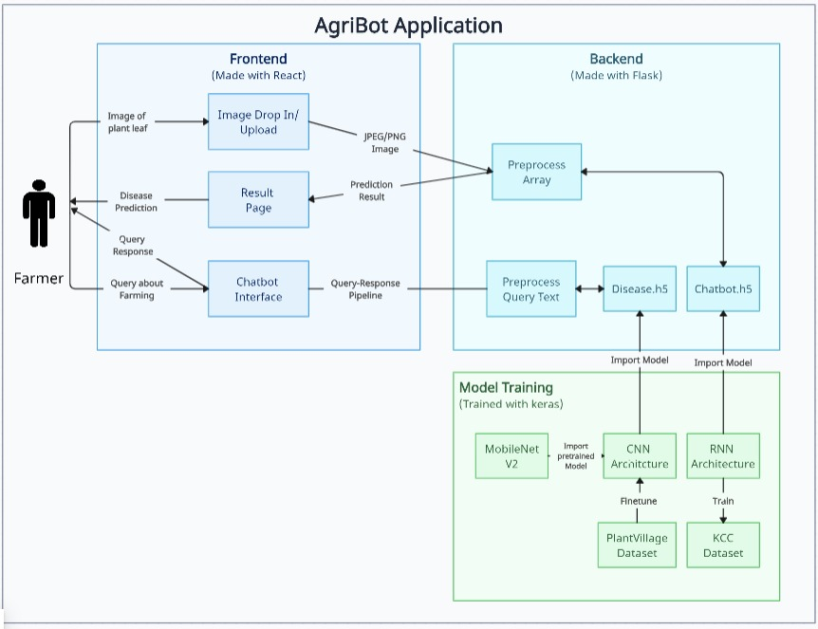
System Architecture

Slide 7
Experimental Investigations
Chatbot Accuracy and Response Time: We collected a diverse dataset of farmer queries and measured accuracy and response time to ensure prompt and accurate responses.
Chatbot NLP Performance: We evaluated the chatbot's natural language processing capabilities to understand its understanding and interpretation of various query types.
Crop Disease Classification Accuracy: This involved using a labelled dataset to measure the system's accuracy in identifying different types of crop diseases.
Weather API Integration: We assessed the performance and reliability of the weather API integration.

Slide 8
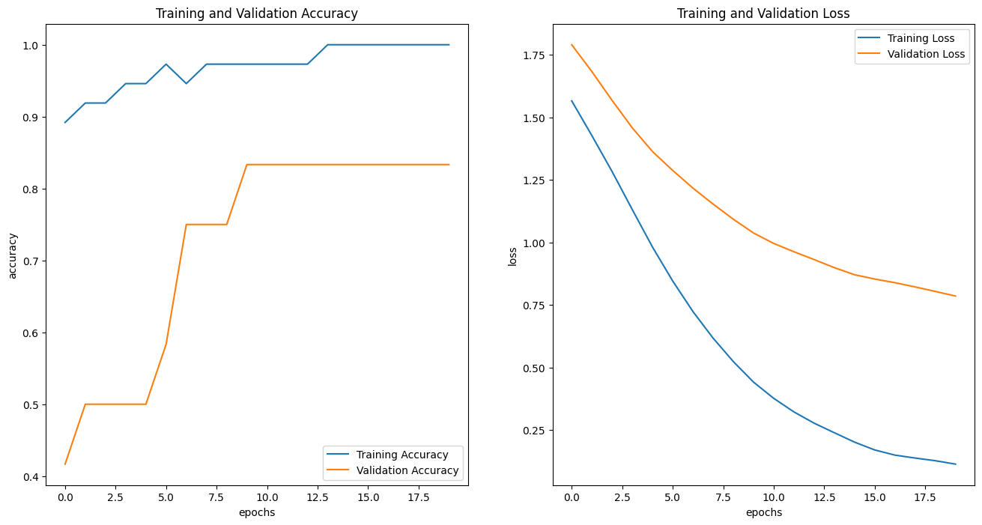
Observations-1
AI Chatbot Performance: The chatbot's performance was evaluated using metrics like accuracy and response time.

Slide 9
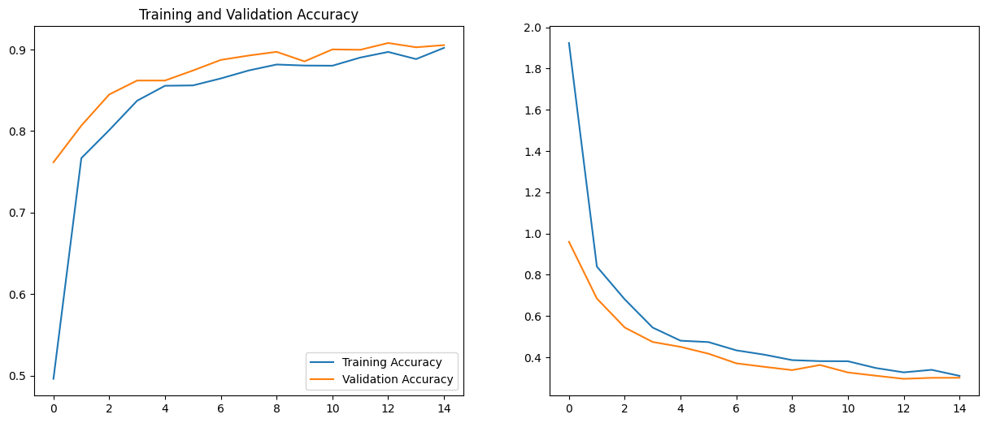
Observation-2
Crop Disease Classification: We measured the accuracy and precision of the crop disease classification system.

Slide 10
Applications
Farmers' Assistance and Guidance: The AI chatbot serves as a virtual assistant, providing instant access to agricultural information, best practices, and expert guidance.
Crop Disease Detection and Management: The crop disease classification system helps farmers identify and manage crop diseases effectively.
Weather Monitoring and Planning: The project's integration with a weather API allows farmers to receive real-time weather updates.
GitHub: Rahulrayudu/farmapp (github.com)

Slide 11
Google Cloud
https://www.cloudskillsboost.google/public_profiles/ae5ef503-2948-4256-b295-73723b423352

Slide 12

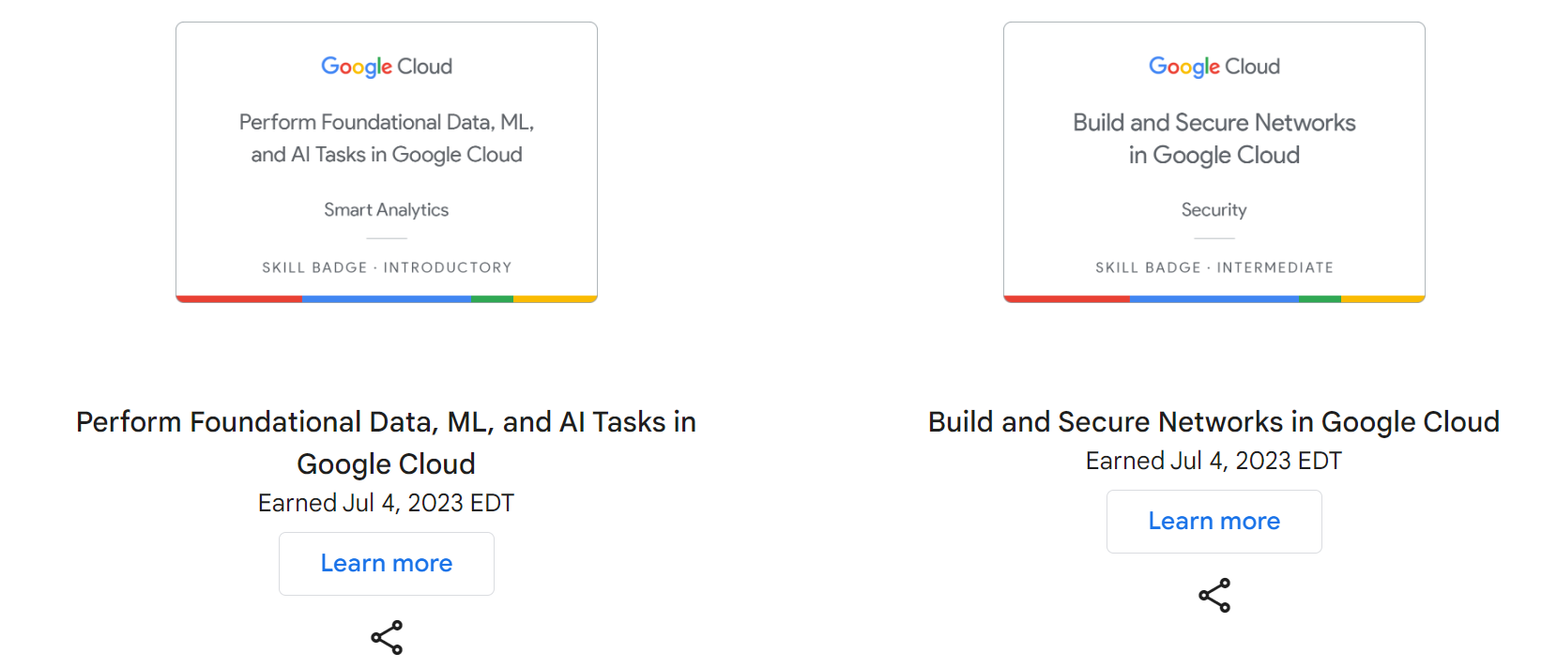
Skill Badges

Slide 13



Slide 14
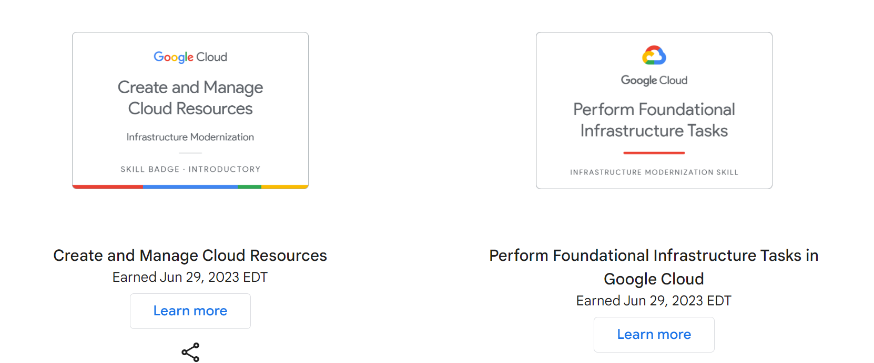
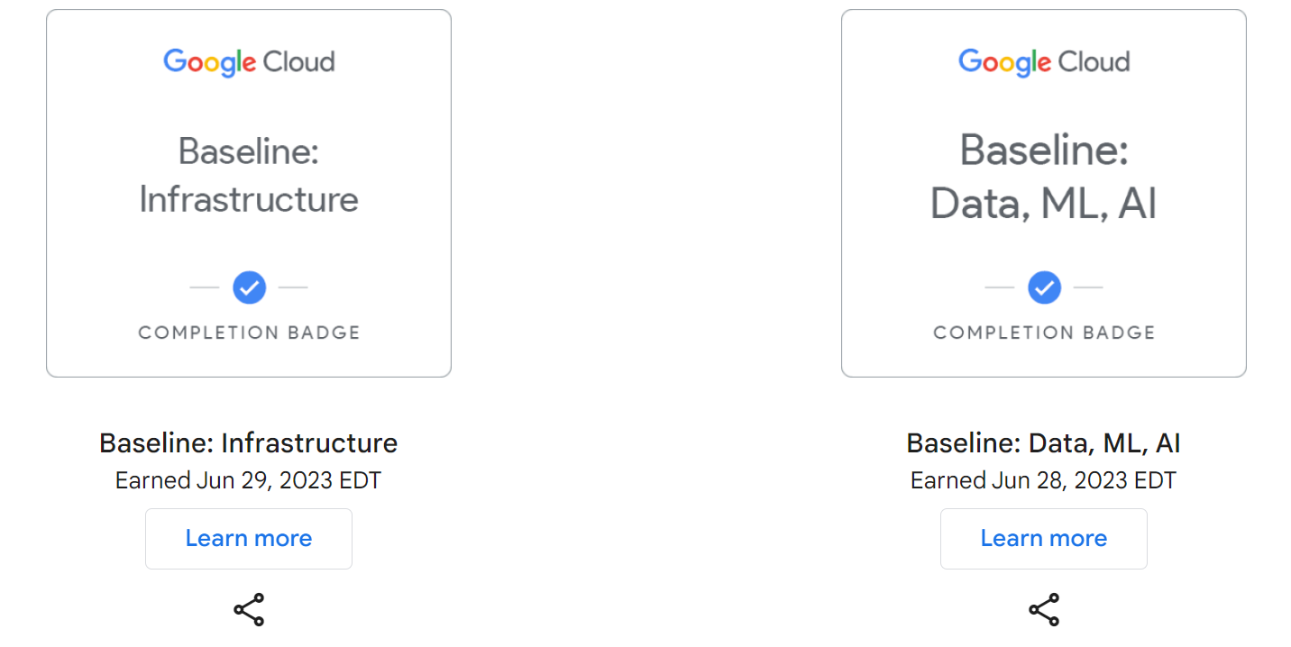

Slide 15


Slide 16

THANK YOU!

