Slide 1
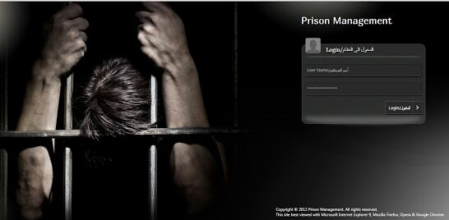
PRISON MANAGEMENT
Mentor Name :
Ms.DEEPA MODI
Project Scenerio:
PRISON MANAGEMENT SYSTEM

Slide 2

Project Details
This project is aimed at developing a PRISON MANAGEMENT SYSTEM that is a collection of registers and reports for the effective management of prison.
This system should contain the modules :
■ Nominal Roll
■ Case Register
■ Automated release diary generator

Slide 3
Portal will contain about:
Prisoner details:
■ Prisoner batch no, name and other important details.
■ Report about his/her crime.
■ Court decision.
■ Rights and duty.
Prison details:
■ No. Of prisons.
■ Capacity rating of the prisons.
.

Slide 4
Users of the System
A. Jail superintendent
B. visitors
C. admin

Slide 5
The prison management system is comprised of the Directorate of prison.
Prisoners living in the prisons.
Prison officer controlling and taking care of the prisoners at different
prisons.
Prison management system is a system to manage the activities related
to prison like tracking and monitoring of activities in all the jails,
effective management of reports, maintenance of prison employee
database.

Slide 6
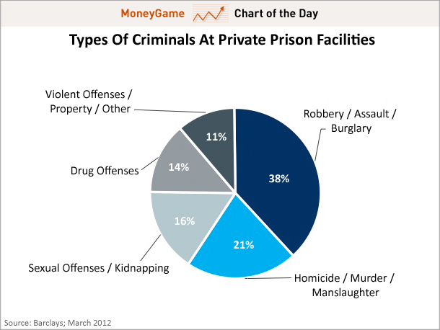

Slide 7

HTML
CSS
Xampp server
SQL
PHP

Slide 8
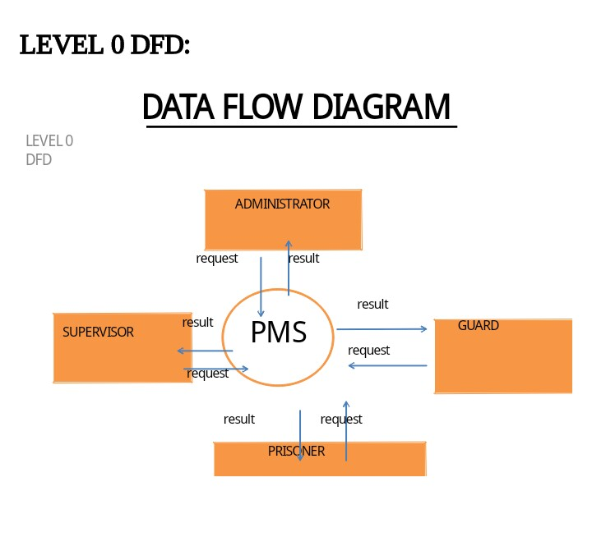

Slide 9
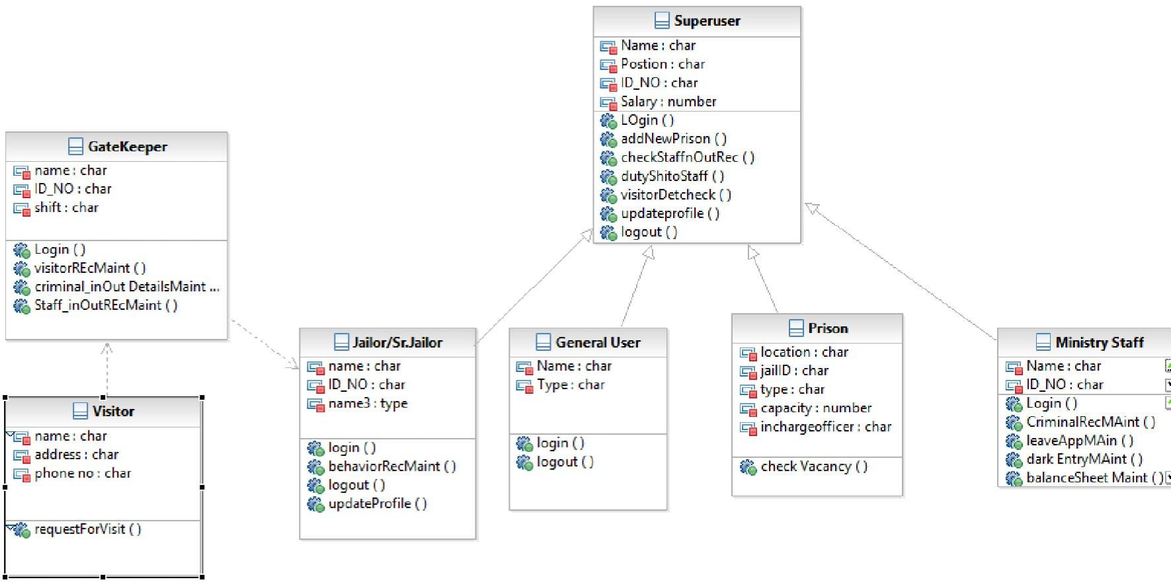
CLASS DIAGRAM :

Slide 10

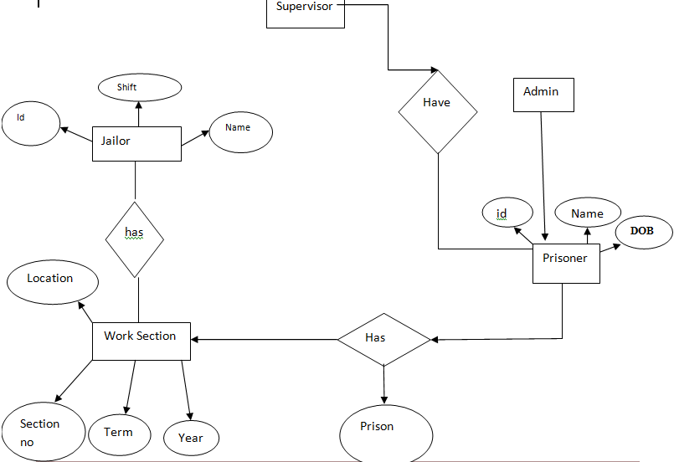

Slide 11
FUNCTION MODULES:
Prison information Management
Activity Management
Visitor Management
Human Resource Management
Inventory Management

Slide 12
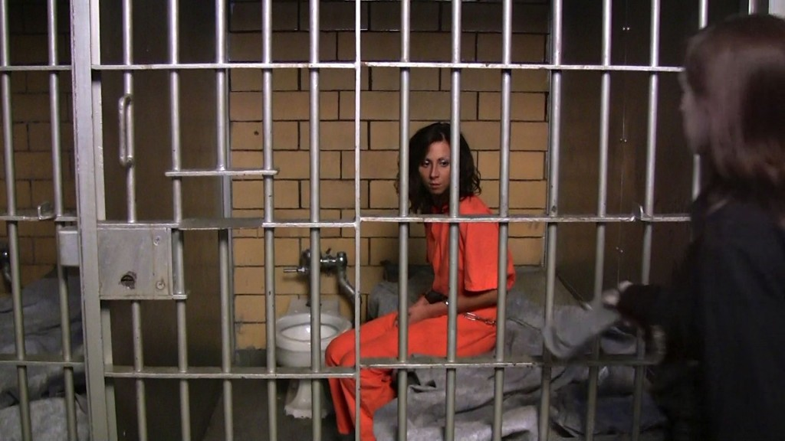

Submitted by:-
Avni Maheshwari
Sumit Safaya
Rahul Sapra
Rashi Bhandari

