Slide 1
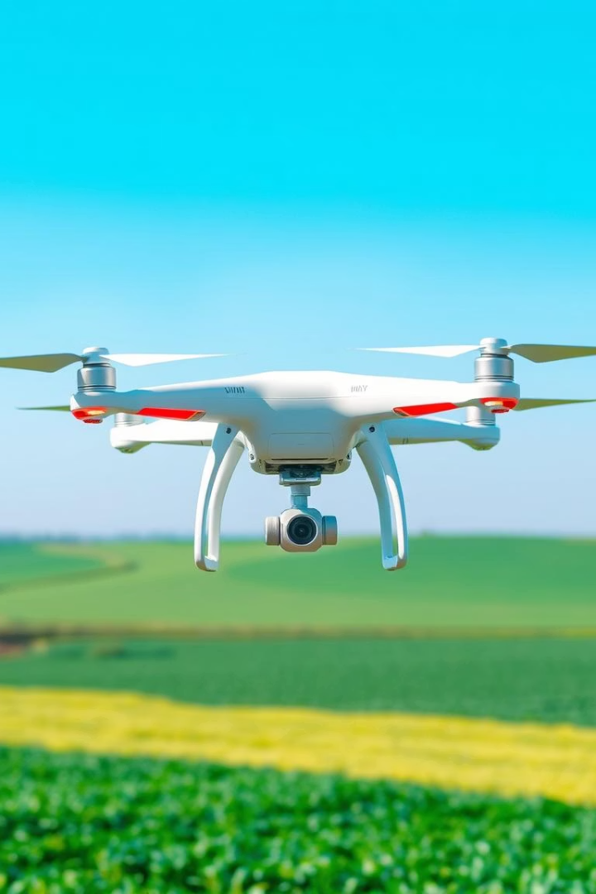
Real-Time Crop Growth Forecasting Using Thermal and Visual Imaging
Combining deep learning and image processing for precise crop monitoring.
Rahul Seeram (12212417)
Sanganamoni Sai Kumar (12201635)

Slide 2
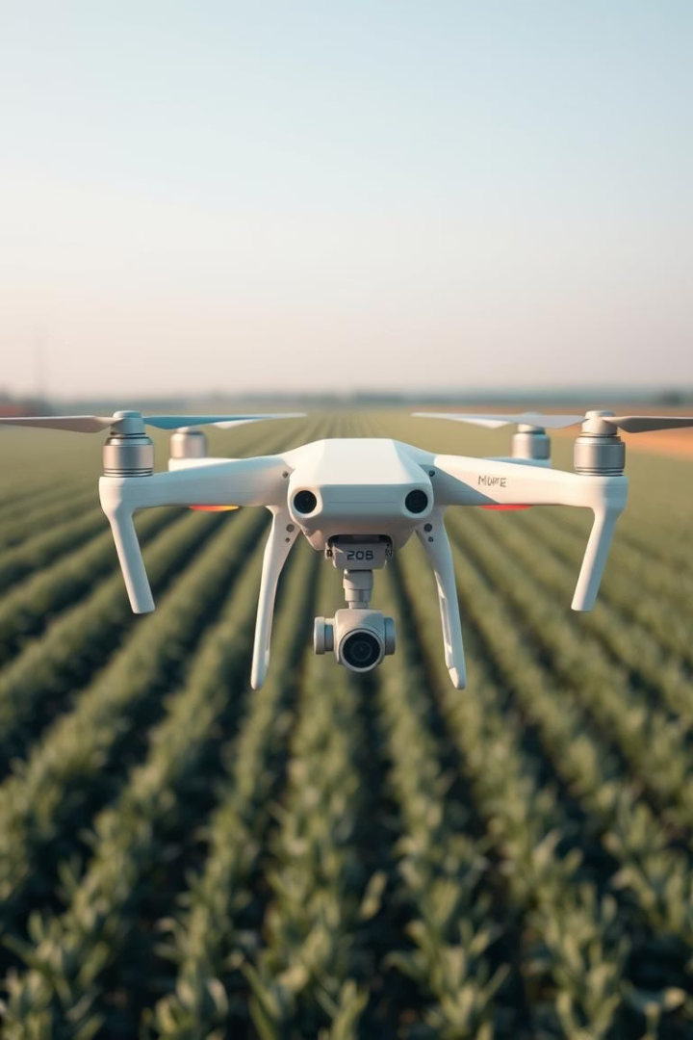
Project Objective
Goal
Predict crop growth stages from thermal and RGB images.
Approach
Utilize drone-based thermal imagery and deep learning models.

Slide 3
Dataset Description
Source
Details
Google Drive folder with labeled subfolders.
Total images: Approximately 1500+
Classes: leaf spot, blast, healthy, etc.
Balanced distribution across labels to ensure robust learning.
RGB and thermal images included.

Slide 4
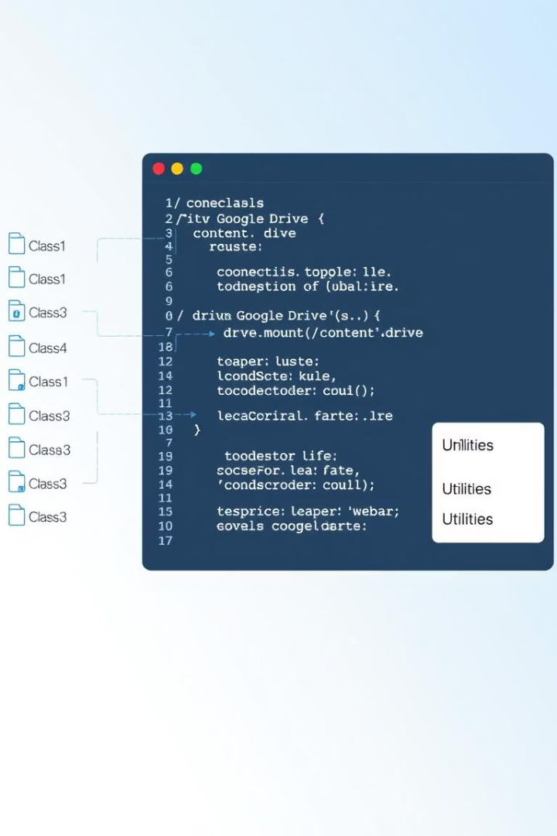
Image Acquisition & Mounting Google Drive
Mounting
Folder Structure
Using drive.mount() to access cloud storage.
Class-wise image folders accessed via os.listdir().
Path Management
Efficient path handling for loading images during training.

Slide 5
Image Preprocessing
Steps
Code Highlights
Resize images to 128x128 pixels
gaussian_denoise(): Removes noise for clearer features
Convert thermal images to RGB with cv2.cvtColor()
enhance_contrast(): Improves image details
Normalize pixel intensities
normalize_image(): Scales pixel values effectively
Denoise using Gaussian filters
Enhance contrast with CLAHE

Slide 6
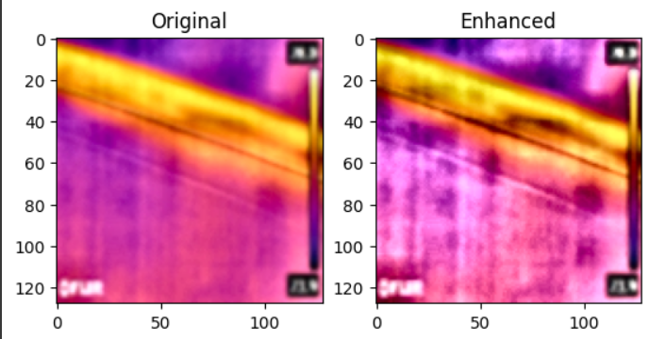
ORB Feature Detection & Visualization
ORB Explained
Visualization
Oriented FAST and Rotated BRIEF algorithm detects keypoints efficiently.
Keypoints drawn with cv2.drawKeypoints highlight important regions.
Keypoints represent unique crop structure features.
Supports structural analysis and feature matching in images.

Slide 7
Label Encoding & Dataset Splitting
Encoding
Splitting
Labels encoded with LabelEncoder and transformed to categorical for model compatibility.
train_test_split ensures representative training and testing datasets.
Shapes of X and y adjusted before and after encoding.

Slide 8
Model Implementation & Comparison
CNN Architecture
Alternative Models
Conv2D and MaxPooling layers
SVM with linear kernel on flattened data
Dropout layers prevent overfitting
Random Forest with 100 estimators
Softmax output for multiclass classification
Random Forest excels on structured features
Adam optimizer and categorical crossentropy loss

Slide 9
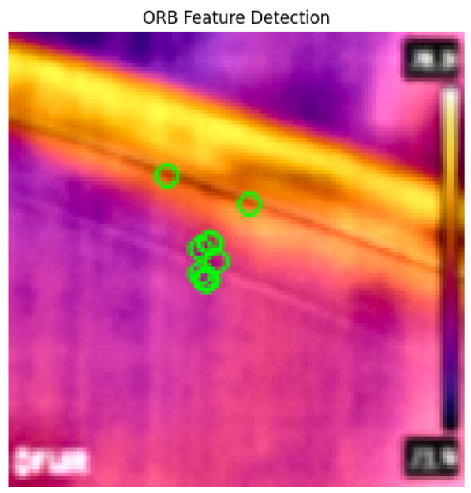

Performance Evaluation & Visual Enhancements
Evaluation Results
Visual Insights
Support – Vector Machine achieved highest accuracy with clear interpretability.
Contrast enhancement via CLAHE improves feature detection.
Confusion matrix shows precise class predictions.
Revisit ORB feature visualization to understand spatial features.

Slide 10
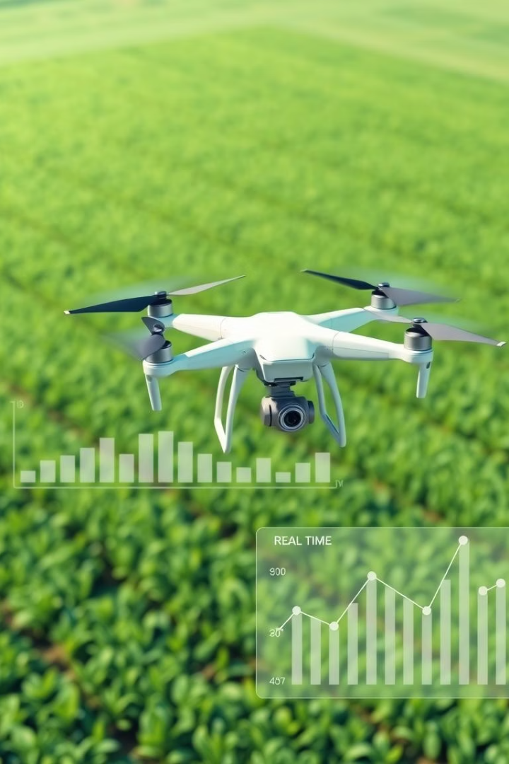
Conclusion and Future Work
Summary
Key Finding
Forecasting crop growth from thermal and visual data is effective.
Random Forest performs well with straightforward feature sets.
Future Directions
Integrate NDVI vegetation indices
Deploy on drone-based real-time systems
Create dynamic dashboards for farmers
Thank you for your attention.

